Slide 1
Shipping to Egypt Fayoum University
Servers & Lab Equipment
Ian
1 Oct 2025
Was started months ago…..

Slide 2
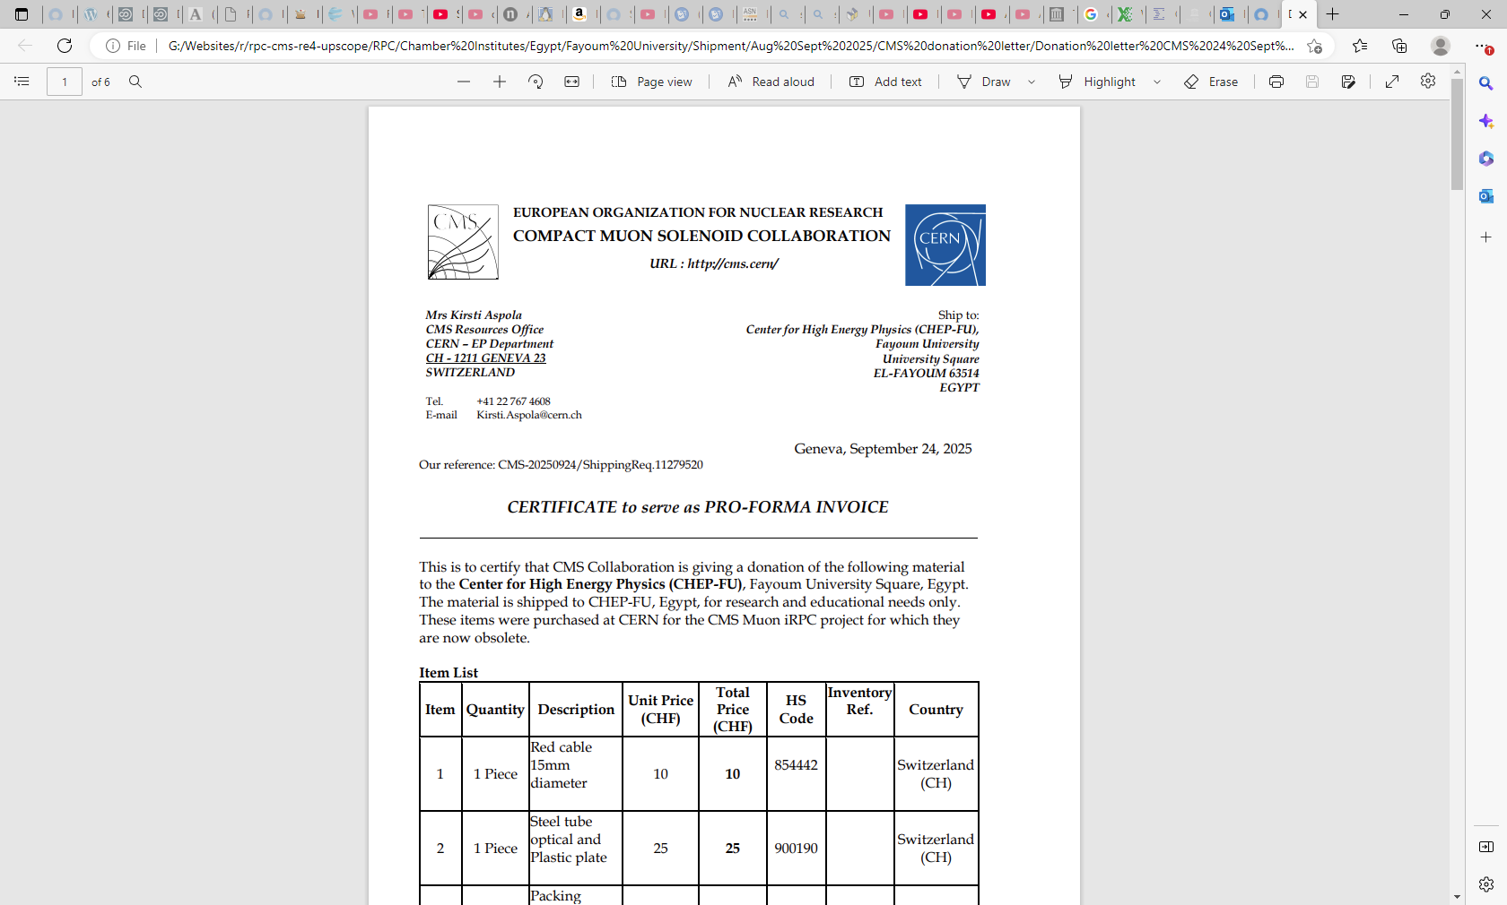

Slide 3
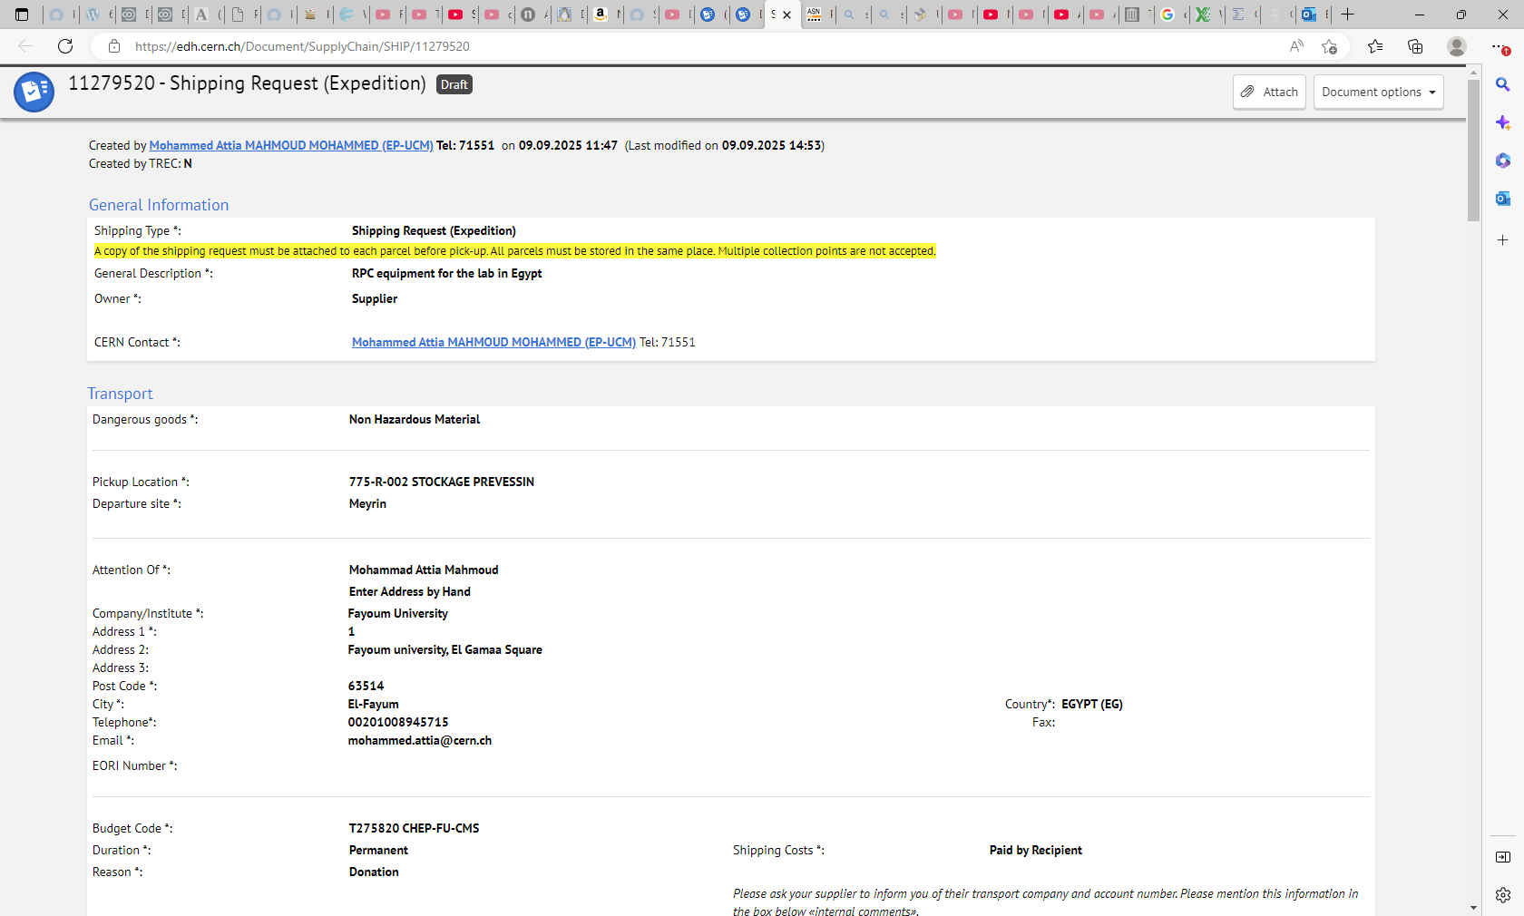
11279520 - Shipping Request (Expedition)

Slide 4
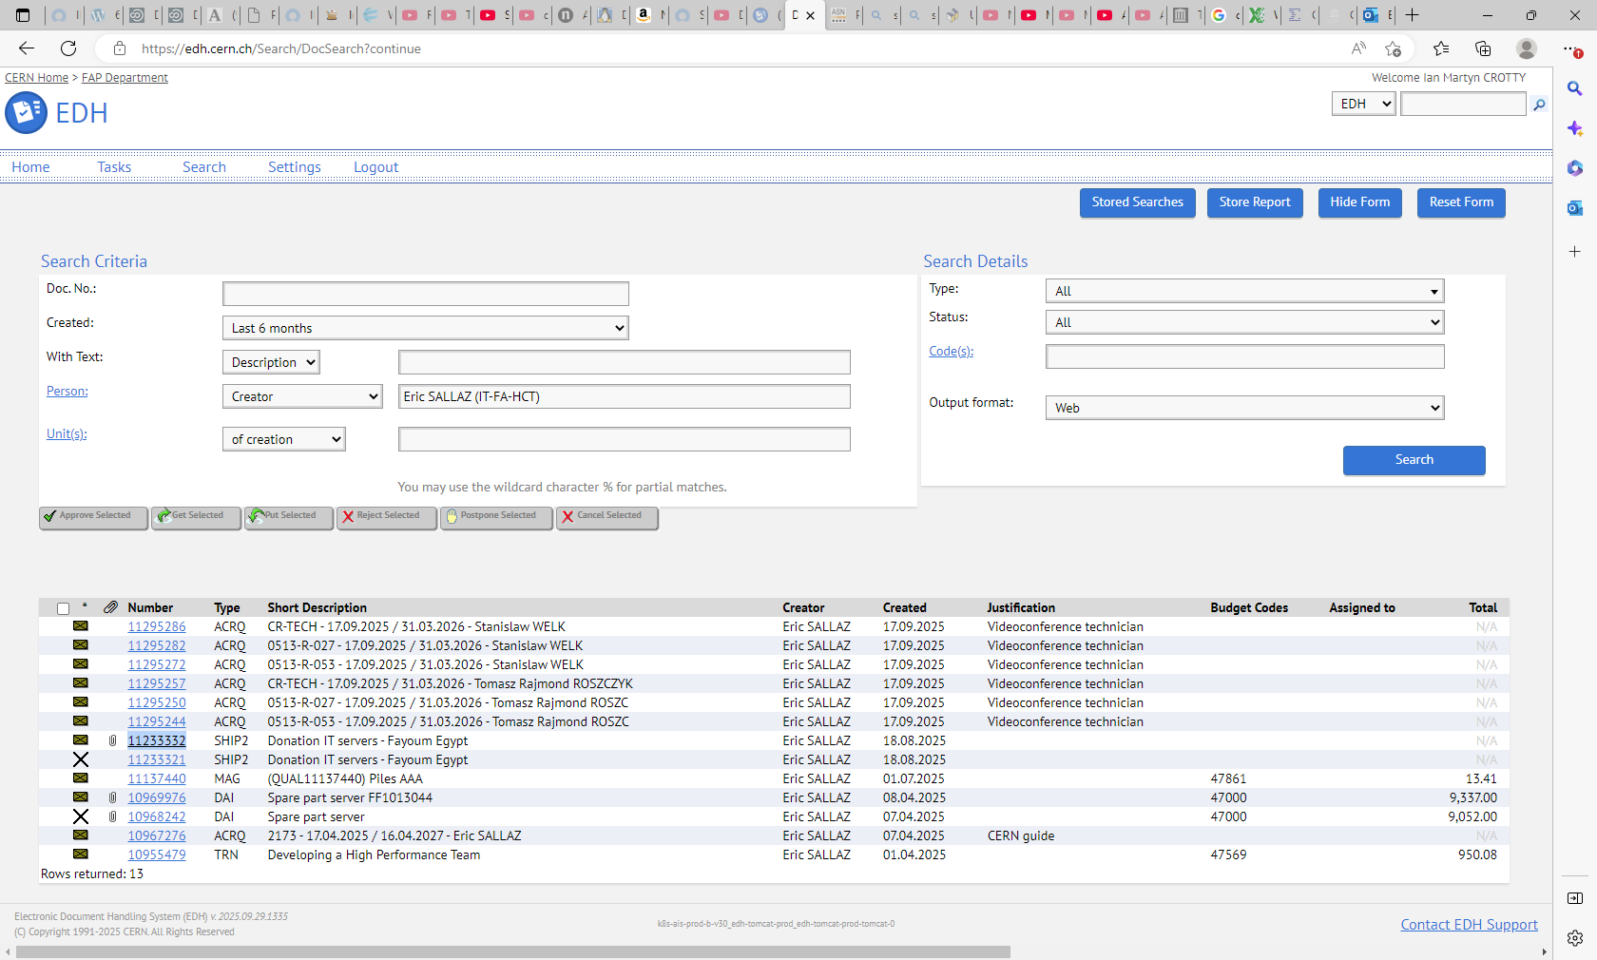

Slide 6
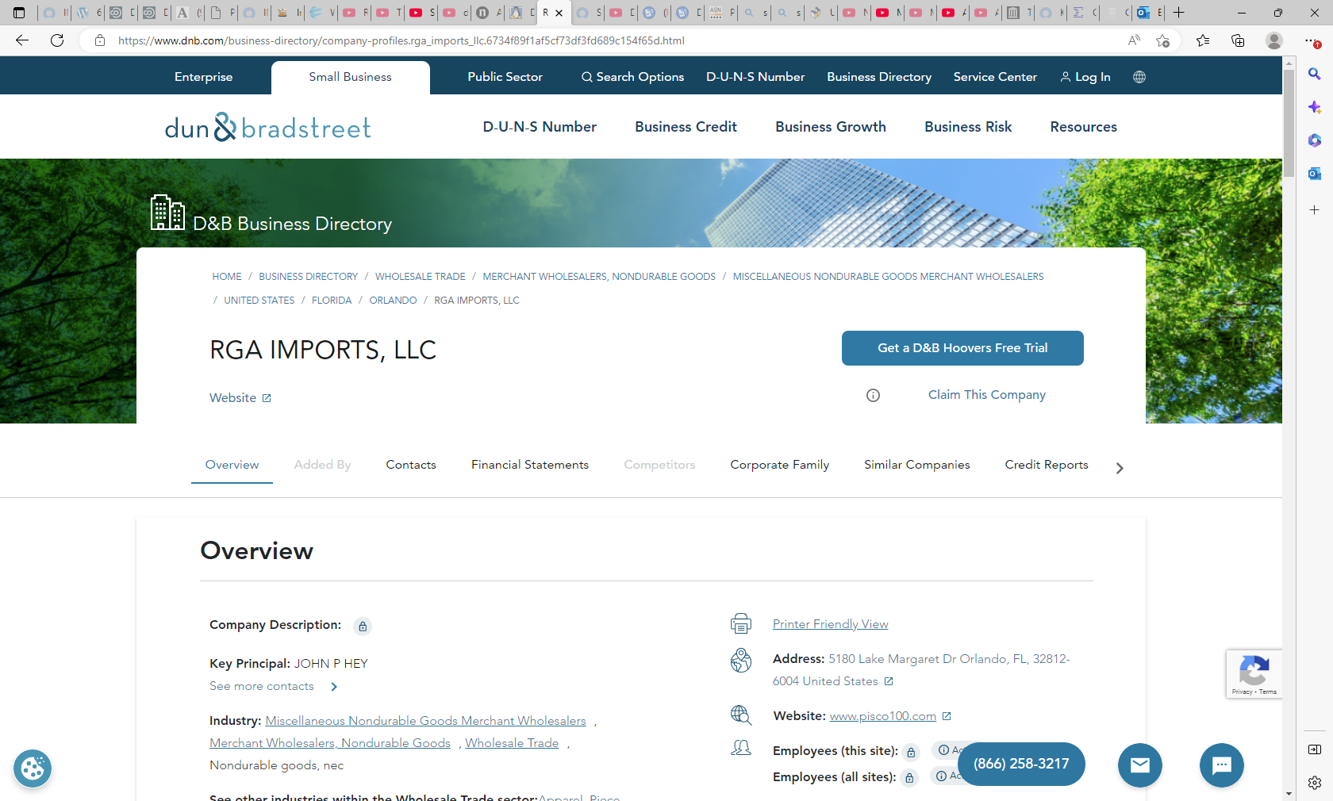

Slide 7
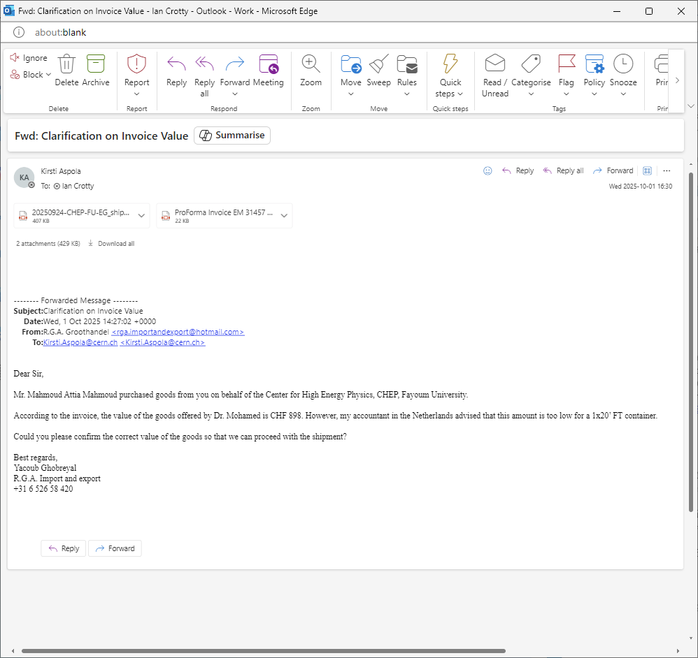

Slide 9
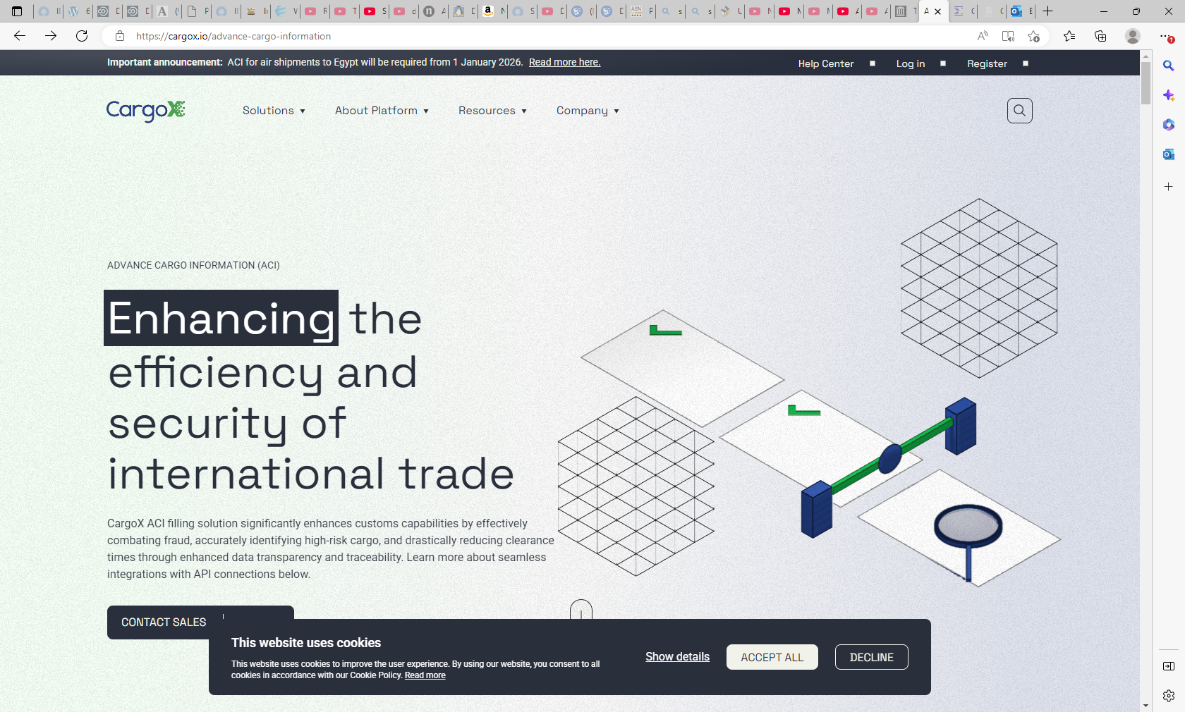
https://cargox.io/advance-cargo-information
ACI = advanced cargo Information
CargoX ACI filling solution significantly enhances customs capabilities by effectively combating fraud, accurately identifying high-risk cargo, and drastically reducing clearance times through enhanced data transparency and traceability. Learn more about seamless integrations with API connections below.

Slide 10
Is CargoX mandatory for Egypt?
ACI for sea freight became mandatory on 1 October 2021. All Egyptian importers are required to use the NAFEZA platform to register incoming shipments and all foreign exporters are required to use the CargoX Platform to complete ACI filing over the blockchain.3 Sept 2025

Slide 11
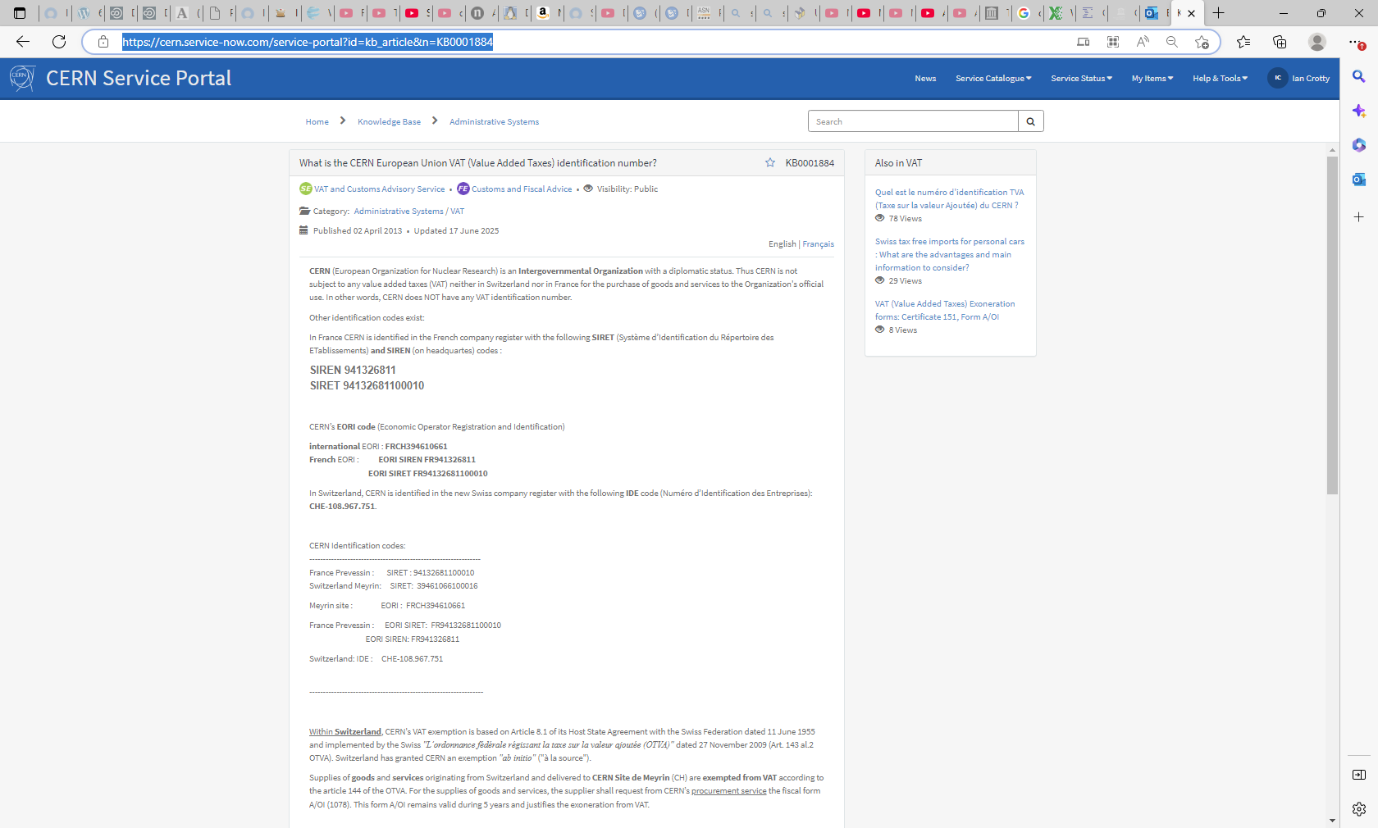
https://cern.service-now.com/service-portal?id=kb_article&n=KB0001884

Slide 12
What is the CERN European Union VAT (Value Added Taxes) identification number?KB0001884
Service Element VAT and Customs Advisory Service • Functional Element Customs and Fiscal Advice • Visibility: Public
Category: Administrative Systems / VAT
Published 02 April 2013 • Updated 17 June 2025
English | Français
CERN (European Organization for Nuclear Research) is an Intergovernmental Organization with a diplomatic status. Thus CERN is not subject to any value added taxes (VAT) neither in Switzerland nor in France for the purchase of goods and services to the Organization's official use. In other words, CERN does NOT have any VAT identification number.
Other identification codes exist:
In France CERN is identified in the French company register with the following SIRET (Système d’Identification du Répertoire des ETablissements) and SIREN (on headquartes) codes :
SIREN 941326811
SIRET 94132681100010
CERN’s EORI code (Economic Operator Registration and Identification)
international EORI : FRCH394610661
French EORI : EORI SIREN FR941326811
EORI SIRET FR94132681100010
In Switzerland, CERN is identified in the new Swiss company register with the following IDE code (Numéro d’Identification des Entreprises): CHE-108.967.751.
CERN Identification codes:
---------------------------------------------------------------
France Prevessin : SIRET : 94132681100010
Switzerland Meyrin: SIRET: 39461066100016
Meyrin site : EORI : FRCH394610661
France Prevessin : EORI SIRET: FR94132681100010
EORI SIREN: FR941326811
Switzerland: IDE : CHE-108.967.751

Slide 13
Within Switzerland, CERN's VAT exemption is based on Article 8.1 of its Host State Agreement with the Swiss Federation dated 11 June 1955 and implemented by the Swiss "L’ordonnance fédérale régissant la taxe sur la valeur ajoutée (OTVA)" dated 27 November 2009 (Art. 143 al.2 OTVA). Switzerland has granted CERN an exemption "ab initio" ("à la source").
Supplies of goods and services originating from Switzerland and delivered to CERN Site de Meyrin (CH) are exempted from VAT according to the article 144 of the OTVA. For the supplies of goods and services, the supplier shall request from CERN’s procurement service the fiscal form A/OI (1078). This form A/OI remains valid during 5 years and justifies the exoneration from VAT.
Within France, CERN's VAT exemption results from Article IX.3 of its Host State Agreement with France, dated 13 September 1965 as amended 16 June 1972. France has opted for an exemption by reimbursement of any VAT payable in France.
Supplies of goods and services (works) originating from France and delivered to CERN Site de Prévessin (France) are subject to French VAT. The French VAT must be included on the invoice and the supplier's French VAT identification code must be clearly stated together with the reference of the purchase order or the contract number.
Within EU, supplies of goods only (services excluded) originating from the European Union (except France) and delivered to CERN Site de Prévessin (France) are exempt from VAT according to the article 151 of the Directive 2006/112/EC and article 13 of the Directive 2008/118/EC. For the supplies of goods, the supplier shall request from CERN’s Import service a fiscal form 151 stamped by the French Customs office in Ferney-Voltaire, which justifies the VAT exemption in regard to the supplier’s fiscal authorities and customs.
Supplies of services within the EU are subject to local VAT (where the service is supplied). The VAT must be included on the invoice. CERN shall claim the VAT back from the state of the supplier according to the article 6 of the Protocol 2004 on CERN's Privileges and Immunities in the CERN member states, when applicable.
Outside EU: Deliveries of goods to CERN Meyrin Switzerland from any other country than Switzerland, OR from NON-EU states to CERN Prévessin France, are exonerated from VAT when EXPORTED out from the country of departure through official customs formalities. The supplier receives his stamped copy of the export declaration. Regardless the Incoterms delivery conditions, it is the supplier's responsibility to ensure that he gets his original export declaration back with the official customs' stamps for fiscal justification.
Triangular: Additional instructions are given at request for any deliveries of goods and services for CERN's official use to other destinations than CERN Meyrin (CH) or CERN Prévessin (F).
Kindly note that Reverse-Charge Mechanism cannot be applied with CERN as CERN does not have any VAT id. code and CERN does not either carry out any value added tax (VAT) declaration.
Please contact logistics.service@cern.ch for more information if needed.

