Slide 1
Spirit of any successful collaboration
Different components come to
a meeting table with
common interests
Mutual beneficial programmes
are defined
Each component goes back
with certain benefits

Slide 2
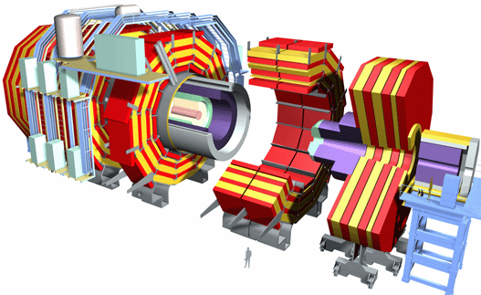
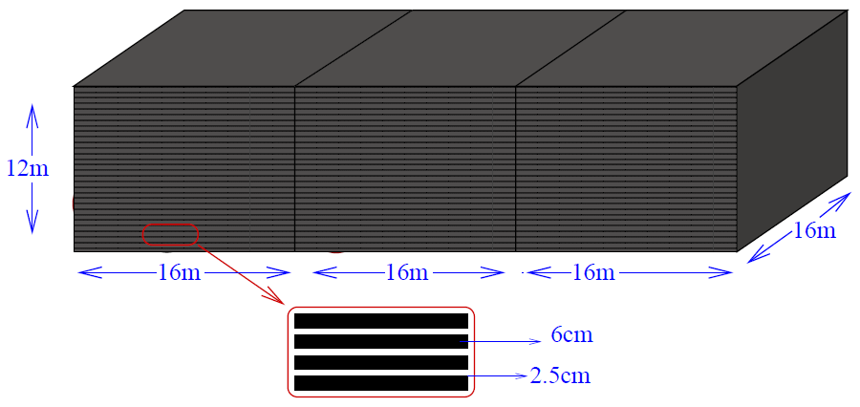
The CMS-RPC collaboration
Muon : central to both
RPCs : detector element
Compact Muon Solenoid
Experiment, CERN
∼ 1000 RPCs
Resistive Plate Chambers
Large area coverage (each ∼ 2-4 m²)
Excellent time resolution (∼ 2 ns)
Count rate capability (∼ kHz / cm²)
Art of fabrication
Handling (each ∼ 60 -70 kg)
Long term performance
Associated gas handling
Detector management
Still learning ……
India-based Neutrino Observatory
Separate talk by spokesperson, Naba Mondal
∼ 27,000 RPCs

Slide 3
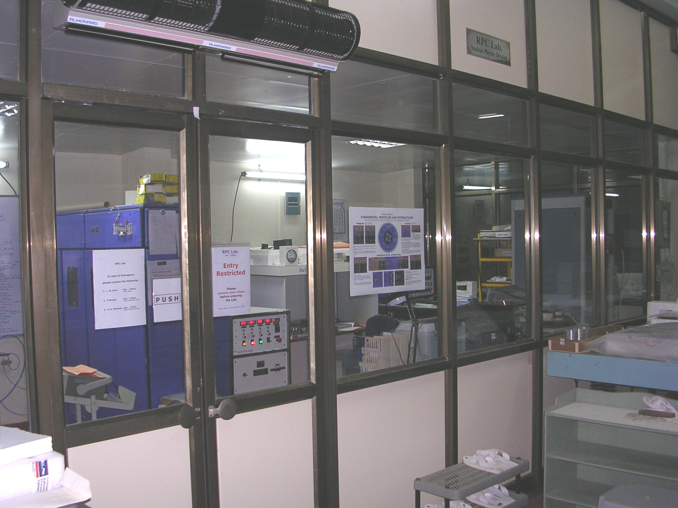
RPC Lab. @ NPD-BARC, Mumbai
2006
India-CMS-RPC collaboration :
Nuclear Physics Division, BARC, Mumbai &
Panjab University, Chandigarh

Slide 4
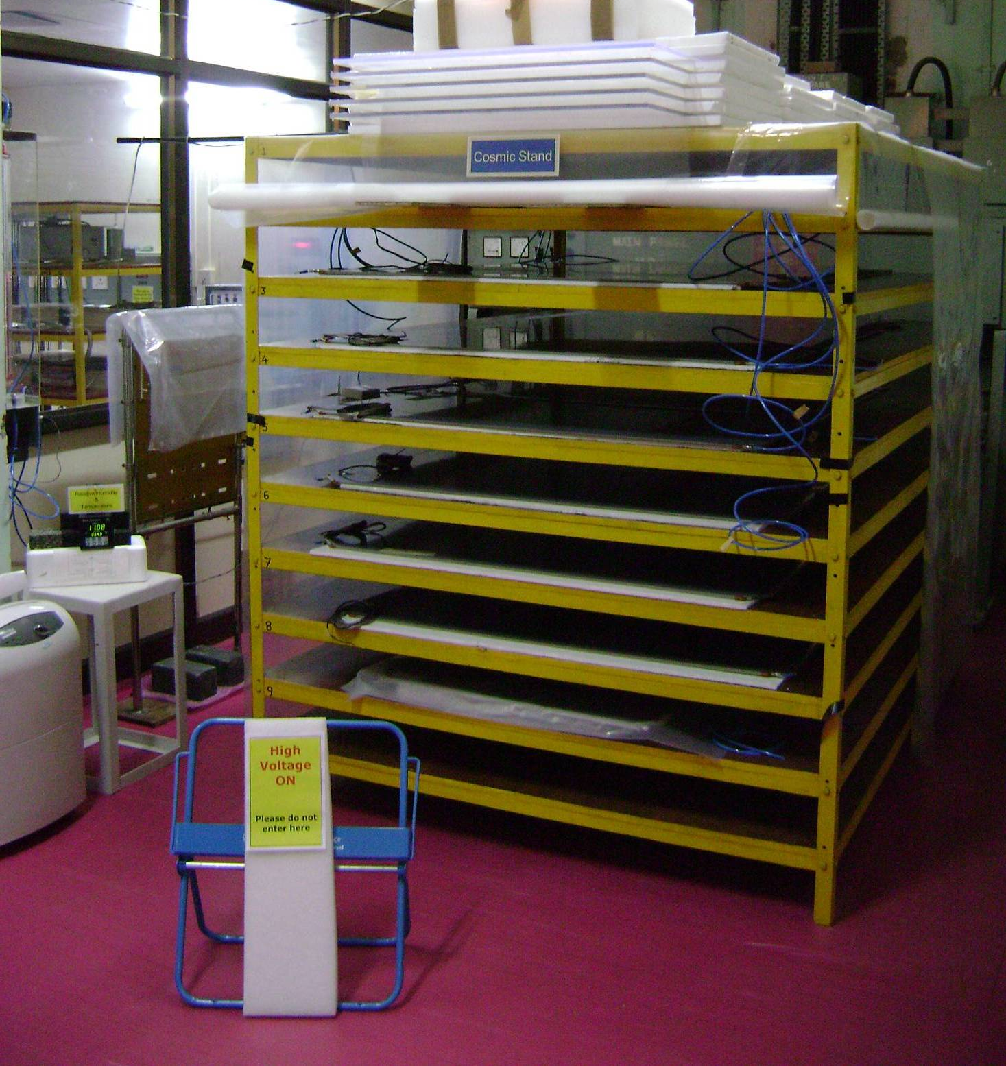
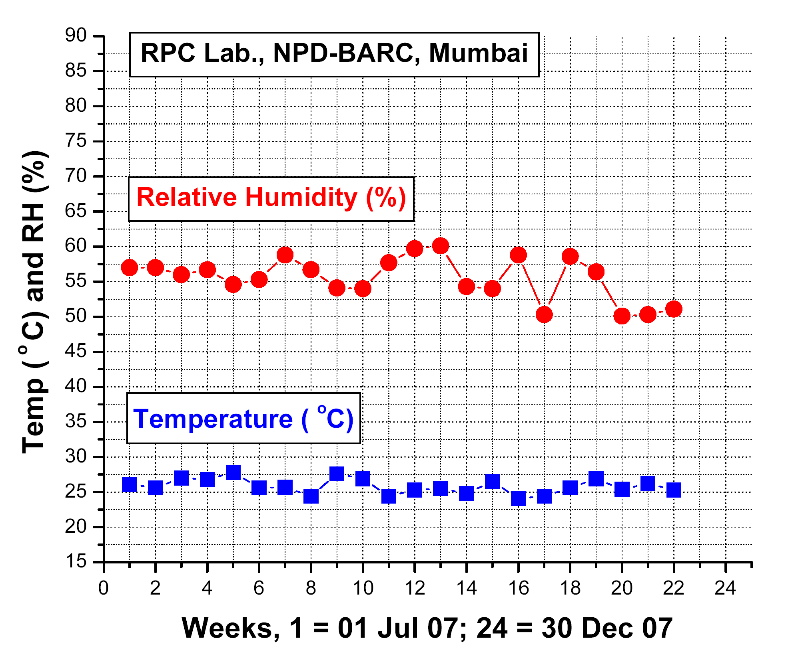
Leakage current vs. HV measurements for gas-gaps at NPD-BARC, Mumbai
January '2008
Cosmic stand for
leakage current &
efficiency measurements

Slide 5
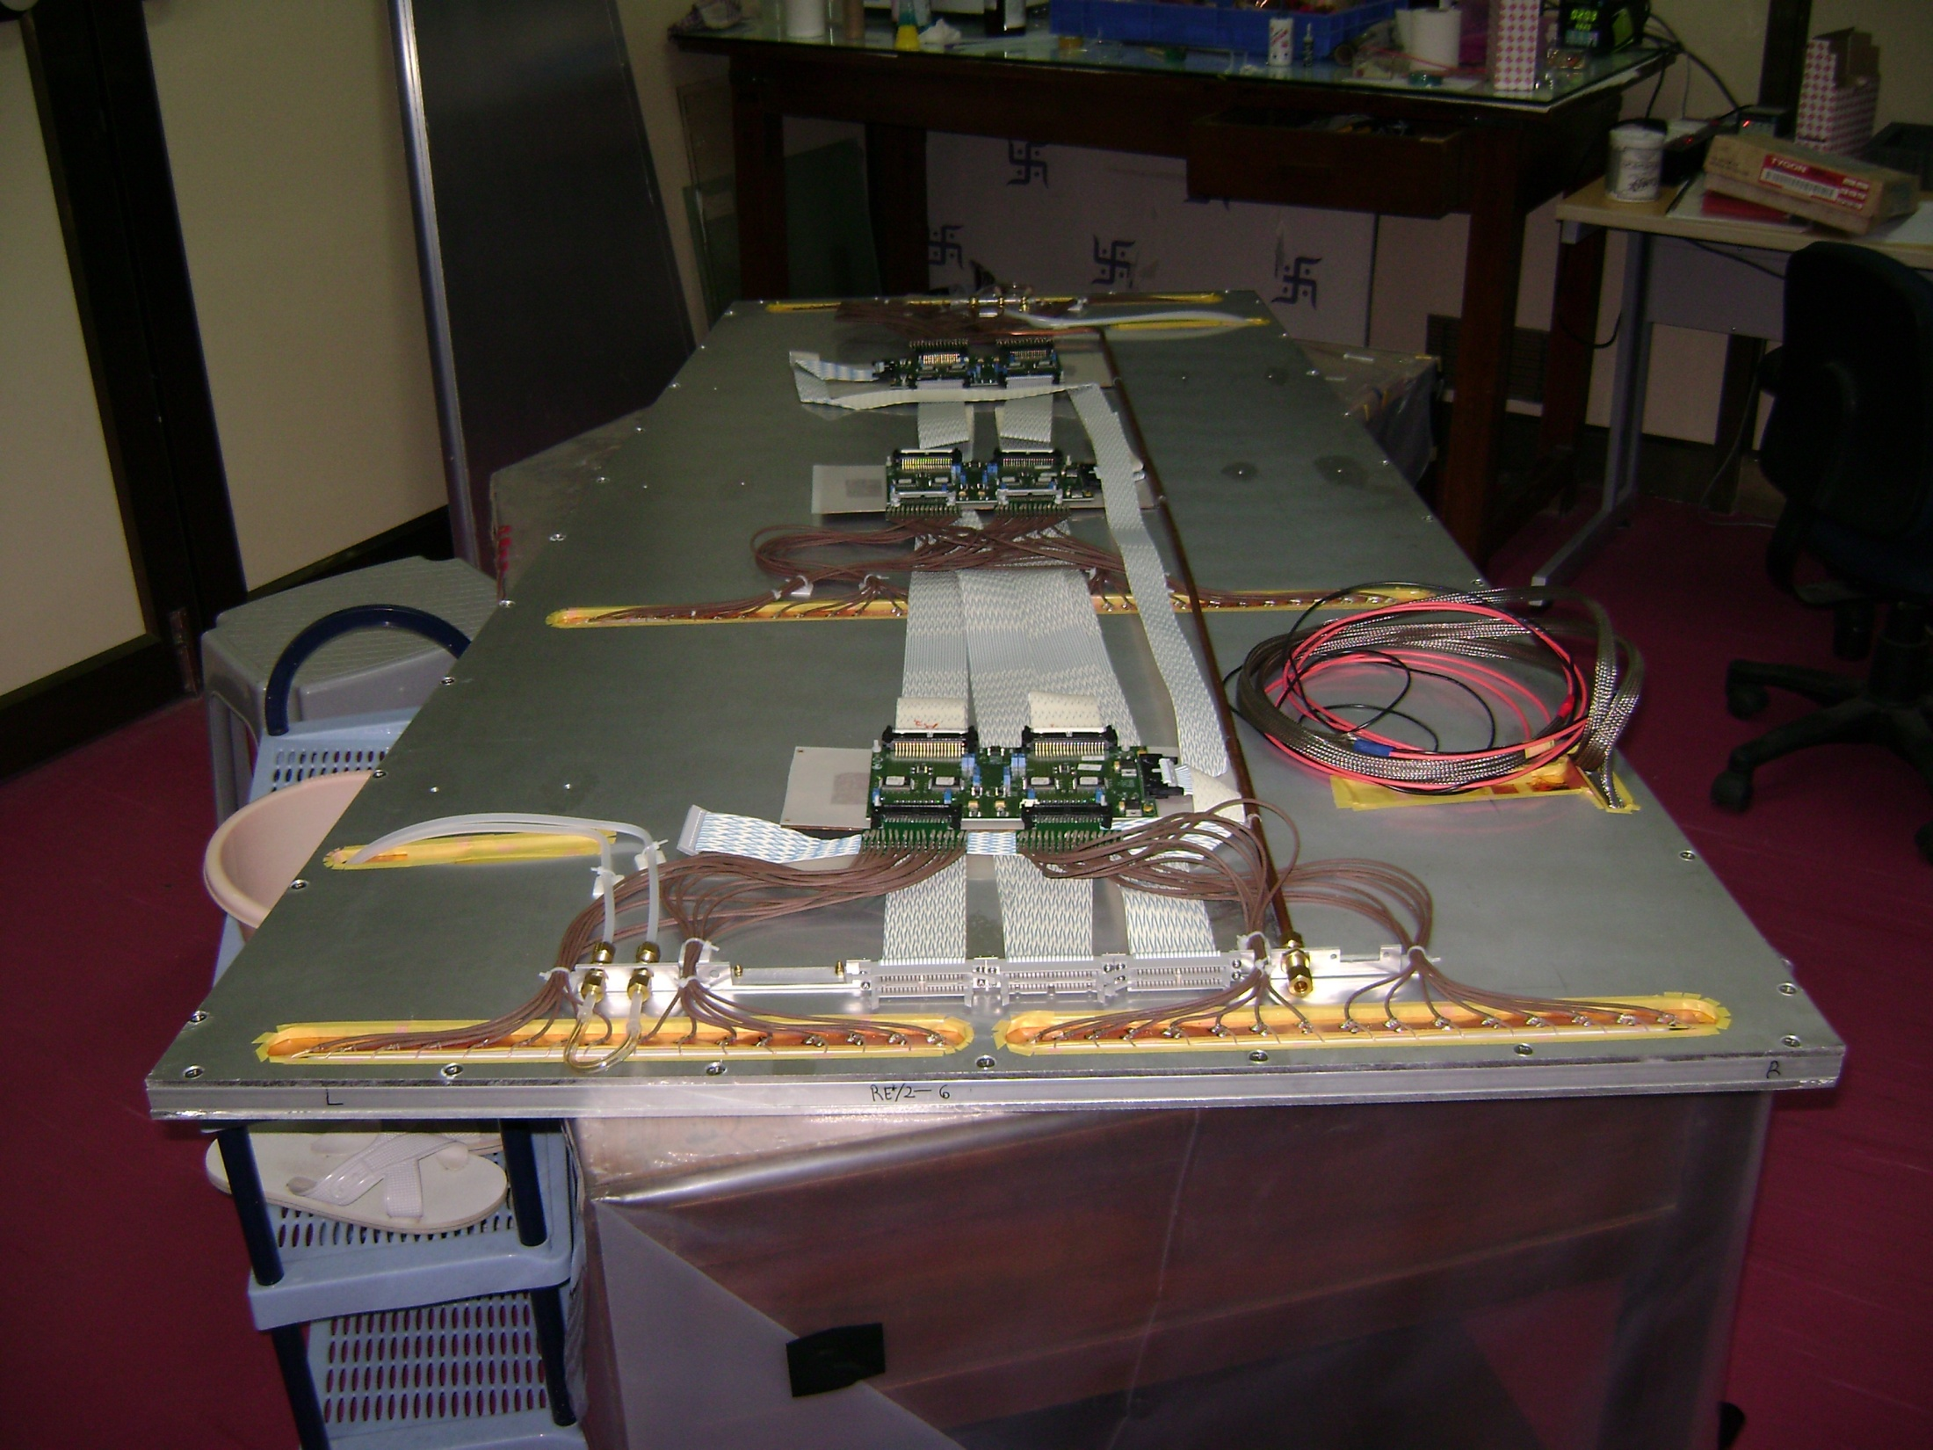
Fully assembled RPC with front end electronics,
gas flow pipes, cooling pipes, HV and signal cables at
NPD-BARC, Mumbai
June '2008

Slide 6
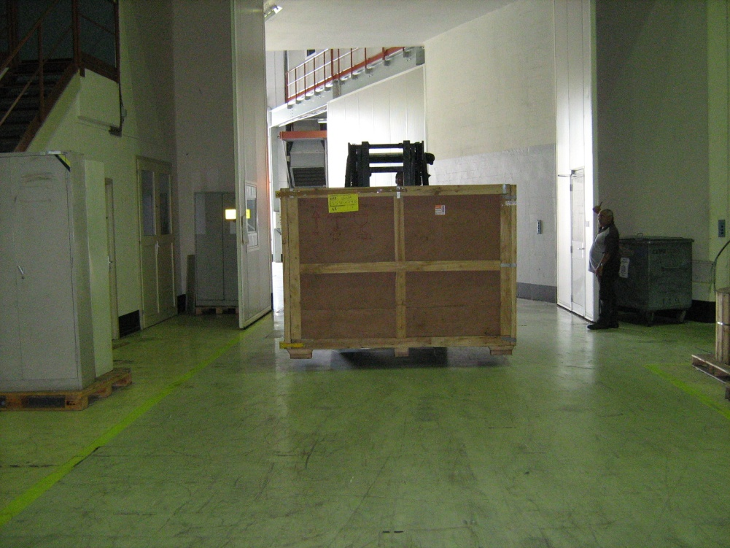
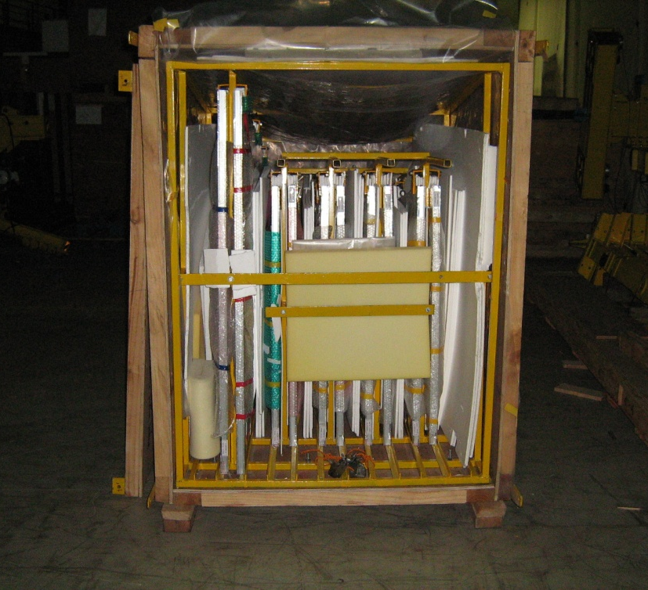
RPC consignment from India (10 RPCs) : 866 kg
Mumbai to Geneva : July 2008
RPC Box from India, entering
the ISR Lab. in CERN : Jul 08
July '2008
The ten RPCs : INTACT

Slide 7
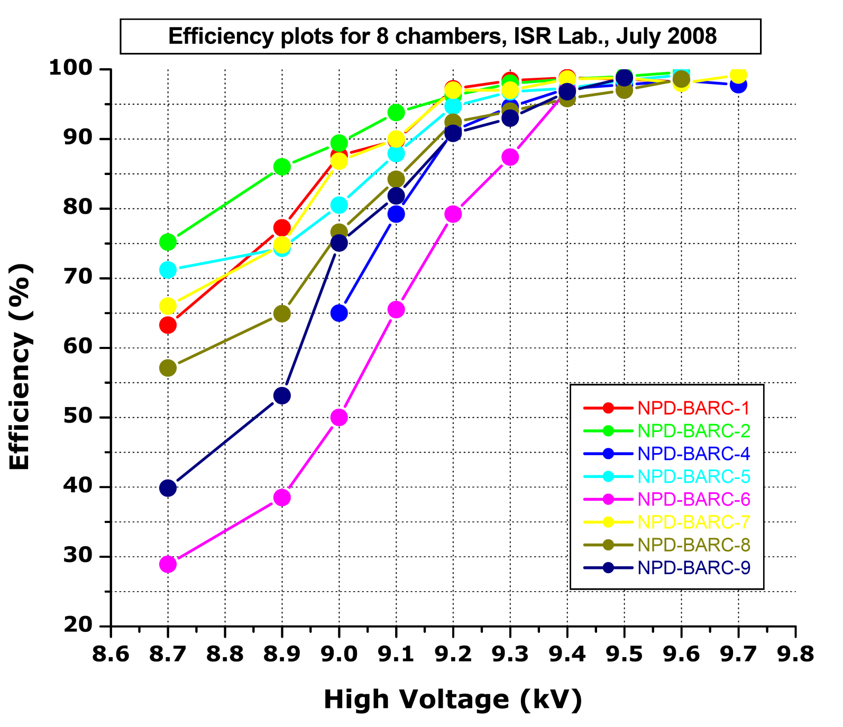
Efficiency plots for eight chambers measured in ISR Lab., with the cosmic hodoscope
ε > 95%
Not corrected for T & P
Threshold ~ 200 mV
Operating
Range ?

Slide 8
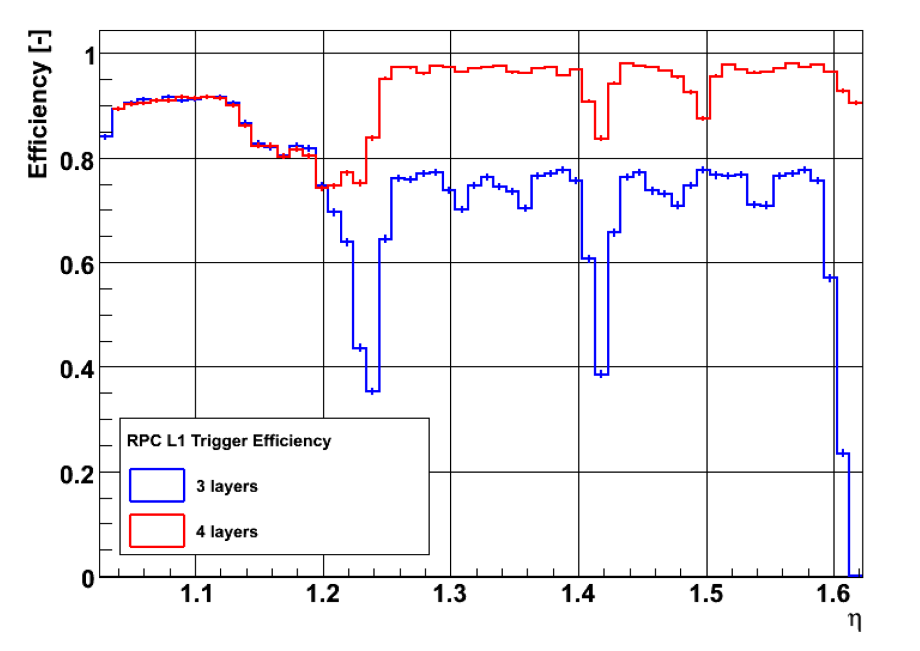
simulated trigger efficiency plot : Piet Verwilligen
the 4th layer is in between η = 1.2 and 1.6
small dips are due to an interface
between different
rolls in one chamber
η = 1.24
η = 1.42

Slide 9
barrel
end-cap
end-cap
Longitudinal section of CMS
CMS
pseudorapidity, η = - ln tan(θ/2)
θ Is the polar angle of the particle wrt the beam axis
Present
end-cap
RPC
coverage
upto
± 3 layers
High η region
FRPC upgrade
2016(?)
RPCs are segmented in strips of Δ η x Δ φ ~ 0.1 x (5/16)º
which makes possible a p_{T} measurement of ~ 50 GeV

Slide 10
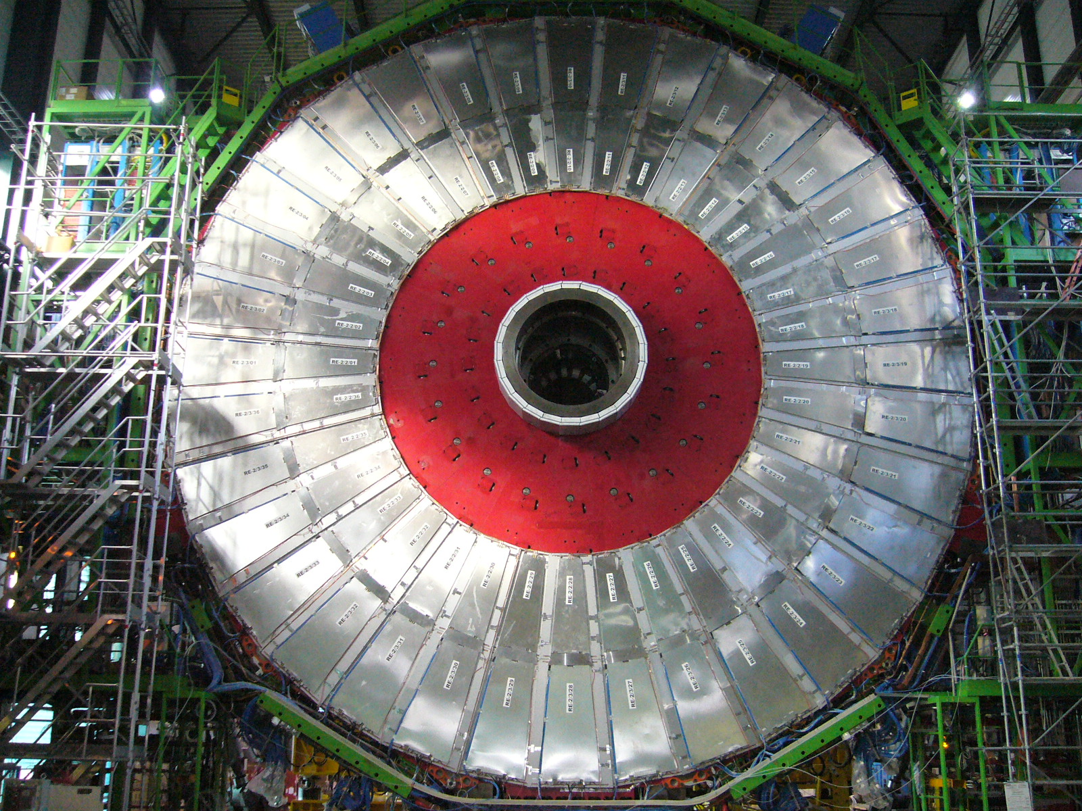
RE4/2 sector : 2 end caps x 36 chambers + spares
= 100 chambers

Slide 11
The groups involved with financial contributions
k CHF →
figures relative to CERN and Italy are only estimates on the basis of the
responsibility matrix, but no formal agreement exists

Slide 12
RPC assembly sites
Type of chamber | No. of chambers | Asembly sites
RE4/2 | 40 | India
RE4/2 | 60 | CERN – 904
RE4/3 | 40 | Ghent
RE4/3 | 60 | CERN – 904
The manpower to run this facility will be provided by the respective institutes when their detectors are being tested

Slide 13
Prototype assembly of RE4 chambers
(positive results → green signal for mass production)
Validation of bakelite quality
    Surface smoothness
    Bulk resistivity
Validation of gas gap fabrication procedures
a. mechanical and electrical QCs
b. gluing of gaps
c. bonding strength of spacers
d. efficiency in a cosmic hodoscope
Oct. '2010

Slide 14
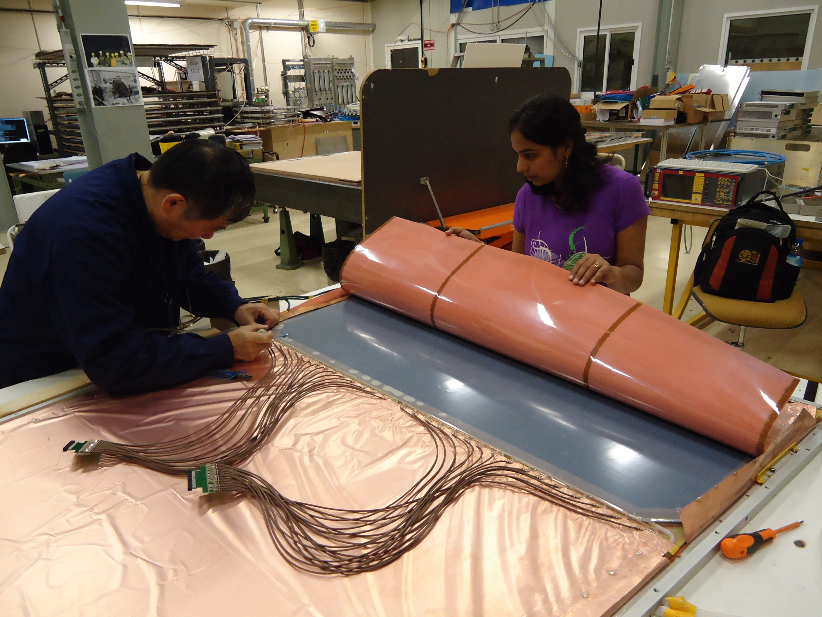
Assembly of first prototype for RE4 station at ISR lab, CERN
Oct. '2010

Slide 15
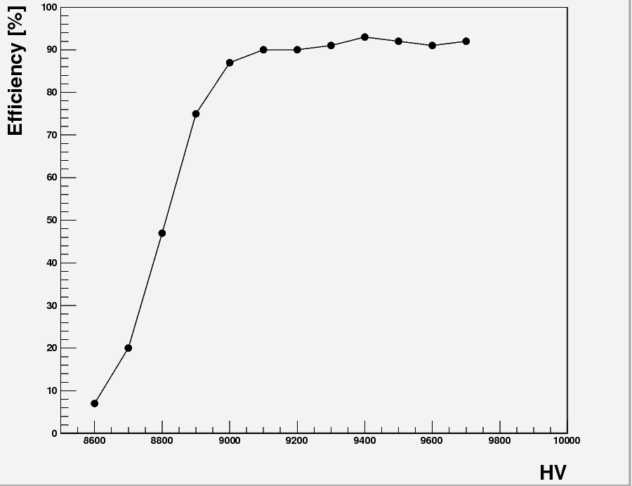
18 Nov 2010 : Efficiency plot of first RE4 chamber

Slide 16
Prototype assembly RE4 station : Outlook
Further assembly scheduled at CERN in March 2011 where all the participating institutes will evolve a common assembly / testing procedures
2. Assembly sites :
a. in India - fully functional at Mumbai
b. cosmic hodoscope ∼ mid 2011
c. MDPDD-BARC is involved in a major way
for fabrication of various components
d. Panjab University, Chandigarh is also
gearing up as an additional site
e. Ghent assembly site to be functional soon
cosmic hodoscope ∼ mid 2011
f. 904 assembly site to be ready ∼ mid 2011

Slide 17
RPC Upscope : the road map
Oct’10
Dec ’10
Mar ’11
Jun ’11
Dec ’11
First RE4
chamber
assembled
Validation
& go ahead
for bakelite
production
Mass
Production
of gas-gaps,
mechanics,
electronics
Assembly
of chambers
at sites
Testing,
Comissioning
& Complete
Installation
This of course depends, if the shutdown is in 2012 ?

Slide 18
Acknowledgements
Atul Gurtu, TIFR
V. C Sahni, BARC
S. Kailas, BARC
Naba Mondal, TIFR
R. K. Choudhury, BARC
Archana Sharma and the staff at CERN
CDM, MDPDD, Spectroscopy Div., at BARC
Staff and students from Panjab University, Chandigarh

Slide 19
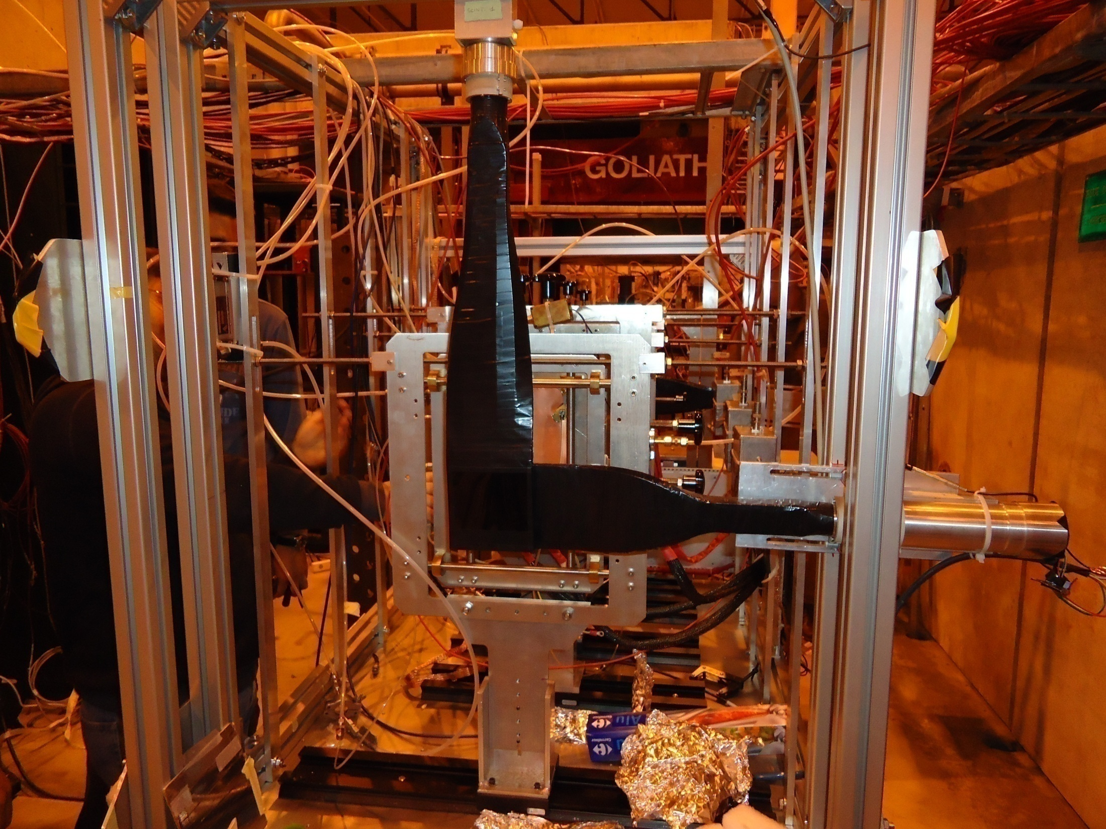
Looking further : possible upgrades : GEMs
EoI for GEM upgrade (1.6 < η < 2.1) : Sept. 2010
Local industry being looked into for GEM fabrication
GEM testing facility has been set up at NPD-BARC
GEM foils from CERN characterised : pitch and hole diameter
Gaseous etching of polymide surface being set up
CERN support : GEM electronics and consolidating the program
GEMs being exposed to muon beams at CERN

