Slide 1
CPT to MEX
Ian
24 Jan 2018

Slide 2
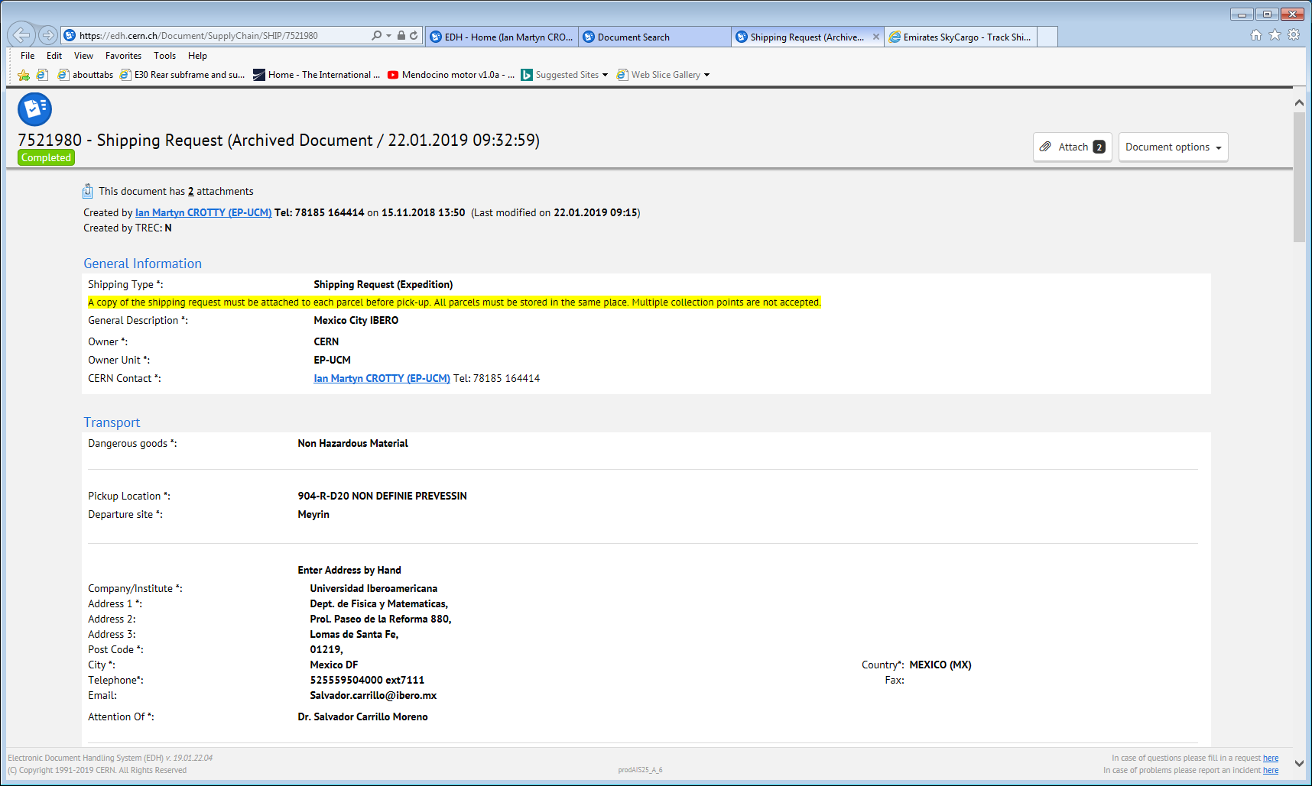

Slide 3
Transport by DIRECT FLIGHT - AIR - Carrier : FRACHT S.A.
24.01.2019 17:07 Packing : 1 package(s) - 28 Kg(s)
24.01.2019 17:07 Delivery conditions : CPT MEXICO DF
24.01.2019 17:07 Air waybill number : 176-0080 1441
24.01.2019 17:07 Flight no : EK 9930/30 DXB-MEX
24.01.2019 17:07 Transportation costs : 570 CHF

Slide 4
Up date 24 Jan 2019
https://www.track-trace.com/aircargo
https://skychain.emirates.com/skychain/app

Slide 5
Up date 29 Jan 2019 @ 1722hrs
DXB Dubai International airport to
Al Maktoum International Airport (DWC)
Jebel Ali, United Arab Emirates (AE)
Geneve (GVA) to DXB Dubai International airport Dubai, United Arab Emirates (AE)

