Slide 1
Notes made from Conductive paint bottles in the ALICE lab of Guillermo Tejeda Munoz
July 2018

Slide 2
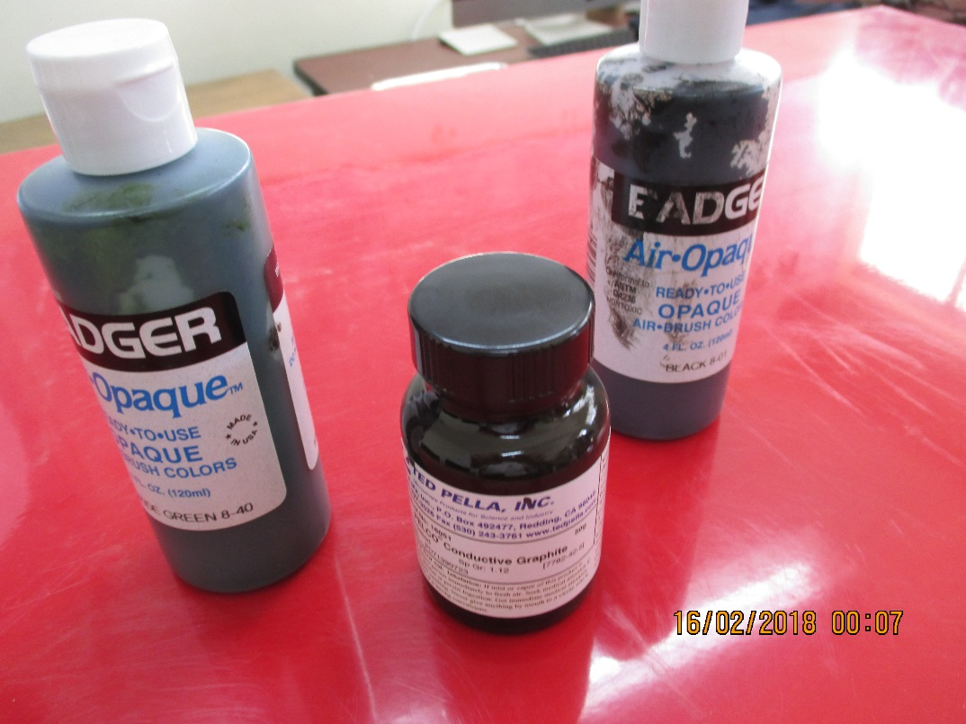
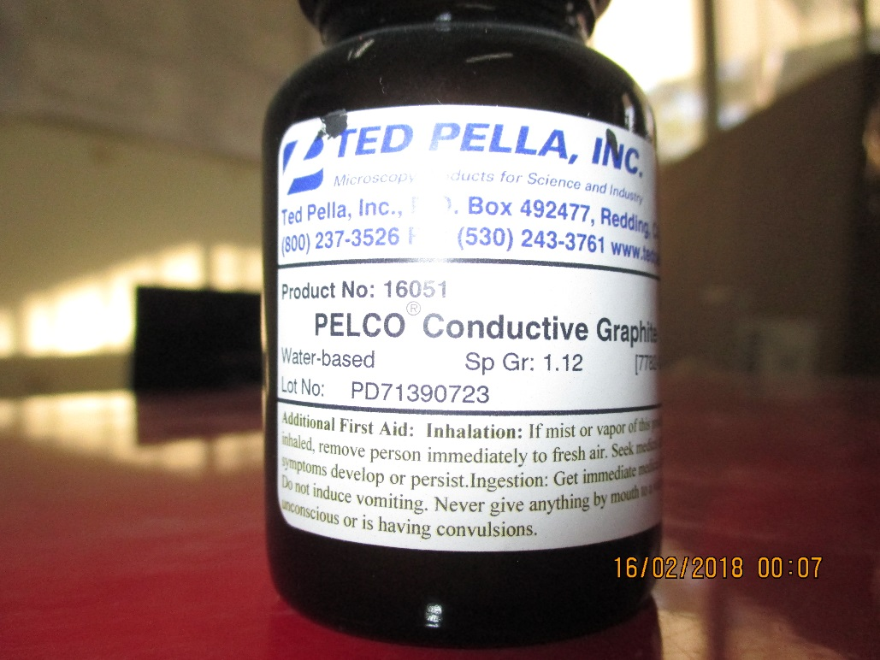
Badger
Air-Opaque
Air Brush colors. Ready to use. Green 8-40, Black 8-01
Ted Pella
Ted Pella Inc
P.O. Box 492477, Redding
Pelco Conductive Graphite. Product No. 16051
Water based

Slide 3
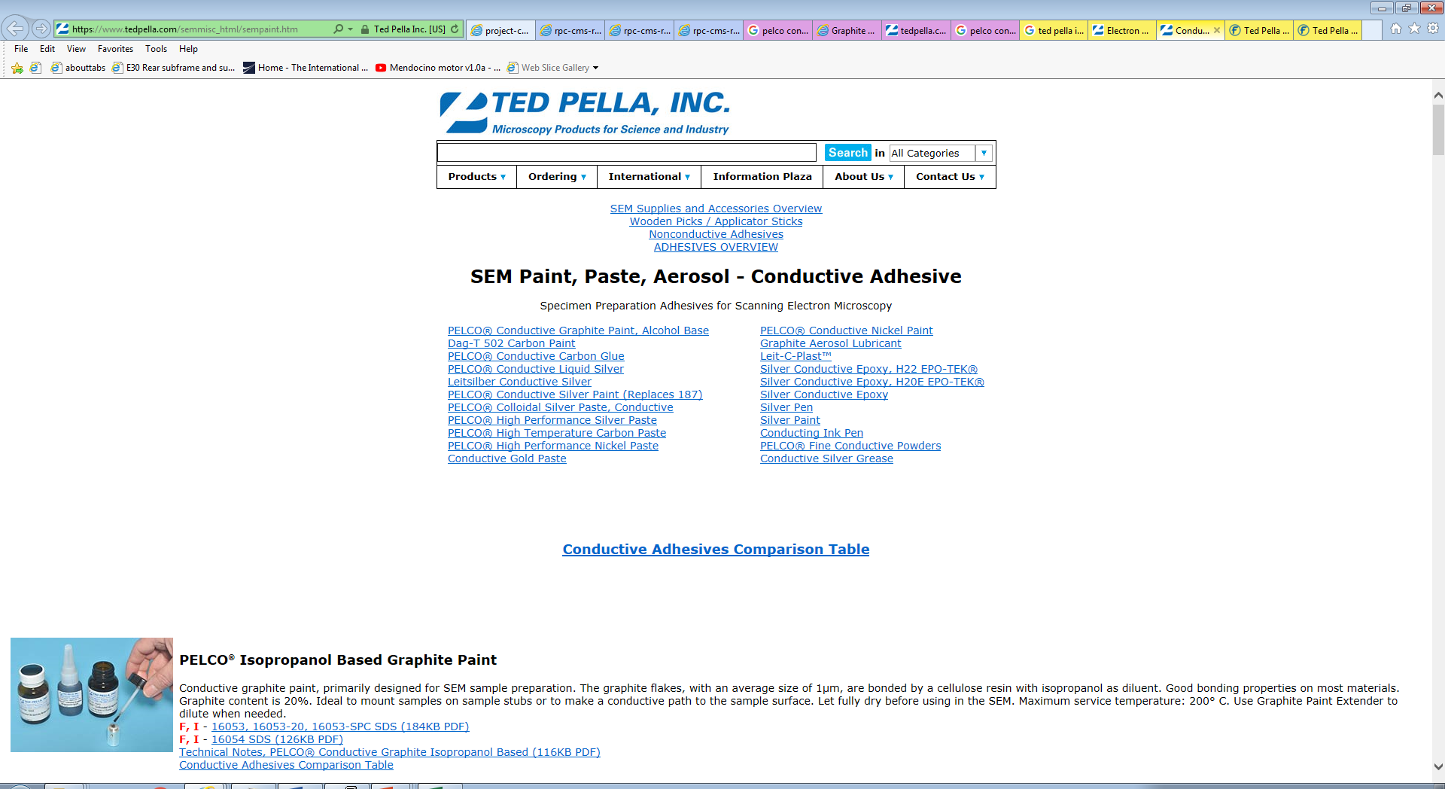
https://www.tedpella.com/semmisc_html/sempaint.htm
https://www.tedpella.com/technote_html/16051TN.pdf

Slide 4
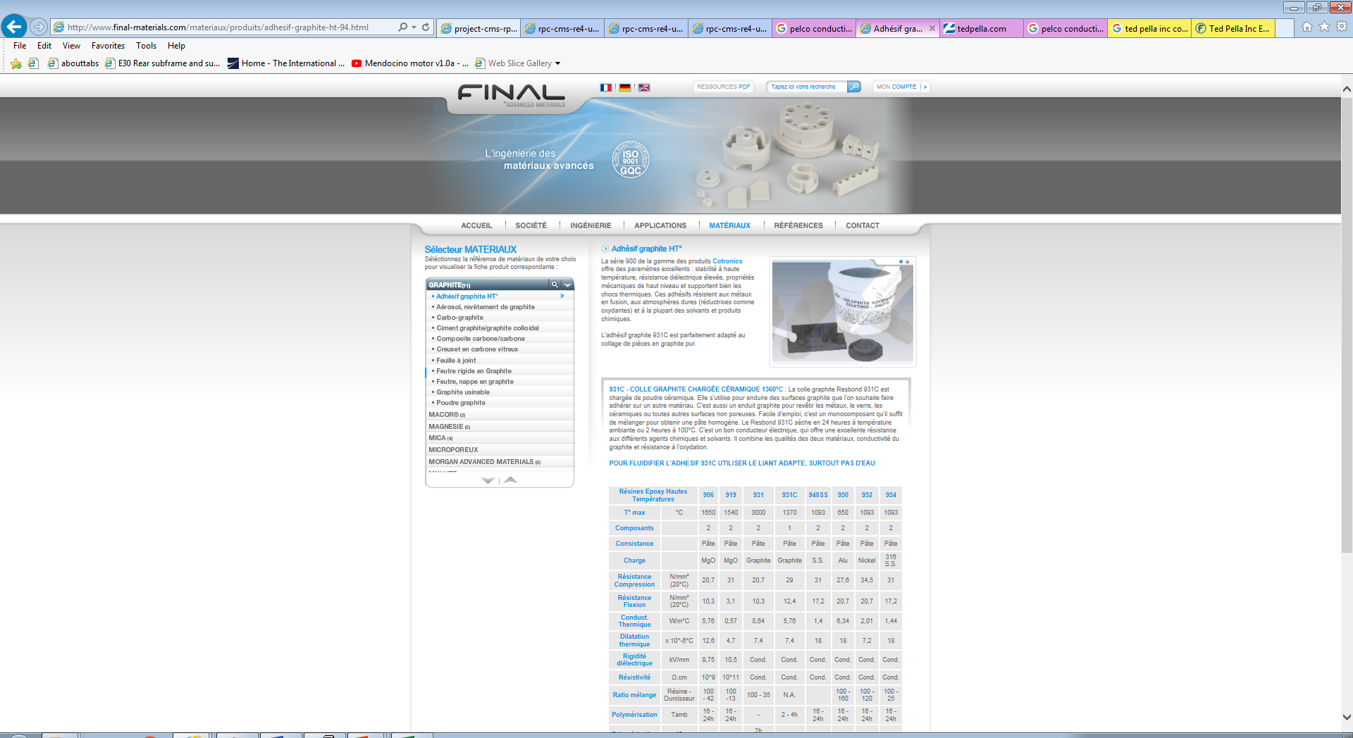
http://www.final-materials.com/materiaux/produits/adhesif-graphite-ht-94.html

