Slide 1
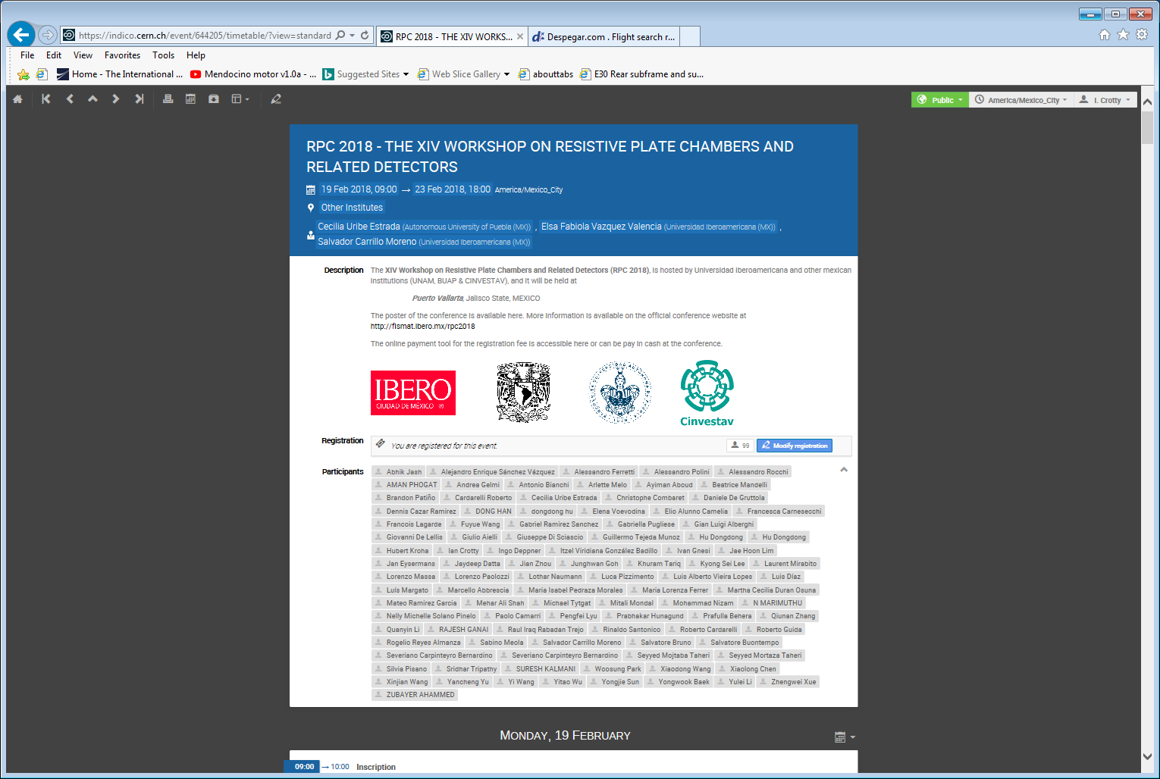
https://indico.cern.ch/event/644205/timetable/?view=standard

