Slide 1
Water in Mexico City Chapultepec aqueduct in Tenochtitlan
Ian
Feb 2018

Slide 2
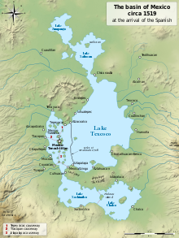
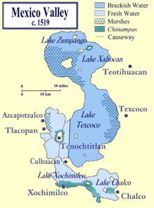

Slide 3
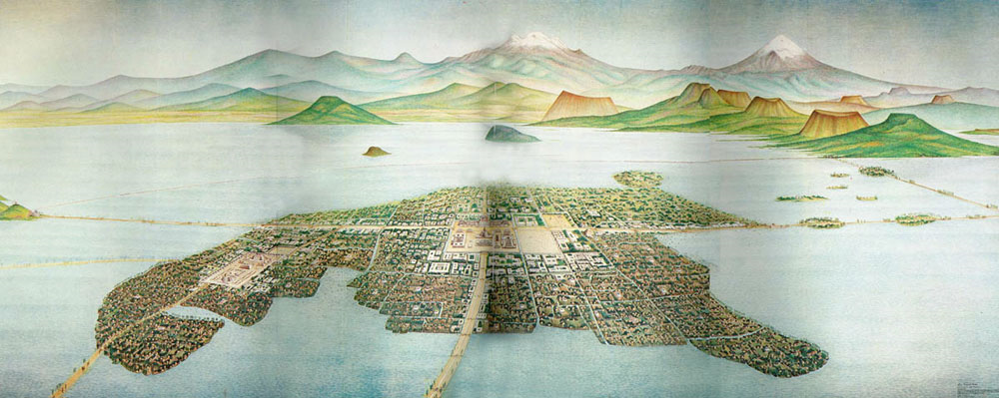

Slide 4
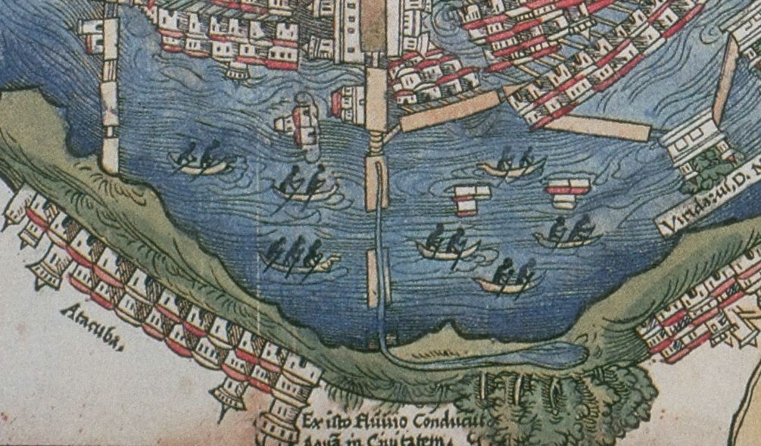
The aqueduct along the causeway from Chapultepec, from the 1524 Nuremberg map

Slide 5
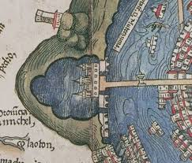
Map of Tenochtitlan, the Aztec capital, printed 1524 in Nuremberg

Slide 6
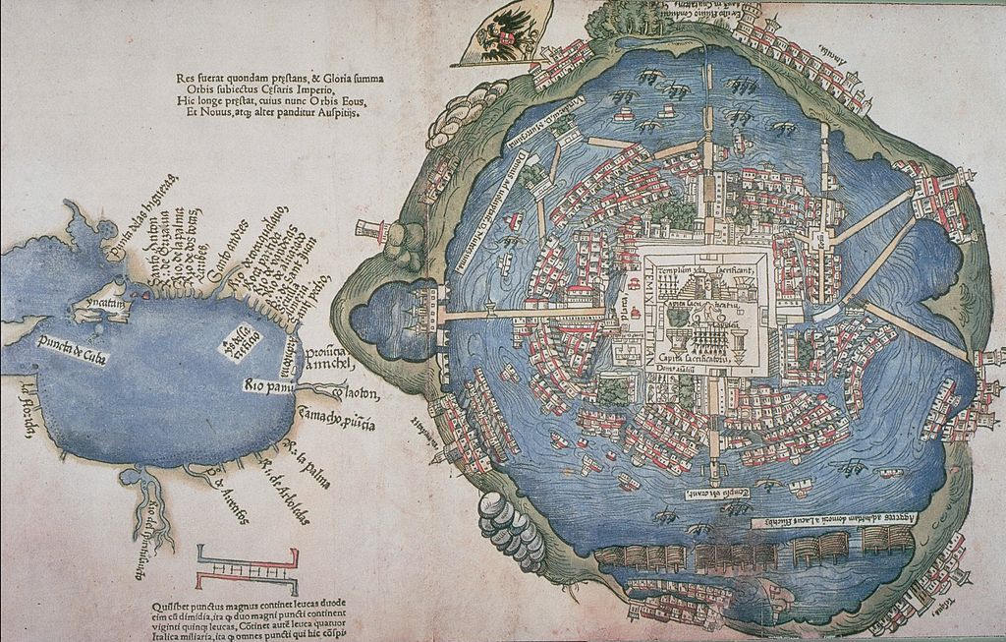
North straight up ?
It appears that there is an east west screw up on some maps…

Slide 7
The text in german , translate ??

Slide 8
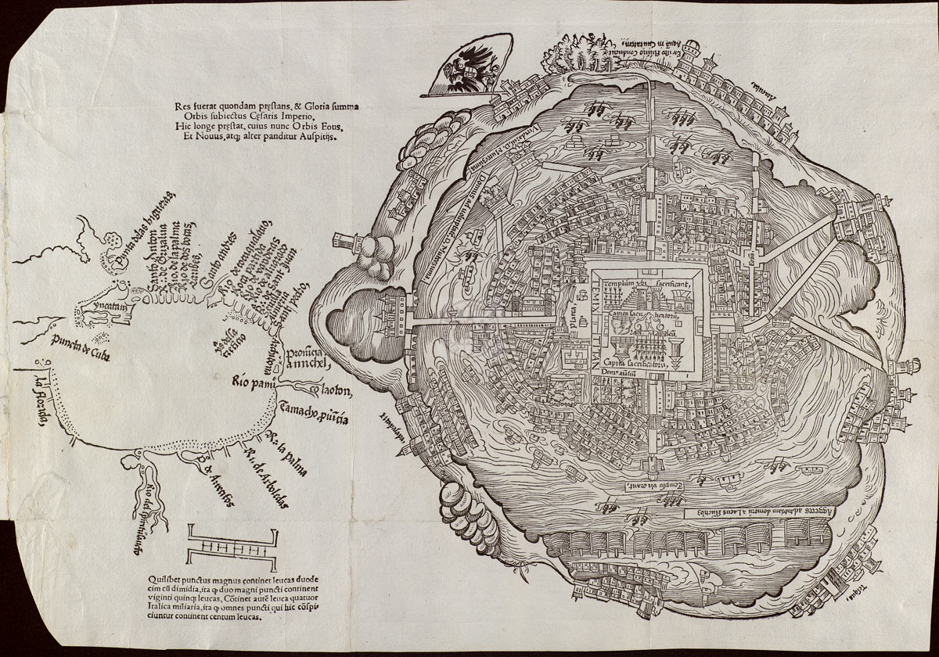

Slide 10
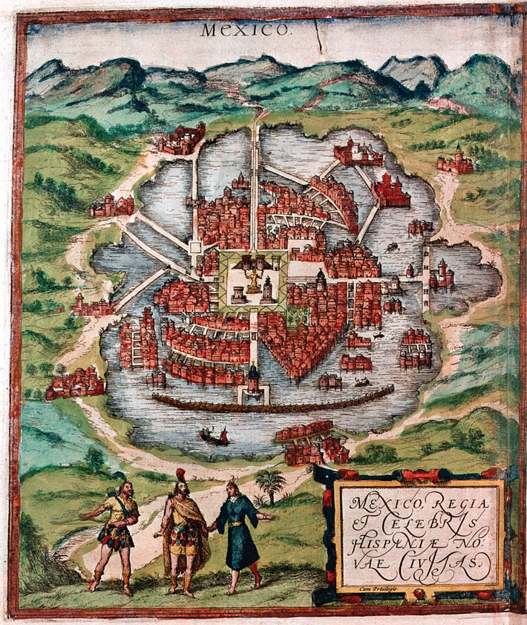
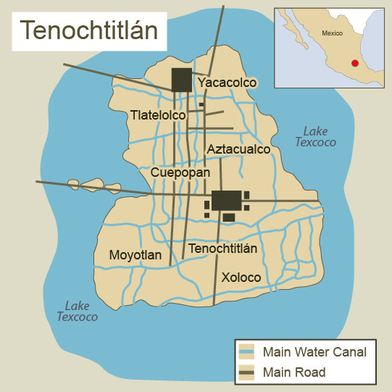
Map 1524
Showing canal supply in yellow

Slide 12
Cortez 1500??
Built 13 century

Slide 13
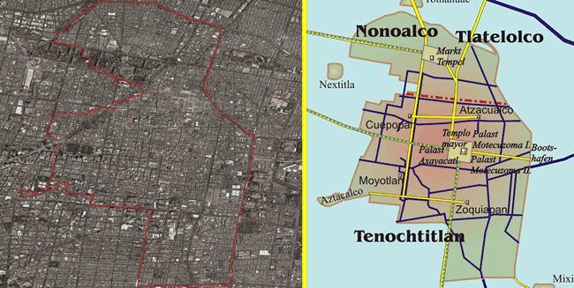
What are the blue lines ?

Slide 14
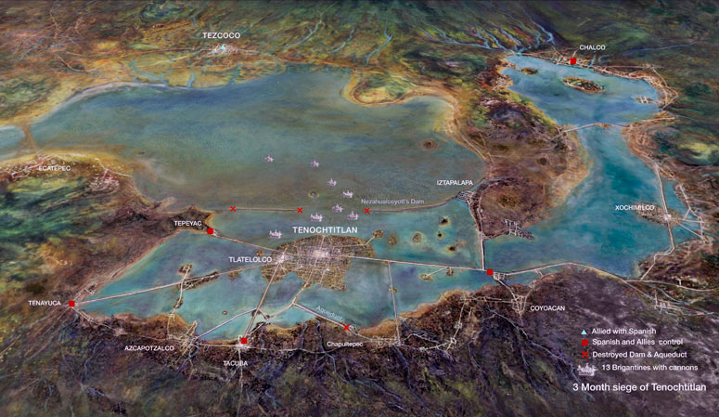

Slide 15
Aquaduct, south of Tacuba ?

Slide 16
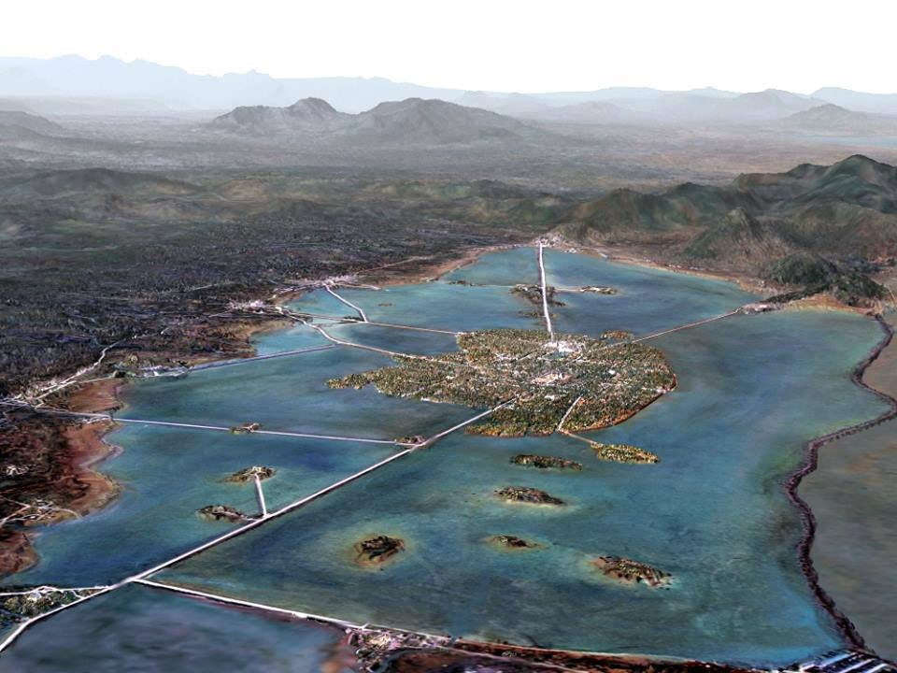
Mexico
The Valley of Mexico in the 15th century. The basin of Mexico was rich in natural resources, especially water. It was formed by more than 40 rivers and 5 Lakes (Zumpango, Xaltocan, Xochimilco and Texcoco Chalco). A conceptual aerial view of the valley by Mexican Tomás Filsinger

Slide 17
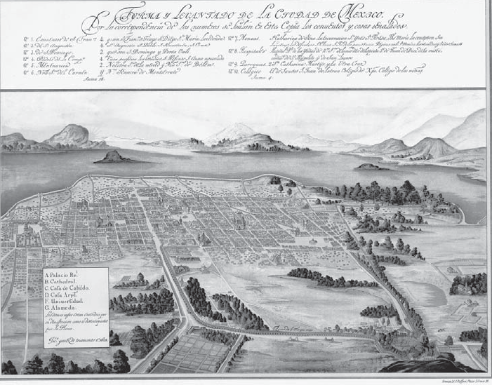

Slide 18
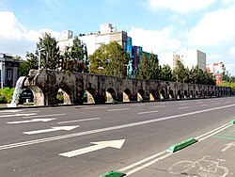
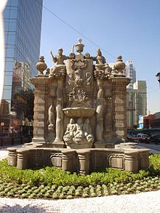
The Chapultepec aqueduct (in Spanish: acueducto de Chapultepec) was built to provide potable water to Tenochtitlan, now known as Mexico City.
https://en.wikipedia.org/wiki/Chapultepec_aqueduct
https://en.wikipedia.org/wiki/Chapultepec_aqueduct
Replica of the Salto del Agua Fountain

Slide 19
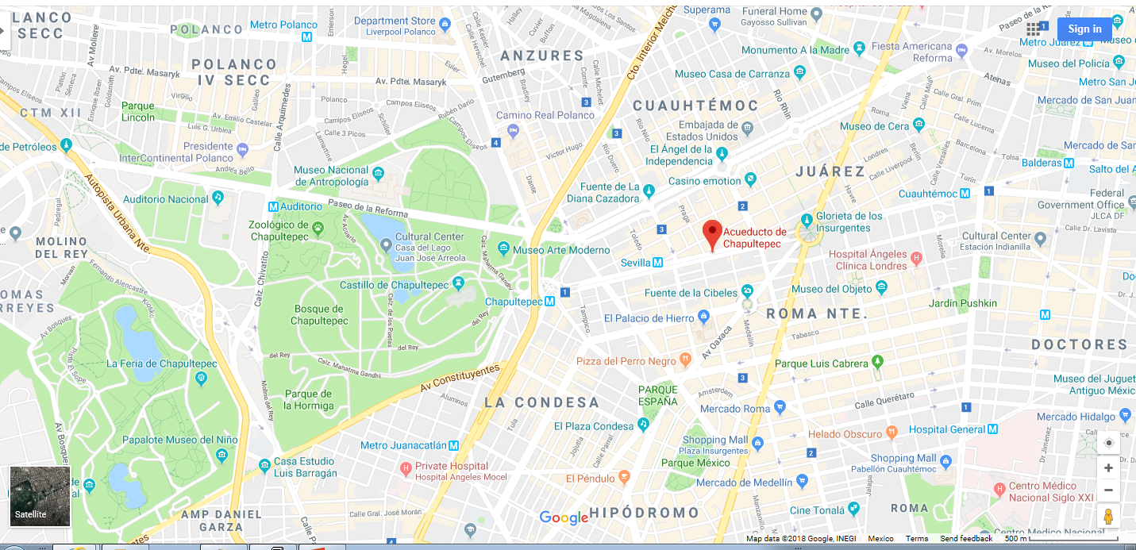
http://highscalability.com/blog/2011/3/28/aztec-empire-strategy-use-dual-pipes-in-your-aqueduct-for-hi.html

Slide 20
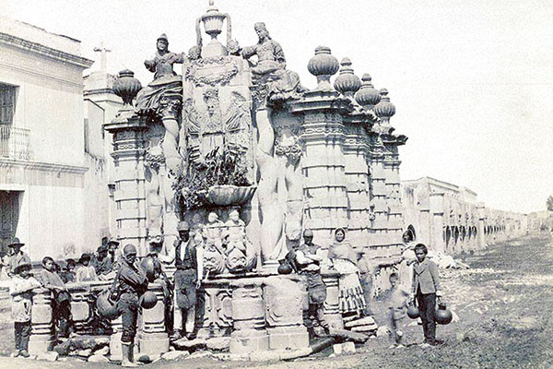

Slide 21
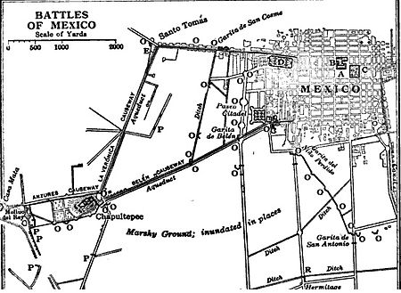

Slide 22
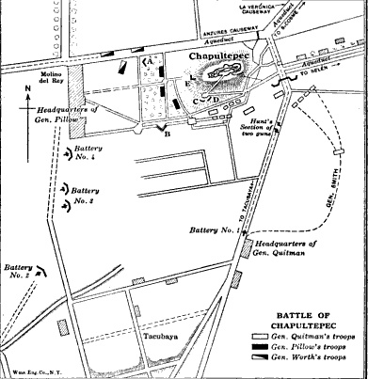
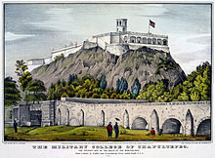
https://upload.wikimedia.org/wikipedia/commons/b/ba/Chapultepec_disposition_of_forces.jpg

Slide 23
Museo del Agua
Monumento A Los Indios Verdes

Slide 24
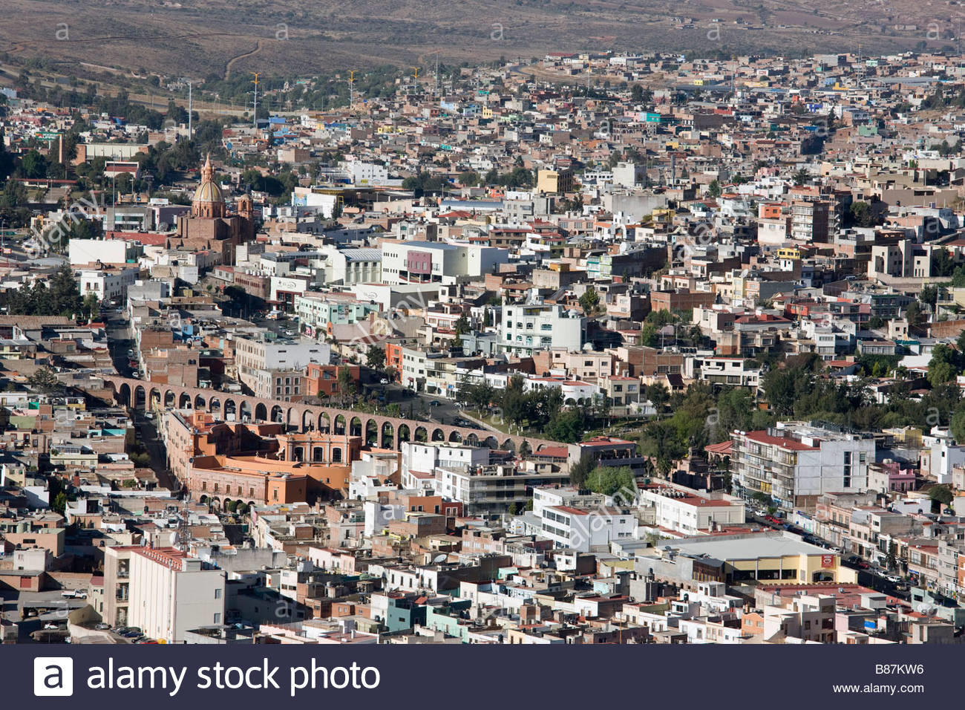
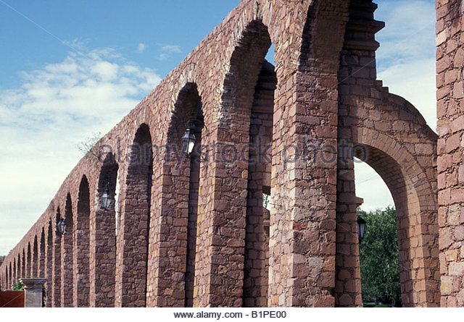
zacatecas mexico aqueduct
610km NW

Slide 25
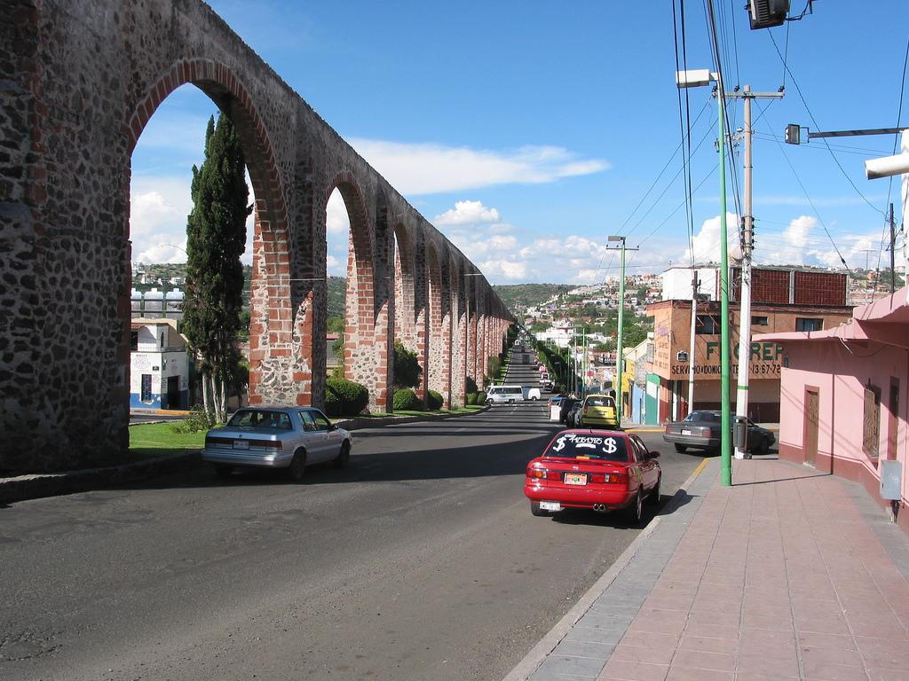
Querétaro Aqueduct

Slide 26
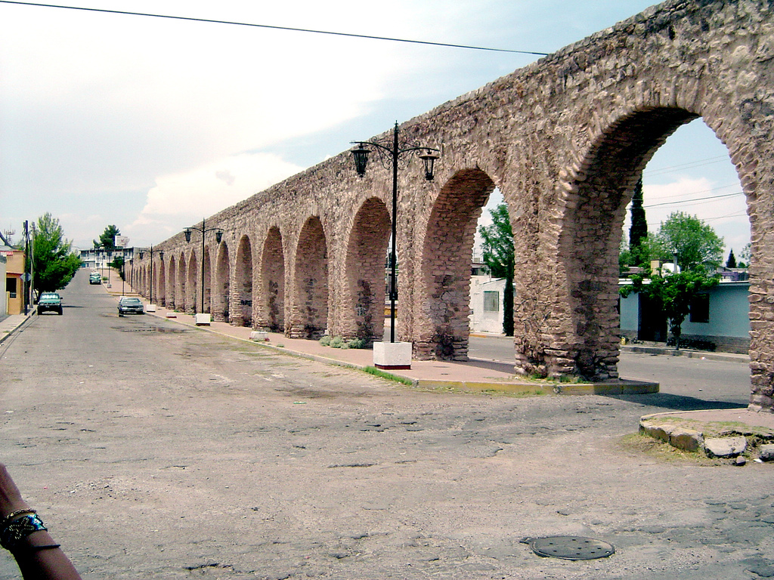
Chihuahua Aqueduct
https://books.google.com/books?id=wW...ueduct&f=false

Slide 27
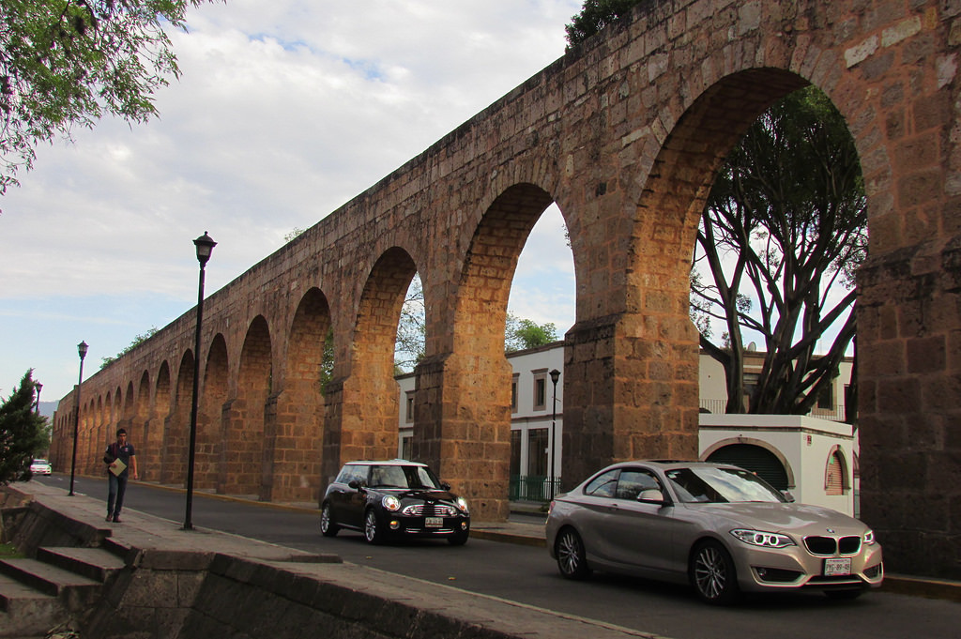
Morelia Aqueduct
https://en.wikipedia.org/wiki/Morelia#History

Slide 28
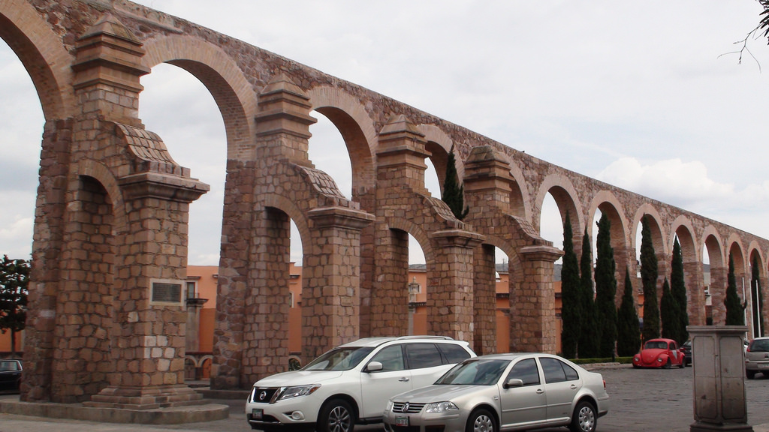
Plaza de Toros and El Cubo Aqueduct - Zacatecas, Zacatecas, Mexico
https://en.wikipedia.org/wiki/Zacate...er_attractions

Slide 29
zacatecas mexico aqueduct

Slide 30
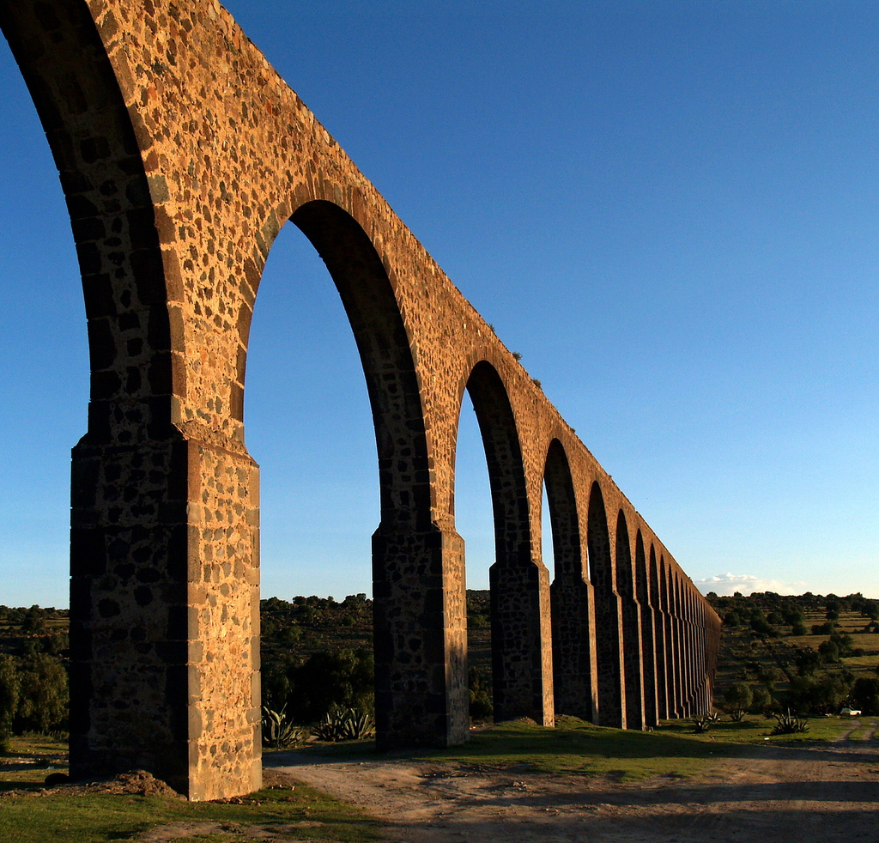
Aqueduct of Padre Tembleque - Between the towns of Zempoala, Hidalgo and Otumba, in the State of Mexico
48km , 39.65m high
http://www.inah.gob.mx/images/infografias/20150705_tembleque.pdf
https://en.wikipedia.org/wiki/Aquedu...adre_Tembleque

Slide 31
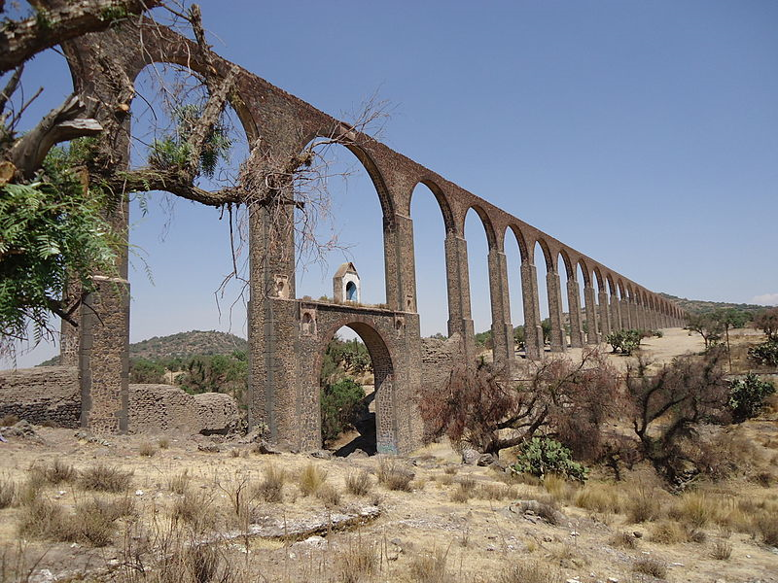

Slide 32
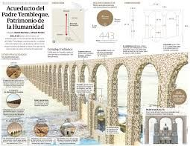
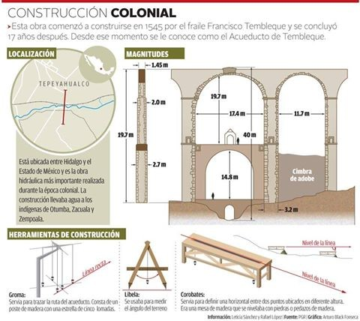
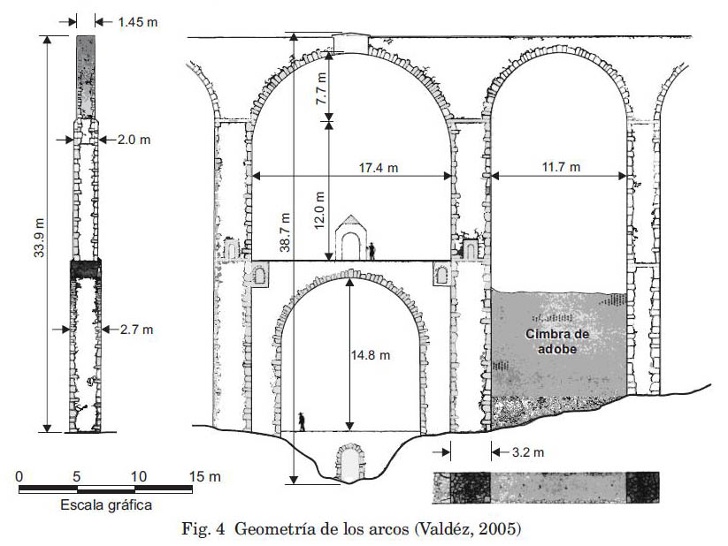

Slide 33
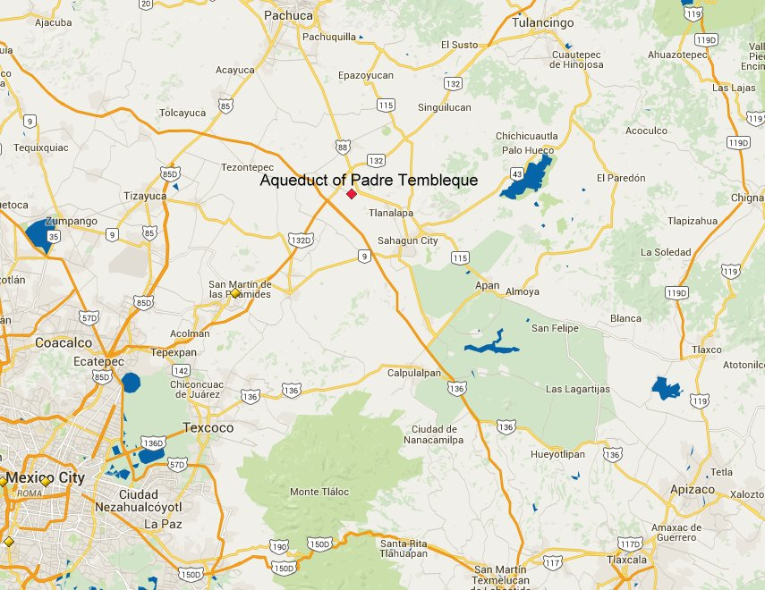

Slide 34
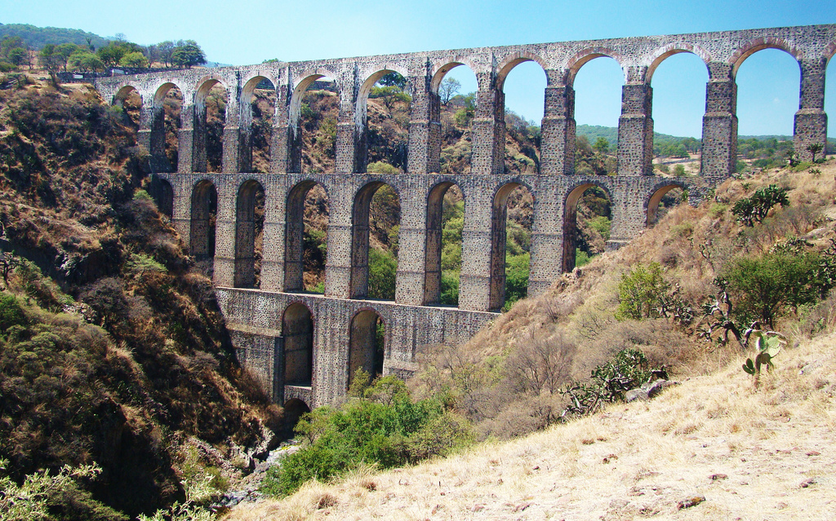
Arcos del Sitio - Tepotzotlán, Mexico, Mexico
https://en.wikipedia.org/wiki/Tepotz...ts_of_Interest

Slide 35
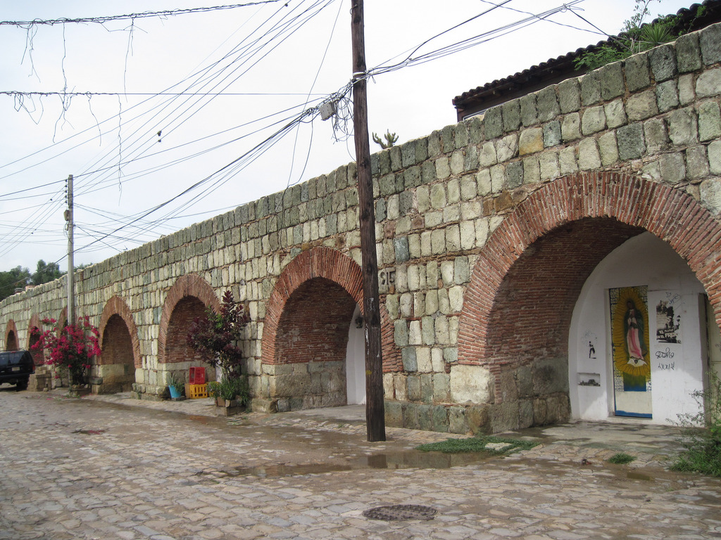
Los Arquitos - Oaxaca, Oaxaca, Mexico
http://www.oaxacanotes.com/Los_Arqui....A7unyWb3.dpuf

Slide 36
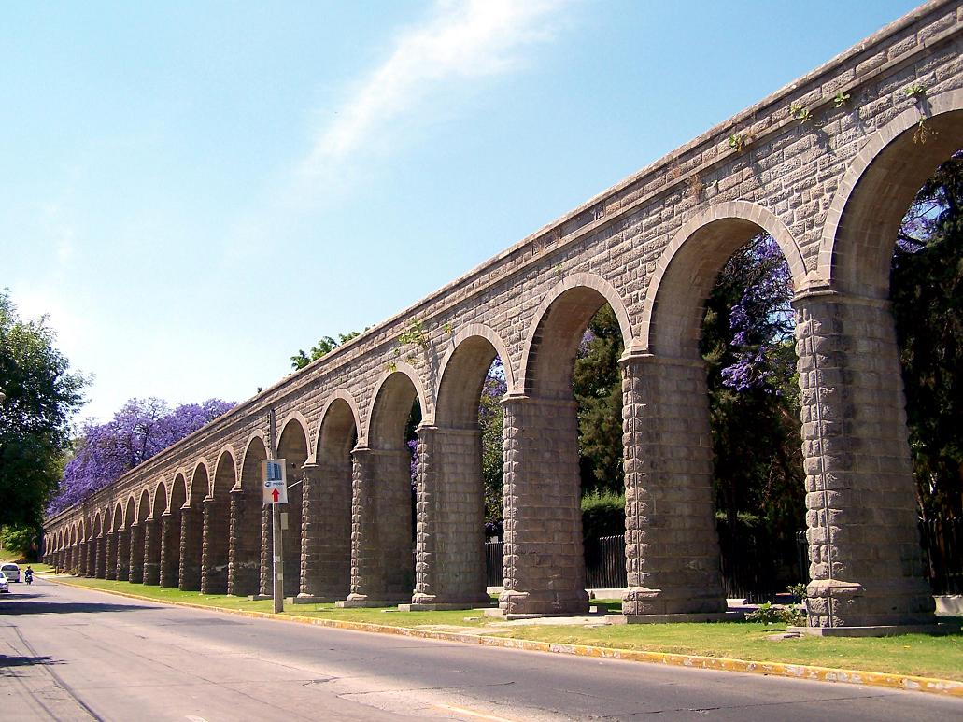
Av. Pablo Casals
Guadalajara, Jalisco.

Slide 37
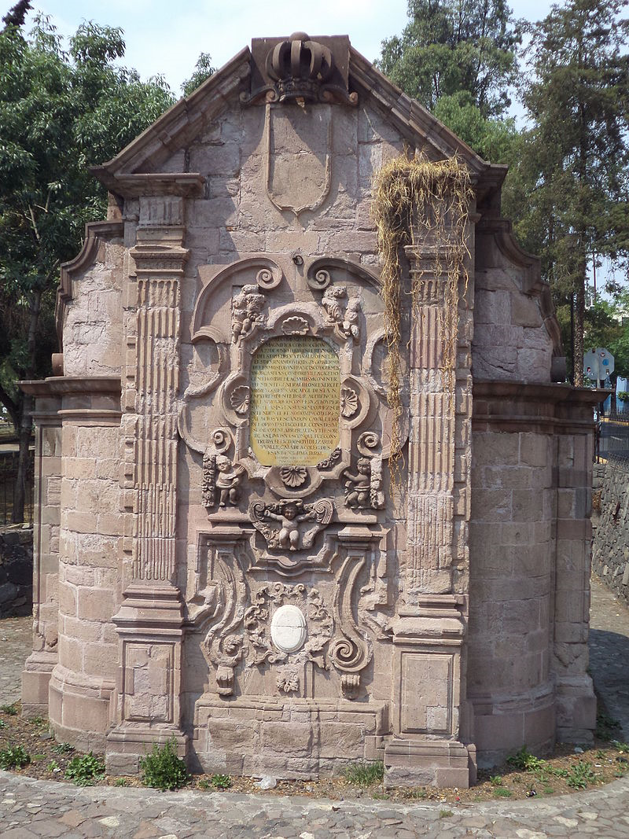
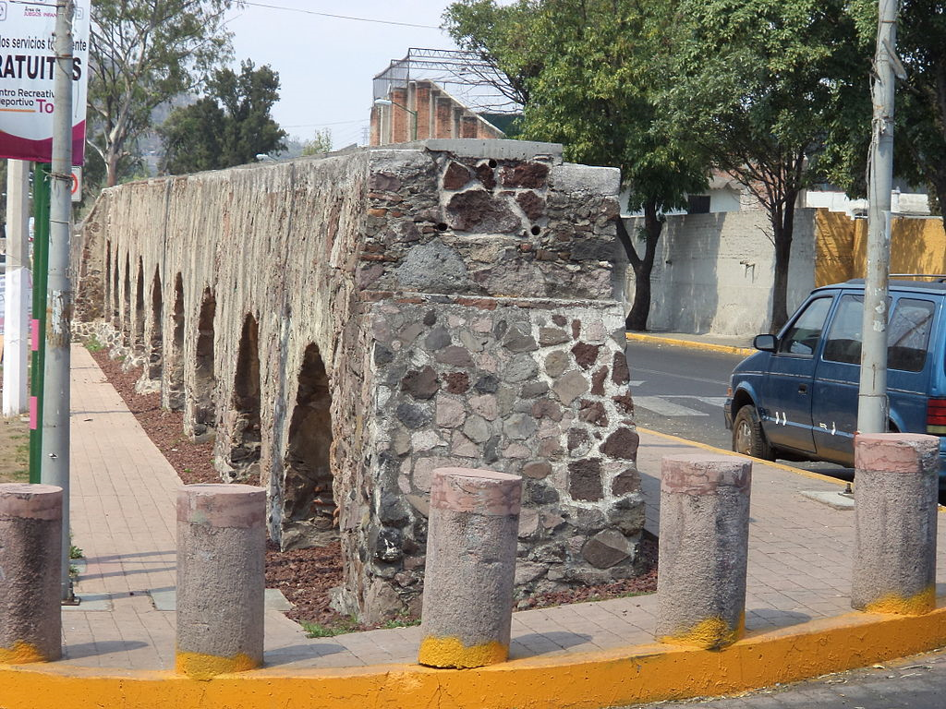
Guadalupe Aqueduct, Mexico City
https://es.wikipedia.org/wiki/Acueducto_de_Guadalupe
2 k arches and 10km long the logest in Mexico city

Slide 38
The Aqueduct of Guadalupe is located in Gustavo A Madero , within the Federal District. The site was built in 1751 and it was an important hydraulic work of the time.
The purpose of its construction was to bring drinking water from the Tlalnepantla River in the town of Santa María to Villa de Guadalupe, to be connected to the aqueduct that carries water to Santiago Tlatelolco, a site north of what is now Mexico City.
At the moment it is considered as a recognized and visited historical and artistic monument . In the vicinity of the aqueduct is the city Colonia Acueducto de Guadalupe.
The Aqueduct of Guadalupe had an original extension of 10 kilometers and had the purpose of solving the water problems in the Villa. The same began in the Tlalnepantla river and ended in a box of water that was behind Basilica . In the front of the temple you could see a fountain that was used for public service, about ten meters in diameter, in the center was a column with effigies representing the four parts of the world.
At that time this work was very advanced, using unique advances, much of it was built underground, all a novelty for the time. On the outside it was supported by 2310 arches on which the water pipe ran. Some of the elements of architecture are from the Baroque period. Among the pieces that formed the aqueduct, we found repositories, pools, fountains, all built with quarries that came from Cerro de Guadalupe.

Slide 39
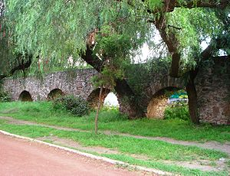
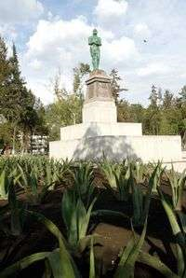
https://es.wikipedia.org/wiki/Acueducto_de_Guadalupe
http://www.jornada.unam.mx/2006/07/17/index.php?section=capital&article=040n1cap
Museo del Agua
Monumento A Los Indios Verdes
Parque del Mestizaje, the parc of the green
Indians, also the water museum !!
Como parte del rescate del acueducto también se incluyó el del Parque del Mestizaje, que inicia a un costado del monumento, entre Insurgentes y Ticomán, donde fueron colocados los Indios Verdes.

Slide 40
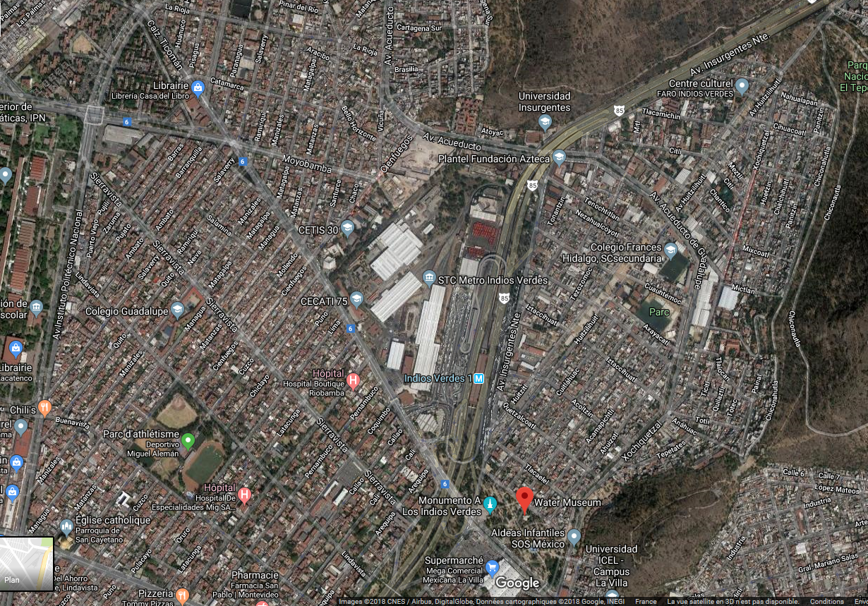

Slide 41
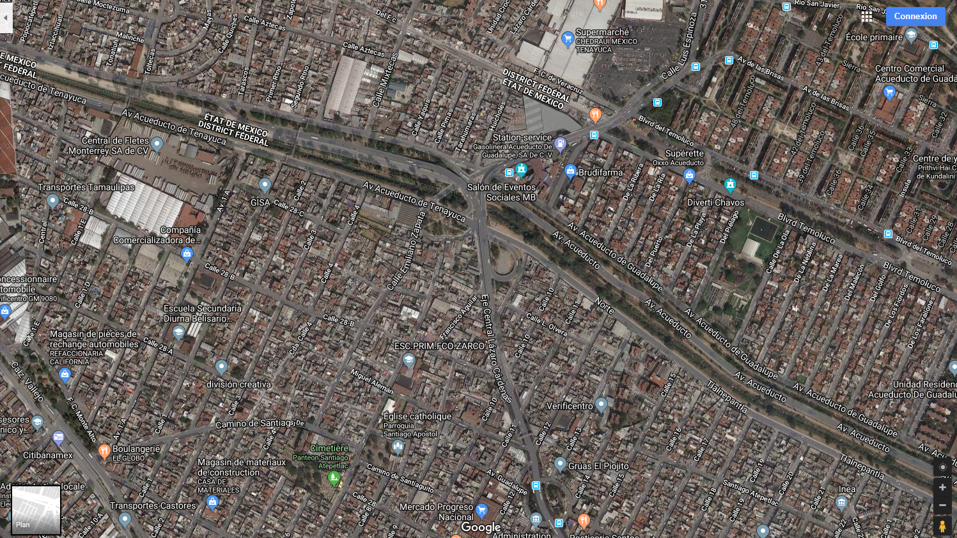
Transition from Av acueducto de Guadalupe to Av acueducto de Tenayuca

Slide 42
https://web.archive.org/web/20130520003316/http://www.cronica.com.mx/notas/2005/216024.html
https://web.archive.org/web/20130313031127/http://www.eluniversal.com.mx/ciudad/78263.html
How to get there;
https://moovitapp.com/index/en/public_transit-Acueducto_De_Tenayuca-Ciudad_de_Mexico-site_35745973-822
https://www.vivemx.com/col/acueducto-tenayuca.htm

Slide 43
There are xx underground rivers in Mexico city
http://www.hiddenhydrology.org/mexico-city/
Piedad River in Mexico City Paved over in 1942, what was once one of the biggest rivers in the area now flows under the Miguel Alemán Viaduct, a major east-west . 45 now-covered rivers in the capital's Anahuac watershed. The first phase would involve uncovering about 9.3 miles of the Piedad River, now part of a drainage network.
Amajac River, Piedad River, Río Magdalena, Rio Churubusco,
Rio Churubusco, a major freeway that was once a river.
Map of mexico rivers
http://geo-mexico.com/?p=9117
https://www.nytimes.com/2017/02/22/world/americas/mexico-city-canals-xochimilco-chinampas.html

Slide 44
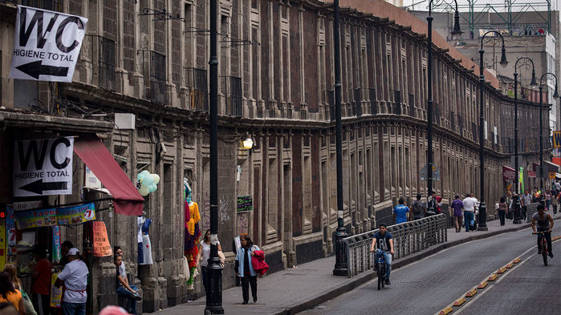
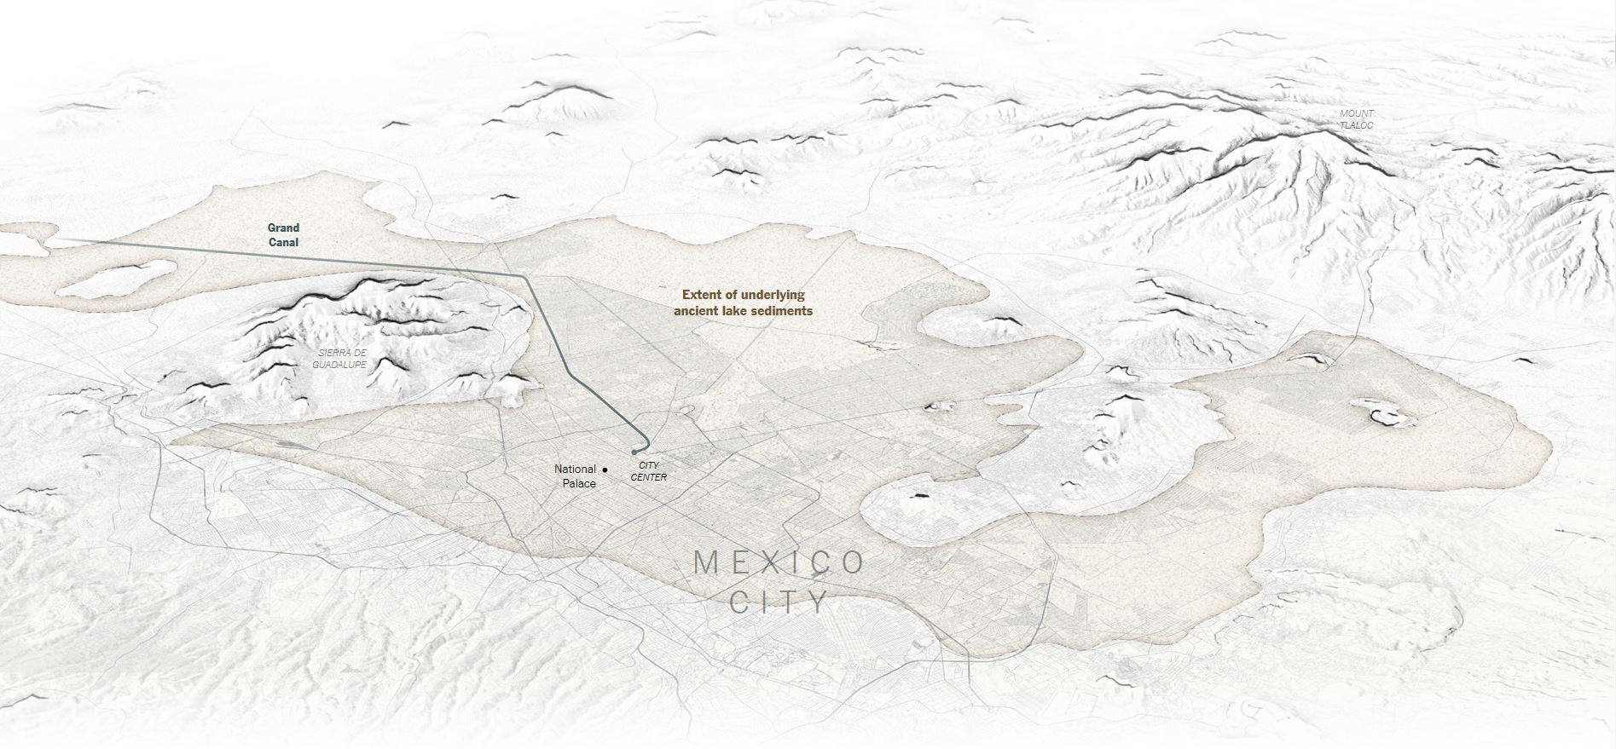
http://www.hiddenhydrology.org/mexico-city/

Slide 45
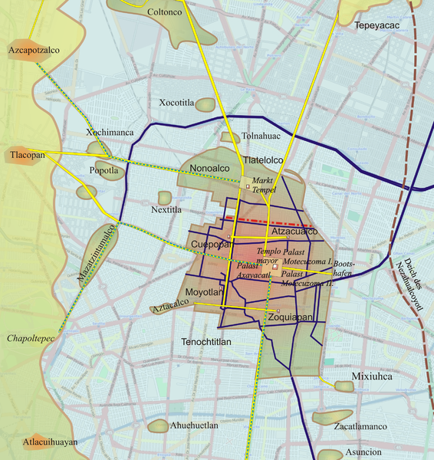

Slide 46
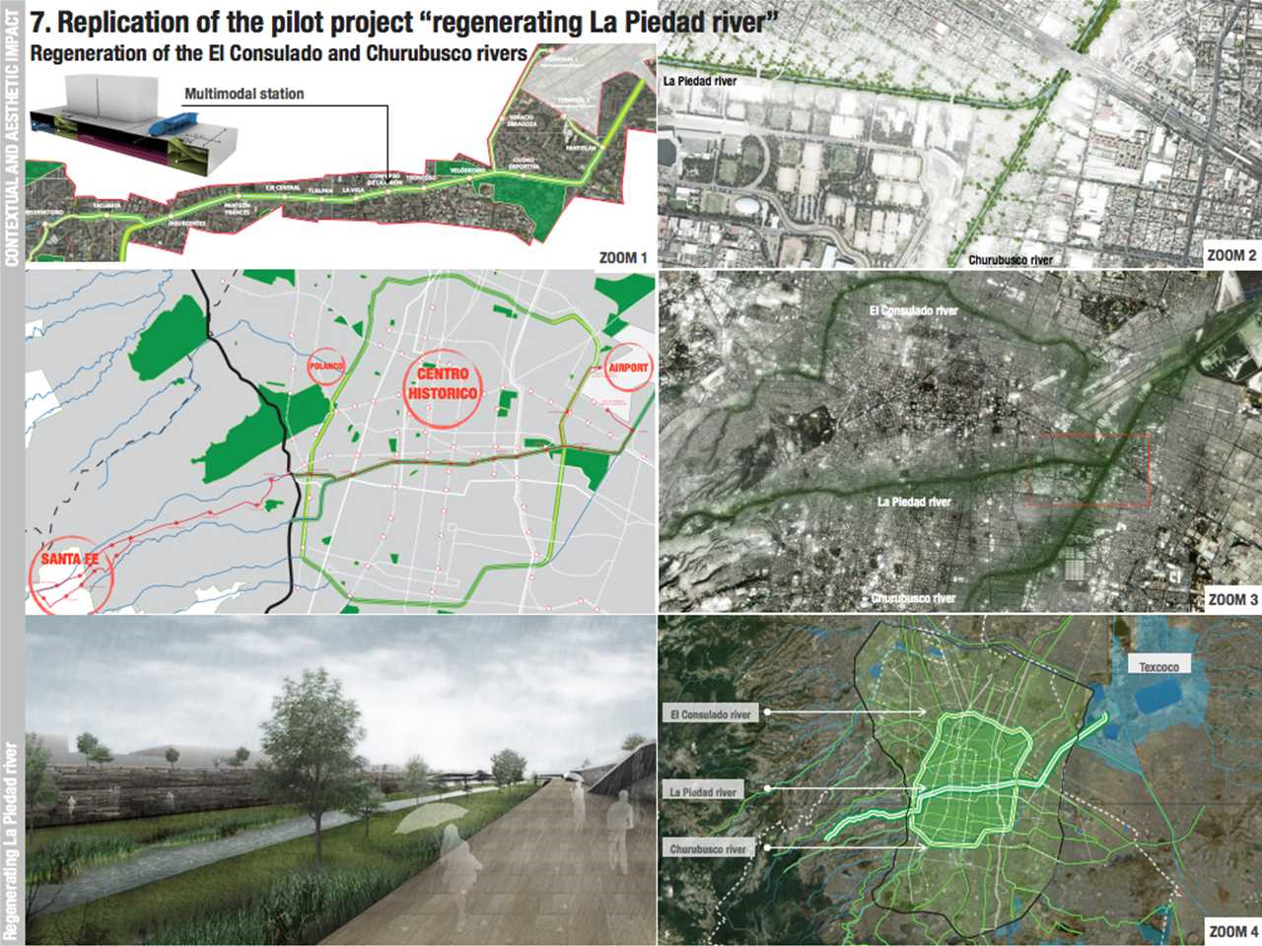
https://www.lafargeholcim-foundation.org/projects/urban-transit-corridor-and-river-remediation-master-plan-mexico
https://src.lafargeholcim-foundation.org/dnl/3a0ddd39-0411-4b43-b26c-f972988e0813/HolcimAwards11_LATAM_acknC.pdf

Slide 47
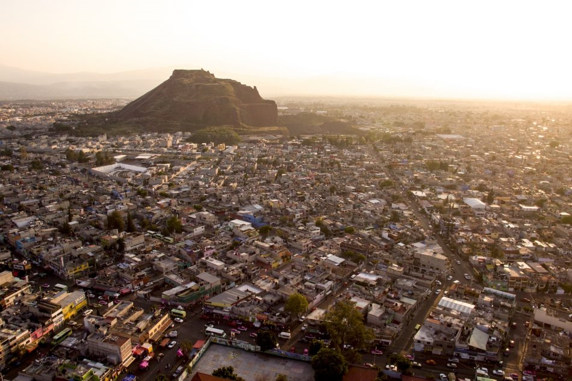
Modern day water supply problems , they are great !
http://blog.lucforsyth.com/2016/12/urban-drought-mexico-citys-water-crisis/
Waiting for pipas to arrive is a daily occurrence for residents Mixcoatl, a neighbourhood in Iztapalapa.
Ecatepec, 30 minutes outside Mexico City.
Iztapalapa is Mexico City’s most populous borough, home to roughly 2 million people. It is also one of the most water starved.

Slide 48
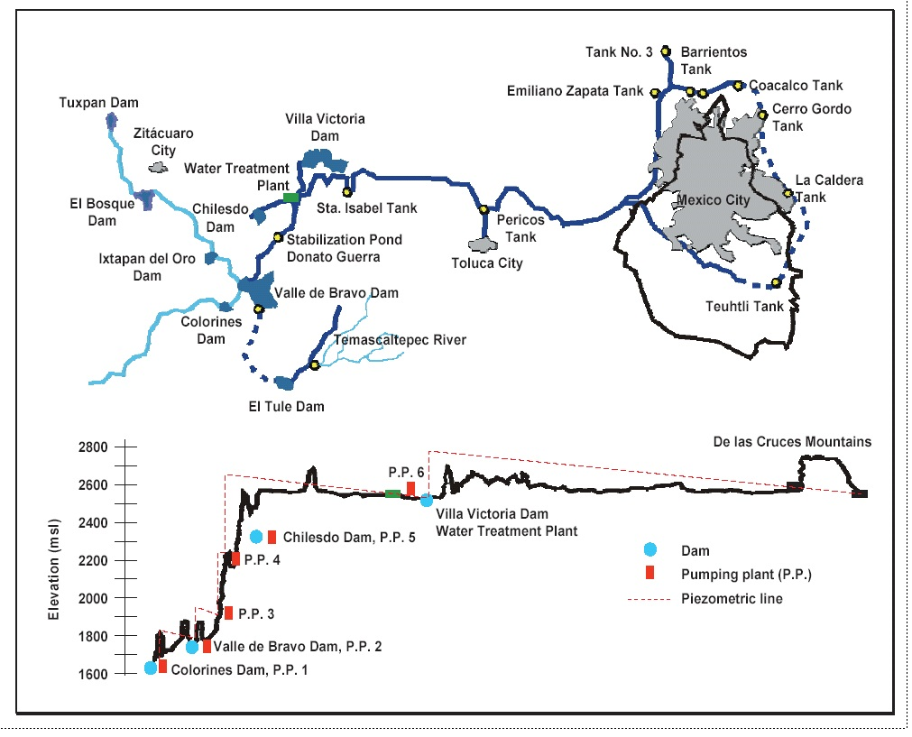
http://geo-mexico.com/?p=9043

Slide 49
http://www.ediblegeography.com/julio-the-sewer-diver/

Slide 50
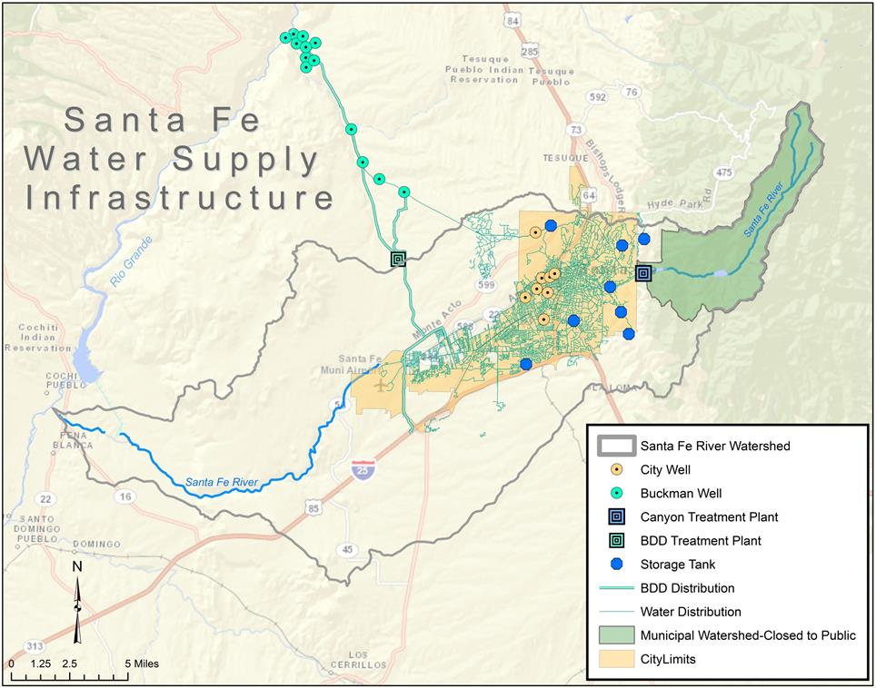
USA ?

Slide 51
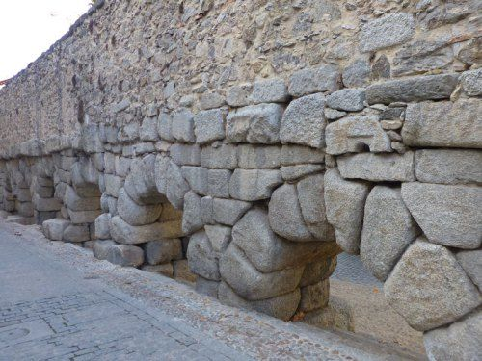
This is in Spain !

Slide 52
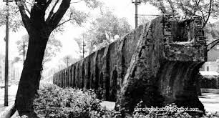
El Bable: Acueductos Novohispanos
El Bable: Acueductos Novohispanos: Esos monumentos que pasan casi ...
El Bable
El Acueducto de "Arcos del Sitio" en una estampilla del Correo mexicano.

Slide 53
La Fuente de la Tlaxpana, que estuvo frente al actual Mercado de San Cosme, hacia 1880

Slide 54
Los Arcos de Huichapan

Slide 55
El acueducto romano de Almuñécar

Slide 56
Refs
The remarkable hydrological works of the Aztec civilization.
http://docchecker.info/?page=Aztec+Civilization.pdf
http://www.mexicolore.co.uk/aztecs/ask-experts/where-did-the-aqueduct-go-to-from-tenochtitlan
http://www.skyscrapercity.com/showthread.php?t=1822064
In deapth stdy in spanish
http://bibliotecadigital.ilce.edu.mx/sites/ciencia/volumen2/ciencia3/102/html/sec_7.html
http://www.hms.civil.uminho.pt/sahc/2014/topic12-fullpaper001.pdf
http://arquitecturamexicovirreinatomoderna.blogspot.mx/2016/05/infraestructura-del-virreinato.html#!/2016/05/infraestructura-del-virreinato.html
http://islaurbana.org/english/project/distrito-federal/
https://www.youtube.com/watch?v=sBE9LRf0J5Q
https://aztectoromanaqueducts.weebly.com/aztec-aqueduct-design.html
https://en.wikipedia.org/wiki/Valley_of_Mexico

Slide 58
Earth quakes and the lake
https://www.nytimes.com/interactive/2017/09/22/world/americas/mexico-city-earthquake-lake-bed-geology.html

Slide 59
http://geo-mexico.com/?p=11867
Mexican doc from 1952 - 1964
https://issuu.com/doncelesdigital/docs/name87bab4

Slide 60
References
Maps
The best source
http://legacy.lib.utexas.edu/maps/mexico.html
http://www.mappery.com/Puerto-Vallarta-Map
Other essentials !!
Drugs
http://www.storybench.org/visualizing-mexicos-drug-cartels-roundup-maps/
The tunnel under the pyramid
https://www.smithsonianmag.com/history/discovery-secret-tunnel-mexico-solve-mysteries-teotihuacan-180959070/

Slide 61
Trains in mexico and another rbtter on made by the English 1919
http://legacy.lib.utexas.edu/maps/historical/mexico_handbook_1919/txu-oc-7643168-portfolio-03.jpg

