Slide 1
Shipping Oman
Ian
12 Sept 2024

Slide 2
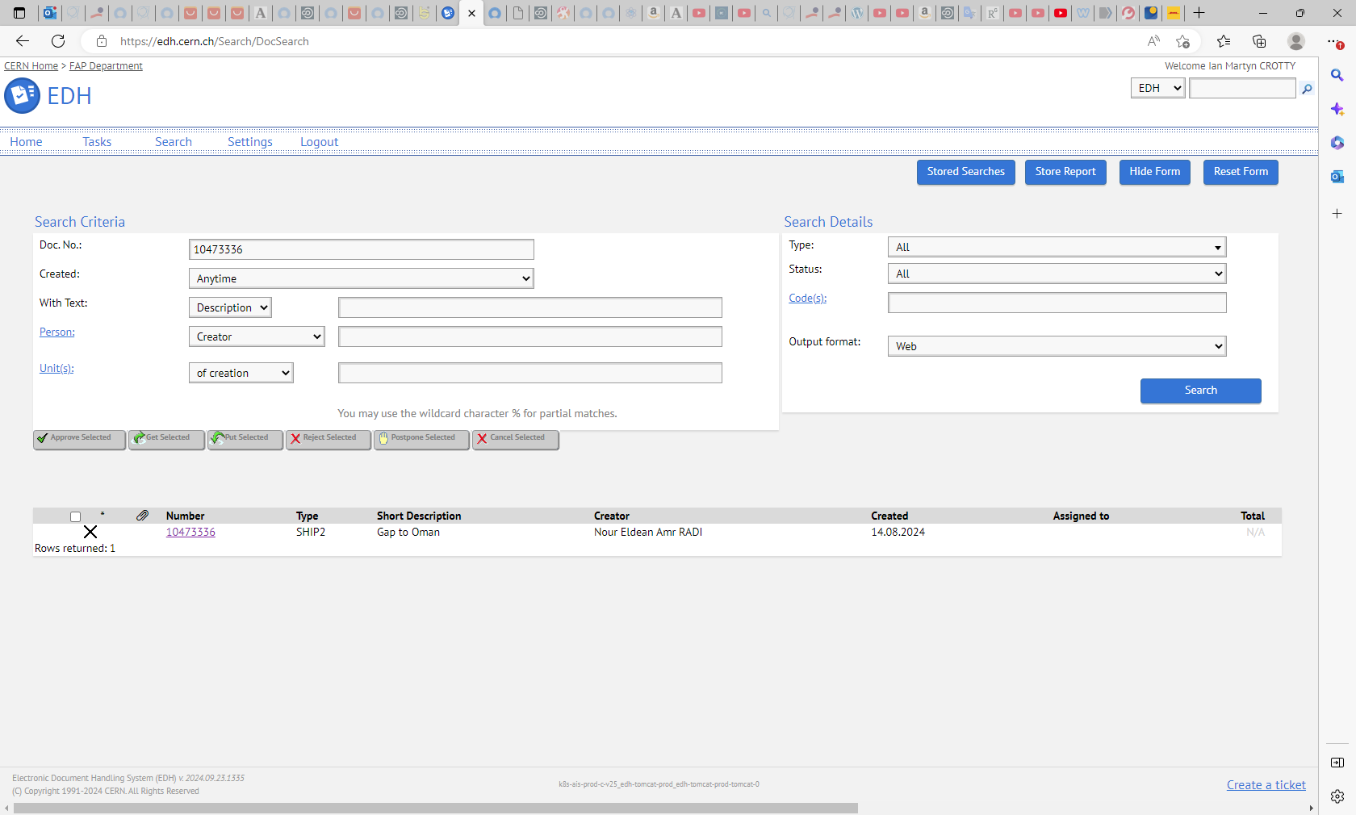
Nour Eldean Amr RADI
EDH 10473336

Slide 3
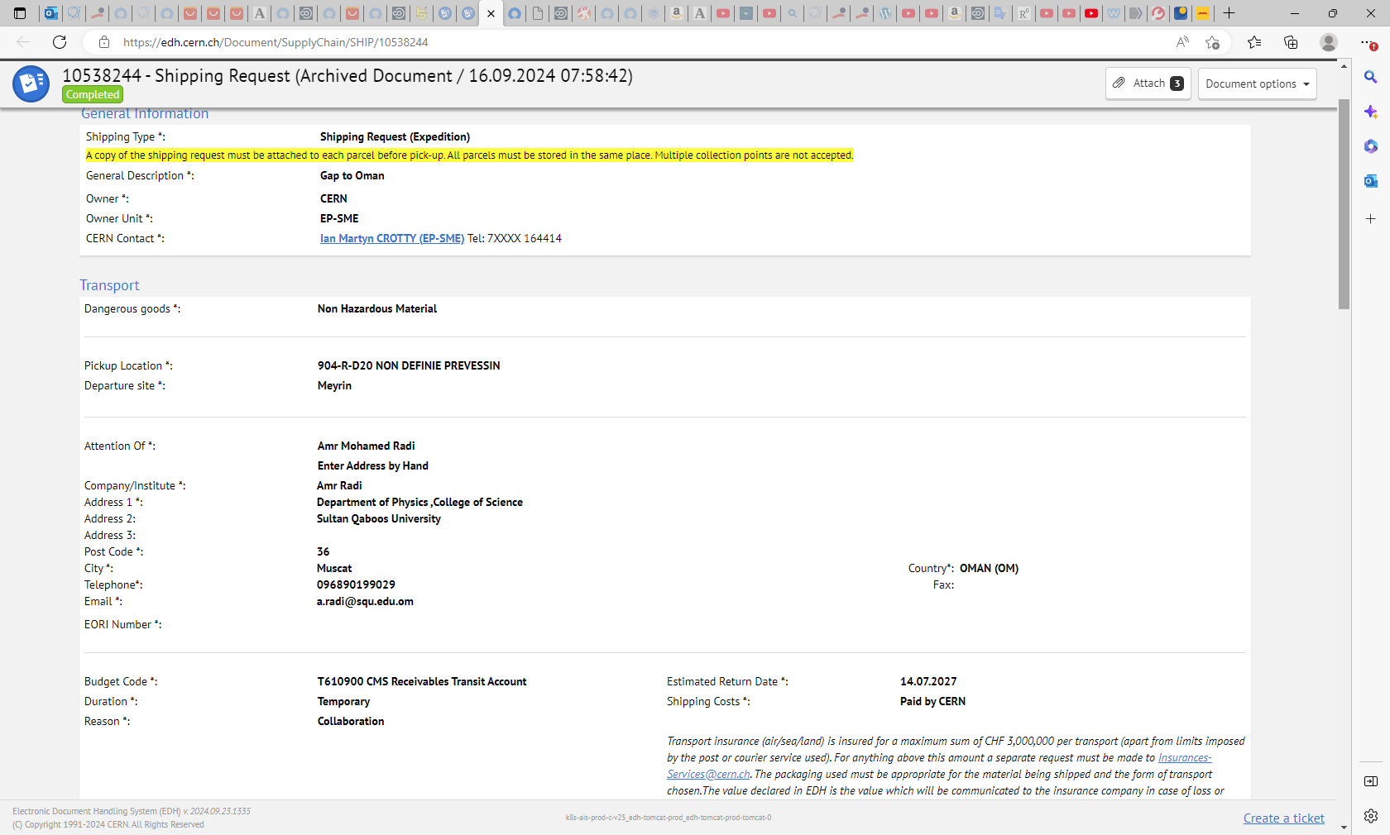

Slide 4
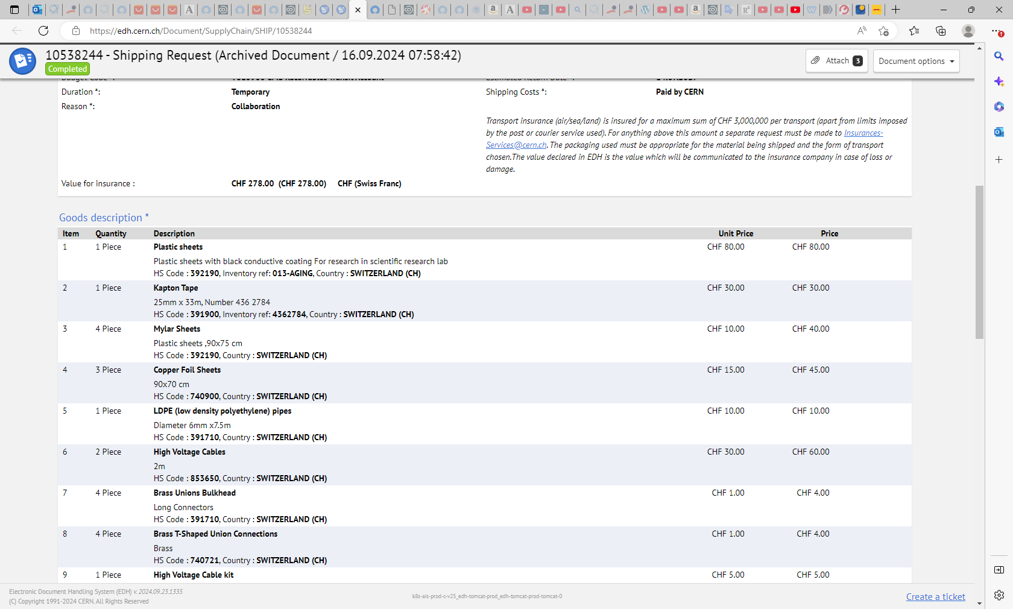

Slide 5
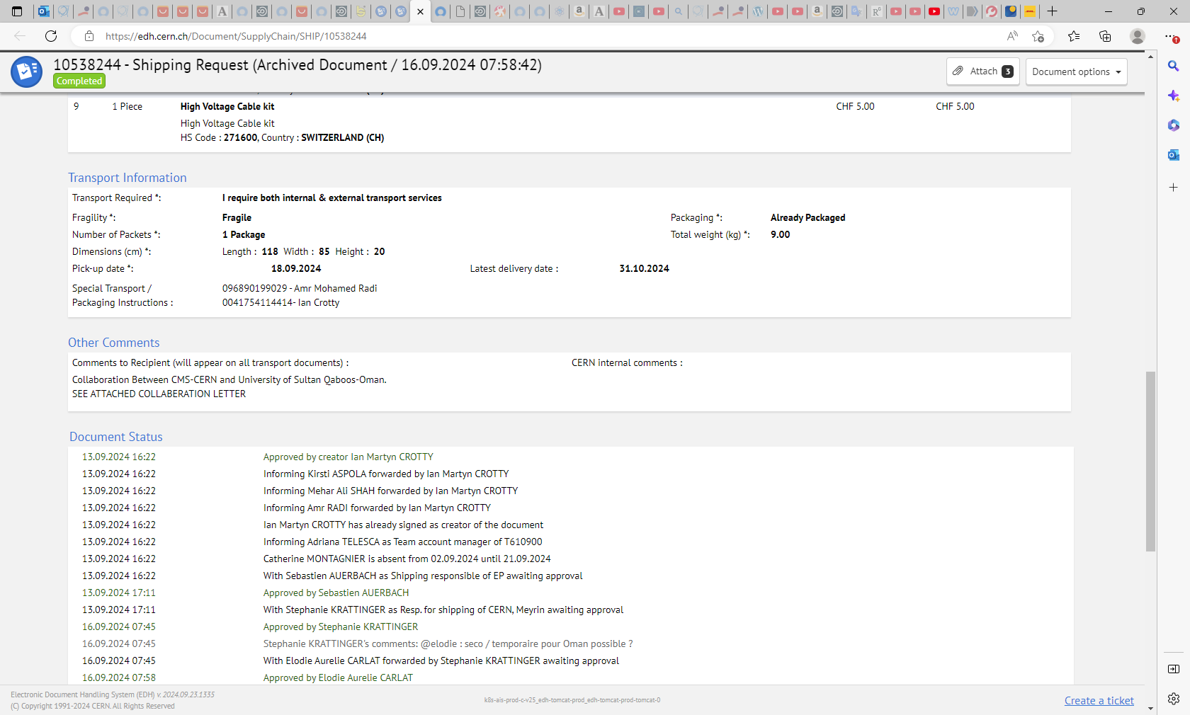

Slide 6
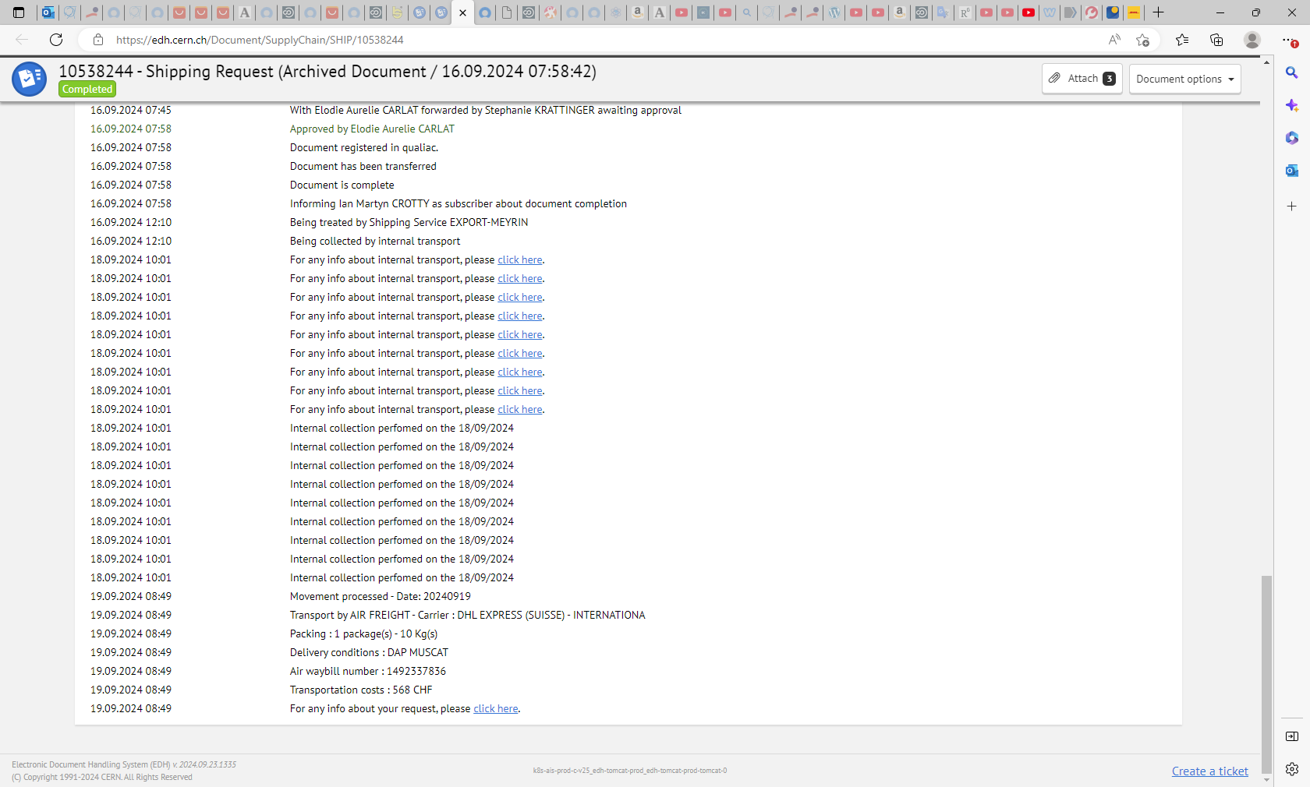
Transport by AIR FREIGHT - Carrier : DHL EXPRESS (SUISSE) - INTERNATIONA
19.09.2024 08:49 Packing : 1 package(s) - 10 Kg(s)
19.09.2024 08:49 Delivery conditions : DAP MUSCAT
19.09.2024 08:49 Air waybill number : 1492337836
19.09.2024 08:49 Transportation costs : 568 CHF
19.09.2024 08:49 For any info about your request, please click here.

Slide 7
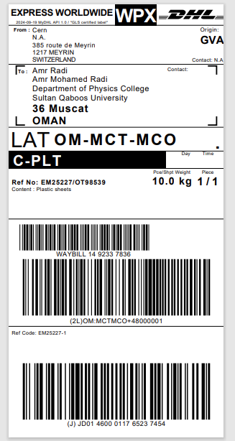
Airway Bill Number
DHL WPX Express
14 9233 7836
Reference No.
EM25227/OT98539
10kg

Slide 8
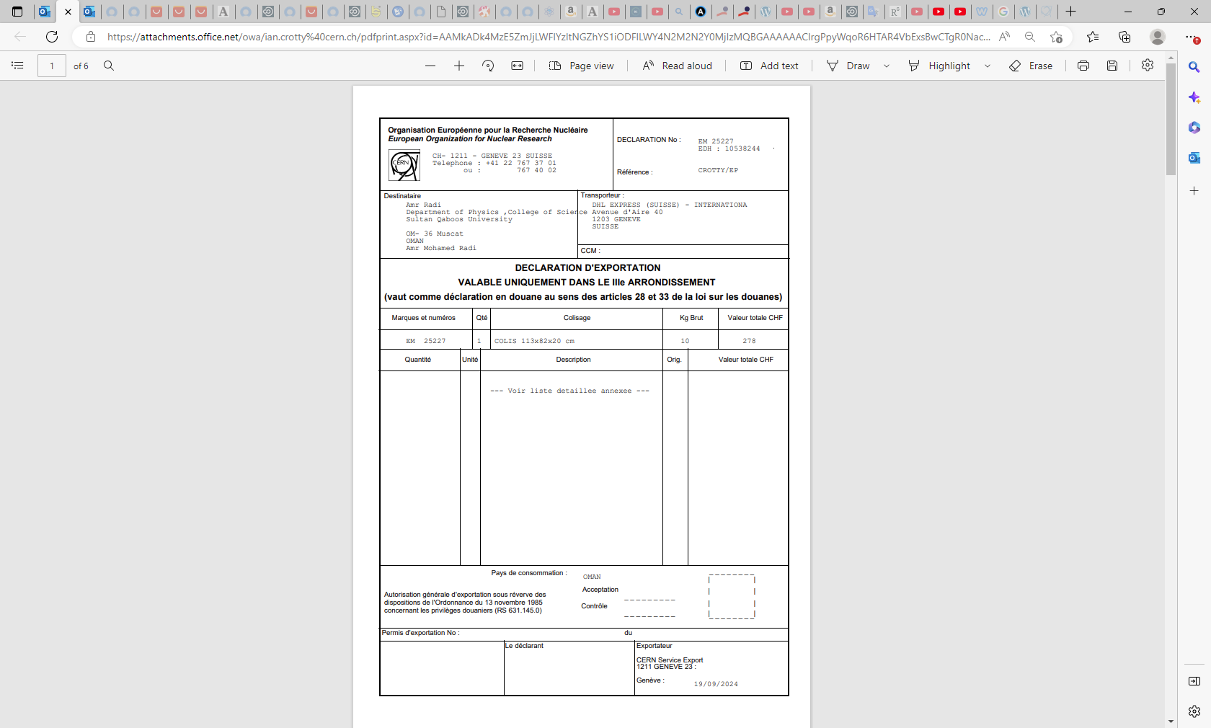

Slide 9
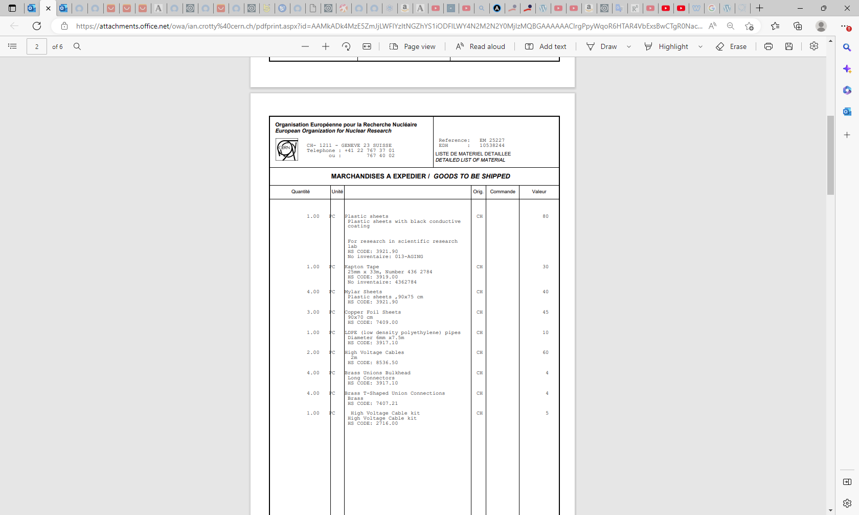

Slide 10
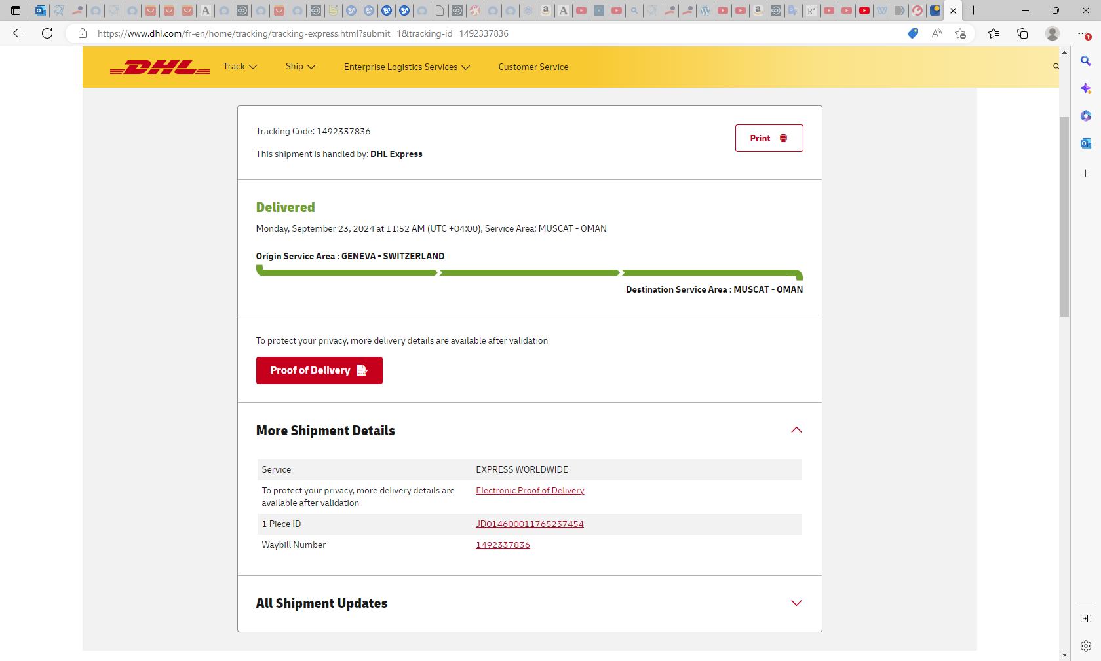
1 Piece ID
JD014600011765237454
Waybill Number
1492337836

Slide 11
