Slide 1
Electronic exports from CERN
Ian
30 Oct 2024

Slide 2
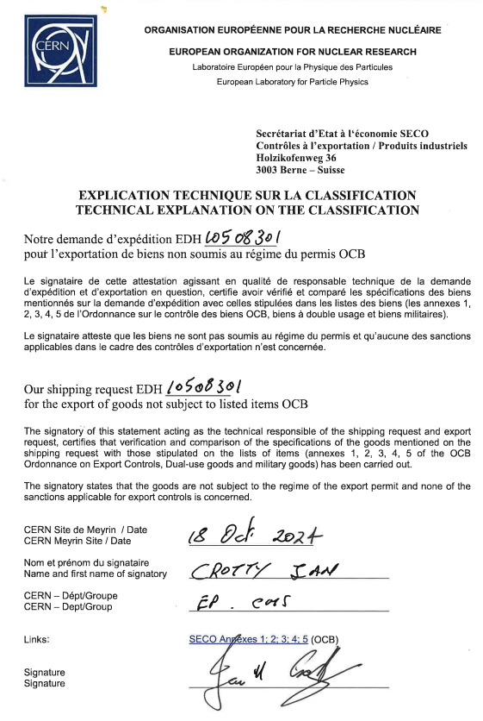
This adventure started off when I realised that shipping iRPC FEBs with FPGAs etc to Mexico might not be just so easy as a signed SECO document see here;
The list of sophisticated elements on the iRPC FEB are;
PetiRoc
FPGA Cyclone V
GBTX Optical to electrical (?) Rad hard
GBTSCA Slow control
VTRX optical transceiver

Slide 3
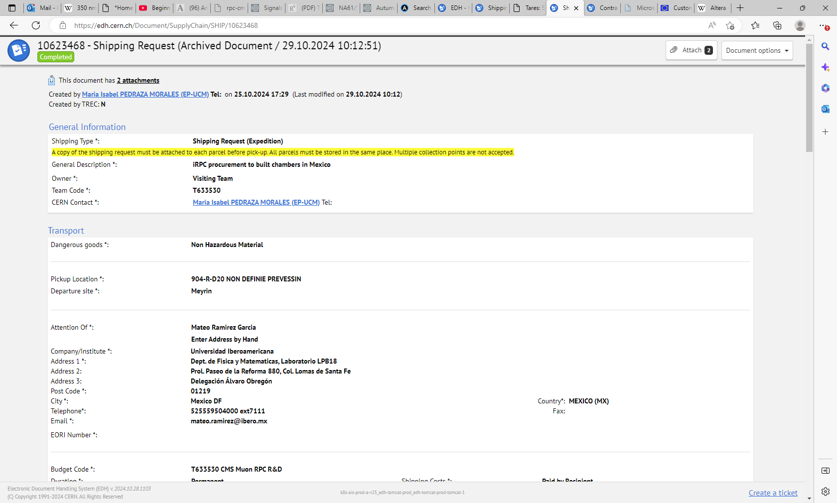

Slide 4
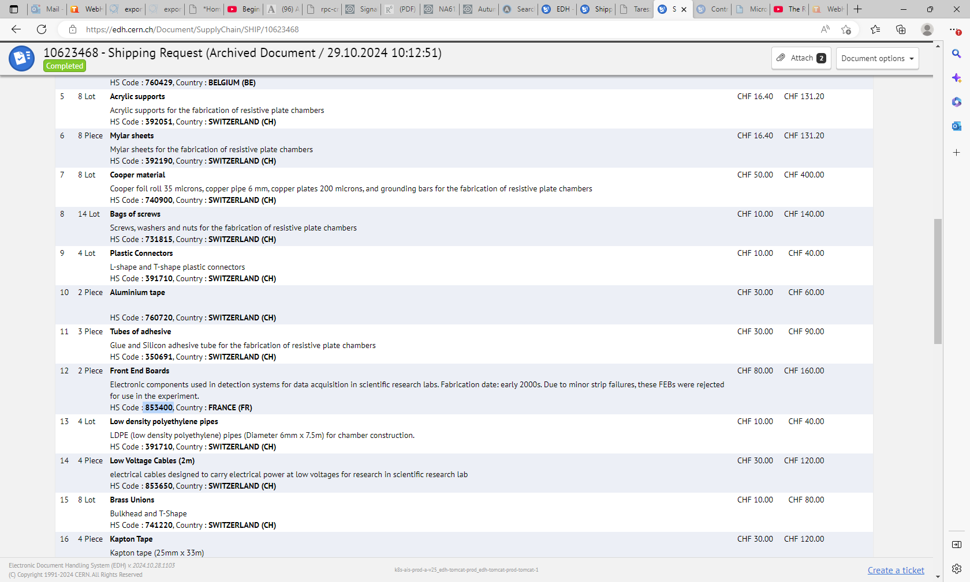

Slide 6
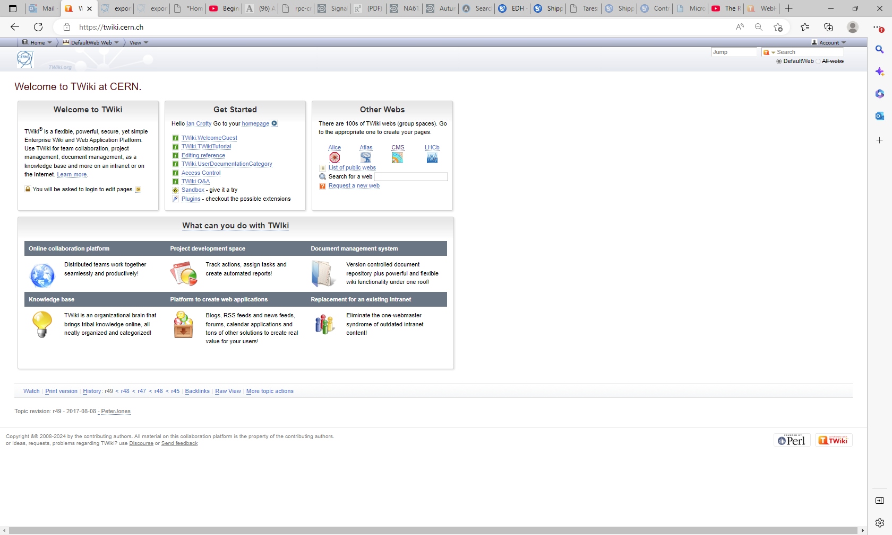
https://twiki.cern.ch/
Log in . To RHS

Slide 7
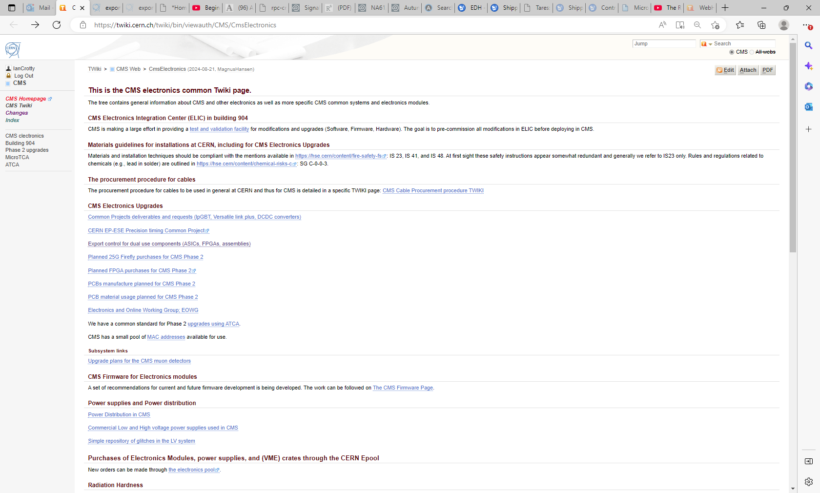
https://twiki.cern.ch/twiki/bin/viewauth/CMS/CmsElectronics

Slide 8
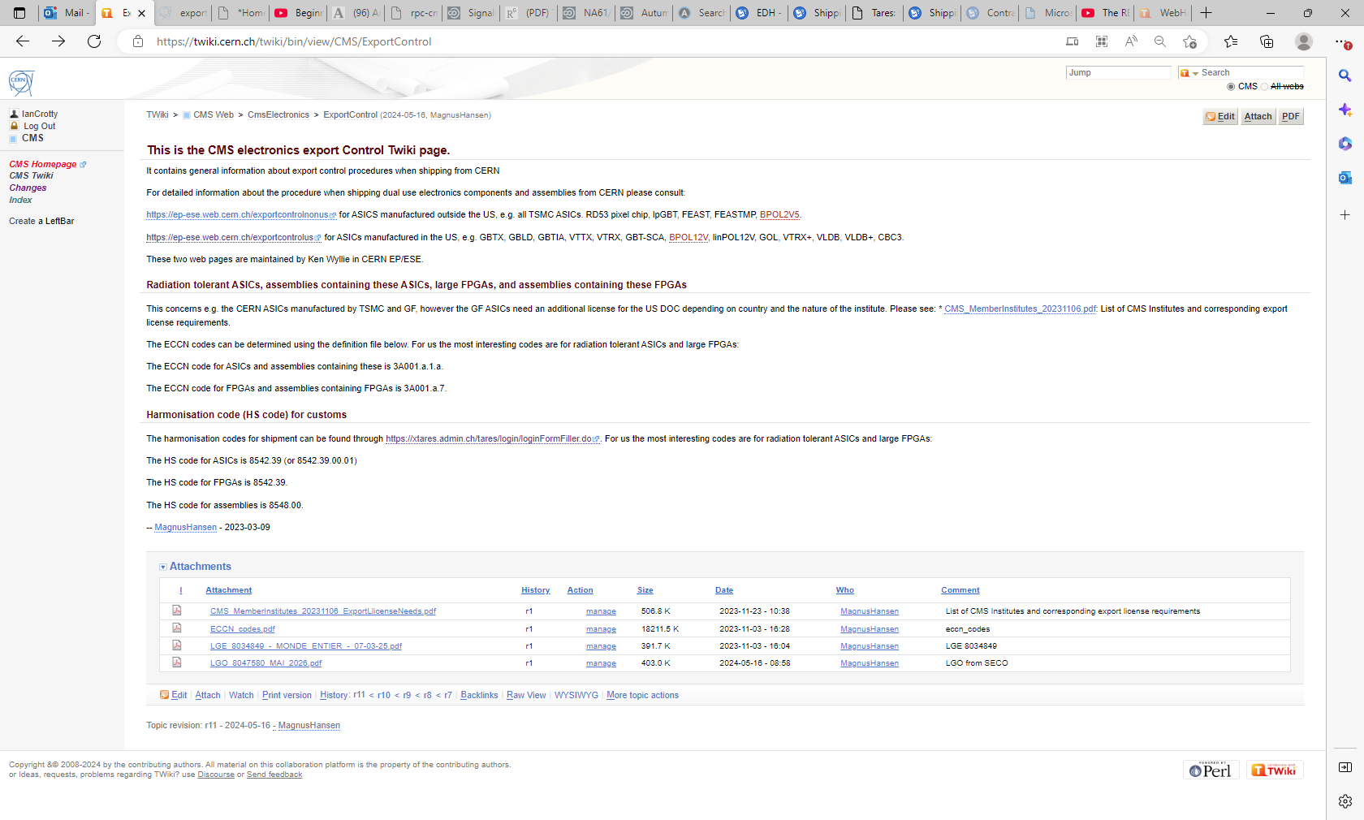
https://twiki.cern.ch/twiki/bin/view/CMS/ExportControl

Slide 9
This is the CMS electronics export Control Twiki page.
It contains general information about export control procedures when shipping from CERN
For detailed information about the procedure when shipping dual use electronics components and assemblies from CERN please consult:
https://ep-ese.web.cern.ch/exportcontrolnonus for ASICS manufactured outside the US, e.g. all TSMC ASICs. RD53 pixel chip, lpGBT, FEAST, FEASTMP, BPOL2V5.
https://ep-ese.web.cern.ch/exportcontrolus for ASICs manufactured in the US, e.g. GBTX, GBLD, GBTIA, VTTX, VTRX, GBT-SCA, BPOL12V, linPOL12V, GOL, VTRX+, VLDB, VLDB+, CBC3.
These two web pages are maintained by Ken Wyllie in CERN EP/ESE.
Radiation tolerant ASICs, assemblies containing these ASICs, large FPGAs, and assemblies containing these FPGAs
This concerns e.g. the CERN ASICs manufactured by TSMC and GF, however the GF ASICs need an additional license for the US DOC depending on country and the nature of the institute. Please see: * CMS_MemberInstitutes_20231106.pdf: List of CMS Institutes and corresponding export license requirements.
The ECCN codes can be determined using the definition file below. For us the most interesting codes are for radiation tolerant ASICs and large FPGAs:
The ECCN code for ASICs and assemblies containing these is 3A001.a.1.a.
The ECCN code for FPGAs and assemblies containing FPGAs is 3A001.a.7.
Harmonisation code (HS code) for customs
The harmonisation codes for shipment can be found through https://xtares.admin.ch/tares/login/loginFormFiller.do. For us the most interesting codes are for radiation tolerant ASICs and large FPGAs:
The HS code for ASICs is 8542.39 (or 8542.39.00.01)
The HS code for FPGAs is 8542.39.
The HS code for assemblies is 8548.00.
-- MagnusHansen - 2023-03-09

Slide 10
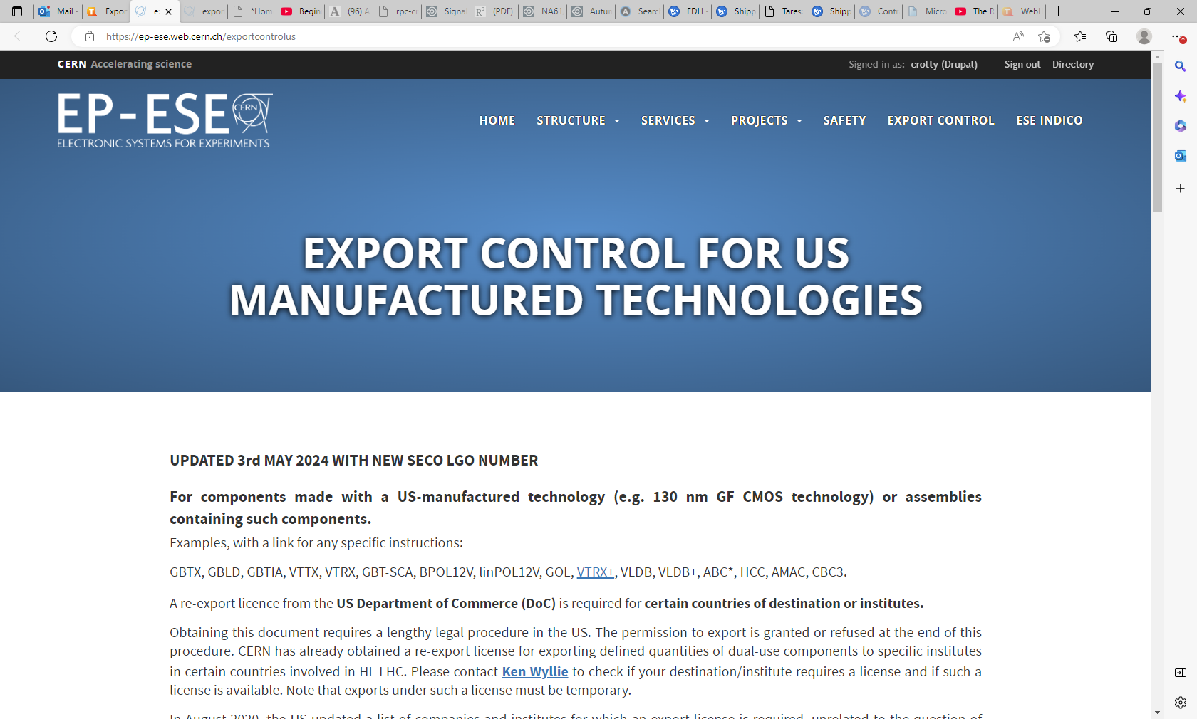
https://ep-ese.web.cern.ch/exportcontrolus

Slide 11
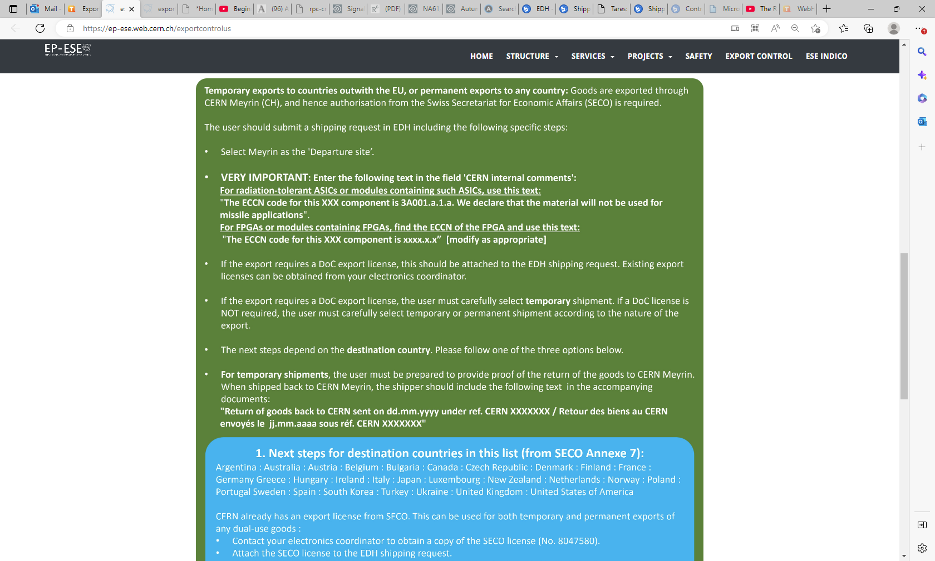

Slide 12
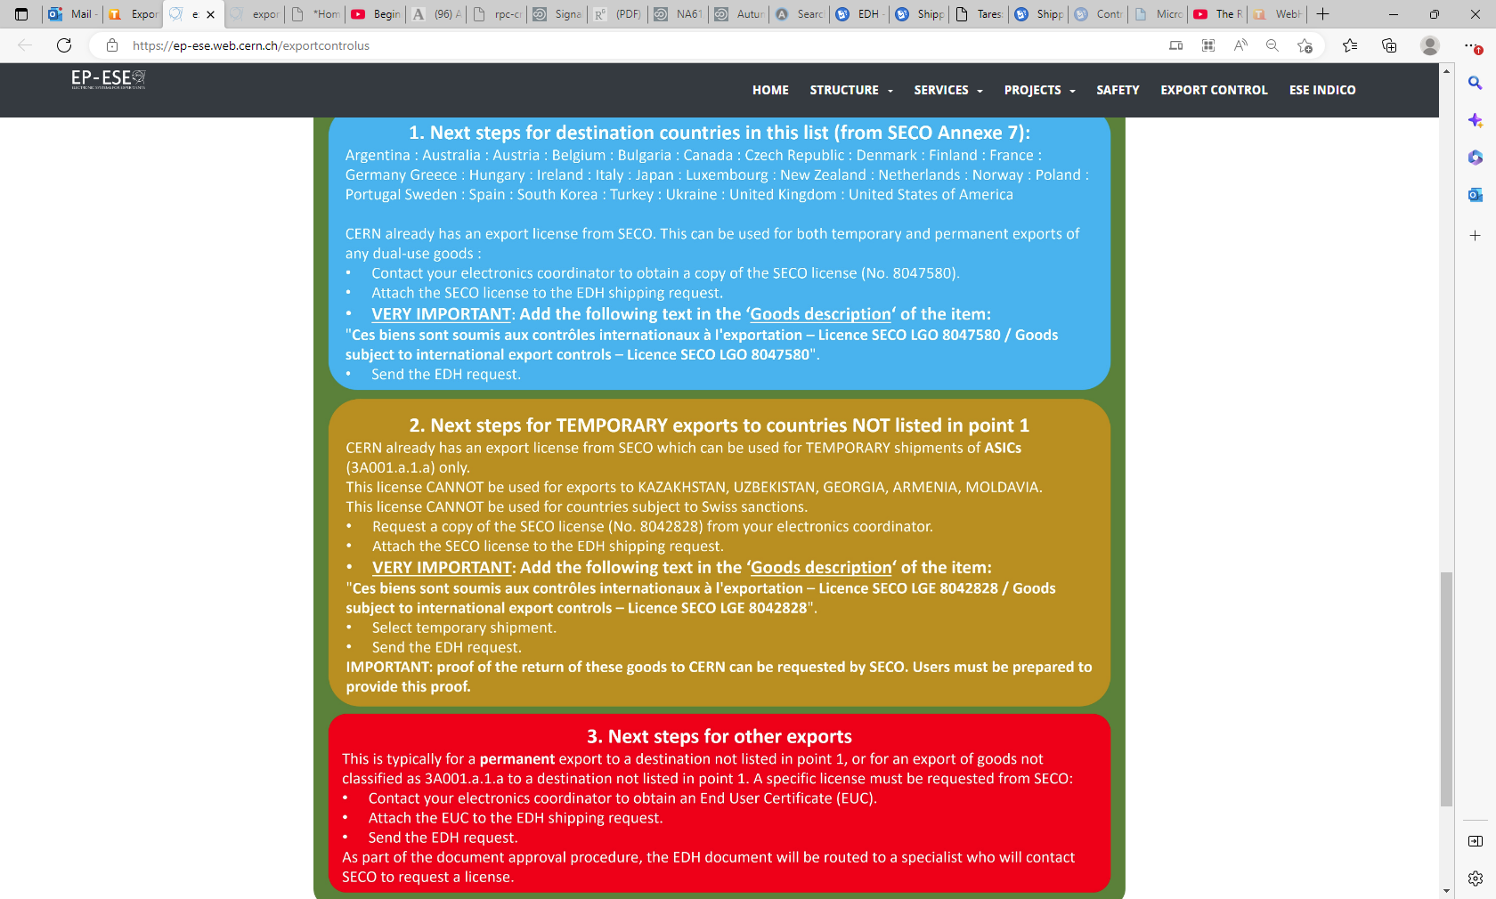

Slide 14
https://twiki.cern.ch/twiki/bin/view/CMS/ExportControl

Slide 15
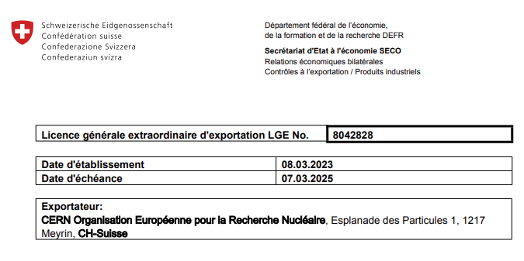
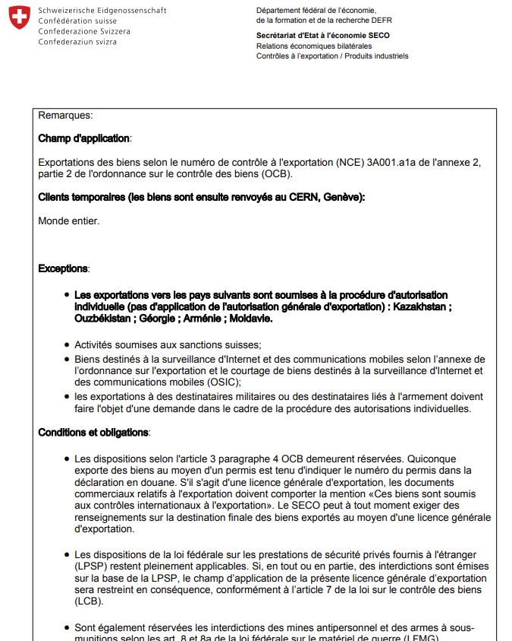
https://twiki.cern.ch/twiki/pub/CMS/ExportControl/LGE_8034849_-_MONDE_ENTIER_-_07-03-25.pdf

Slide 16
https://twiki.cern.ch/twiki/bin/view/CMS/ExportControl

Slide 17
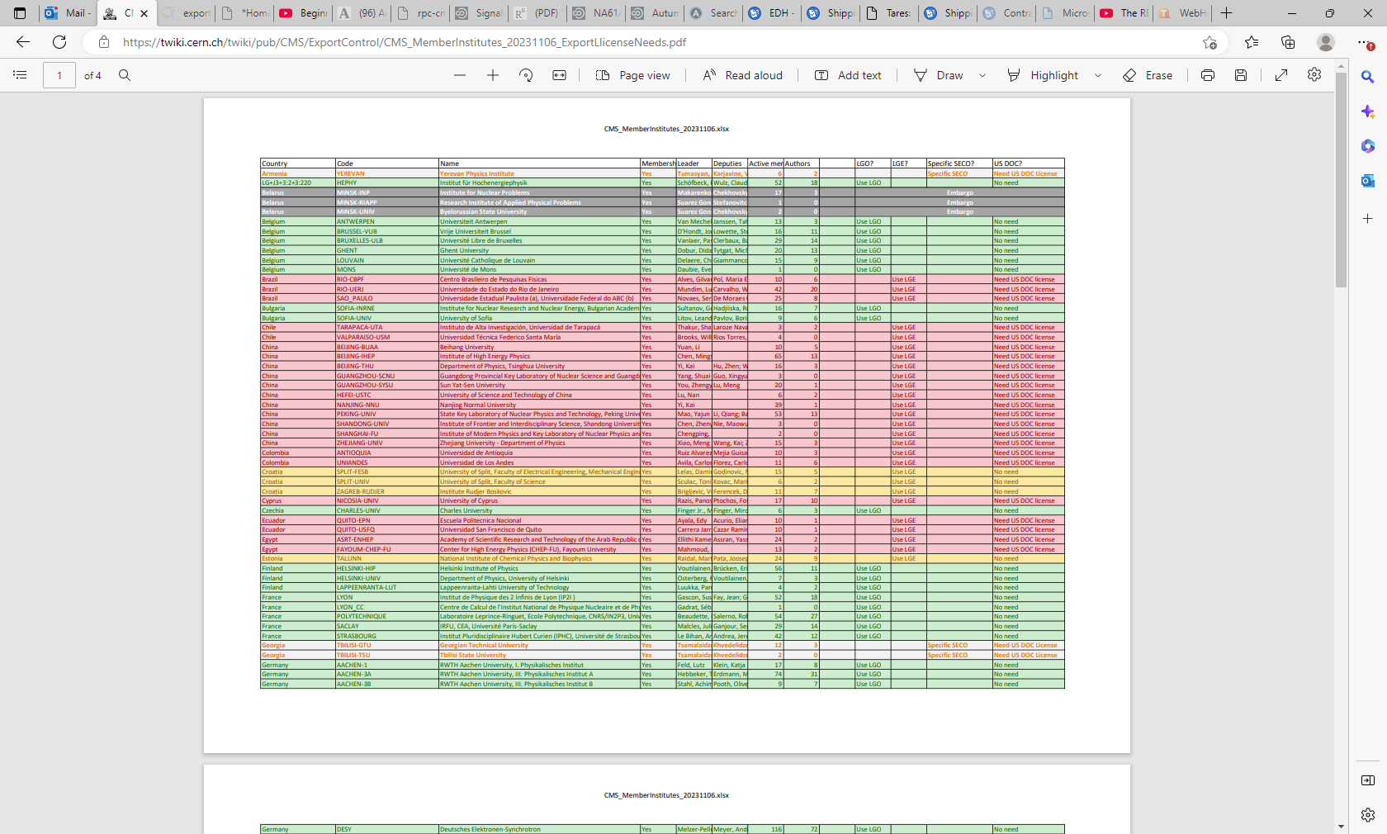

Slide 22
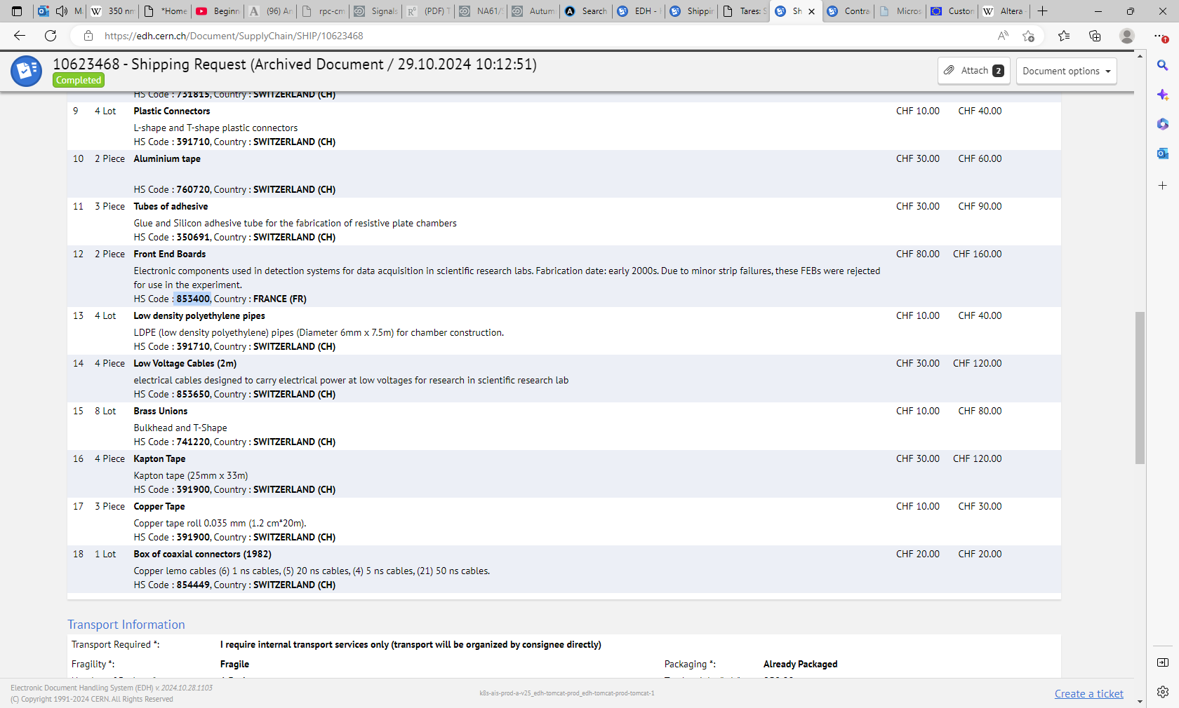

Slide 23
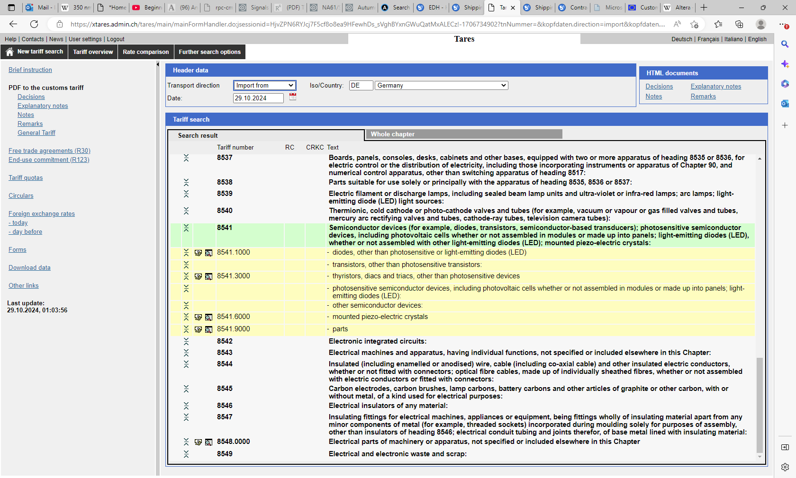

Slide 24
