Slide 1
Incoterms
Ian
12 Dec 2018

Slide 2
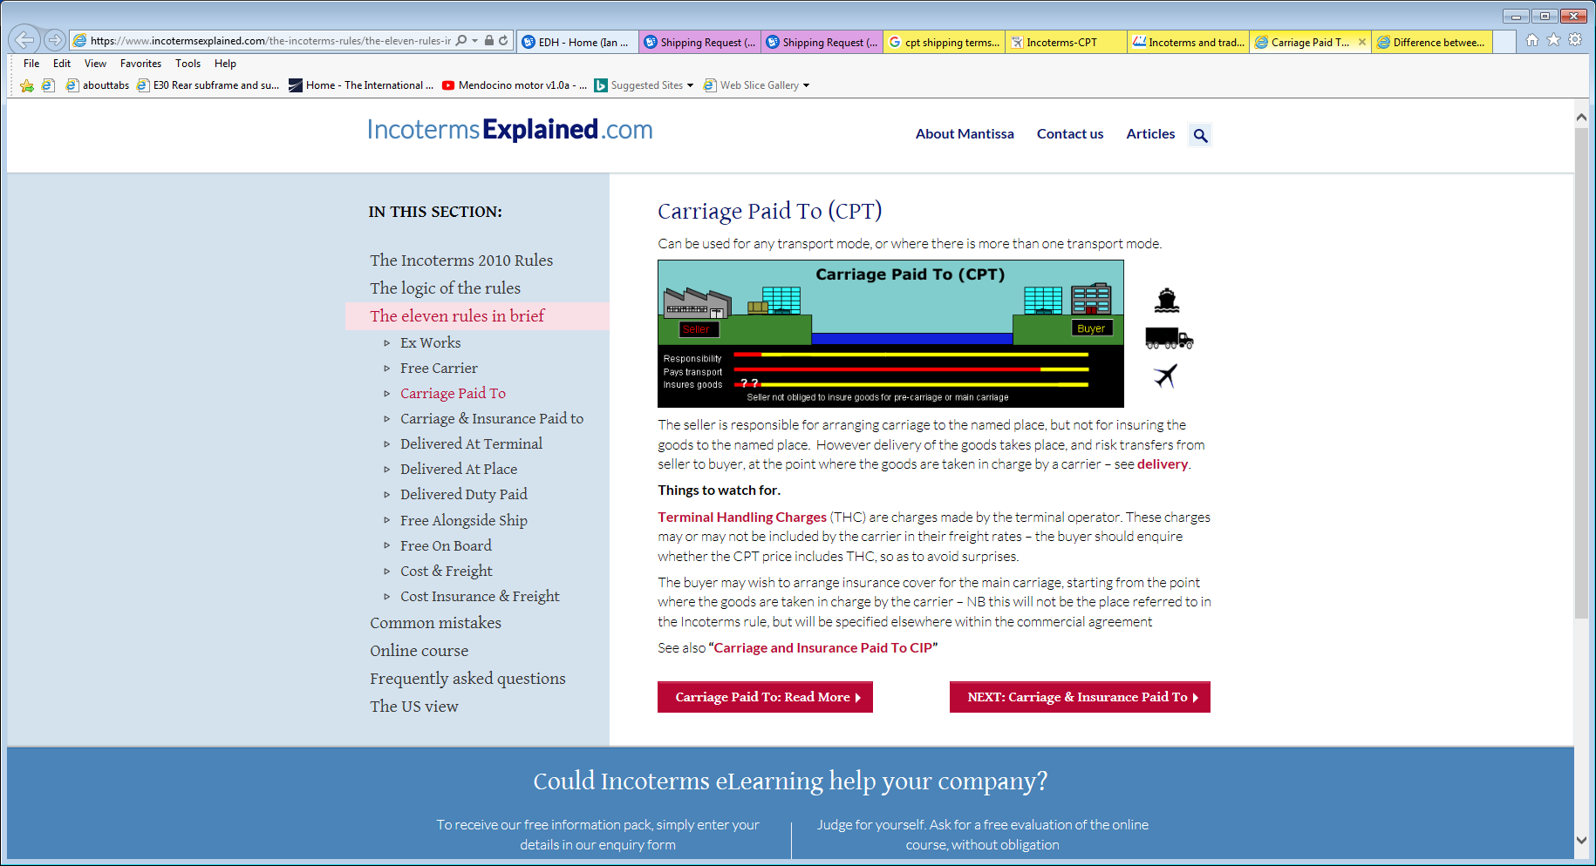
https://www.incotermsexplained.com/the-incoterms-rules/the-eleven-rules-in-brief/carriage-paid-to/

Slide 3
http://www.worldclassshipping.com/incoterm_cpt.html

Slide 4
http://www.mainfreight.be/en/info_point/incoterms.aspx

Slide 5
https://howtoexportimport.com/default.aspx

