Slide 1
STOCKAGE ISR
BAT 283-184-375

Slide 2
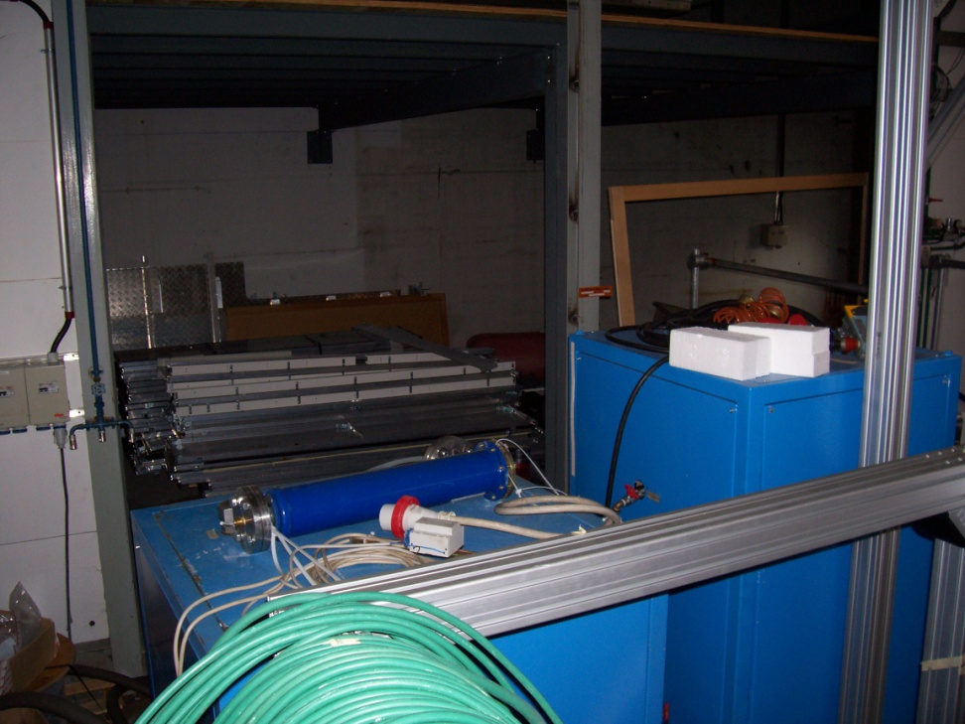
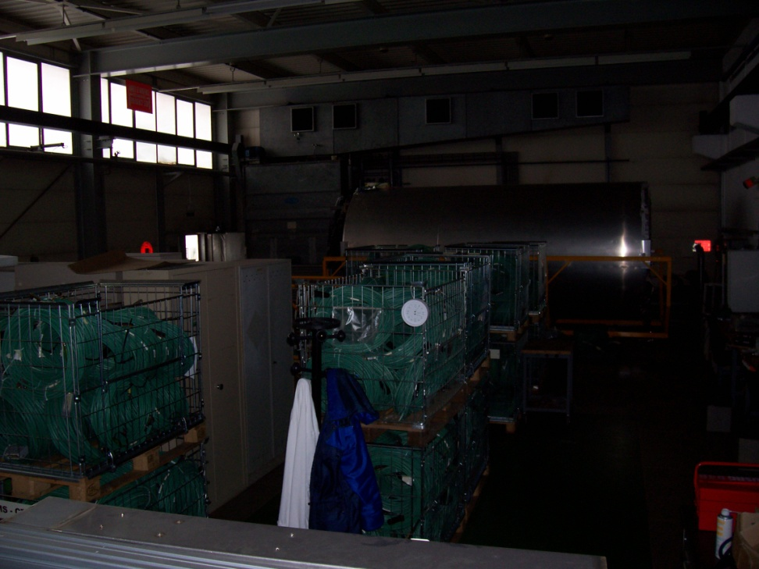
BAT 283/1

Slide 3
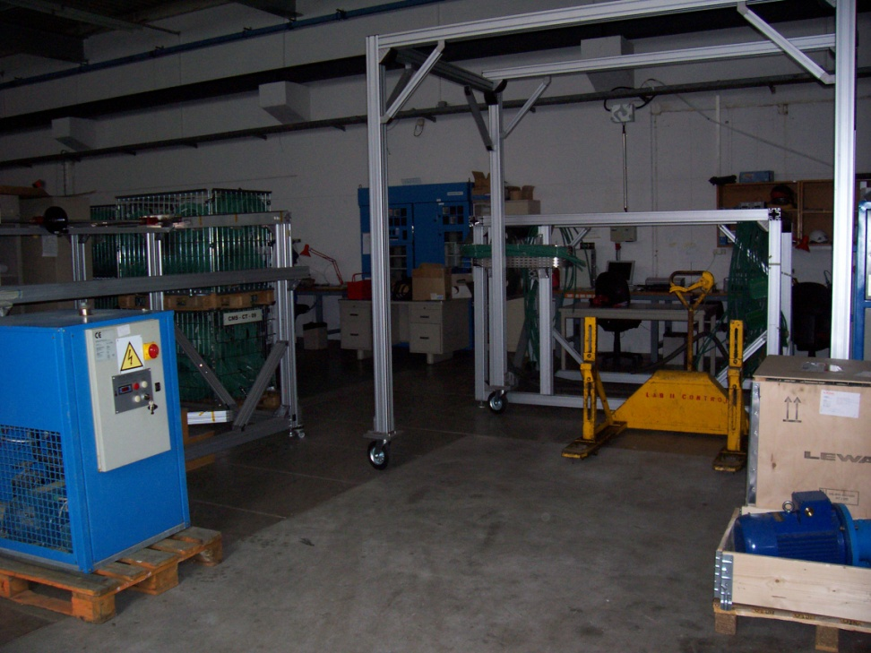
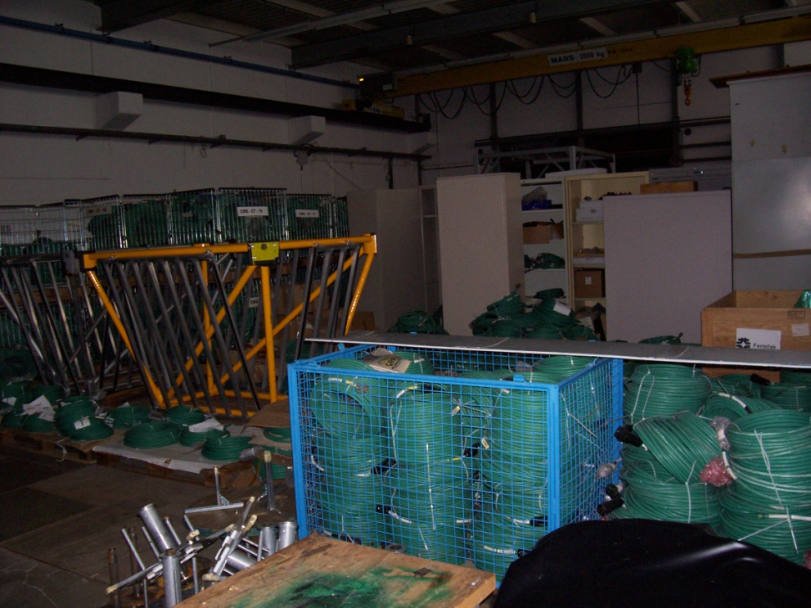
BAT 283/2
SURFACE 270m²

Slide 4
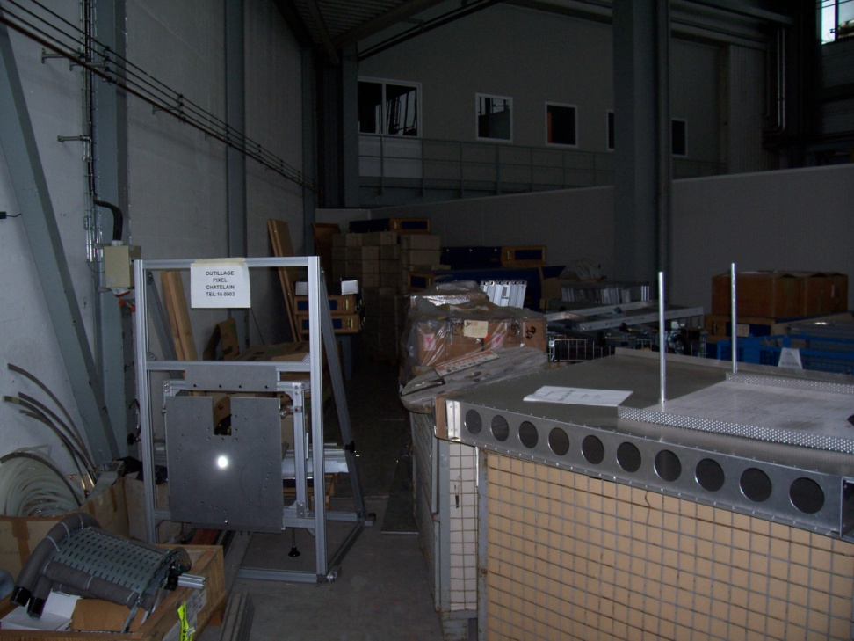
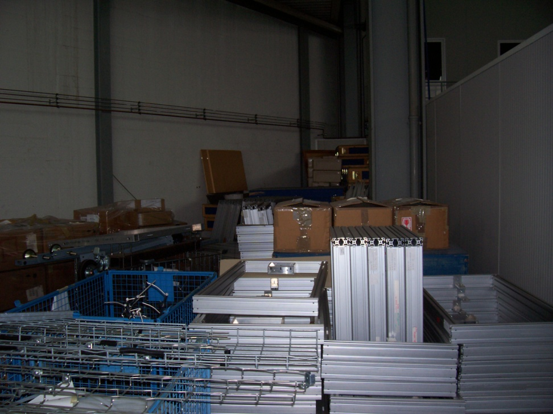
BAT 184 RE03
SURFACE 78m²

Slide 5
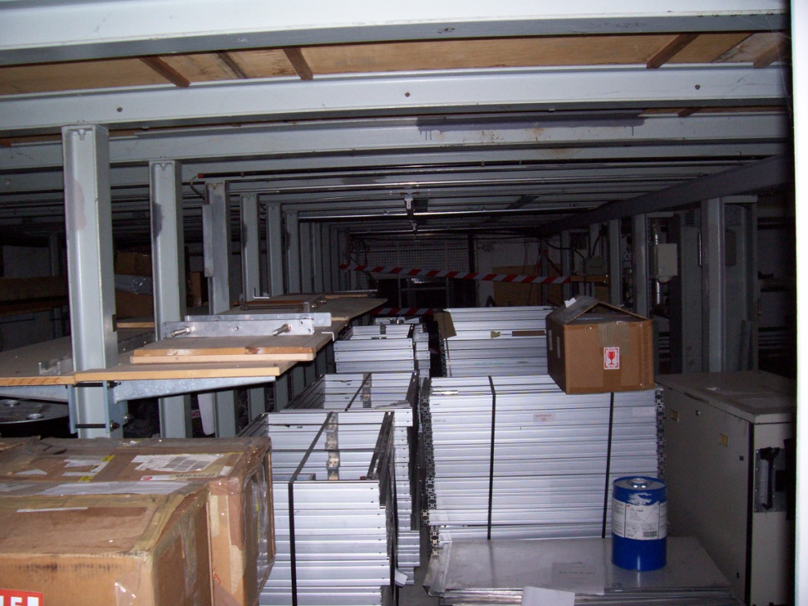
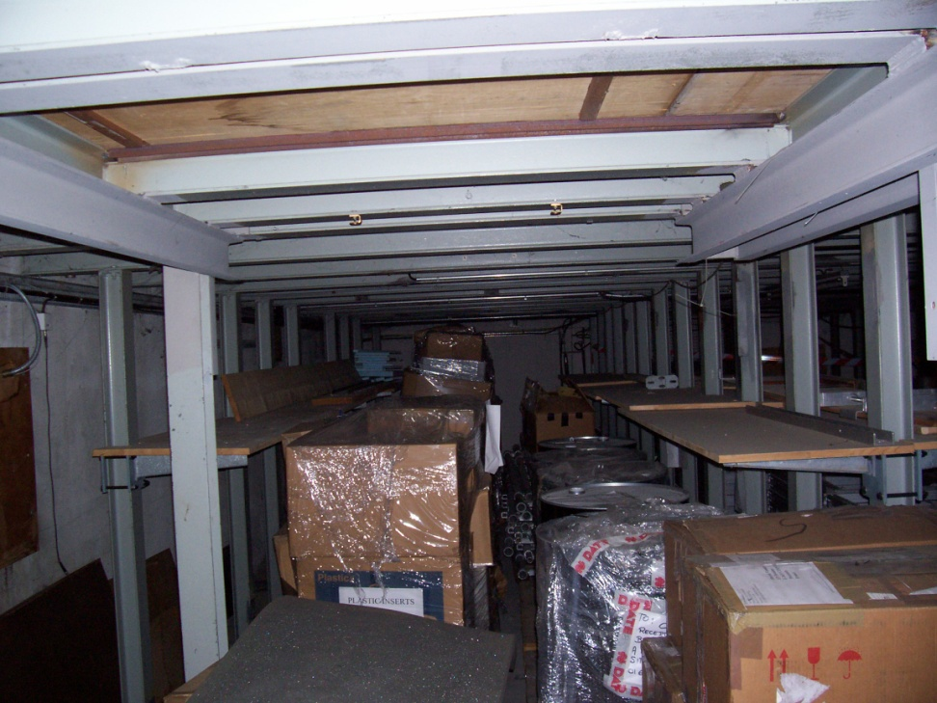
BAT 184 S-C10
SURFACE 50m²

Slide 6
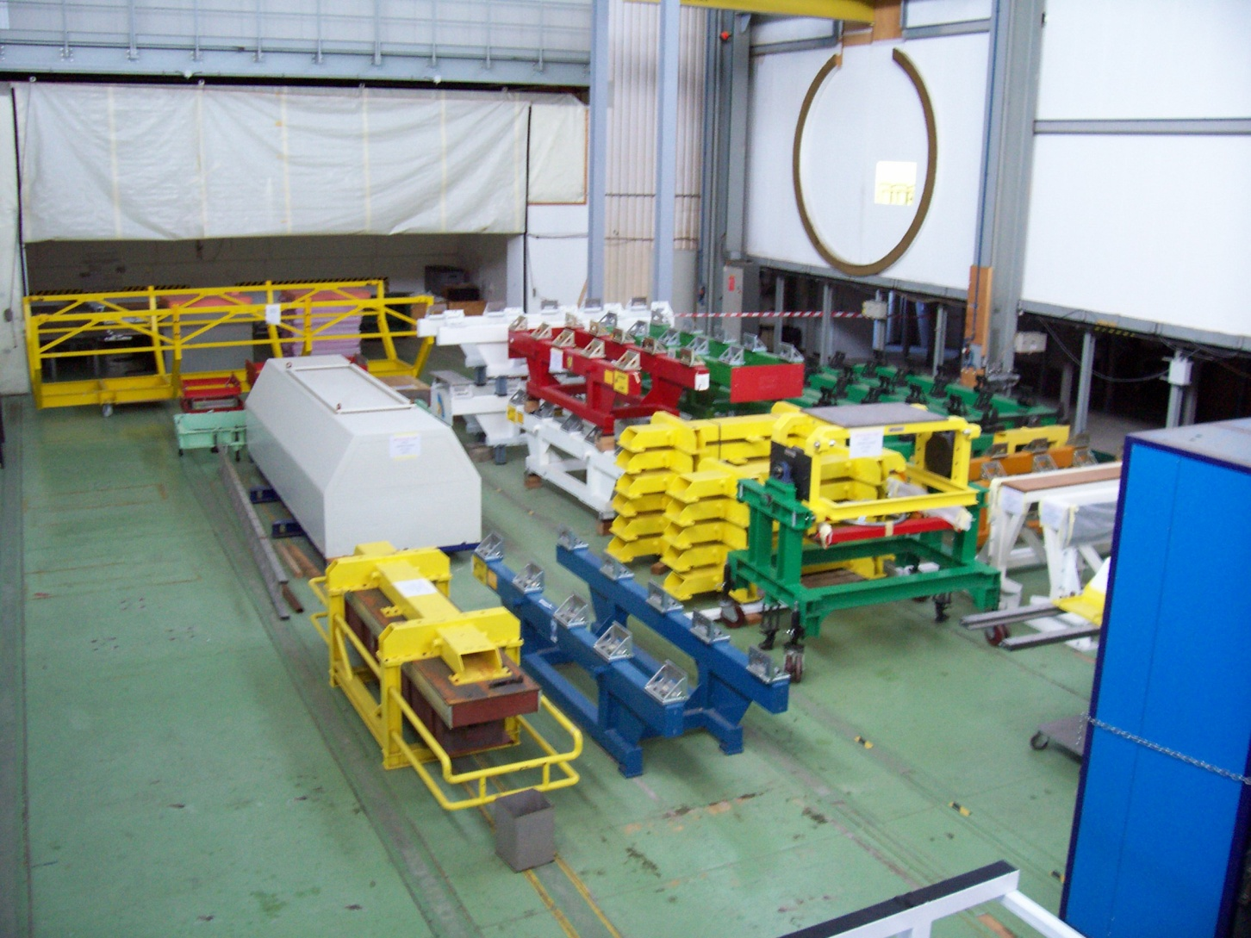
BAT 184 S-C 10
Outillage ECAL TRACKERS 300m²

Slide 7
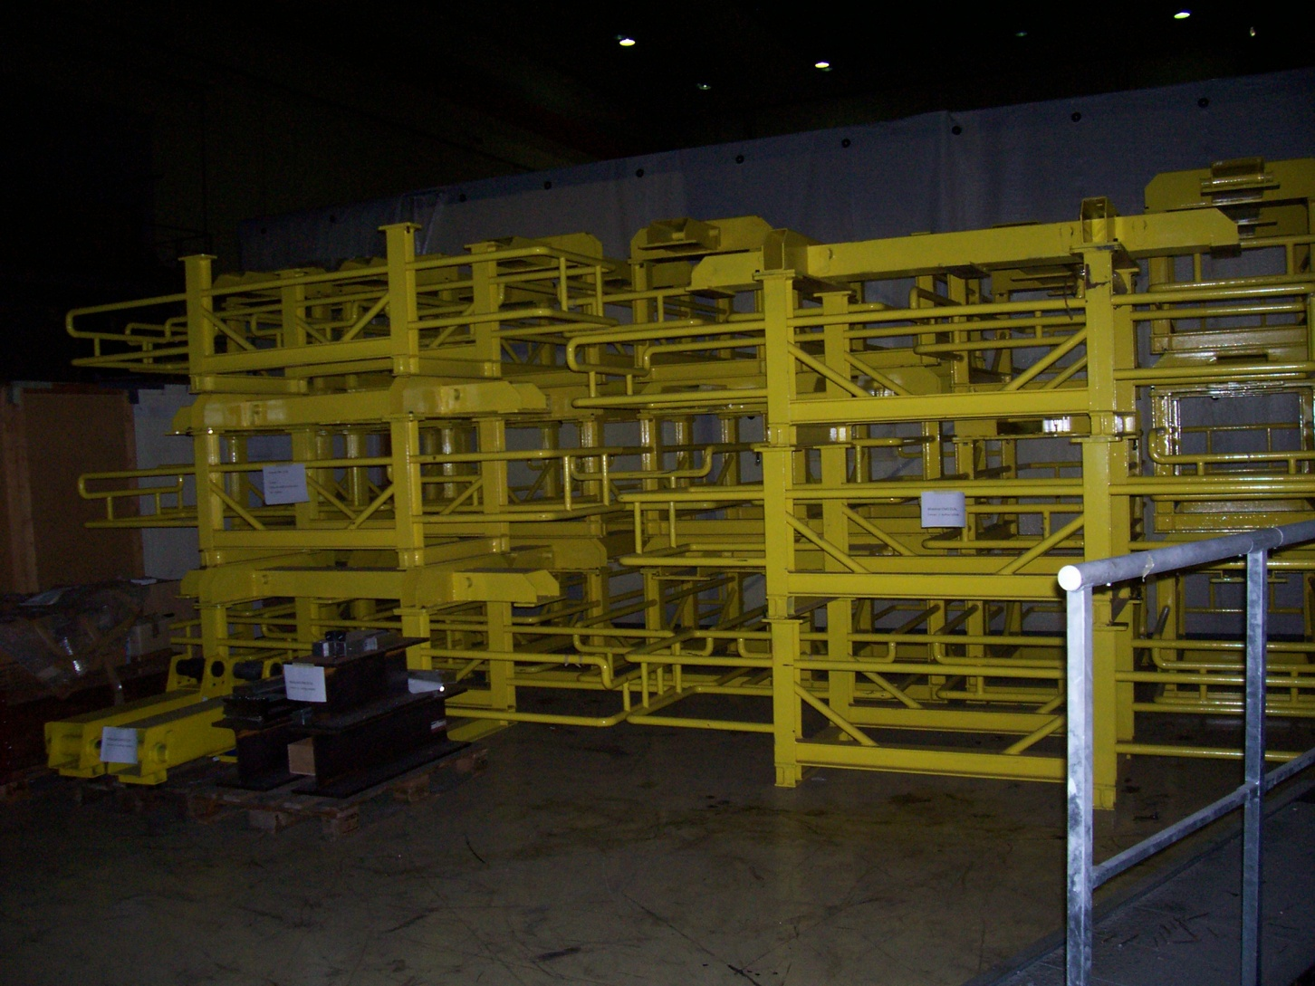
BAT 184 1-C24
Outillage ECAL 45m²

Slide 8
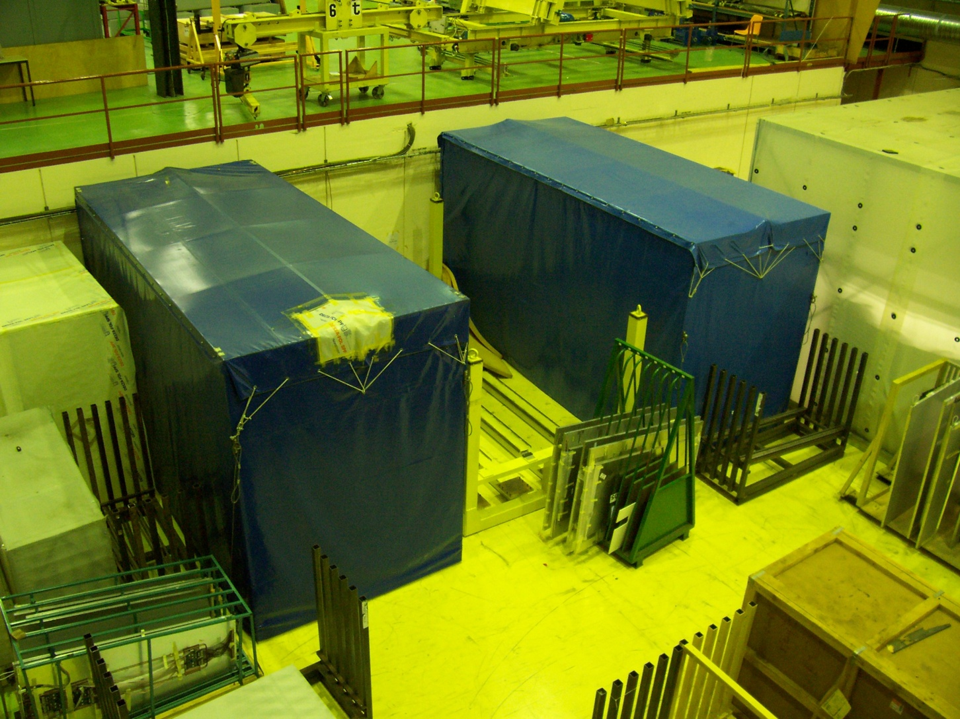
BAT 184S-C 01
MUONS 45 m²

Slide 9
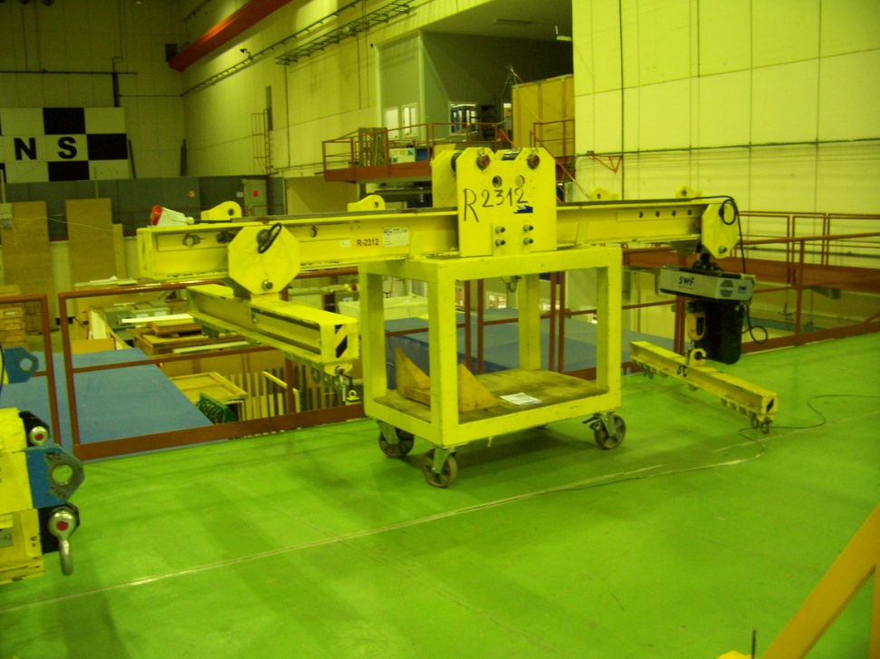
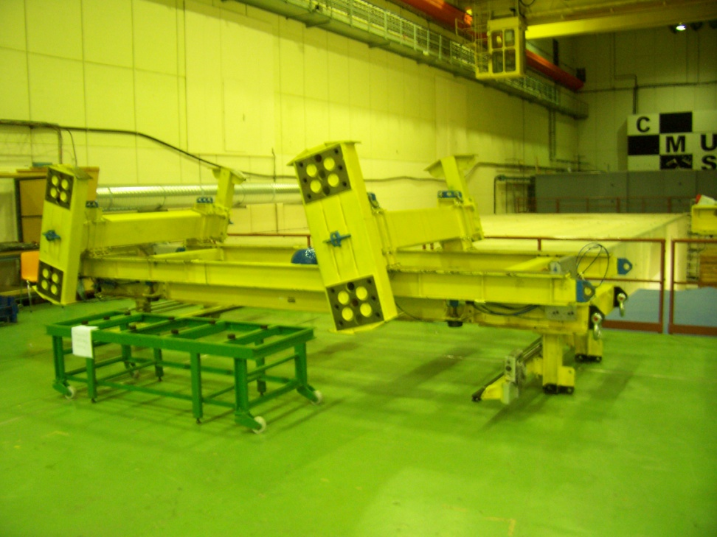
BAT 375 TUNNEL
Outillage MUONS 25m²

Slide 10
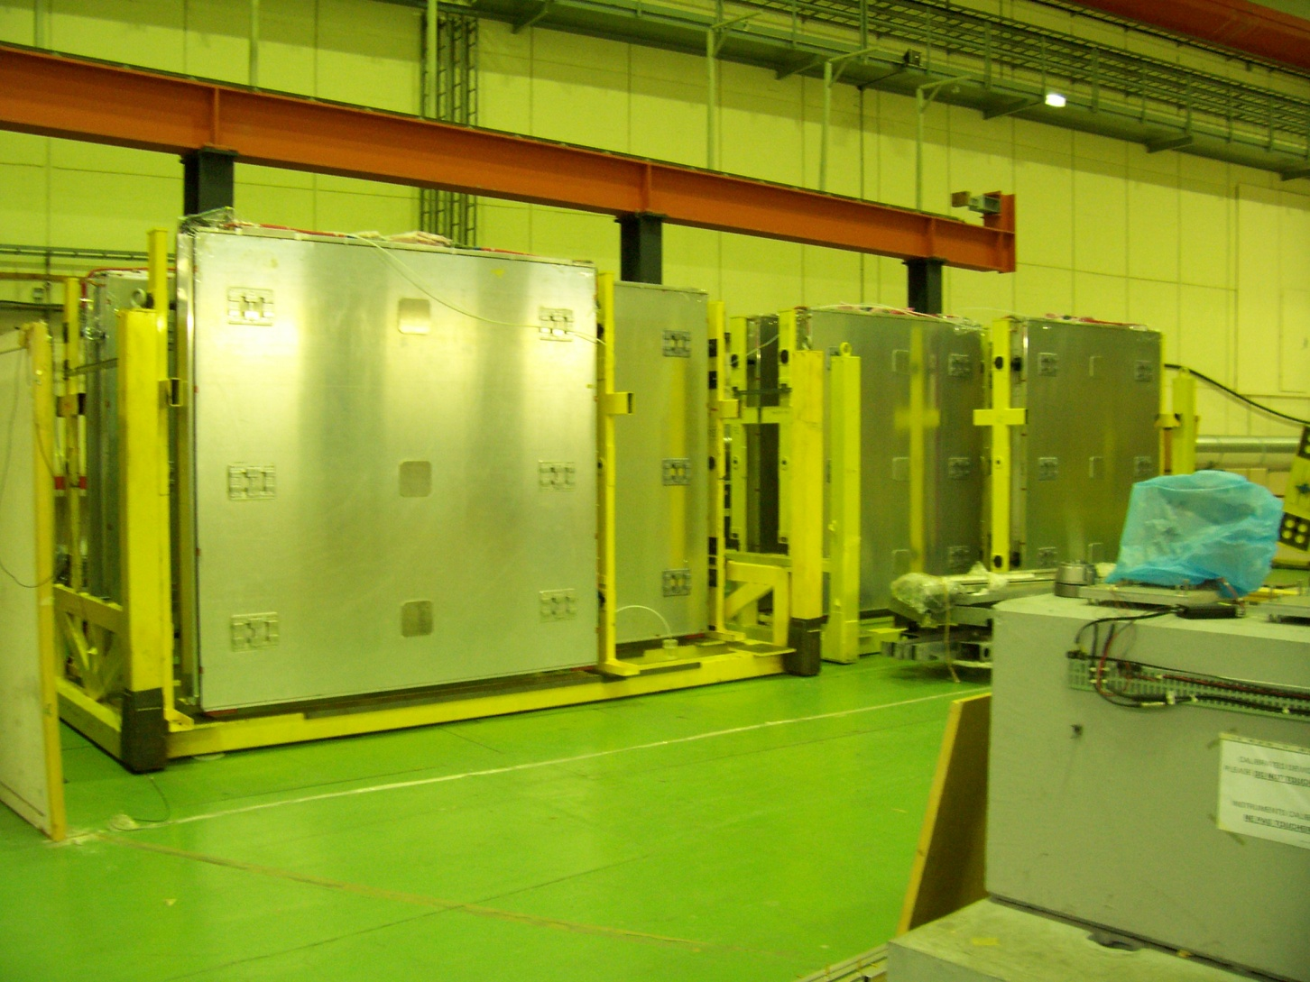
BAT 375 TUNNEL
Outillage MUONS 25m²

Slide 11
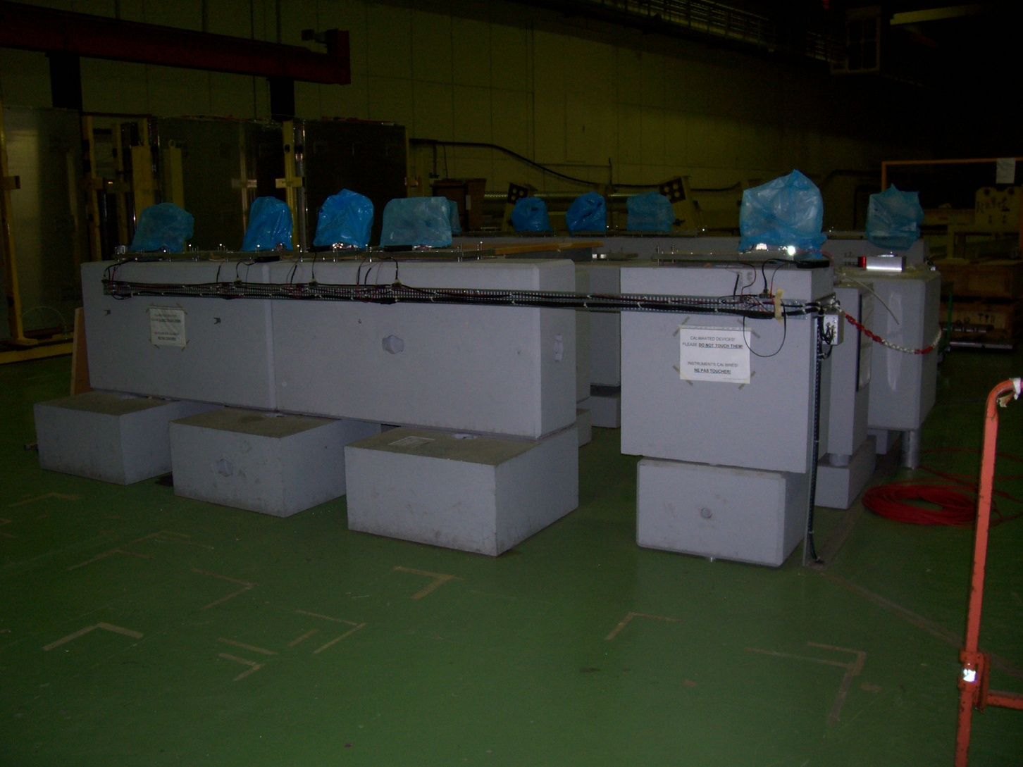
BAT 375 TUNNEL
Calibration MUONS 25m²

Slide 12
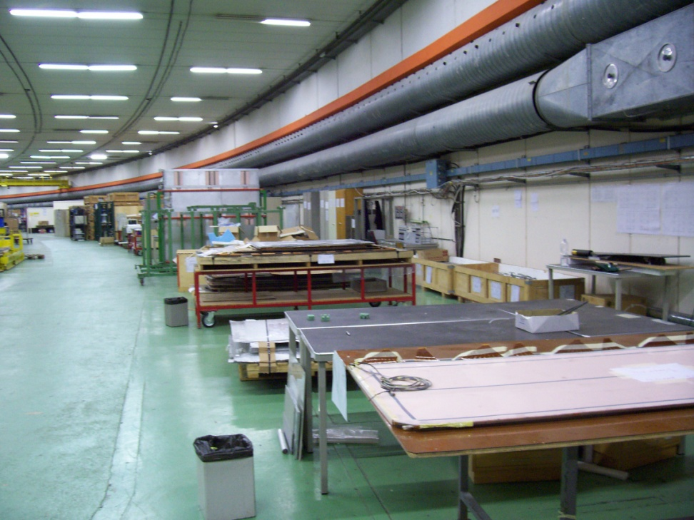
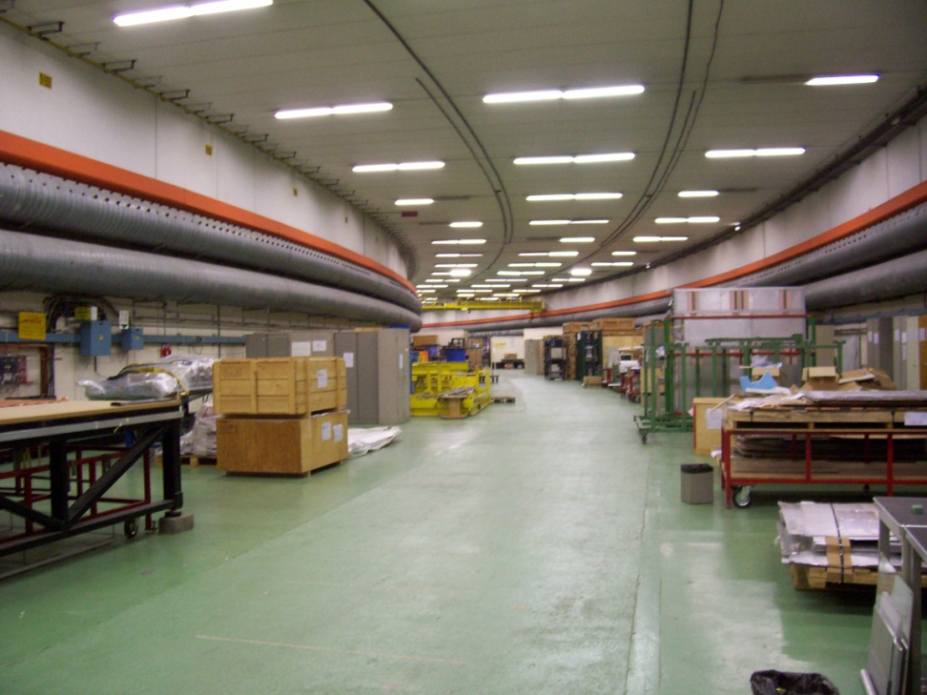
BAT 375 TUNNEL
VUE D’ENSEMBLE 500M²

Slide 13
BAT 283-184-375
TOTAL SURFACE UTILE
1400M²

