Slide 1
Discussion for QC steps
Leak & Pop Spacers
As discussed in the previous meeting, we upload 13 gaps in the database.
30 gaps with RE4/2 types with Batch 12 HPLs.
Destroyed ~ 20 gaps to investigate the inside oil condition.
Problem !
In the test step for leak & pop spacers test, the current rejection limits seem to be too tight. We have to take into account pressure & temperature variation of the test laboratory. The pressure measured by the sensor is the gauge pressure p – p₀, NOT absolute pressure.
1. Variation of p₀ outside
2. Variation of T of air inside the gap
∆T = 0.1º during the 10 minutes causes a pressure variation ~ 0.33 hPa.
0.2 hPa would be an uncontrollable amount.
The proper rejection limits seem to be
RE4/2 TW: 0.3 hPa, RE4/2 TN: 0.3 hPa, RE4/2 B: 0.4 hPa
RE4/3 TW: 0.3 hPa, RE4/3 TN: 0.4 hPa, RE4/3 B: 0.5 hPa

Slide 2
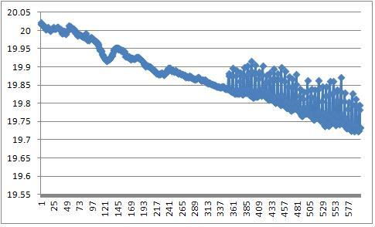
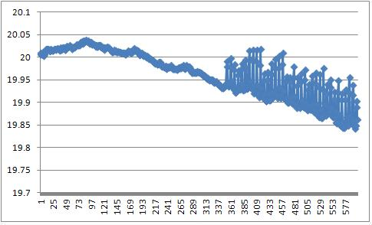
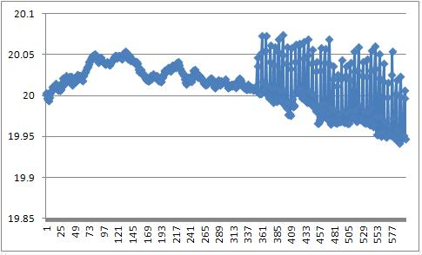
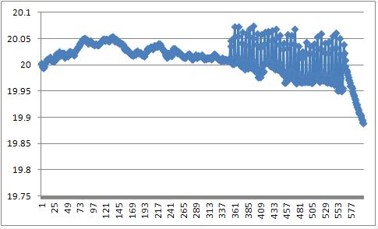
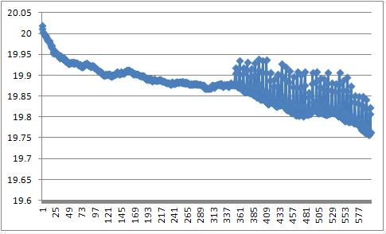
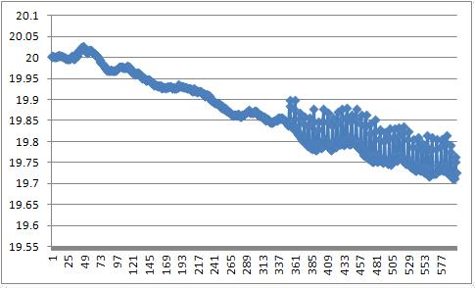
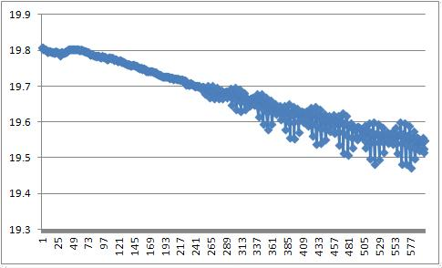
RE4/2 bottom (large gaps)
KODEL-TEST-RE4-2-B004
KODEL-TEST-RE4-2-B005
KODEL-TEST-RE4-2-B006
KODEL-TEST-RE4-2-B007
KODEL-TEST-RE4-2-B008
KODEL-TEST-RE4-2-B009
KODEL-TEST-RE4-2-B010

Slide 3
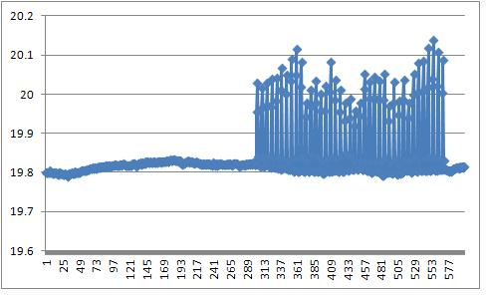
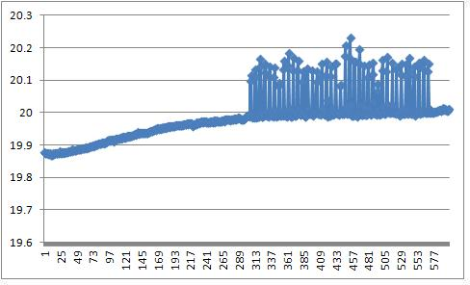
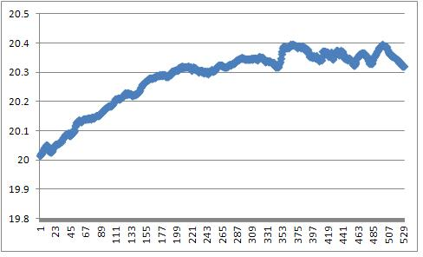
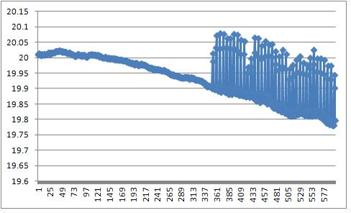
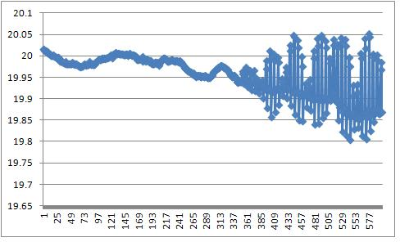
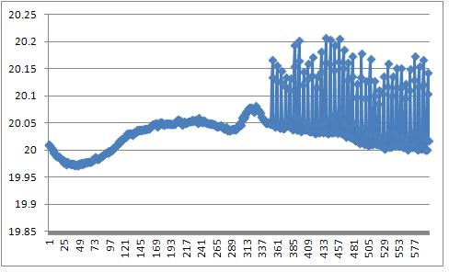
KODEL-TEST-RE4-2-TW004
KODEL-TEST-RE4-2-TW006
RE4/2 Top wide
(small gaps)
KODEL-TEST-RE4-2-TN004
KODEL-TEST-RE4-2-TN005
RE4/2 Top narrow
(mid-sized gaps)
KODEL-TEST-RE4-2-TN006
KODEL-TEST-RE4-2-TN008

