Slide 1
HPL
HPL Manufacture change
Cutting & Surface treatment
Quality assurance
Schedule
Gaps
Quality Assurance Testing

Slide 2
HPL Production Source
Original supplier Pan Pla has gone bancrupt. A larger well organised company Puricelli has been found just North of Milan.
Two key people are still available, one in Puricelli and the other as consultant to Puricelli
4 Pre-production batches to learn and fine tune the new production chain. Results are not perfect but meet the original specification.

Slide 3
HPL Quality Assurance
Characterisation Parameters
Resistivity
Roughness
Bonding strength
Polymerisation
Tracing and labeling is done by Pavia.
The 9 point Rho jig will be in operation this summer
In time for mass production

Slide 4
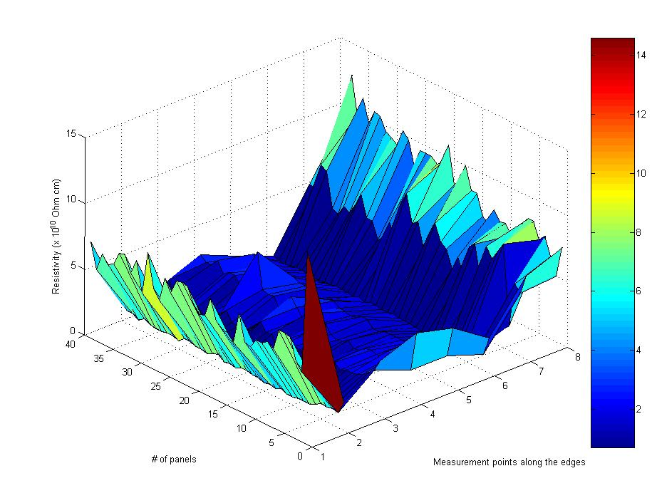
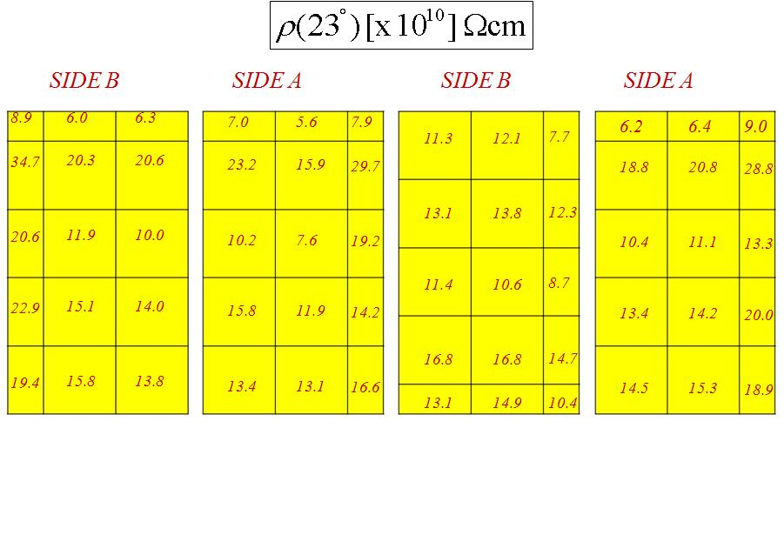
Resistivity measurements Puricelli and Pavia
Initial values were far away from our specs.
Resistivity of 1- 6 x 10^10Ω.cm @ 20C and with Average/Std < 0.5 is now achieved.

Slide 5
Roughness and Bonding
KODEL report 200N to spacer bond failure
Planned to study the “form” and gap topology
2003 2010
Ra 0.12µm 0.10µm
Rt 1.24µm 1.8µm

Slide 6
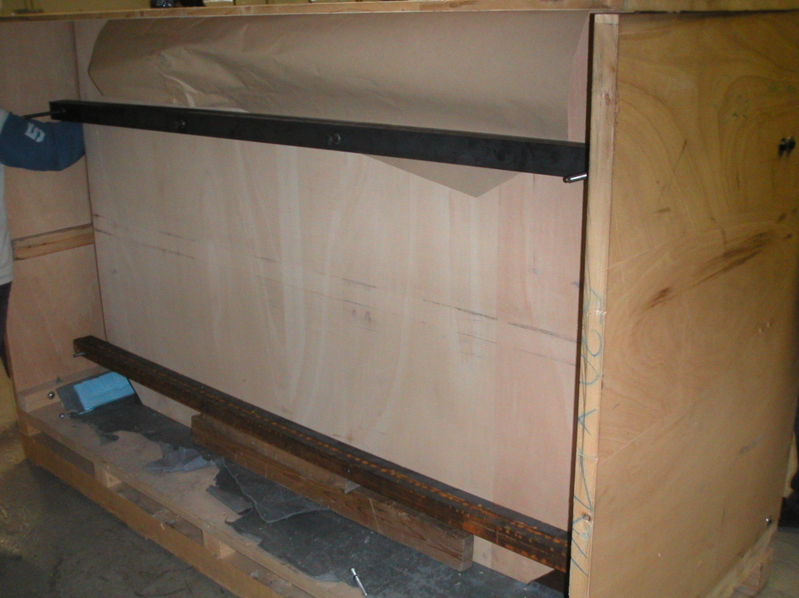
Packing and Cleaning
The packing boxes are identical but with 2 levels of pre-stressed clamping bars to help avoid bending of HPL sheets due to crippling forces.
GT have done the cleaning with the same machine and apparently new MEK.
The shipment is ready to go on Monday
Buckled sheets
Pre-stressed Bars @ 2 levels

Slide 7
Prototype Gap Production
Two sources of Prototype gaps
KODEL and GT
GT will make 9 rectangular gaps of 1.2m x 1.5m. Xx will be made with 9 HV pads in an attempt in the GIF by Roberto to understand gas flow distribution inside a gap.
KODEL gaps
Material conforming to our specs for 5 RE*/2 and 5 RE*/3
Material non-conform for 2 RE*/2 and 2RE*/3 .
Gap testing will agree with previous CMS production
Over pressure test @ 20 hPa for 10 minutes.
Spacer bonding integrity test
Gas leakage <0.2 hPa for 10 minutes.
HV tests 8.5kV for 12 hrs
HV tests @ 9.4 for 4 days with current limits ( 2.0μA, 3.0μA, and 5.0μA) according to gap size
Production time approx 30 days from reception of HPL

Slide 8
Conclusions
The HPL procurement has developed rather fast in 4 months
Quality Assurance is going on in parallel.
Yield of first good batch is already 75%
Prototype gaps should be at CERN by end of August or early September
corresponding to the arrival of mechanics from China .

