Slide 1
Bakelite Data Upload in RPC Construction Database
Anton Dimitrov
RPC Upgrade Meeting
03 May 2011

Slide 2
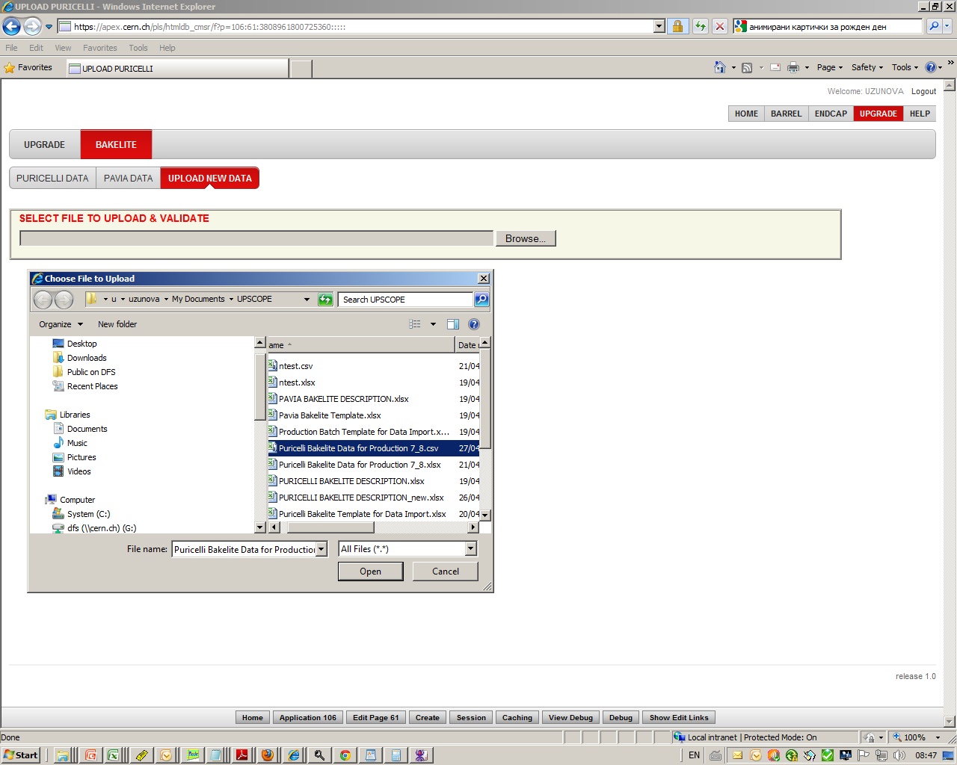
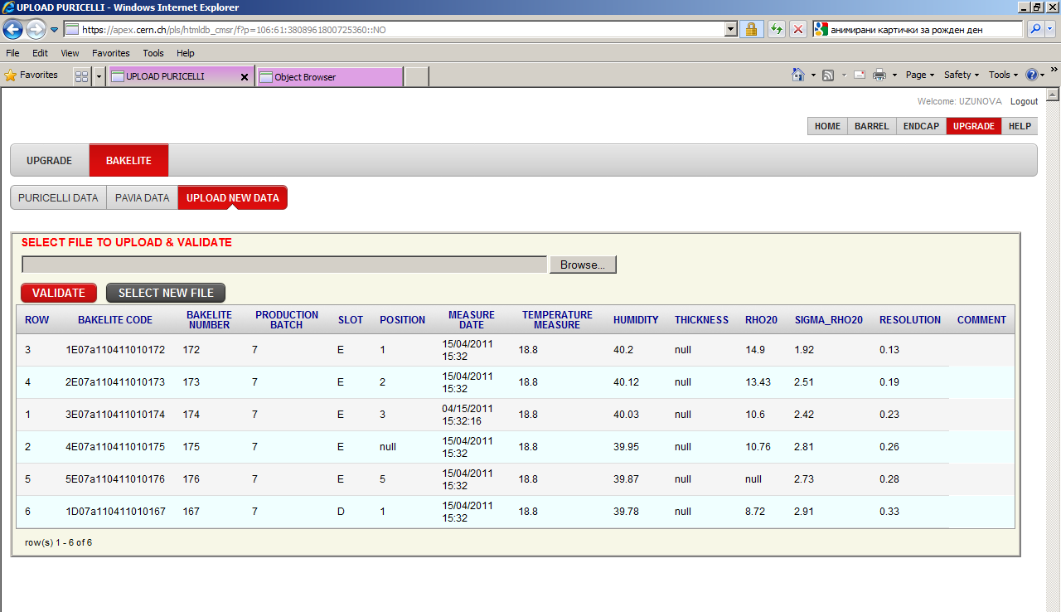
Guided upload of data.
Step1: SELECT the File with Puricelli data to be uploaded.
The interface checks file & data for:
Duplicated records (Bakelite code);
Missing data (Bakelite code & number, Production Batch, Slot, Position, Date, RHO20, SIGMA_RHO20, Resolution;
Wrong data format;
Non numerical value in numerical fields;
Extra fields in file;
Blanc records are automatically ignored.
Step2: VALIDATE data in the file.

Slide 3
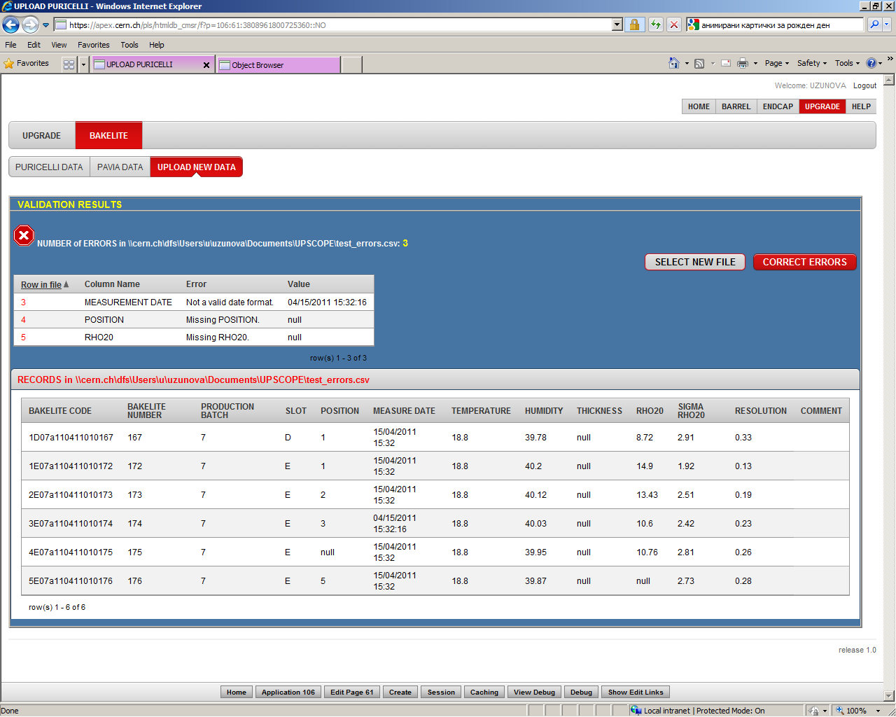
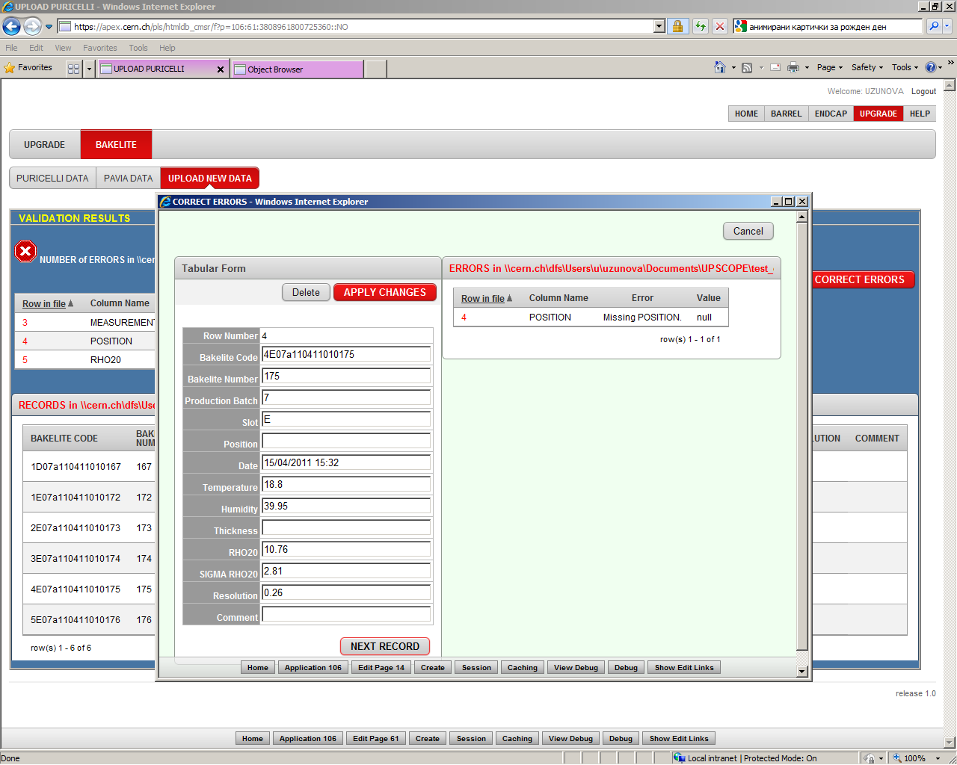
Step3: Correction of errors - ONLINE
The errors are corrected row by row and submitted for new validation.
Step 5. Enter Production Batch Common Data.
Step 6. Attach File with measurements of Pistons.
Step4. SAVE data.

Slide 4
Conclusions
Bakelite Structure created in RPC construction database – separate tables for production (Puricelli) and certification (Pavia) measurements
Complicated data verification algorithm applied for data import
First production measurements for batch 7&8 imported in database
Duplicated data in original excel file – 10 entries for batch8 – A1-A5 and B1-B5 different data for the same HPL panels?
HPL specification not completely followed – no thickness and sample roughness measurements provided

