Slide 1
Cooling leak tests of RE4 chamber circuit.
Pressure
Specification 5 E -4 [mbar.l/s] @ 20bar
Stability
Leak Rate

Slide 2
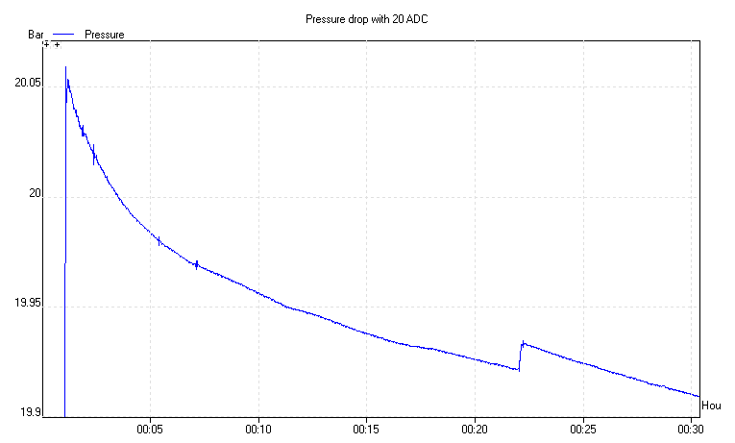
20 Bar pressure.
Long stability period

Slide 3
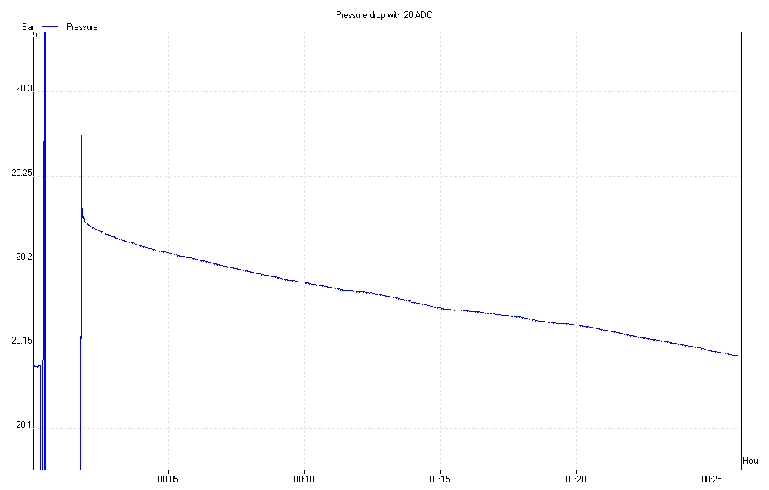
Short stability period
Stable leak rate
7.2 E-3 [mbar.l/s]
with valve leaking.
Leak rate duration

Slide 4
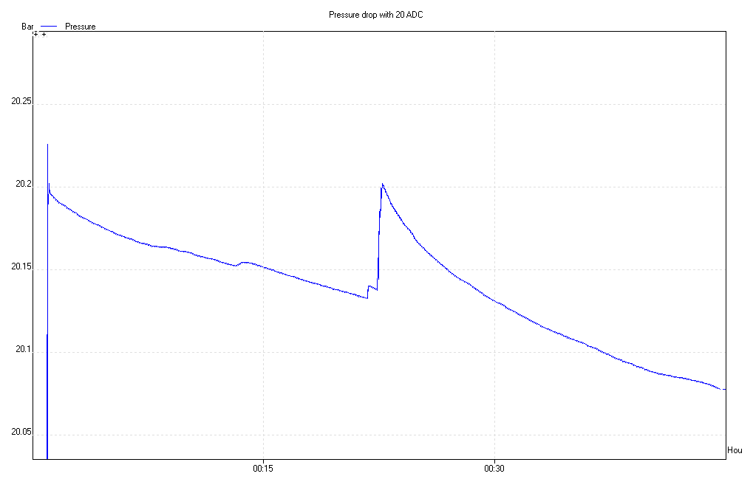
Heat input, 2 hands
Sensitivity to Heat input. I was sitting near the pipe.

Slide 5
Conclusions
Leak rates are readily established using the gradient as the sensor & ADC combination is very sensitive 0.04 [mbar]
Remaining questions:
The stability period definition
Relative temperature control over 200-500s

