Slide 1
Weight and C. of G. for RE4 SM
Ian
18 April 2019

Slide 2
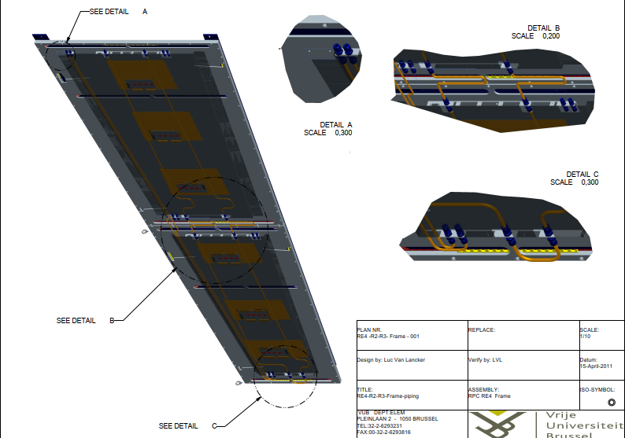

Slide 3
Estimated weight
RE4/3 85kg
RE4/2 65kg
Bars (8 x 80mm) 2 x 10kg
Total = 170kg
Weight taken with tanspalette from Reception 904
Error perhaps ± 1kg 178kg

Slide 4
CL
1725
C. Of G. as measured from chamber edge along steel bar(8 x 80mm) = 1725mm approx. error ± 20mm.
This happens to coincide with the M8 threading in the bar at 1835mm from the high R end.

