Slide 1
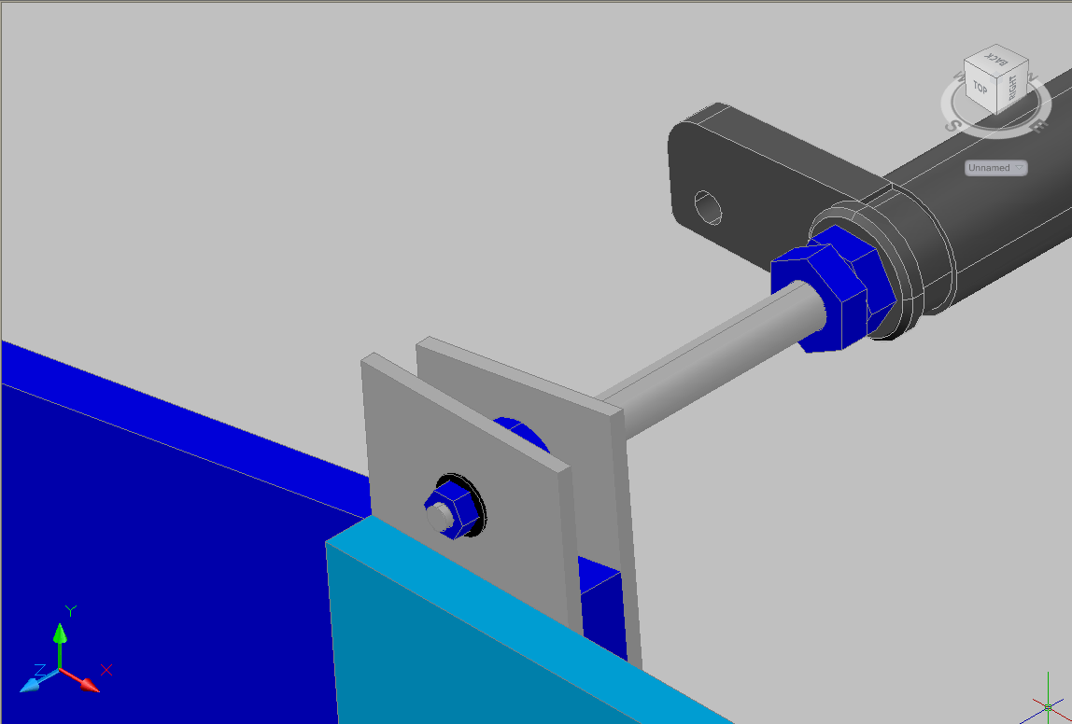
SM connect
WVD 09/2013
Nut M24
Extension M24
Spacer nut M12
Belleville M12
Nut M12
195.3 mm
Stud M12

Slide 2
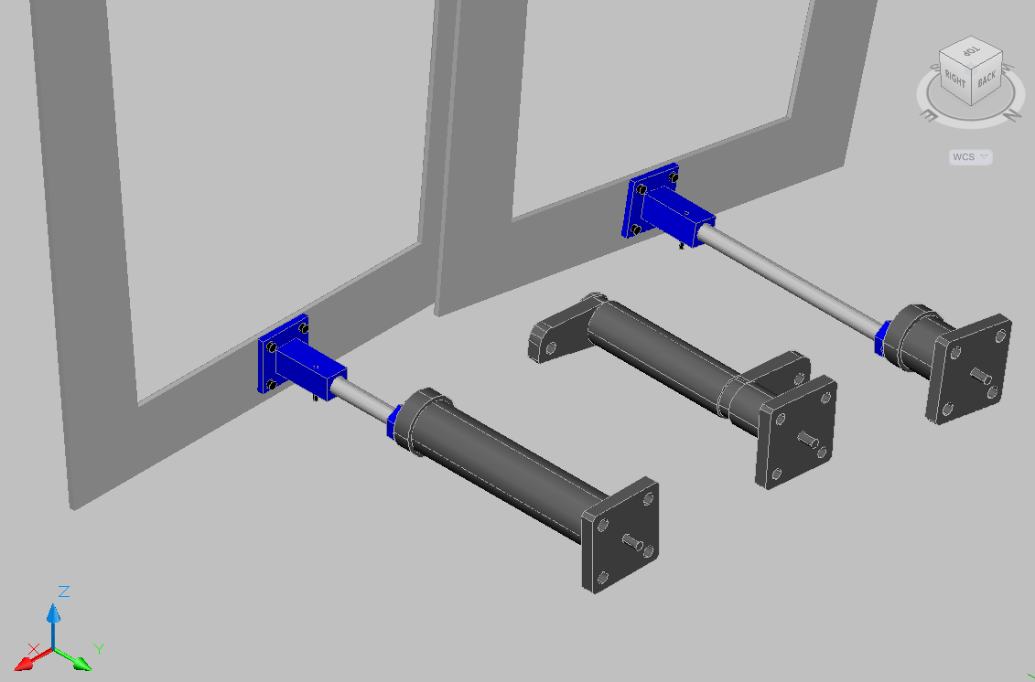
SM connect
WVD 09/2013
353.3 mm
Screw
143.3 mm
Blocking screw
Block
Nut M24

Slide 3
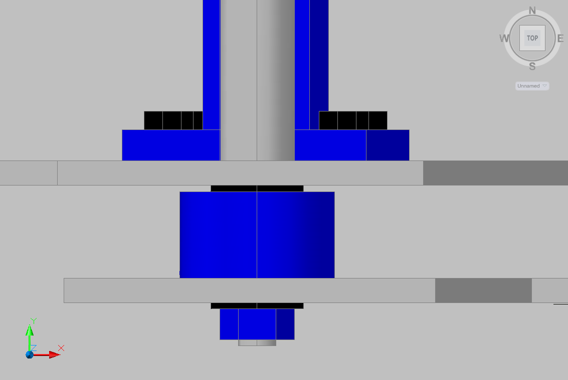
SM connect
WVD 09/2013
Belleville
30 mm

