Slide 1
Temperatures measured in the GIF
First objective is to understand the DCS sensor information that seems to have a “structure”.
The second is to understand the precision and resolution of the DCS.
The third is to see if the temperature can be brought down to normal RPC operational temperature, 20-22degC.
Temperatures measured in the GIF with DCS and Picolog sensors installed in an isothermal box.

Slide 2
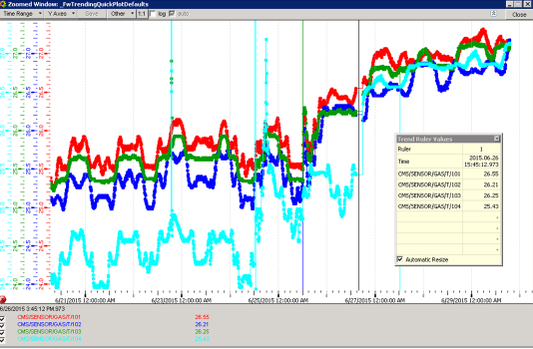
DCS from PCGIFDCS02\gifdcs
4 gas temperature sensors

Slide 3
Gas temperature and environmental DCS values
Notice T3 was outside in Prep Zone. Taken inside on pm 26 June
With T2 and T3

Slide 4
Picolog data, 3 sensors

Slide 6
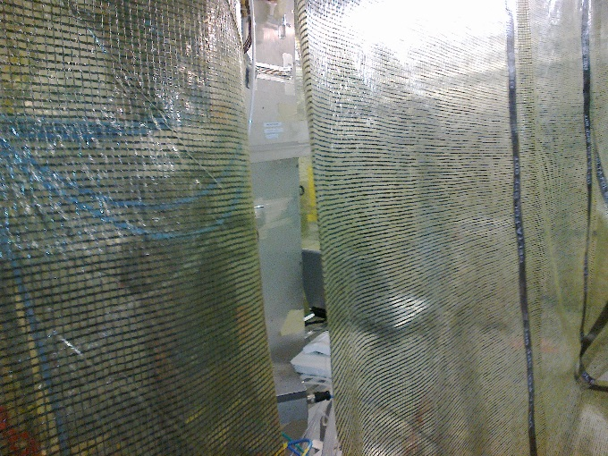
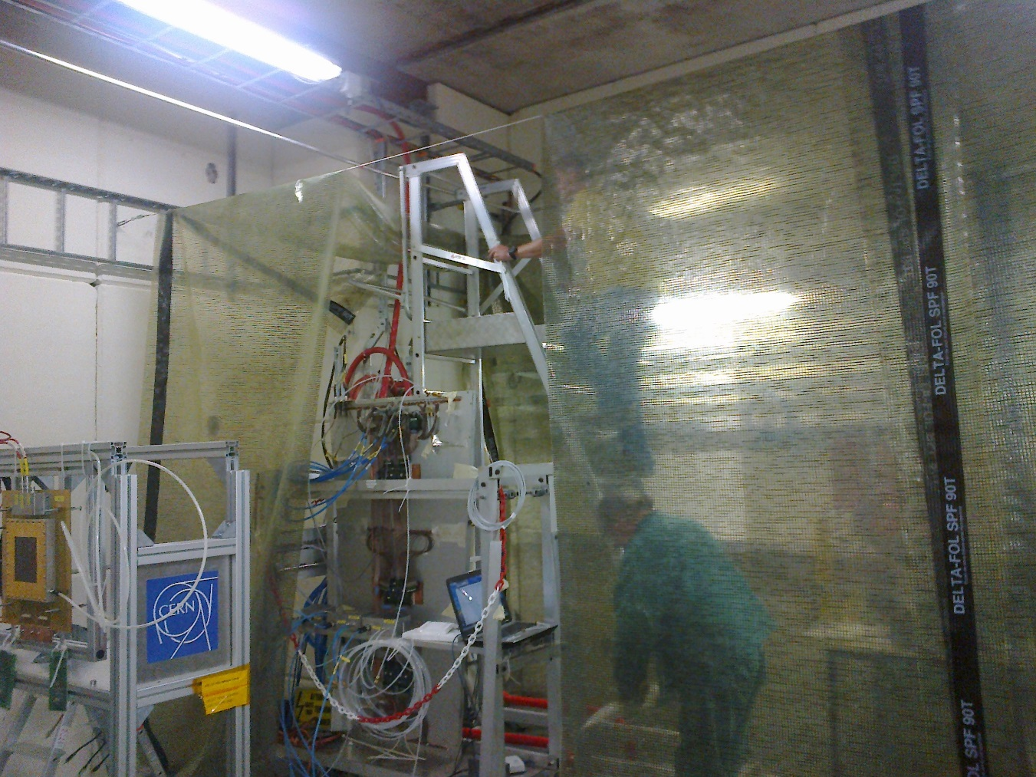
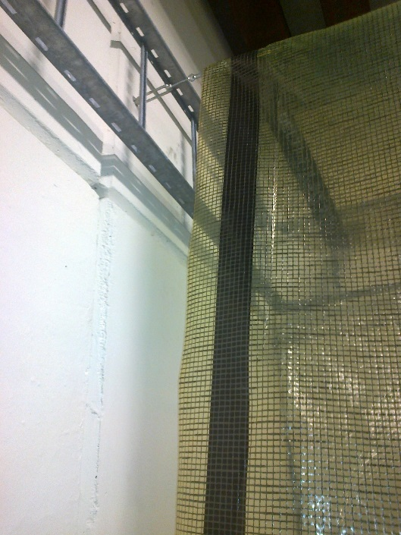
Fire resistant sheeting for temporary tunnel/tent, 3.2m(y) high, ~5m long(x) & 2m wide(z).
One medium size AC unit.
Lots of condensed water being piped upstream under the shielding ! We should have some other solution
Many apertures !
Extracted heat is being pumped into the rest of the bunker

Slide 7
The AC was put on inside the tunnel Tent
AC put on and all sensors removed from Iso box
Green & Cyan gas temps
Blue RPC Env
Red Bunker > Prep Zone
Brown CSC Environmental

Slide 8
Conclusion
The DCS sensors seem to have some form of structure even when in the isothermal box that provides some form of stability. This is not yet understood.
Is the DCS sensor info suitable for RPC operation ?
The AC and Poly sheet tent/tunnel have moved the temp down a few degrees, but insufficient for RPC operation during summer beam tests.
The temperature increase in the rest of the bunker is <1degC.

