Slide 1
GIF ++ ambient condition
The Prep. area outside
Tent and its gradient
CSC area
Geneva meteo station
Ian Crotty 6 Oct 2015

Slide 2
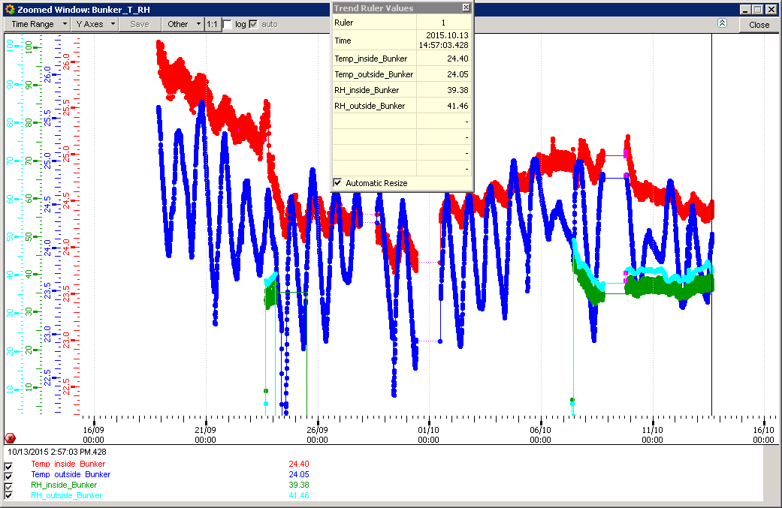
CERN Dip Sensors

Slide 3
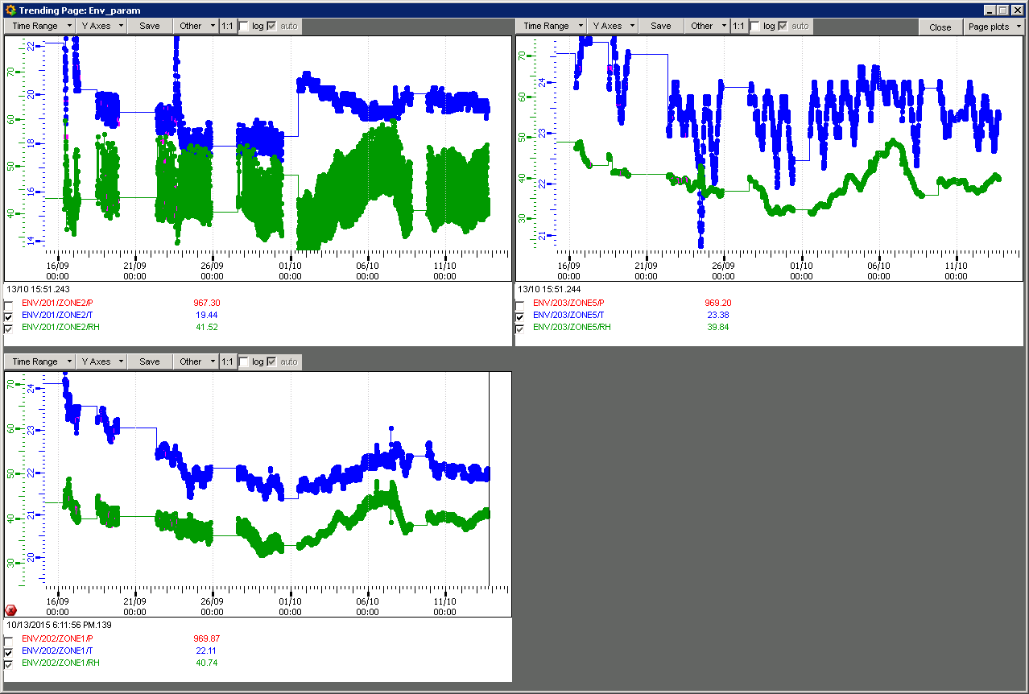
RPC Tent
Prep. Area
Frascati Environmental Sensors
CSC in Bunker

Slide 4
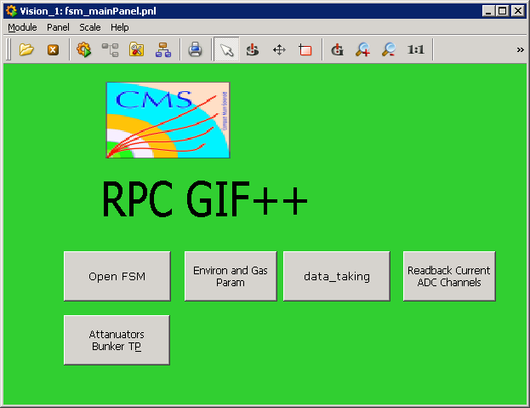
PCDCSGIF04
Environmental sensors from CERN Dip
The Frascati environmental sensors
It would be very good that we can have these two sources of data together.

Slide 5
Comments on the pcdcegif04 display.
Put the CERN environmental sensors with the frascati sensors.
In the Frascati sensors list it should be possible to select what we want to compare.
It seems the CERN sensors are reading higher inside the bunker than the frascati sensors.

