Slide 1
Proposed CMS RPC cable installation in GIF++
Ian Crotty & Nicolas Zaganidris

Slide 2
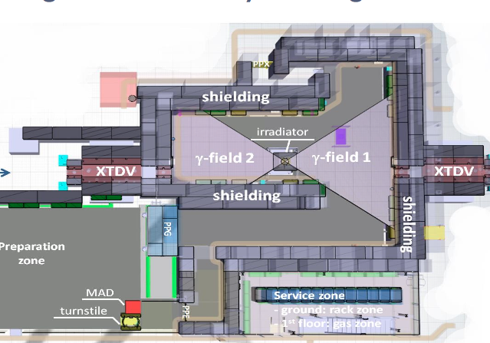
Preliminary set-up
RPCs High eta
RPCs Gas studies
RPCs consolidation
The detector position will better be defined as soon as the γ flux will be measured and when the requests of all users will be defined.

Slide 3
Muon chambers @ GIF++
5 RPC (barrel and endcap)
1 RB3 + (1 RE4 + 1 RE3) (now under test at GIF)
Bakelite (spare production)
CMS electronics
2 new barrel RPC
Improved gas system - new mechanics & service box & Distribution Board
5 RPC for High eta region
3 RE4-1
Low resistivity Bakelite (≈ 2 10¹⁰ Ωcm, or less)
CMS electronics - New electronics (Atlas chip)
new geometry (smaller gap thickness and multi-gaps)
2 RE4-1 chambers
Low resistivity glass
Double or multi-gaps
2 (glass and Bakelite) RPC prototypes for gas studies
common test with ALICE, ATLAS and CMS

Slide 4
Up stream Cabling
Cables coming up through floor
Signal Cables (x30 , Ø10mm)
HV cables (x1, Ø40mm)
LV (x5, Ø10mm)
I2C (x1, Ø10mm)

Slide 5
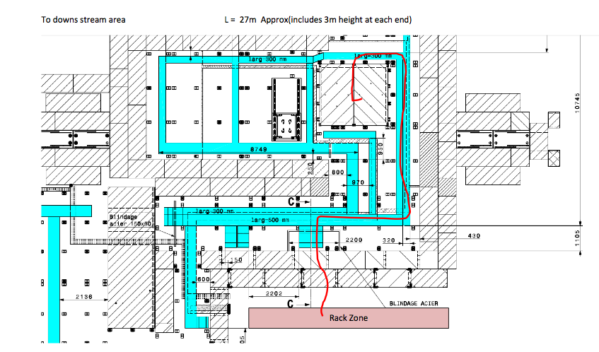
Down stream Cabling
Cables coming up through hole in floor
Signal Cables (x38 , Ø10mm)
HV cables (x1, Ø40mm)
LV (x5, Ø10mm)
I2C (x1, Ø10mm)

Slide 6
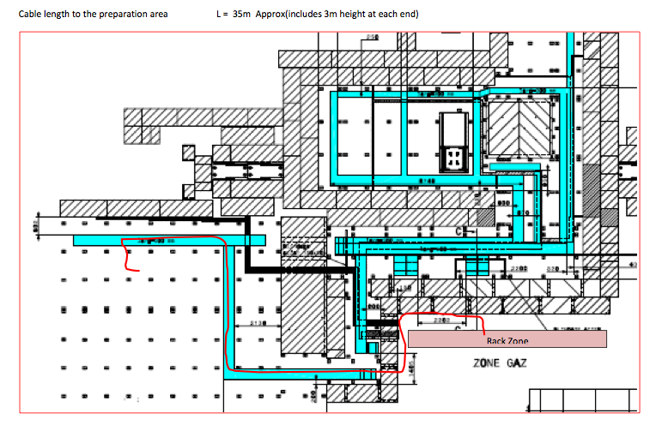
Preparation zone
Signal Cables (x2, Ø10mm)
HV cables (x1, Ø40mm)
LV (x1, Ø10mm)
I2C (x1, Ø10mm)

