Slide 1
T1
Ian

Slide 2
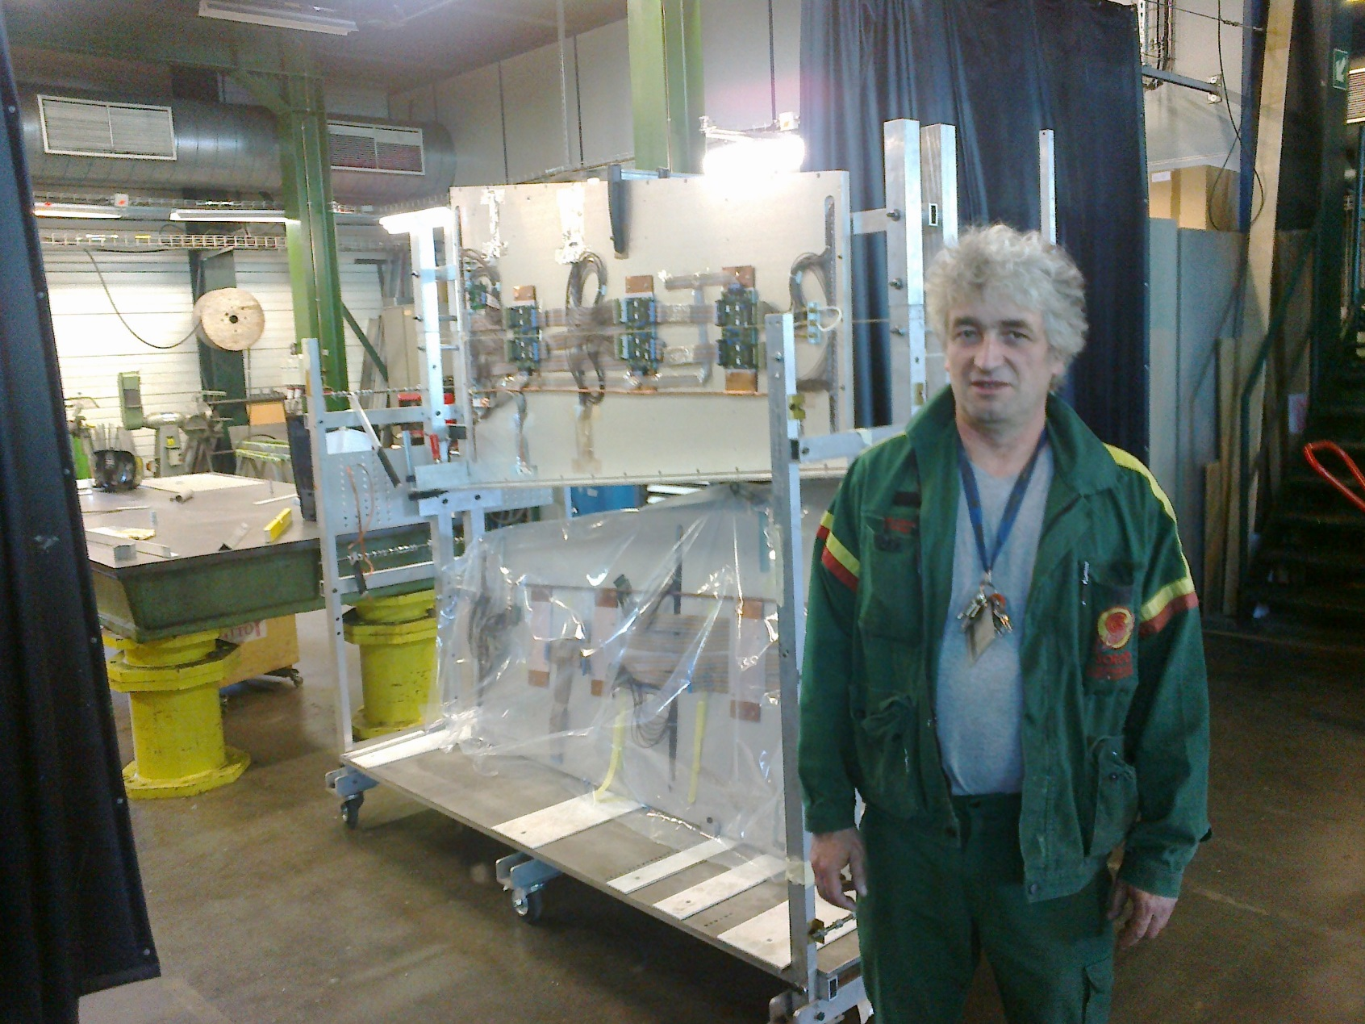
Progress 18 May 2015

Slide 3
Conclusion
Ready this week

