Slide 1
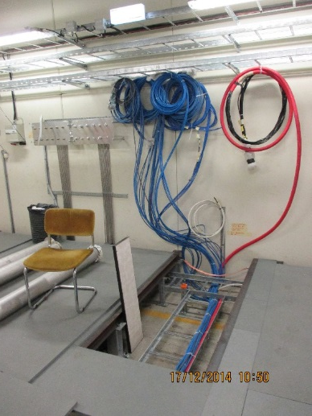
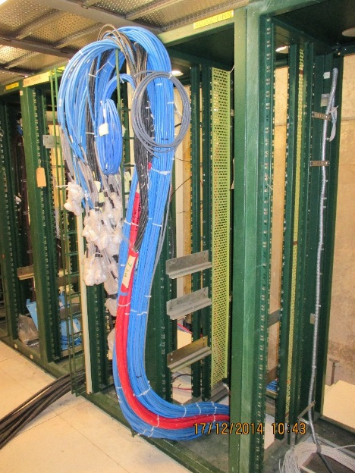
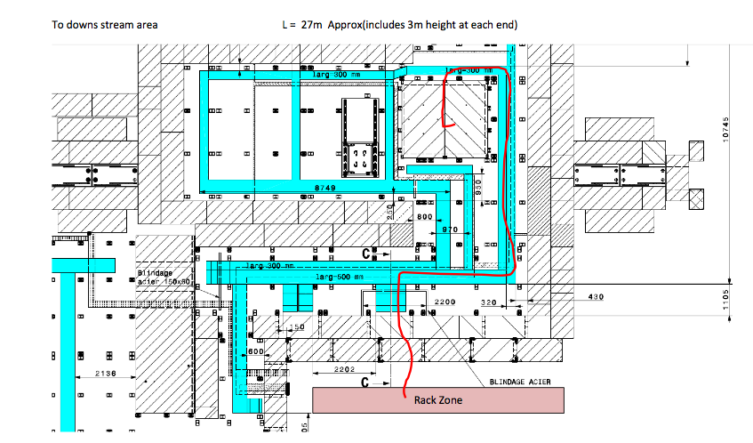
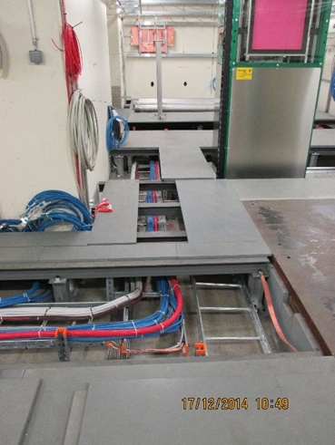
Bunker Cabling to Rack
Rack outside under gas zone

Slide 2
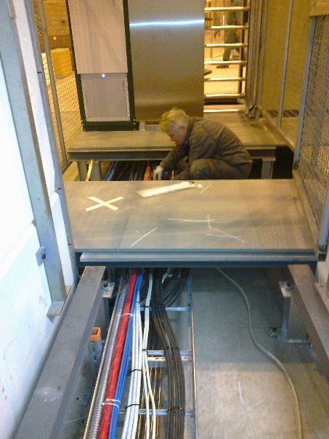
Services
All cables installed to 3 zones, Preparation Zone, Up stream and Down Stream.
Requires 20 connectors and labels to finalise
RPC Gas system almost operational
No AC foreseen, cooling is requested.
More Photos available here; http://rpc-cms-re4-upscope.web.cern.ch/rpc-cms-re4-upscope/RPC/GIFPlusPlus/Services/PhotosCableLay11to16Dec2014
Cable function | Zone installed |  |  | Total
 | Prep. | Down Stream | Up stream
HV | 1 | 1 | 1 | 3
LV | 1 | 5 | 5 | 11
DCS | 1 | 1 | 1 | 3
Signal | 2 | 38 | 30 | 70

