Slide 1
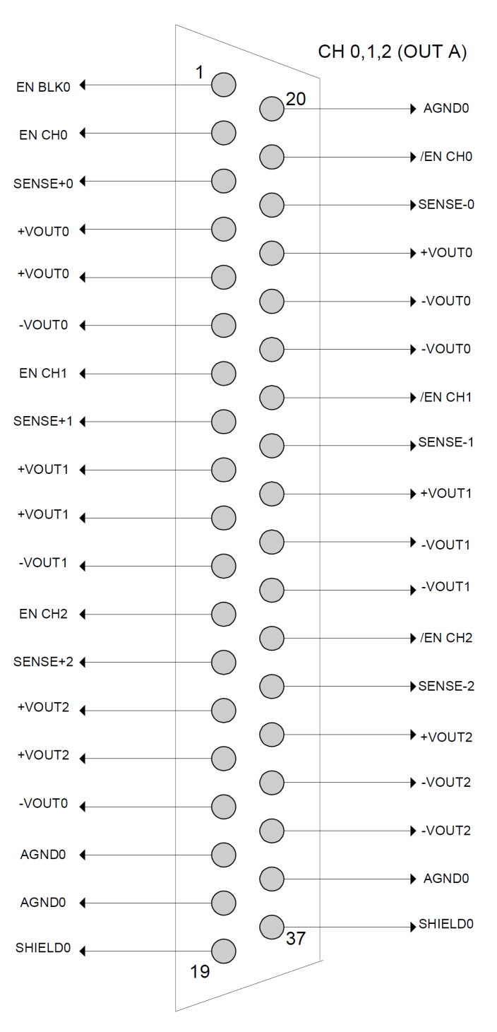
LV schematic
Analog + (4, 5, 23)
Channel 0,
Analog = 7.0 Volts / 0.350 µA)
Analog - (6, 24,25)
Digital + (9, 10, 28)
Channel 1,
Digital = 7.5 Volts / 0.750 µA)
Digital - (11, 29,30)
Channel 2,
Not in use

Slide 2
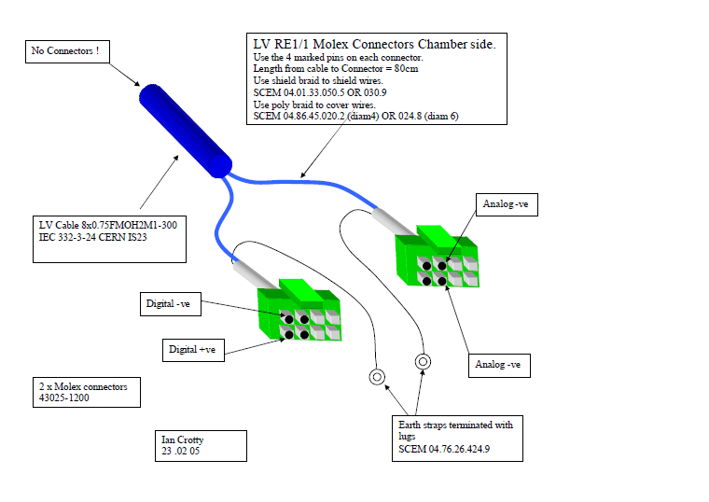
LV schematic
Analog +ve

