Slide 1
Services in GIF++ HV Cables LV cables DCScables Signal Cables Ian Crotty 17 Dec 2014

Slide 2
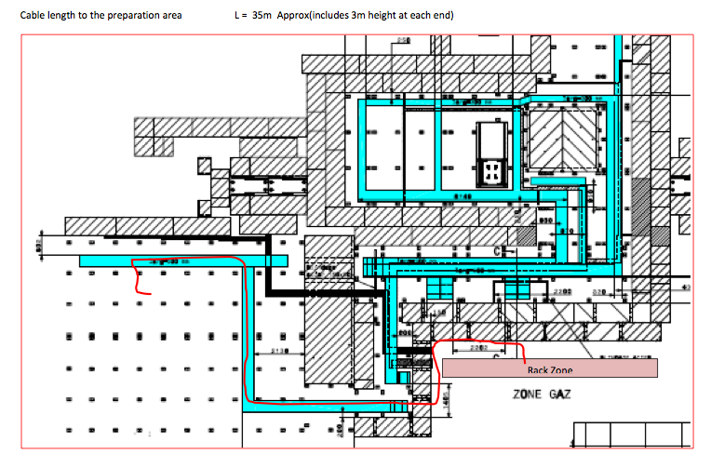
Preparation zone
Signal Cables (x2, Ø10mm)
HV cables (x1, Ø40mm)
LV (x1, Ø10mm)
I2C (x1, Ø10mm)

Slide 3
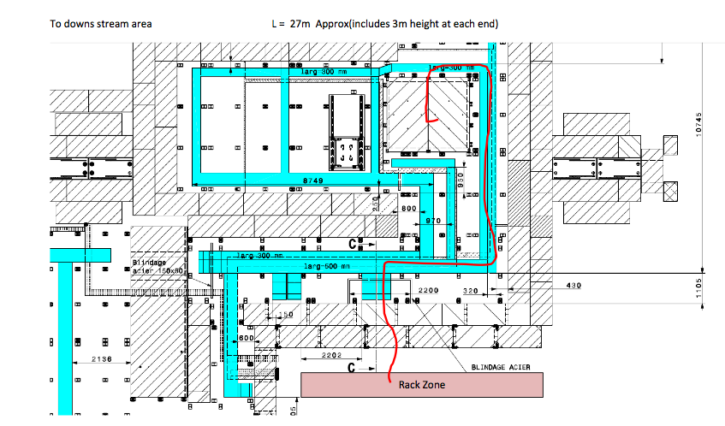
Down stream Cabling
Cables coming up through hole in floor
Signal Cables (x38 , Ø10mm)
HV cables (x1, Ø40mm)
LV (x5, Ø10mm)
I2C (x1, Ø10mm)

Slide 4
Up stream Cabling
Cables coming up through floor
Signal Cables (x30 , Ø10mm)
HV cables (x1, Ø40mm)
LV (x5, Ø10mm)
I2C (x1, Ø10mm)

Slide 5
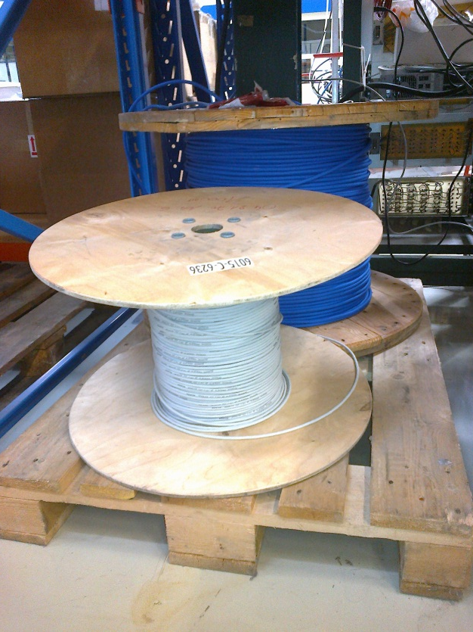
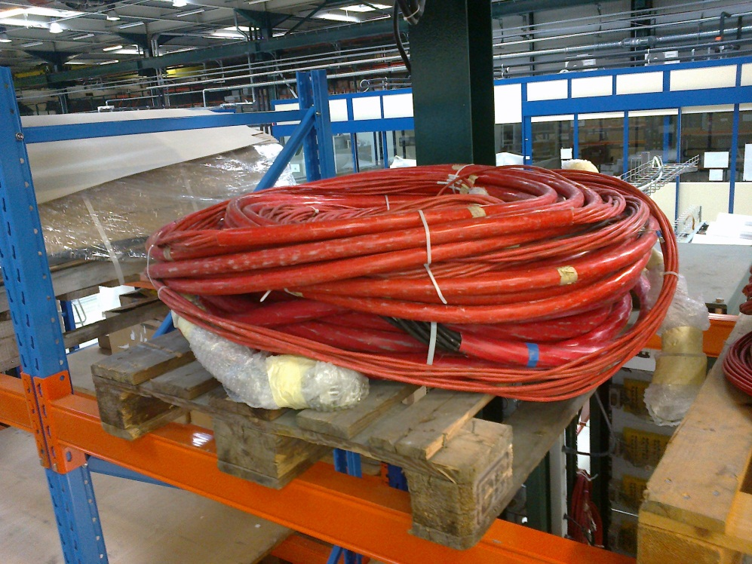
Readiness

Slide 6
Readiness
HV Cut to length , needs connectors and testing
LV Cut to length , needs connectors and testing
DCS In stoke in 904 and P5
Signal Ready but need protection
Cooling No plans

Slide 7
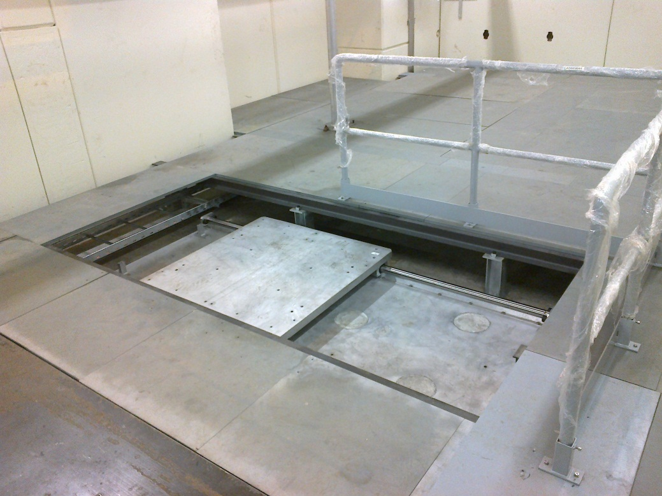
GIF++ Status
Beam Line
Source Platform

Slide 8
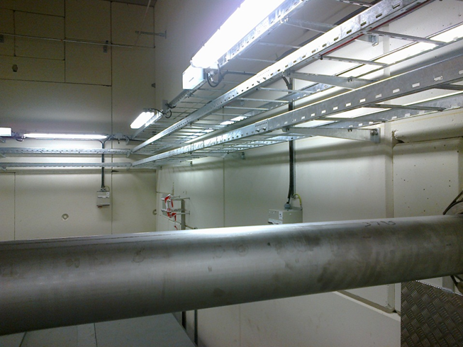
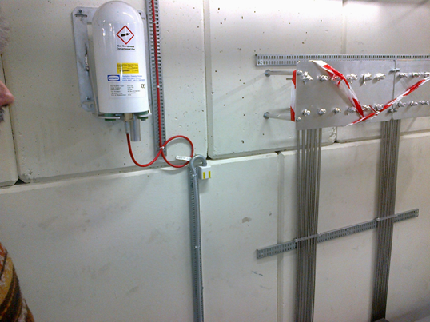
GIF++ Status
Cable Trays for users
Slot for cables to come on top of the floor
Ethernet

Slide 9
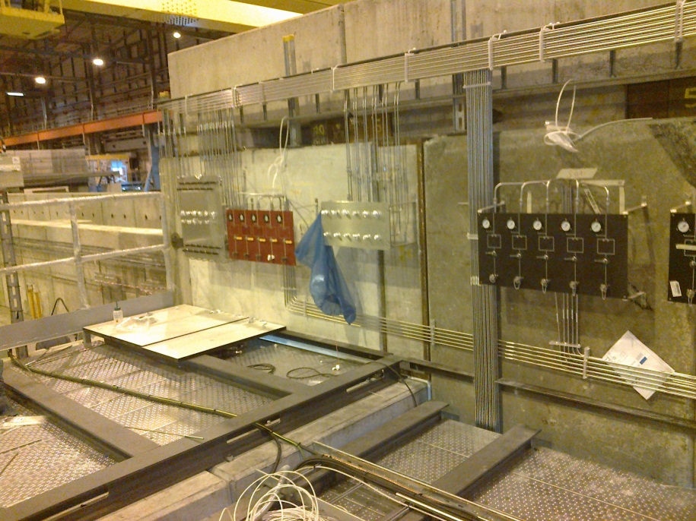
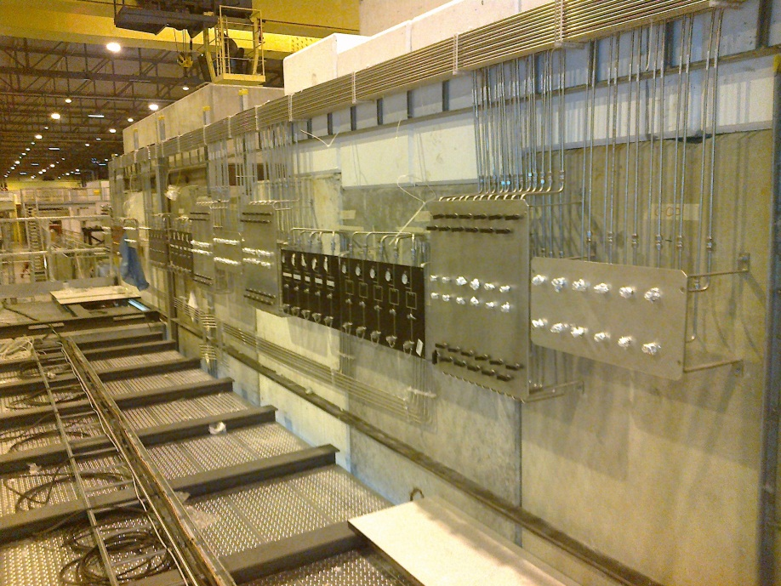
GIF++ Status
Gas Panels upstairs
Flammable gas Panel
Gas panel inside

Slide 10
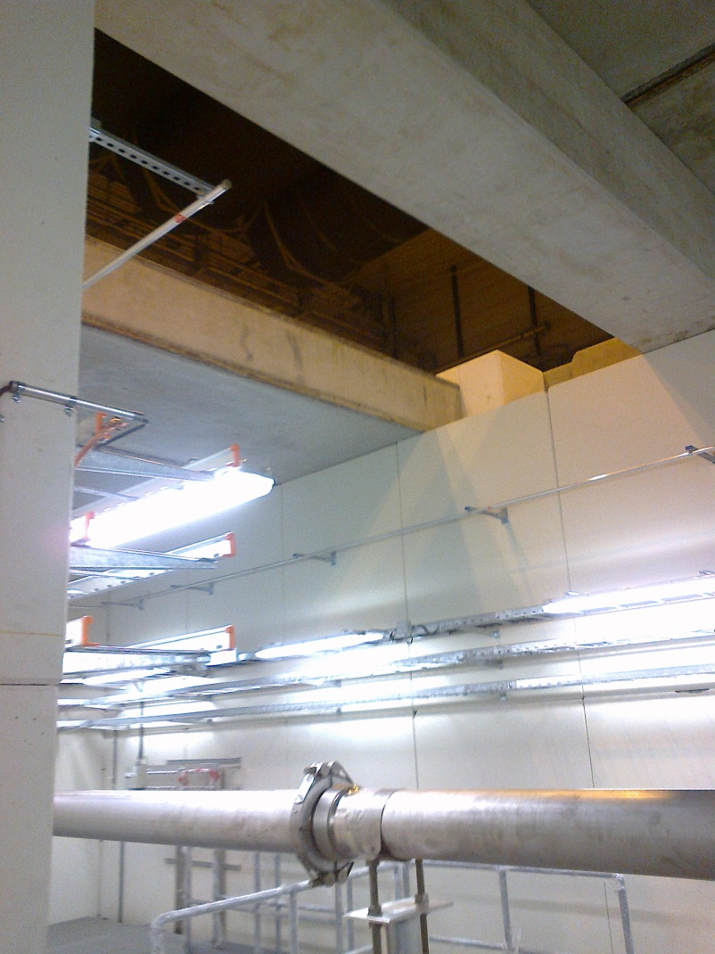
GIF++ Status
Sliding platform for source and “Cosmic Floor”
Access ofr source next week

