Slide 1
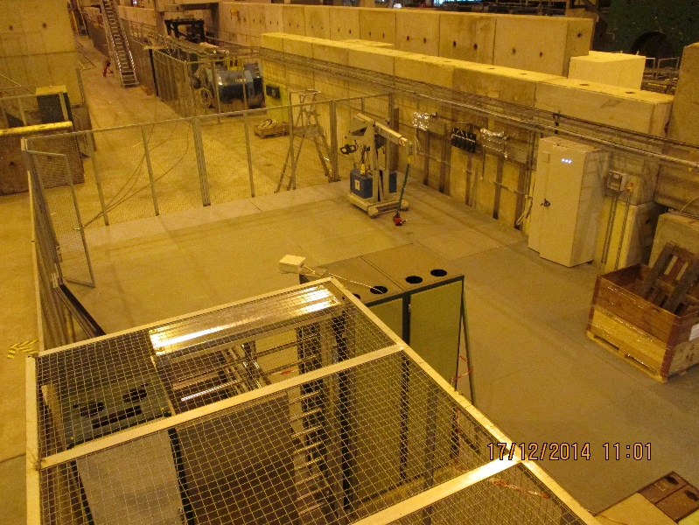
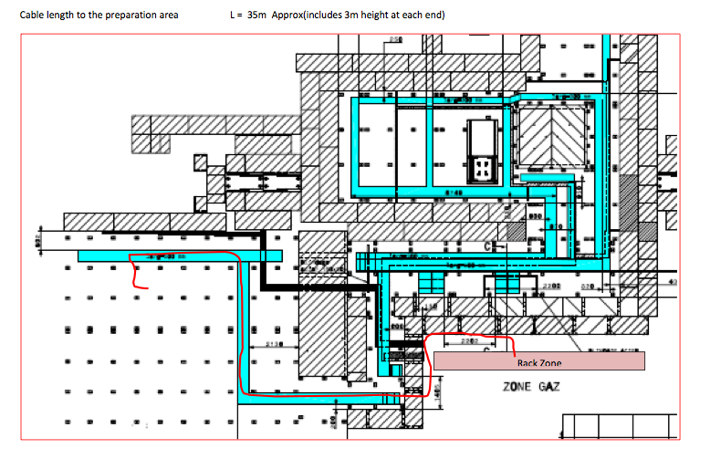
Preparation zone
Signal Cables (x2, Ø10mm)
HV cables (x1, Ø40mm)
LV (x1, Ø10mm)
I2C (x1, Ø10mm)

