Slide 1
Gems Flow sensors
Ian
21 March 2022

Slide 2
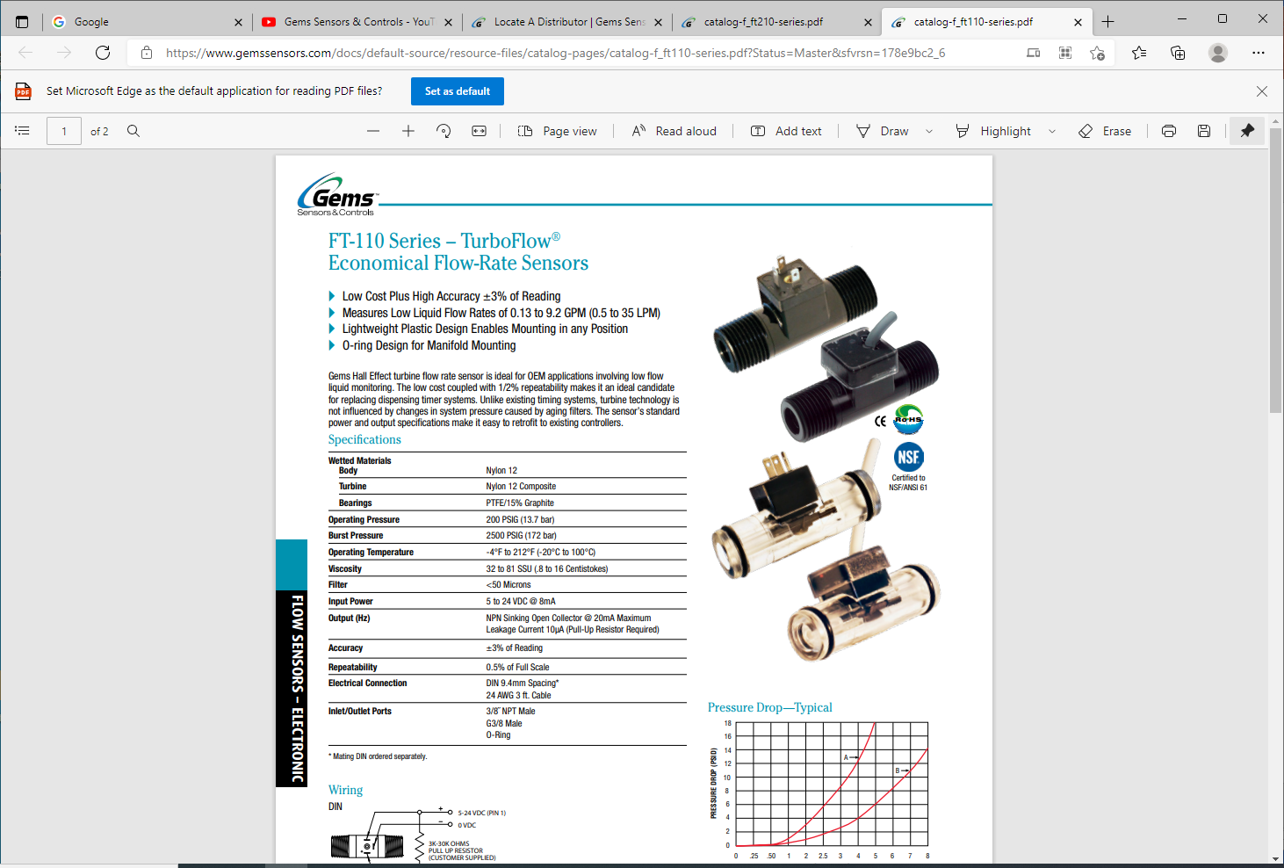
https://www.gemssensors.com/docs/default-source/resource-files/catalog-pages/catalog-f_ft110-series.pdf?Status=Master&sfvrsn=178e9bc2_6

Slide 3
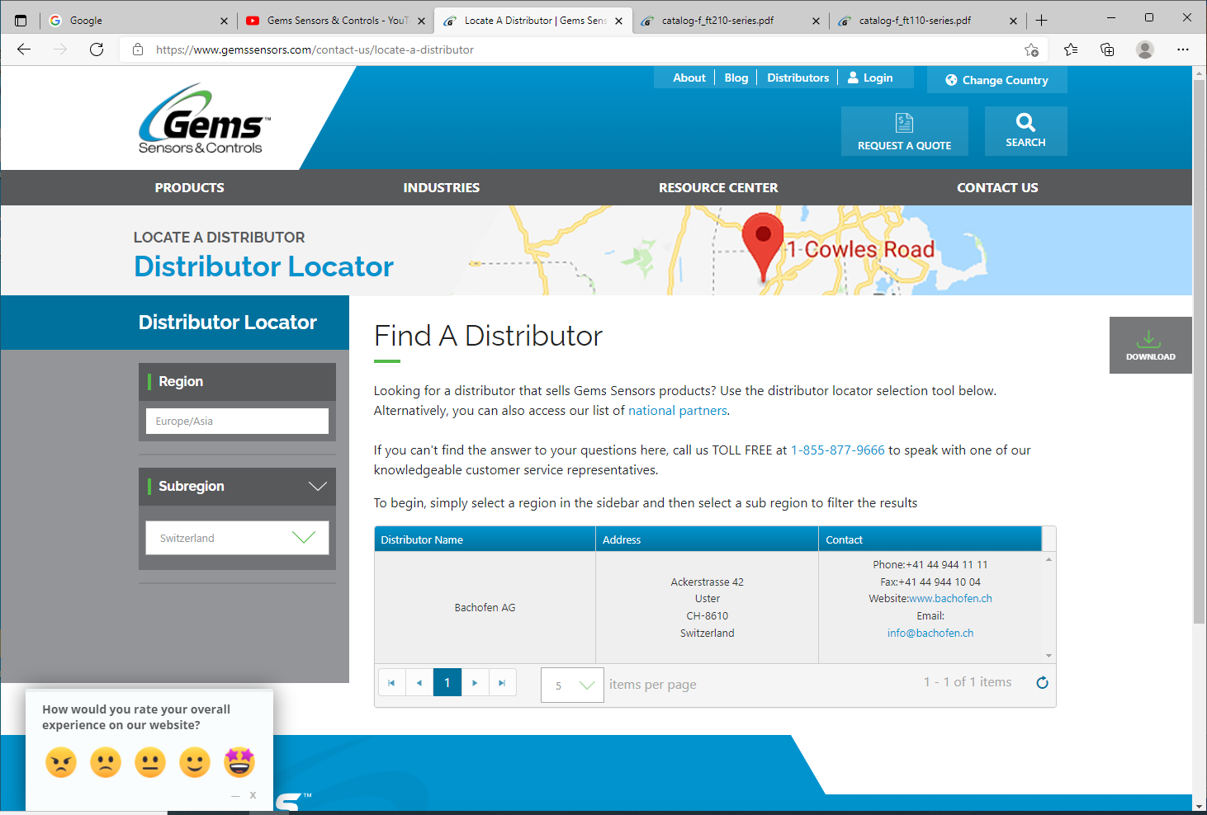

Slide 4
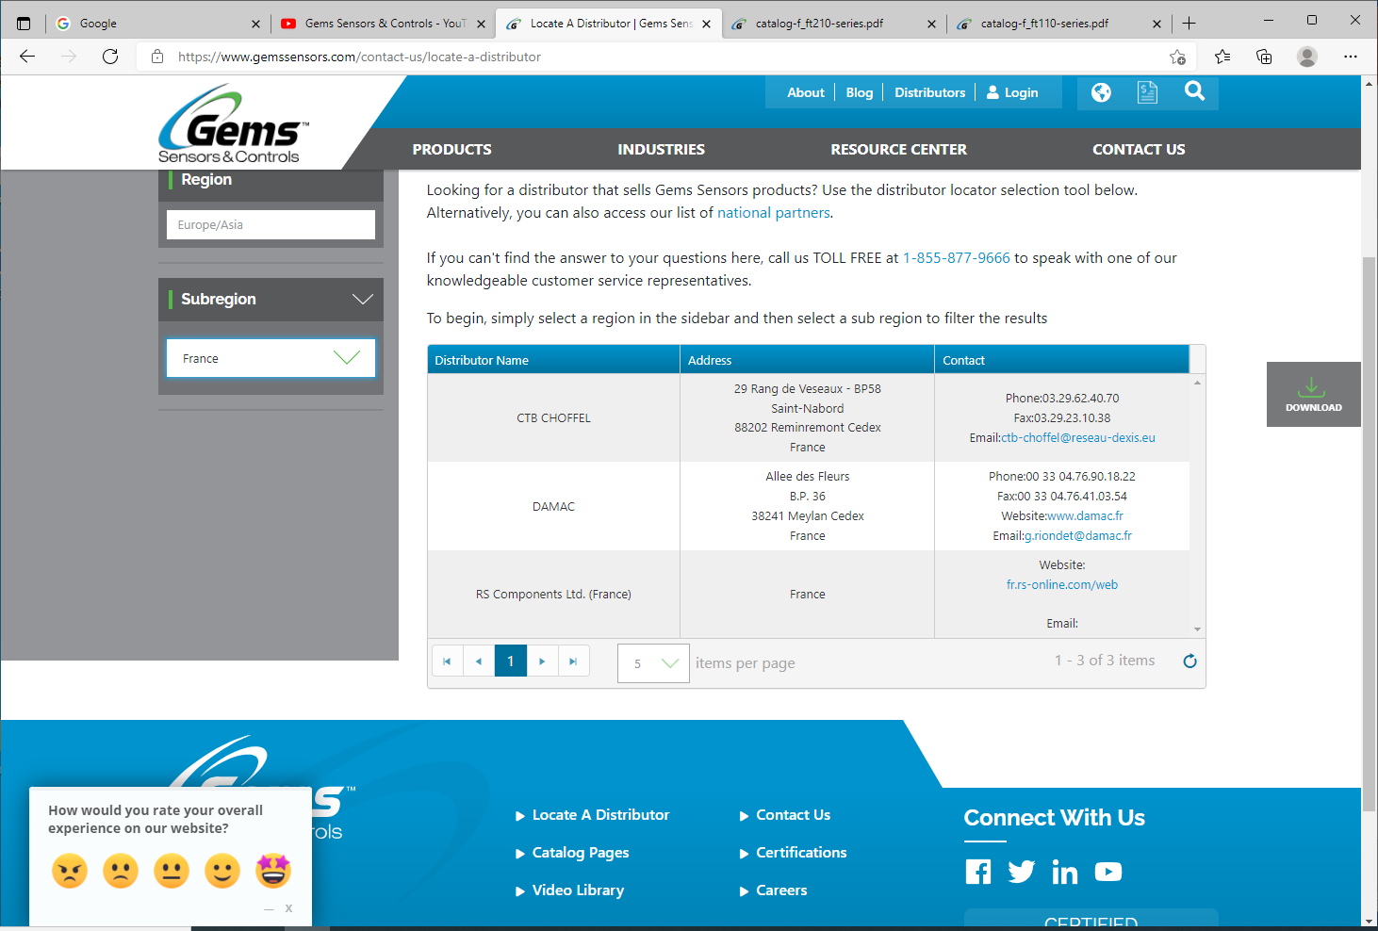
Phone:03.29.62.40.70
Fax:03.29.23.10.38
Email:ctb-choffel@reseau-dexis.eu
Phone:00 33 04.76.90.18.22
Fax:00 33 04.76.41.03.54
Website:www.damac.fr
Email:g.riondet@damac.fr
fr.rs-online.com/web

Slide 5
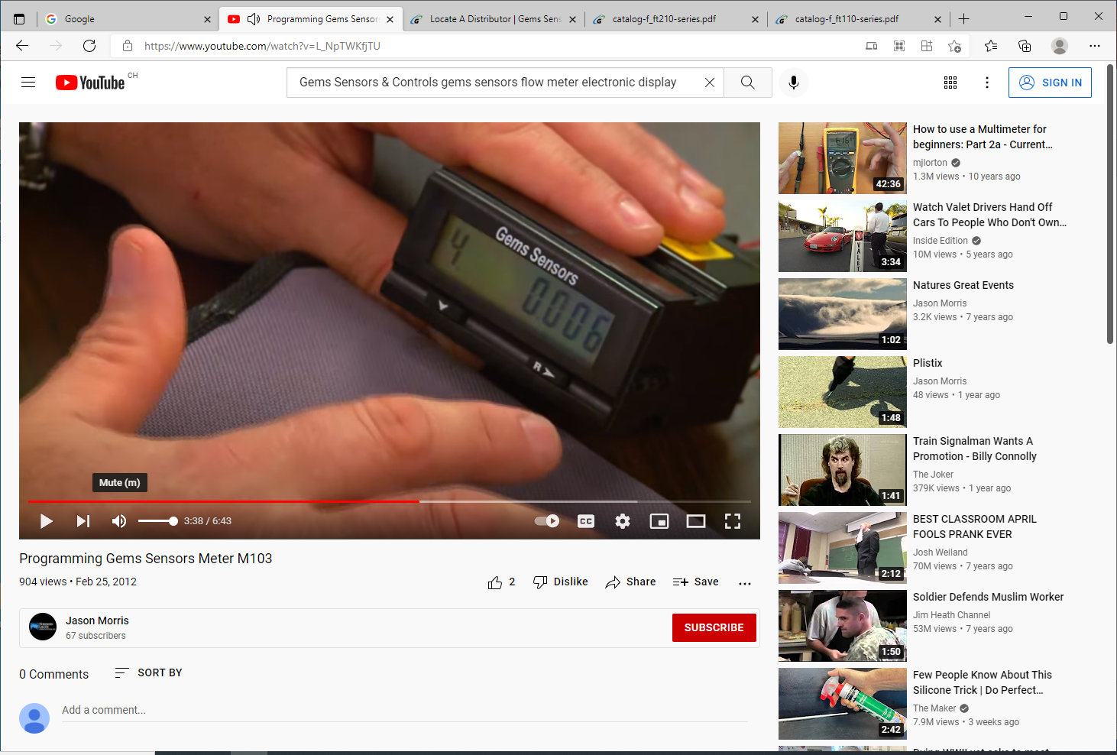
https://www.youtube.com/watch?v=L_NpTWKfjTU

Slide 6
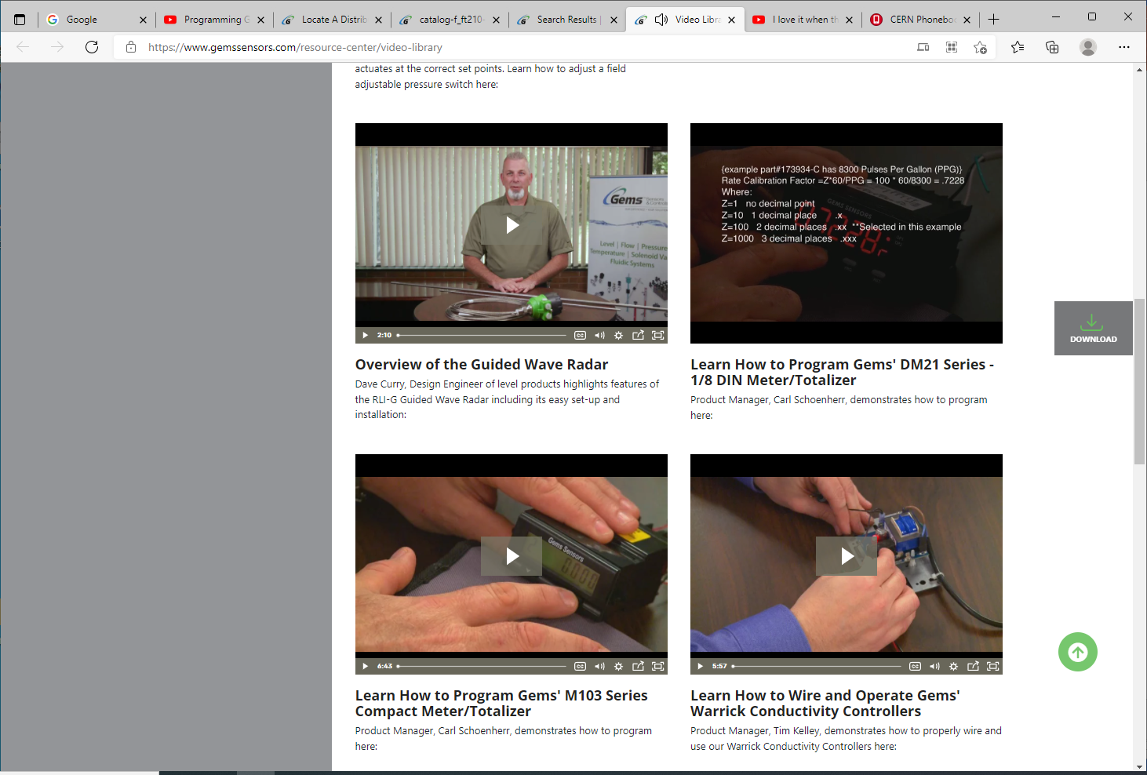
https://www.gemssensors.com/resource-center/video-library
Manual below
https://www.controlcomponents.com.au/Open-File/734/DM21%20-%20manual.pdf
DM-21 meter

Slide 7
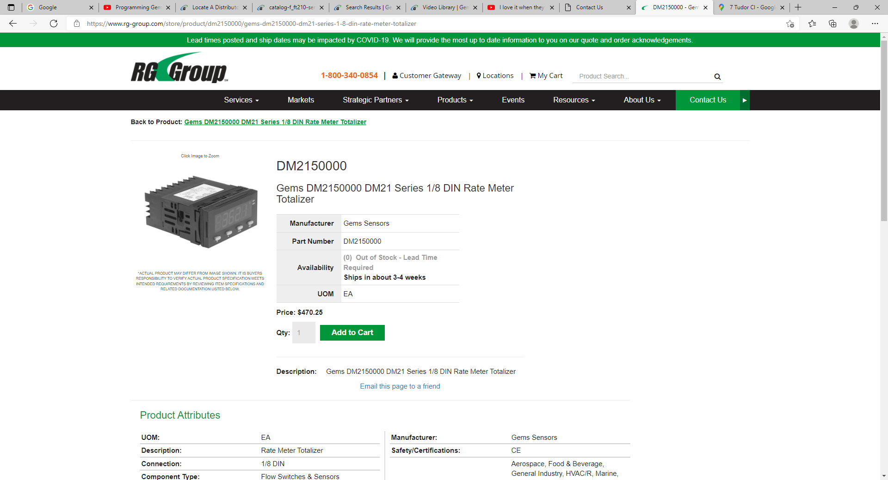
https://www.rg-group.com/store/product/dm2150000/gems-dm2150000-dm21-series-1-8-din-rate-meter-totalizer

Slide 8
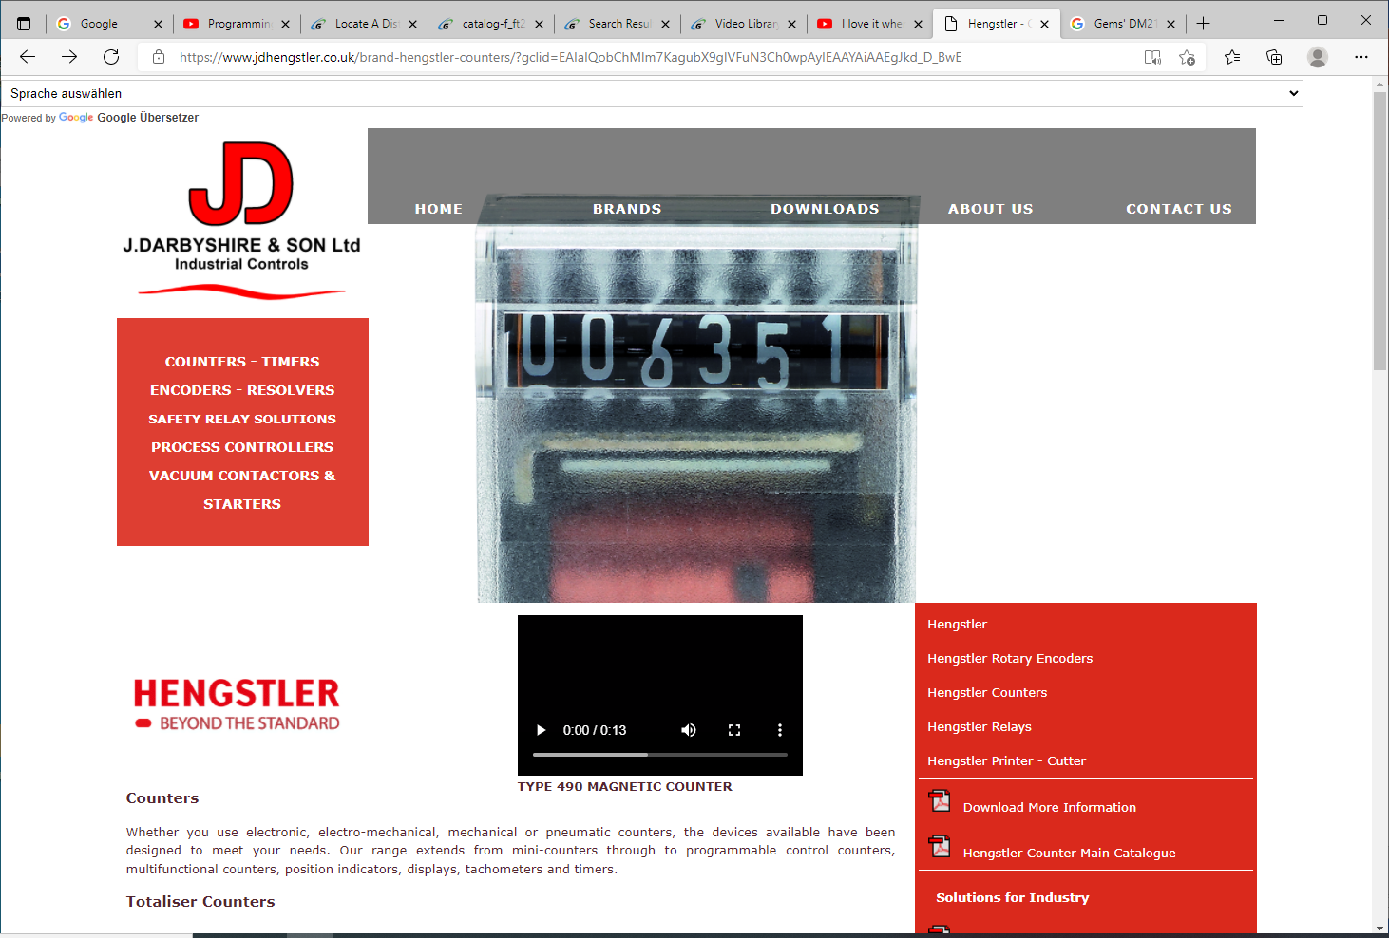
https://www.jdhengstler.co.uk/brand-hengstler-counters/?gclid=EAIaIQobChMIm7KagubX9gIVFuN3Ch0wpAyIEAAYAiAAEgJkd_D_BwE
Sales Contact - Philip John Darbyshire
7 Tudor Close
Poulton-le-Fylde
Lancashire
FY6 7TD
United Kingdom
Tel: +44 1253 893878
Fax: +44 1253 891020
Cellphone: 07947 817591
Email: sales@jdhengstler.co.uk

