Slide 1
Survey targets
YE+3 origin
YE+3 Posts
ME+4
RE+4
ME+4
YE+4

Slide 2
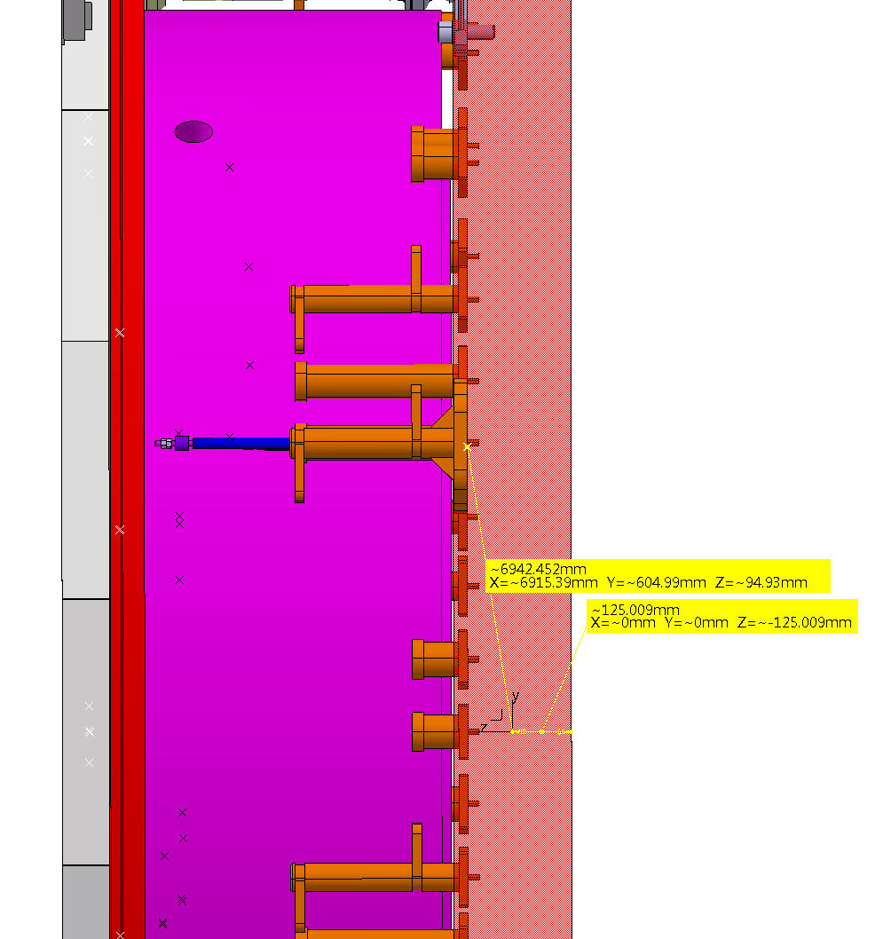
YE+3 origin
Post position
(machined surface)
“This means the origin of the YE+3 coordinate system as at about 95mm from the machined surfaces for the CSC posts on the outer circle on the compression side.” A. Behrens

Slide 3
ME+4202
ME+4202

Slide 4
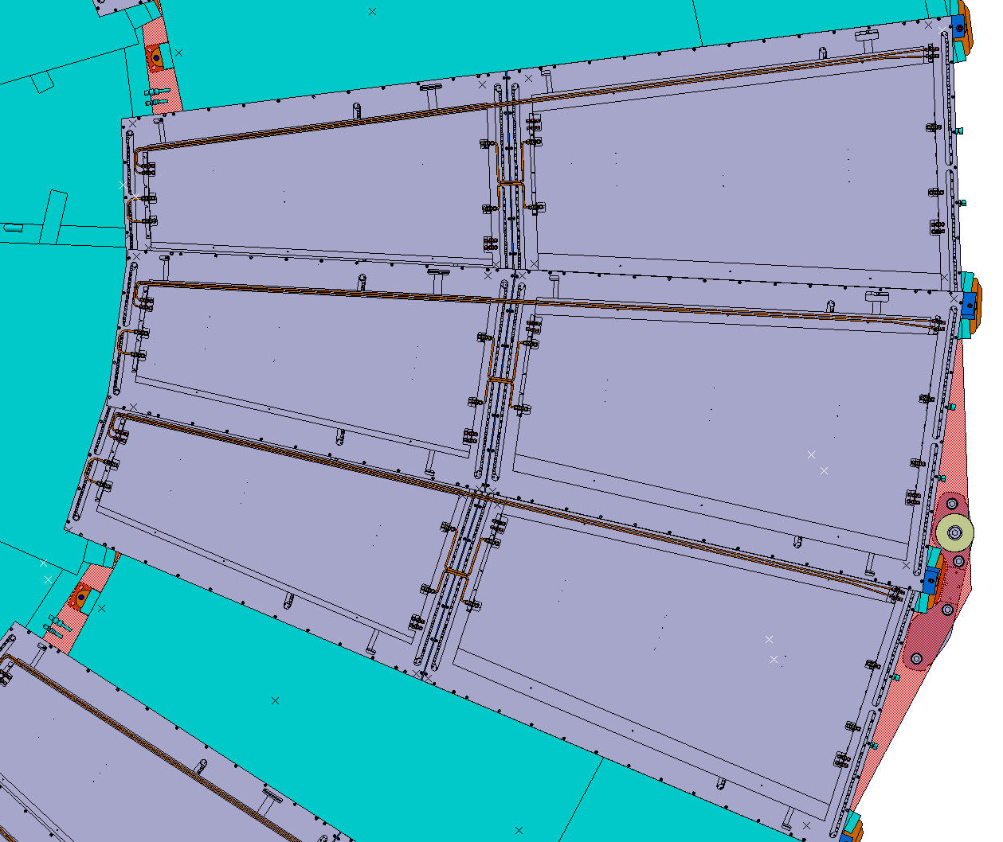
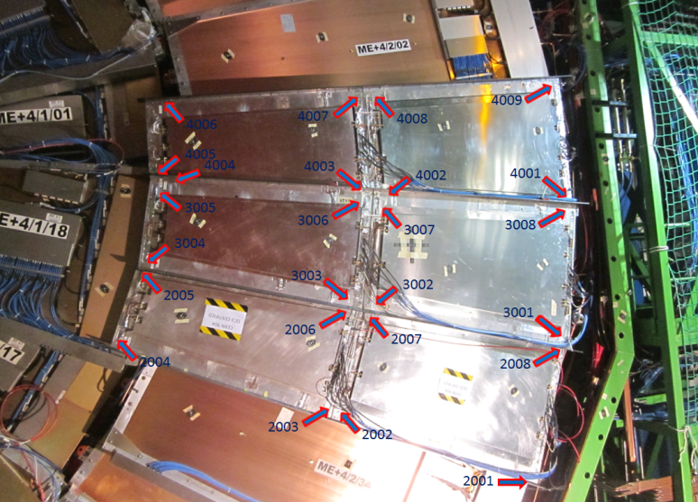
RE+4, test installation

Slide 5
YE+4 position

Slide 6
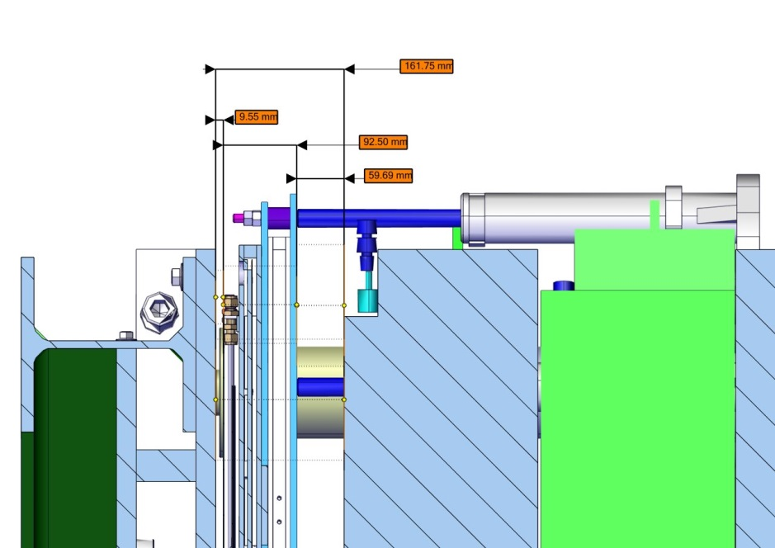
ME+4, RE+4 and YE+4
YE+4 – ME+4
YE+4 – RE+4
RE+4 – ME+4
YE+4
installed
RE+4
nominal
ME+4
installed

