Slide 1

The Multigap RPC
Why do they work so well?
Crispin Williams - INFN Bologna and CERN

Slide 2
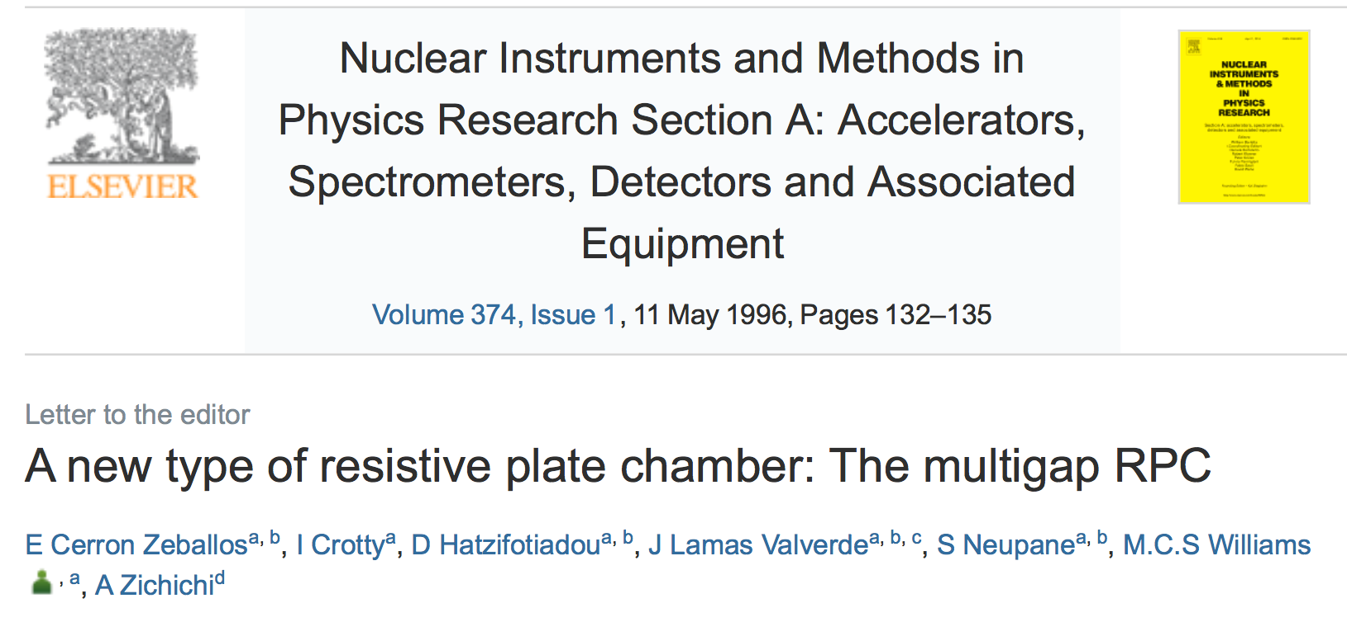
20 years ago the Multigap RPC was born

Slide 3
OUTLINE
A brief outline of the development of the MRPC
      Space charge
Importance of differential readout
MRPC as a trigger device
MRPC with 16 ps time resolution
Summary

Slide 4
The Multigap RPC was born at the ‘95 RPC conference
Rinaldo Santonico explained a critical difference between the ‘wire chamber’
and the ‘parallel plate detector’.
electrons drift and arrive at the wire one after another - depending on drift distance
Example: wire in a tube
b
The signal on the wire comprises of a series
of signals
+ kV
a
c
a b c
but only the first avalanche (produced by first arriving electron) is used for timing measurements

Slide 5
Parallel Plate Chamber
All electron avalanche processes start immediately: the induced signal (due to movement of charge) is the sum of all avalanches: thus all ionisation produced in chamber plays a role.
uniform
high electric field
+ kV
cathode
However: not so clear in practice: avalanche grows across full gap width (this means that only avalanches that originate close to cathode will ever grow sufficiently large to generate a signal).
2 mm
gap
anode

Slide 6
Putting in some numbers:
Set the gain for a single electron to be 10⁸ across a 2 mm gap (just below the transition to streamers)
fast signal/Total charge= 1/αD
fast signal is 800 fC
Now if initial electron is located 0.5 mm from cathode: gain reduced to 10⁶:
fast signal is 8 fC
cathode
0.5 mm
2 mm
gap
anode
Only avalanches that start with some hundreds of micron of cathode will grow large
enough to create detectable signal.
The fast signal created movement of the electrons within 100 micron of anode

Slide 7
Going back to Santonico’s picture
To get these avalanches each producing a detectable signal at the start of the avalanche would require setting the gas gain extraordinary high - sparks,etc
uniform
high electric field
+ kV
Solution: add barriers within the gas gap to
stop development of the avalanche
+ kV
The Multigap Resistive Plate Chamber

Slide 8
MULTIGAP RESISTIVE PLATE CHAMBER
Stack of equally-spaced resistive plates with voltage applied to external surfaces (all internal plates electrically floating)
Pickup electrodes on external surfaces (resistive plates transparent to fast signal)
Internal plates take correct voltage - initially due to electrostatics but kept at correct voltage by flow of electrons and positive ions - feedback principle that dictates equal gain in all gas gaps
Signal electrode
Cathode -10 kV
(-8 kV)
(-6 kV)
(-4 kV)
(-2 kV)
Anode 0 V
Signal electrode

Slide 9
But is the signal from the MRPC due to a larger number of avalanches?
cathode
Reminder: only avalanches that start within some hundreds of microns of the cathode will grow larger enough
2 mm
gap
anode
Surely the same will be true for the multigap - however since the gaps are smaller - avalanches have to start within some 10’s of micron of the cathodes - so again the observed signal corresponds to one or two avalanches??
Question: why does the Multigap RPC work so well?

Slide 10
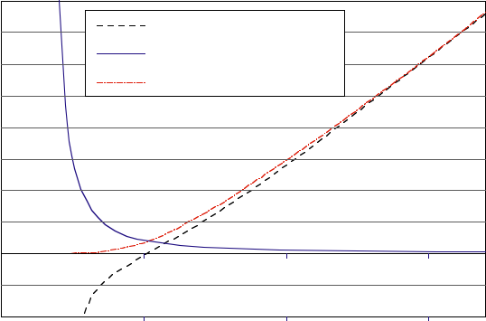
A clue obtained from the Townsend coefficient
Magboltz output for 90% C₂F₄H₂ 5% SF₆ 5% i-C₄H₁₀
400
Effective Townsend coefficient
Coefficient [mm-1]
Attachment coefficient
300
Townsend coefficient
250 micron gas gaps
ALICE mrpc’s operate here
200
100
Standard 2mm gap RPC
0
-100
0
50
100
150
Electric field [V/cm]
N, the number of electrons in avalanche given by: Noe^{αx} α is the Townsend coefficient
α 150 mm⁻¹, gap is 250 μm: 2.10¹⁶ electrons in avalanche when arrives at anode
This gas gain is crazy: so what is going on here??

Slide 11
The answer is space charge
As the ‘avalanche’ grows - every time an ionising collision creates an electron, there is also a positive ion created. Since the positive ion is heavy - it is stationary (in time scale of avalanche formation). The charge of these positive ions reduces the electric field seen by the electrons in the ‘head’ of the avalanche. i.e. Gas gain is reduced - so avalanche grows to certain size and then growth slows down.
-HV
+
+
+
+
+
+
+
+
+
+
+
+
+
+
-
+
+
-
-
-
-
-
+ HV
Low field region due to space charge
Small gas gaps - avalanche is more dense - space charge is more important

Slide 12
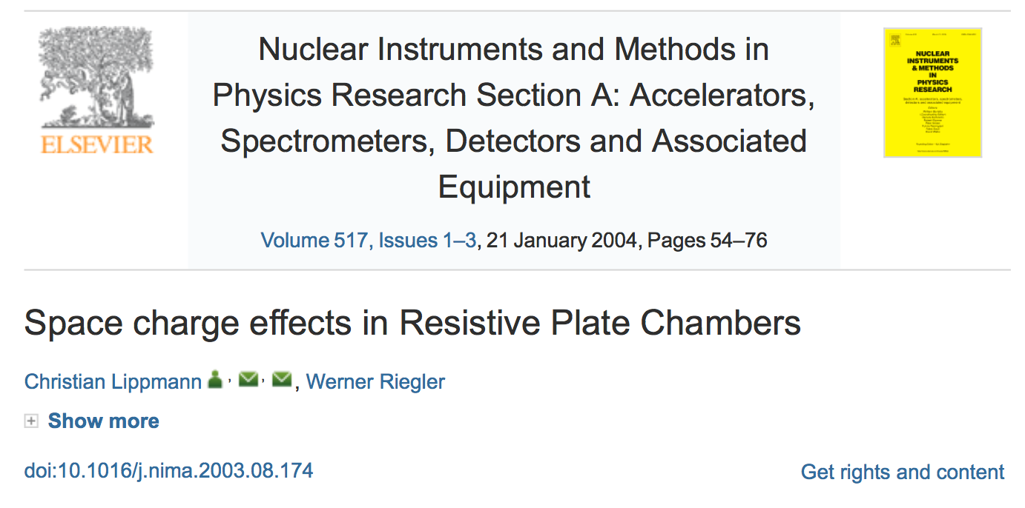
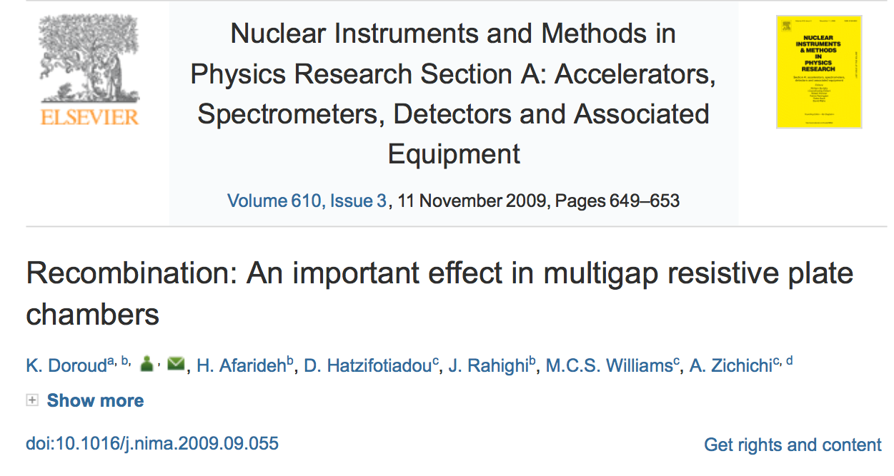
Modelling space charge is non-trivial
A very good description can be found here
An implementation of the Lippmann Riegler paper

Slide 13
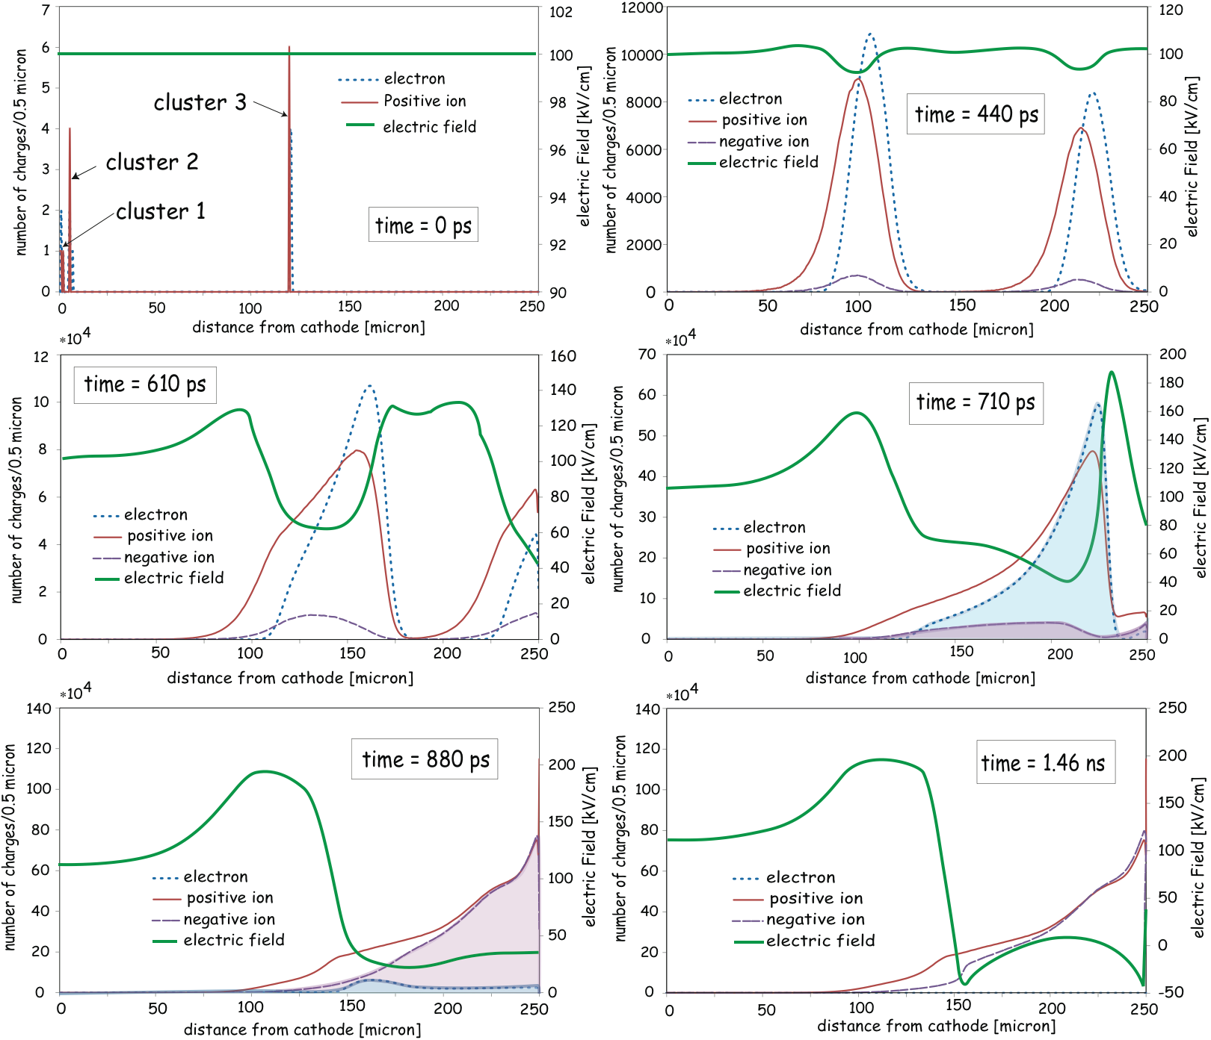

Time dependance of avalanche development
Notes
Avalanche that begins halfway through gap generates a large number of electrons
Electrons present in time 710 ps are captured - and negative ions created by time 880 ps (n.b. attachment coefficient = to Townsend coefficient at 50 kV/cm)
Electric field (100 kV/cm) is completely modified by space charge effects : varies between -40 kV/cm to 200 kV/cm

Slide 14
So what have we learned?
250 micron gaps - avalanches that start 100 micron from cathode can give observable signal: so, as an example, a 10 gap MRPC with 250 micron gaps will have signals from 7 or 8 gaps
Avalanches grow to ~ 10⁷ electrons - then space charge kicks in - stops growth
    Big suppression of ‘streamers’
    gain only weakly dependant on gap size (electric field)
😀
😀
Large amount of ions (negative ions from electron capture and positive ions since gain is so high)
    expect fast signal/total signal to be low and MRPC to be more sensitive to rate effects
😟

Slide 15
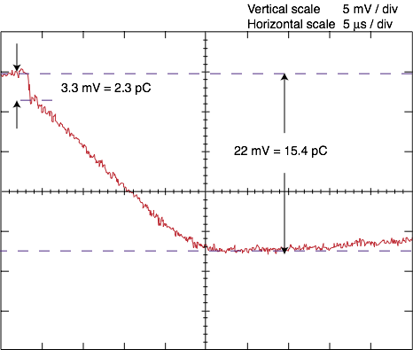
Reminder:
cathode
largest part of signal is generated by positive ions drifting back to cathode
RPC
High impedance
anode
Fast signal: electrons
move towards anode
Slow signal:
positive ion
cloud moves away
from anode
fast/total = 3.3/22 = 15 % in this case
2 mm gap RPC

Slide 16
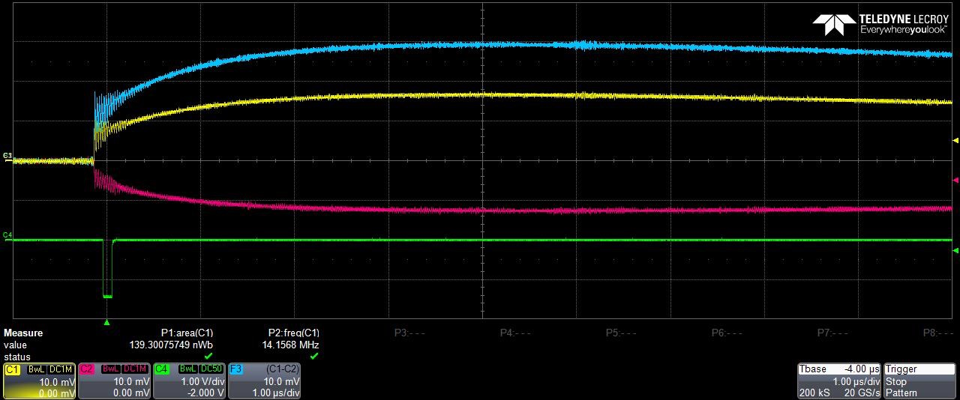
MRPC
fast/total =10/30 = 33%
Fast/Total has high value: no obvious production of extra ions… ??

Slide 17
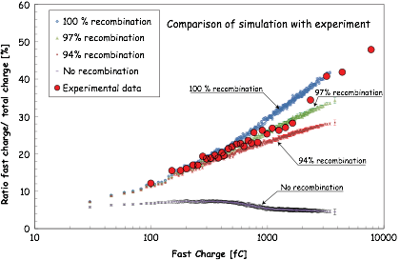
Recombination of positive and negative ions
Fast signal/total charge = 1/aD : around 5% for normal 2 mm gap RPC
Recombination very important effect - most negative ions recombine and do not drift to anode

Slide 18
The Multigap
In reality - the signal is the combination of many small avalanches, but
only because of powerful space charge effects
  allows avalanches that start half way across gas gap create detectable signals
  limits gain to < 10⁸ - and thus has long streamer free plateau
  low dependance of gain on gap size (electric field)
  many extra positive and negative ions produced in avalanche - but they recombine and do not flow through resistive plates- thus does not degrade rate capability

Slide 19
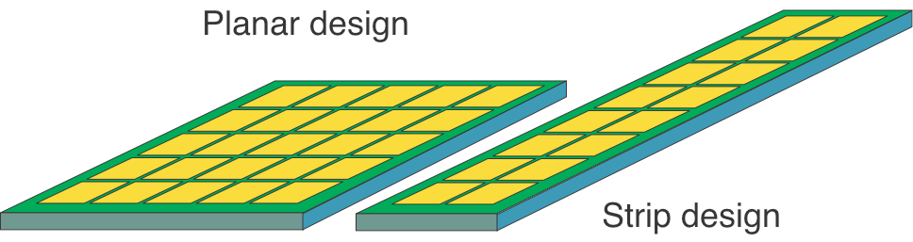
Importance of differential readout
During the initial R&D phase for the ALICE TOF, we considered two geometries for the design of the chambers for ALICE TOF: the planar and the strip

Slide 20
front end electronics
R 50Ω
Induce opposite charge
A current flows from one plate - through the front-end electronics and back to the other plate

Slide 21
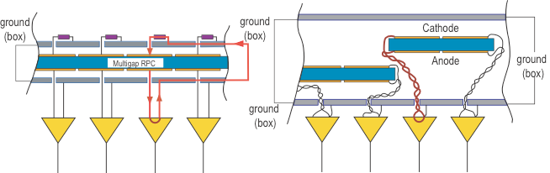
Alice R&D
Planar chamber uses outside box for signal return
Strips allow access to both anode and cathode

Slide 22
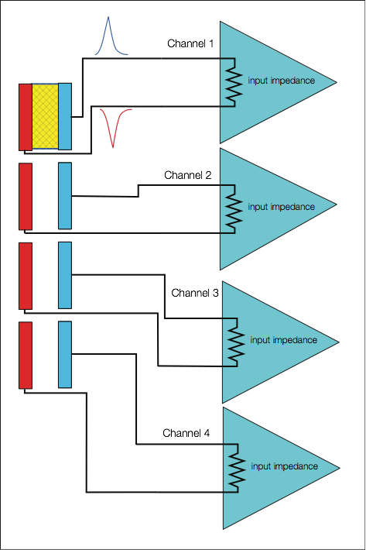
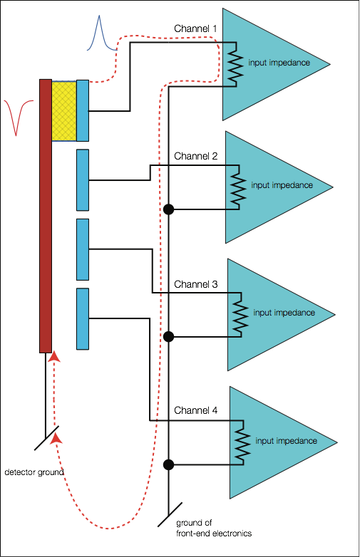
Differential Single-ended
With the single-ended readout: fast current pulses are fed into the common ground; that is the reference level. This is an important source of ‘noise’ and cross-talk. This is especially true when precise timing (< 100 ps) is the goal.
σ t = σV/(dV/dt) dV/dt ~ V/tr σ t =tr/SNR
i.e. Time Jitter ~1/SNR

Slide 23
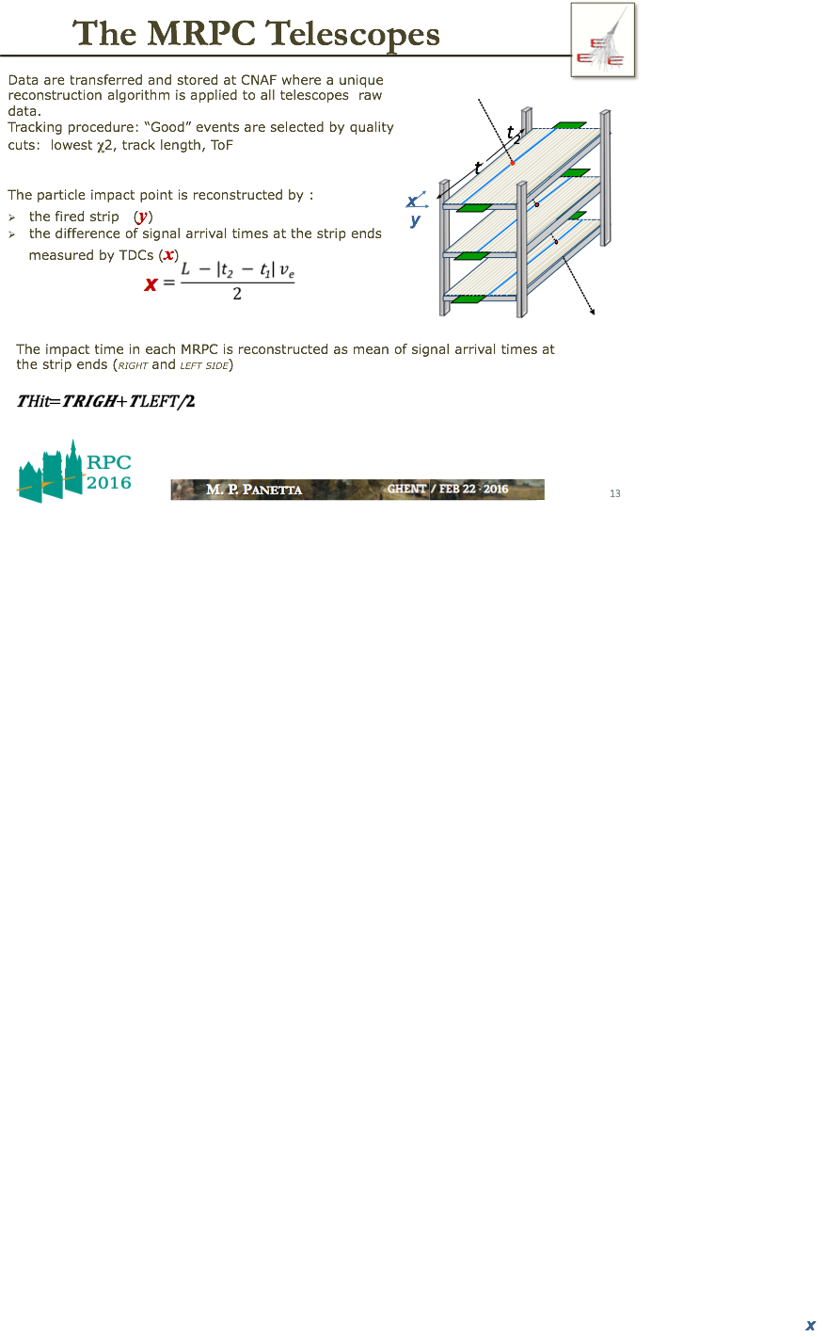
MRPC as a trigger device
Borrowing one slide from Maria Paola Panetta’s talk

Slide 24
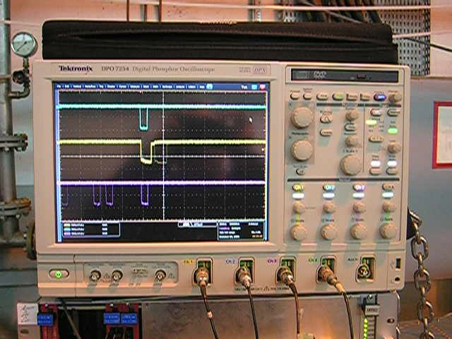
Top chamber
Middle chamber
Bottom chamber
24￼

Slide 25
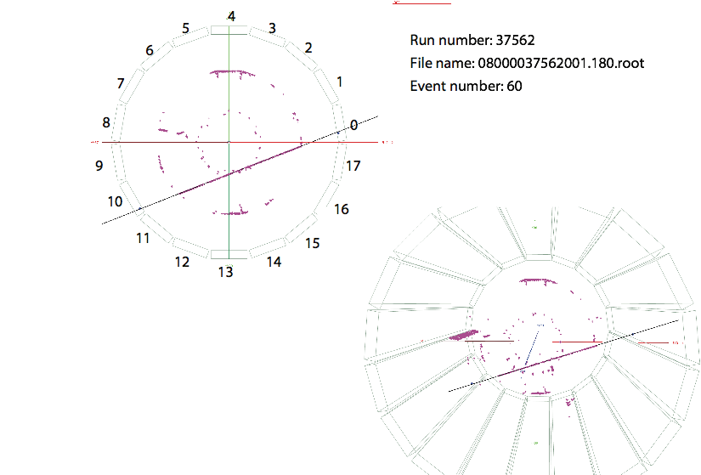
Cosmic ray trigger for ALICE
Preferred cosmic trigger for ALICE
10 Hz trigger rate: 50% purity
dark count rate:
~ 0.2 Hz/cm²
dark current of ALICE TOF:
10’s nA/m²
Low gas flow - and minimal ageing concerns
Just two hits in 150 m² barrel detector

Slide 26
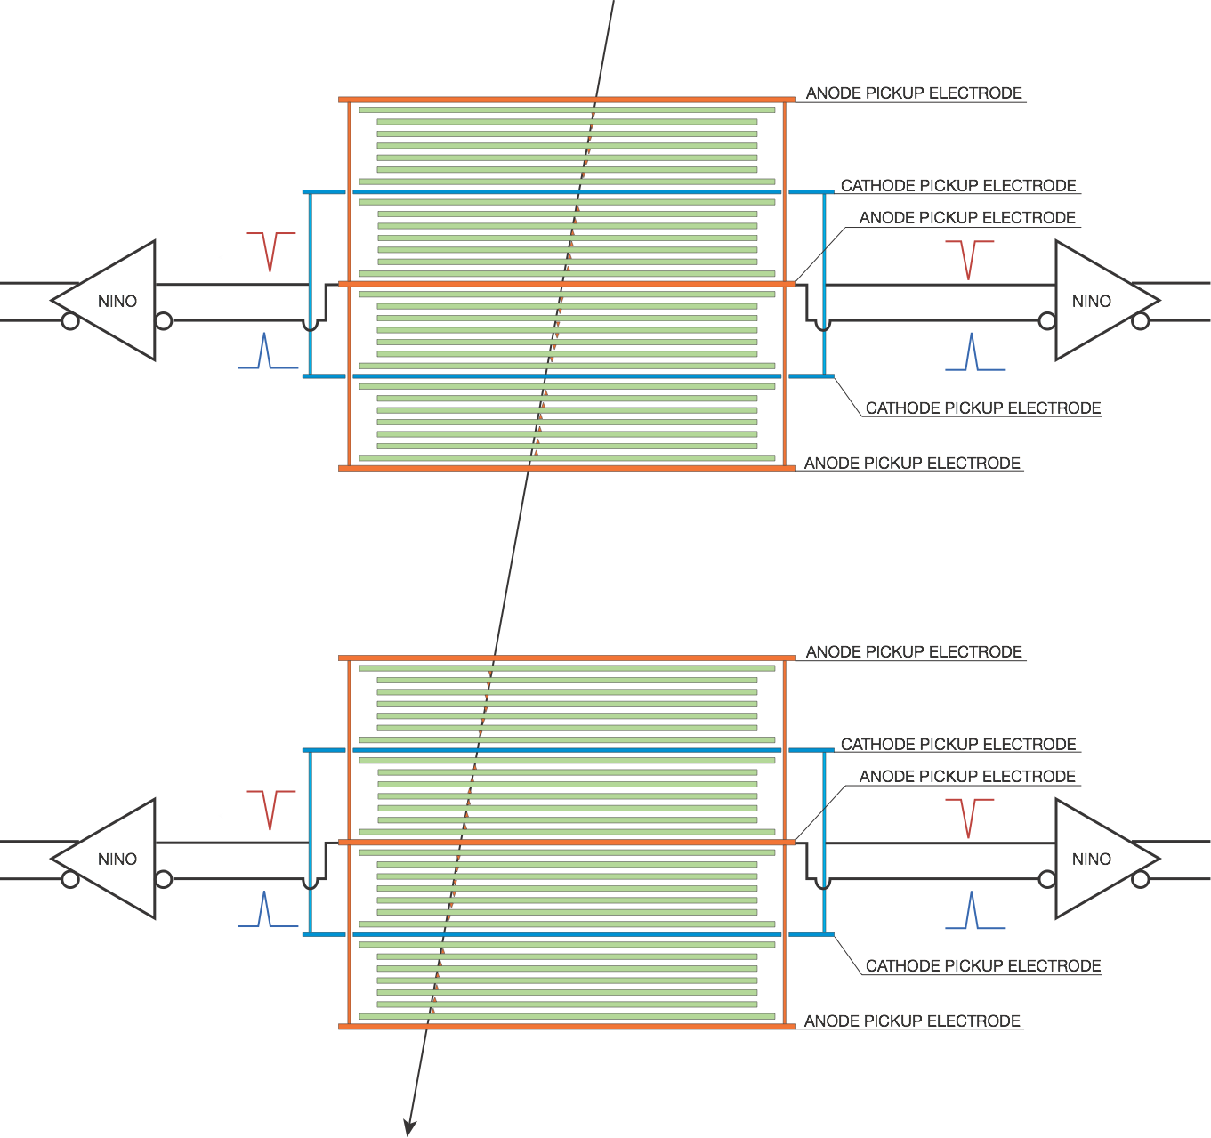
The future…. sub 20 ps?
24 gap MRPC each gap 140 micron

Slide 27
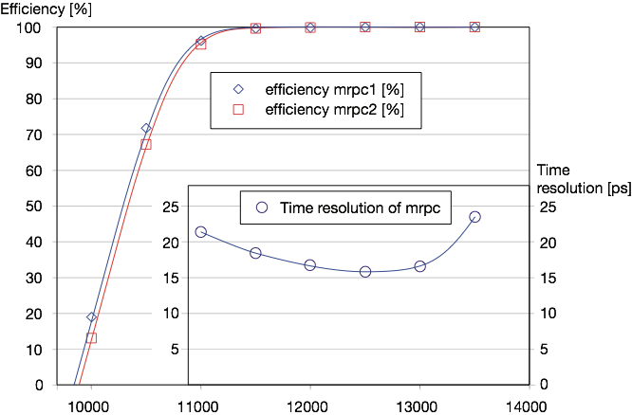
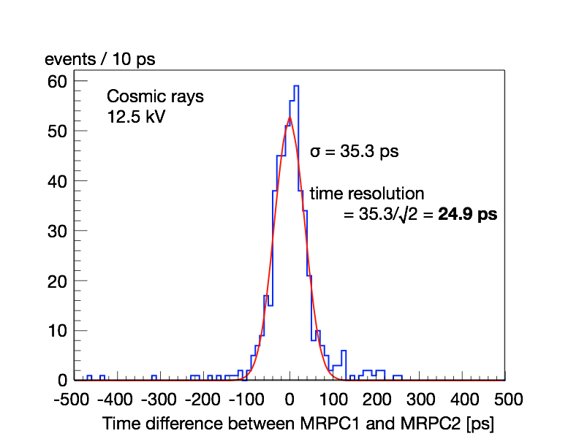
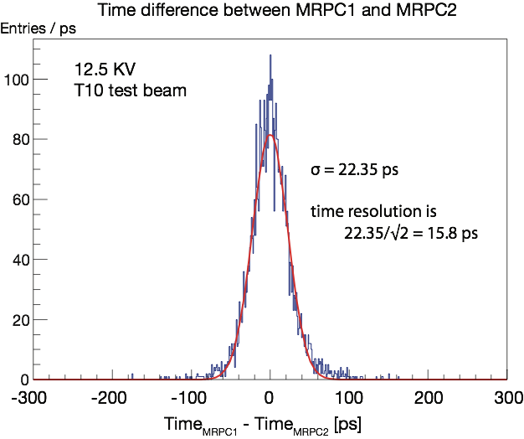
results
T10 test beam
Cosmic ray

Slide 28
Summary
Signal from MRPC is really due to many small avalanches happening in ‘parallel’ (i.e. in time with one another)
BUT only since space charge becomes a dominant effect for small gaps
Space charge suppresses streamer formation and reduces dependance on field strength
Extra ions produced are eliminated by recombination
very low dark count rate, low dark current and low consumption of gas
Differential readout essential for precise timing
Resistive layer : keep the resistivity above 1 MΩ/square
Future: low resistivity glass - etc will allow operation up to 100 kHz/cm²
TOF array with 10 ps timing is a realistic goal

Slide 29
Thank you for your attention

