Slide 1


Status Summary: Estimation of Radiation Levels for the Pixel Insertion in (E)YETS 2016/17 and Residual Radiation Measurements:
YETS 2015/16
S.Mallows on behalf of BRIL Rad Sim
Includes Results and contributions by H.Vincke & I.Bergstrom
(HSE/Radiation Protection Group)

Slide 2
Overview
  Review of status at December meeting of simulations of radiation levels for Pixel Insertion EYETS 2016/17
  https://indico.cern.ch/event/468103/
Summary follow-up work/simulations performed since December
Recent Measurements of residual radiation (YETS 2015/16)
  Gamma Ray Spectroscopy
    N. Beni, Z. Szilasi, S.Mallows,
  Ambient Dose Equivalent Rates: H*(10)

Slide 3
Dependencies: Residual Radiation Estimates
FLUKA Code itself
  In general very well benchmarked for activation with hadronic cascade
    Some issues with isomer production
CMS Model for Prompt Field
  Correct modelling of total mass in regions
  Correct hydrogen (moderating) content for thermalising neutrons
  And, of course - All settings incl. the collision source (DPMJET-III )
CMS Model for Decay Radiation
  Material compositions (e.g. 1% impurity can be responsible for 99% of activity)
Normalization & Luminosity Assumptions
  Total luminosity and time distribution of luminosity. In general:
  Long-lived nuclei - longer cooling times: depend on total luminosity
  Short-lived nuclei - shorter cooling times: depends on instantaneous luminosity

Slide 4
Rad Level Estimates for Pixel Insertion EYETS 2016/17
Review of December Meeting
Simulations with updated Tracker in CMS FLUKA model + SESAME Tool (for open configuration)
Predicted Ambient Dose Eq. Rates, H*(10), higher than expected (considering measurements by S.Bally in LS1)
LS1 simulation (identical model, but LS1 settings) & measurement comparison found here: https://indico.cern.ch/event/468103/ , I Bergtrom.
  Good agreement near beampipe, not so good at larger radii
  https://indico.cern.ch/event/468103/
  for zooms and 1d plots
H*(10) [uSv/h]
Heavy Ion Run is considered as cooling time. EYETS day 1 is 40 days since PP collisions in FLUKA simulations
I.Bergstrom HSE/RP

Slide 5
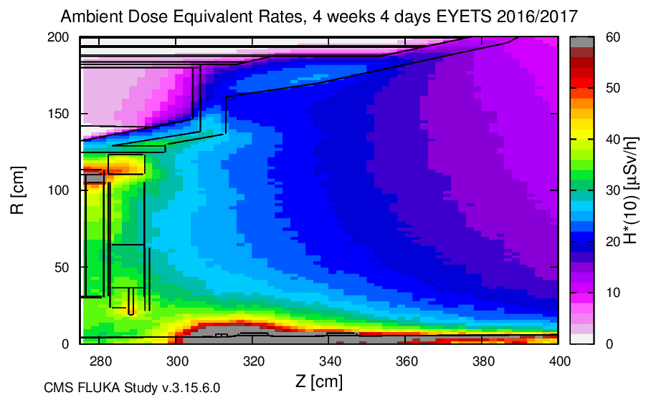
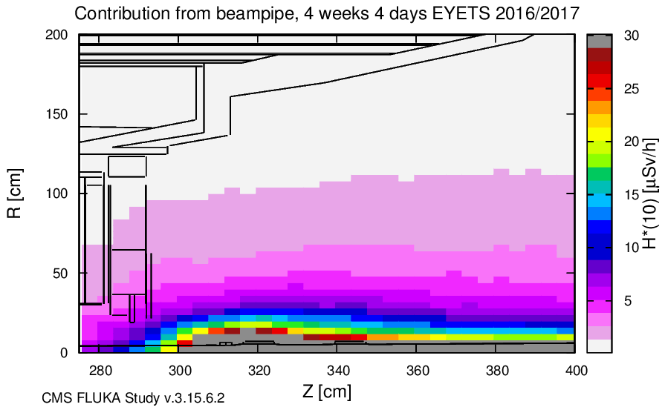
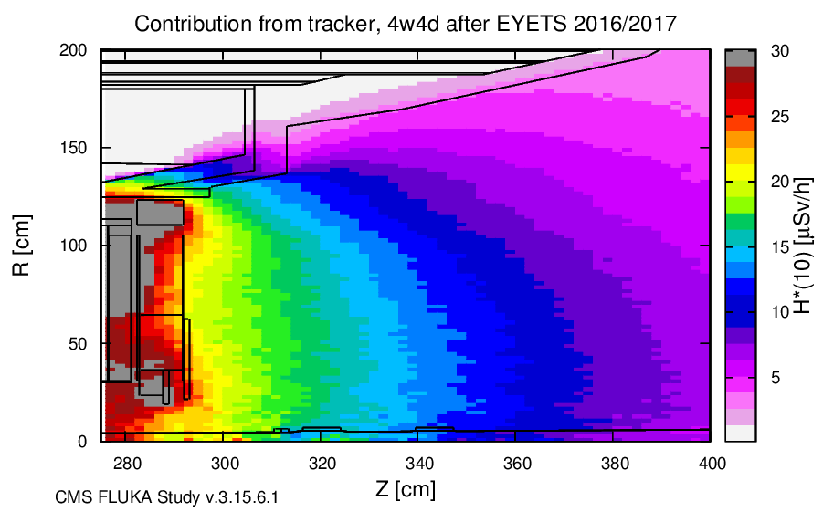
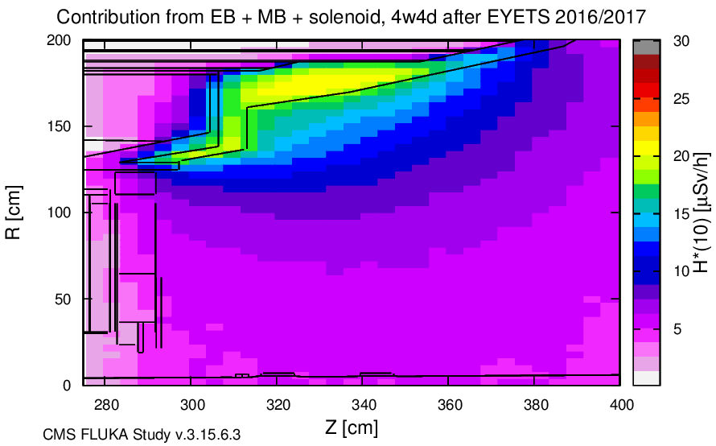
Contributions from Individual Components
Review from December Meeting
T cool: EYETS 2016/17Day 33
All
ALL
Beampipe Only
Tracker
Tracker
Only
EB, MB, HB, Solenoid Only
Main Contribution from Tracker and BH at ~ 30<R<120cm
Plots by L.Gloggler

Slide 6
Conclusions & Follow-Up
Review from December Meeting
I. Bergstrom, HSE/RP
RATIO PLOT
without/with shield at 3.3m flange
FLUKA estimates beampipe activation okay
Beampipe shielding (extended) required at ~3.3 m
HF beam pipe contribution should be addressed (extend shielding/limit stay)
Bulkhead shield study performed by L.Gloeggler (not feasible for use in EYETS 2016→ redo study for LS2)
Key Follow Up Points:
Investigate further Bulkhead contribution to dose rate
  Material check and make further simulations for residual nuclei / Gamma Spectra - identify main contributing nuclides
Investigate cable hotspot region
  Extensive material check already in process I Kurochkin
Profit from Benchmark Measurements in YETS 2015/16
  Gamma ray spec and H*(10) detailed map near bulkhead
Contribution from heavy ion run, in case of Pb-p collisions?
  Simulations recently performed. Please contact Heinz Vincke/Ida Bergstrom for HSE/RP group results
H*(10) Dose Rates: with shielding at 10.7m flange
I. Bergstrom, HSE/RP

Slide 7
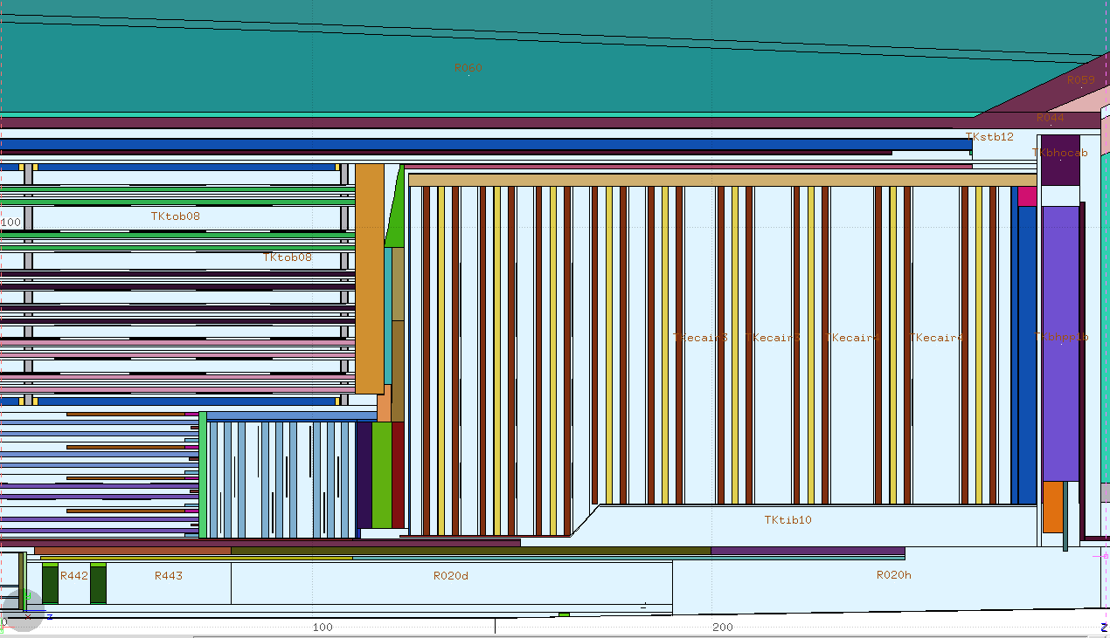
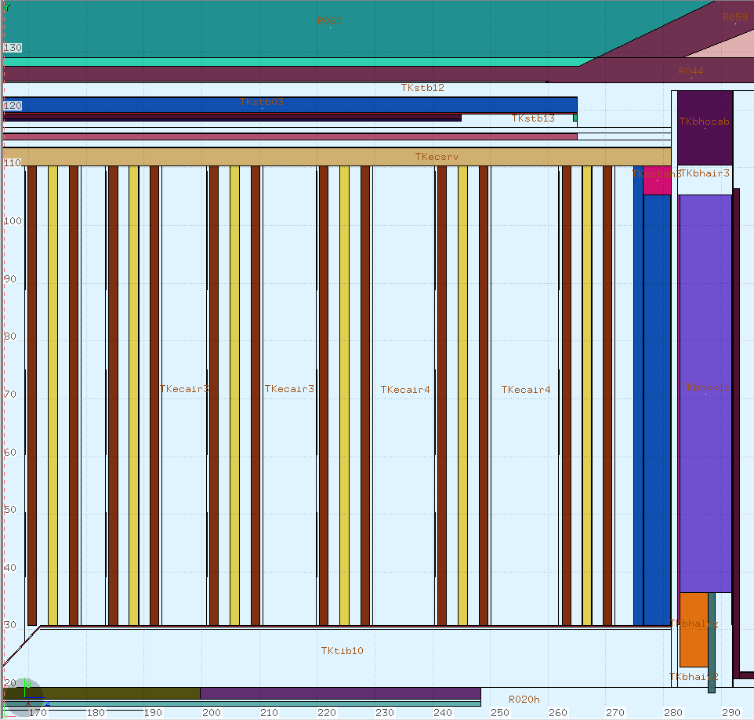
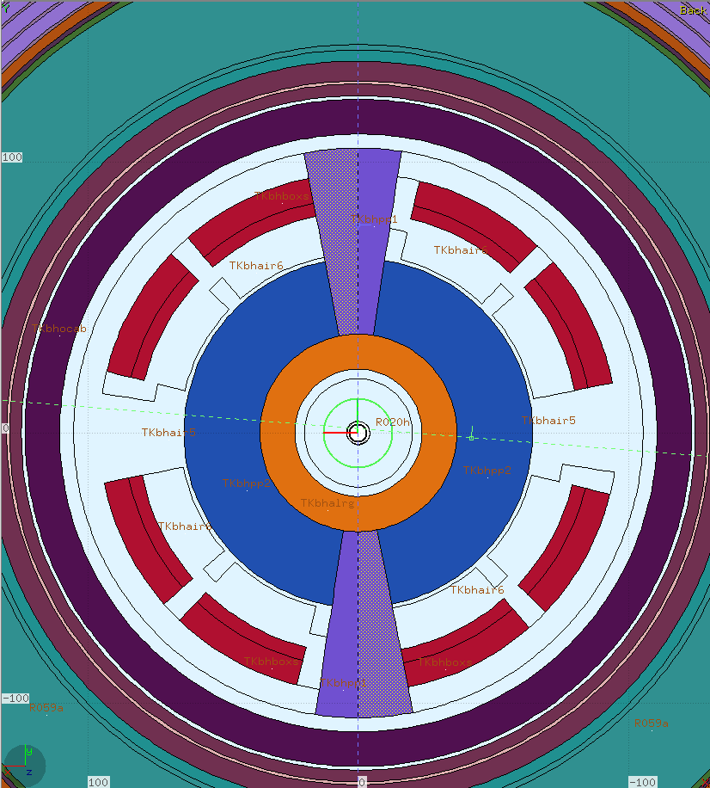
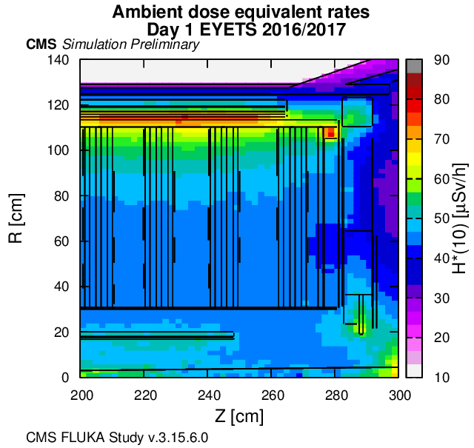
Tracker Model in FLUKA - Material Check
The current CMS FLUKA TK model is based on material budget for Phase I as in CMSSW
  Bulkhead Regions - material taken directly from GEANT 4 model.
I.Kurochkin, N.Bacchetta, check: CMSSW material budget implemented to FLUKA – no faults
However - GEANT 4 /TK model itself may not contain correct material description.
Excess cobalt (2.8%) in “Inconel” used in GEANT4 models. There should be no cobalt (apart from very small trace amounts with nickel)
~200g of cobalt in the thermal screen region should be removed (&10g Cobalt in nose)
& Add trace amounts where there is Nickel..?
Conclusion: We can make minor improvements (as with any region) but this is unlikely cause of simulation/measurement difference
Tracker Model by Igor Kurochkin:
https://espace.cern.ch/cms-project-bril/SitePages/v.3.9.0.0.aspx
https://indico.cern.ch/event/386582/

Slide 8
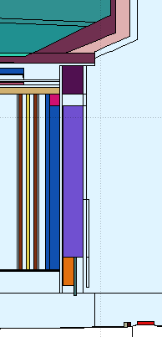
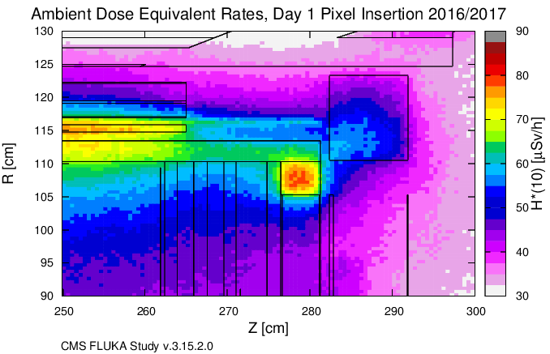
Identification of contributing isotopes
Residual Nuclei (example hotspot region)
material composition:
carbon 19.9%
copper 49.1%
oxygen 0.6%
hydrogen 2.8%
silicon 0.2%
iron 2.6%
aluminum 12.4%
silver 1.7%
fluorine 10.7%
Most active isotopes in material:
  ¹¹⁰Ag (incl. isomer)
  ⁶⁰Co
Hotspot: bulkhead
outer cable region
Plot by L.Gloggler

Slide 9
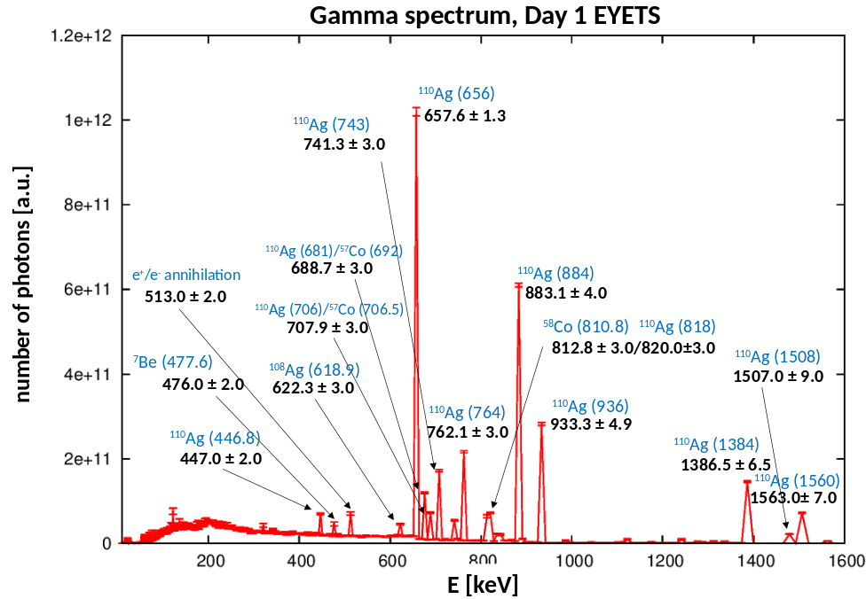
Identification of contributing isotopes
Gamma Spectrum (near example hotspot region)
FLUKA
Boundary
Peak Identification:
Work in Progress
Plot by L.Gloggler
Boundary crossing from air to air at Z=297.3cm and 102 cm < R < 123.3 cm
Day 1 EYETS 2016/2017: Gamma energies consistent with Ag -110m decay

Slide 10
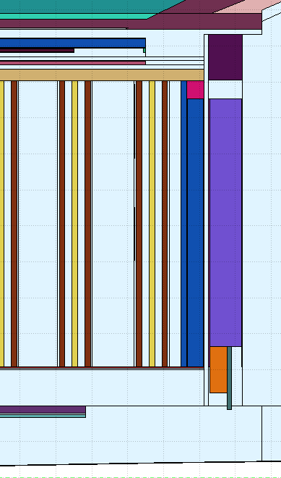
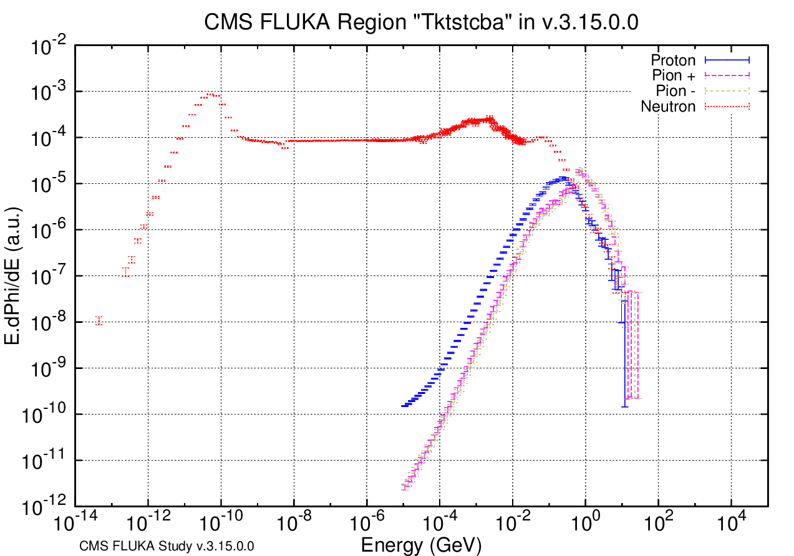
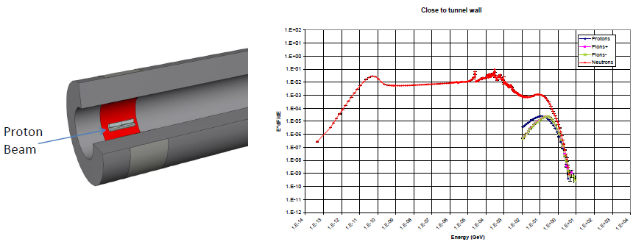
Identification of contributing isotopes
Actiwiz – RP tool (Ida Bergstrom RP)
Advantage: provides info about source, i.e. identifies responsible element in material
Input: prompt spectra, from database + exact material composition for region + irradiation period approximation
Actiwiz Results example:
  From Cable Axial region: Silver Isomer Ag-110m is top contributor (~95%) * or significant contributor*– Production 100% from silver.
  From Pixel Cable Region: contributors* ⁵⁸Co, ⁵⁶ Co, ⁵⁴ Mn. Production of each nuclide from various elements (e.g. ⁵⁴Mn production from iron, copper & manganese etc.)
The results & explanations from Ida/RP helped with understanding on production of various nuclides in hotspot region.
Key Message Ag-110m seems to be main contributor from certain hotspot regions
CMS FLUKA: Bulkhead region –
Axial Cable
Spectrum:
PROMPT FIELD
Actiwiz database example
Close to tunnel wall
*depends on which particular ActiWiz spectra.
- ignoring self-absorption, geo effects
At the moment database is for accelerators only.
ActiWiz 3 will be adapted for CMS experiments

Slide 11
Silver 110m Isomer and FLUKA
FLUKA (and ActiWiz 2) uses 1:1* branching ratio for production of isomeric states
However in FLUKA development version (and ActiWiz3), amongst other changes
  New, more exact isomer production model for isomers created by low energy neutrons (<20MeV) based on JEFF activation
Silver half life info:
  110-Ag : 24.6 s
  110m-Ag : 249.9 days
→ Over production of silver isomer in simulations could lead to overestimates activity in cable regions at relevant cooling times
Quick simulation (not SESAME set up) with Development versus Current FLUKA
(v.2 011.2c.3) by I.Bergstrom:
  Activation in outer tracker and cable regions reduced with devel. version:
  Near bulkhead, day 1 EYETS: reduction in H*(10)by a factor of 2-3 at R~1m, no significant reduction close to beampipe.
Full SESAME simulations will be performed with development FLUKA as soon as possible
(*) 1:1 for 1 isomeric state, 1:1:1 for 2 isomeric states, etc. etc.

Slide 12
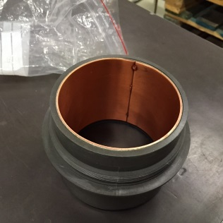
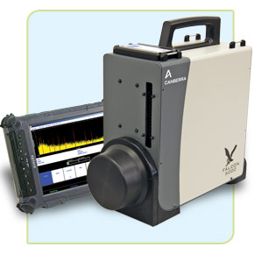
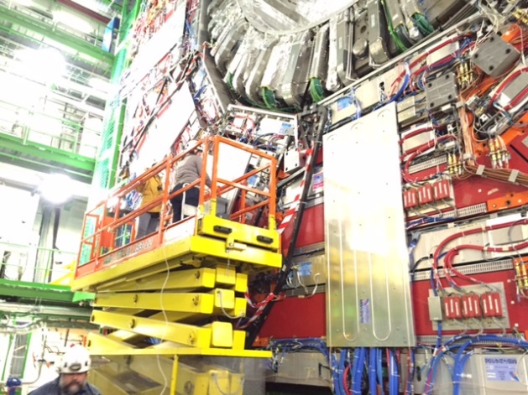
YETS 15/16 Gamma Ray Spec Measurements
Falcon 5000 - Germanium Detector
  Requires cooling (5hrs minimum)
  Good resolution: 1-2 keV up to 1 MeV
  Portable, but heavy (~20 kg):
    measurement/locations require planning
  With additional collimator:
    angular acceptance ~ 45 degrees (based on quick tests with source January).
  Further more extensive characterization is planned in coming weeks
Measurement Locations in Cavern
  18 separate measurements at different locations, and with various shielding scenarios [S.Mallows, N.Beni, Z.Szilasi]
  Locations include:
    Tracker bulkhead
    Beampipe bellows at ~3.3m
    Cable regions on ES
  2 example spectra shown here
collimator

Slide 13
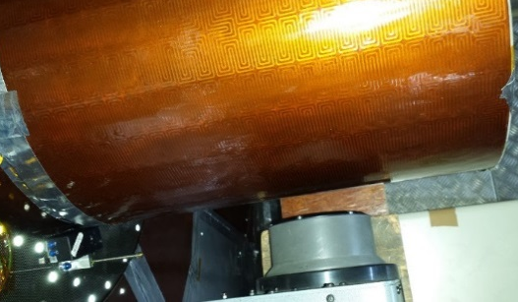
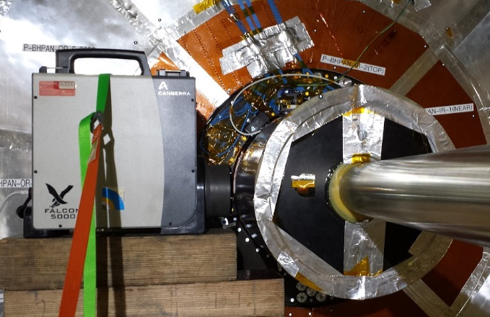
Beampipe, Z = 3.33m
18 reference slides (as below) and corresponding spectra [plots and raw data] have been prepared and will be added to sharepoint:
nose
4 cm
nose
Date: 01/02/2016
Original Filename (FALCON):
  UXC/20160201/BeamPipe_2
Text data File on SharePoint: /cern.ch/bril/SitePages/RadMeasurements.aspx
Live Time:600s
Dead Time:
CMS Scenario:
  ECAL Endcap Front face ES at 8.8m
  No additional shielding
  Nose in place
Location - Front face Falcon collimator in CMS FLUKA Coord System:
  X: -27.0
  Y: 0.0
  Z: 333.0
Orientation: Towards Near (+)
4 cm
27cm
Y
Y
+Y
Z
+Y
X
40 cm
nose
falcon
27cm
+ Z
- X
Z= 293cm
Bulkhead

Slide 14
YETS 15/16 Simulations
Simulations with FLUKA/SESAME and the spectra analysis very much work in progress
  The existing ‘prompt step data’ with fluka2011.2c (NB version with Isomer issues) has same settings as EYETS 16/7 pixel insertion simulations
  → Use this to make some quick ‘decay step’ simulations performed for YETS 15/16
  Need further characterization of Falcon to make better representation in decay step
  ‘Benchmark’ irradiation profile formed for 2015
  2 examples given alongside meas. data in following slides
Further simulations planned:
  Gamma Spectrum at all locations
  Better representation of Falcon
  Exact cooling times
  With and without FLUKA development version

Slide 15
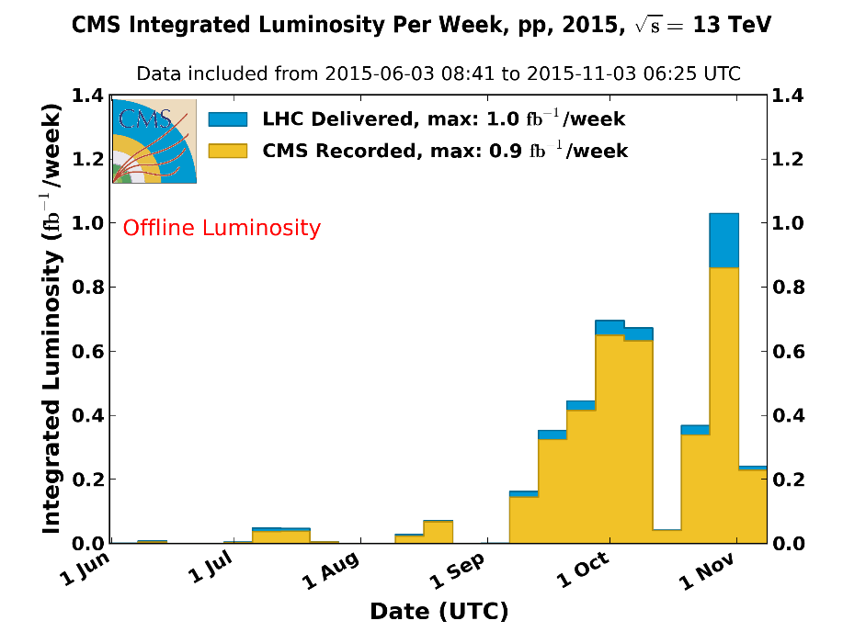
Simulations – Irradiation Profiles
Standard Irradiation Profile and Lumi assumptions finalised by HSE /RP Group
Implemented in FLUKA as continuous P-P collisions in the end of each period, assuming
75% expected peak lumi at
80 mb inelastic cross section 2015
75 mb inelastic cross section in 2010-2012
Benchmark Profile for 2015 (tag ‘BM2’)
  S.Mallows
Extract Lumi data – “Normtag1 “
Relevant Cooling times ~12 weeks
Integrated delivered LHC lumi per week – convert to FLUKA as continuous P-P collision rate for each week
Total lumi 4.22 fb⁻¹
Assuming 80 mb inelastic cross section 2015
Year | Integrated lumi [fb⁻¹] | Instant. Lumi [cm⁻²s⁻¹]
2010-2012 | 30 | 0.8 E 34
2015 | 4 | 0.63 E 34
2016 | 34 | 1.4 E 34
Lumi Assumptions for a ‘standard’ FLUKA irradiation profile for EYETS 2016/17
Remove 2016 for YETS 2015 simulations

Slide 16
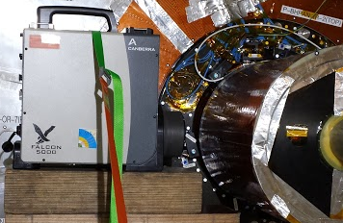
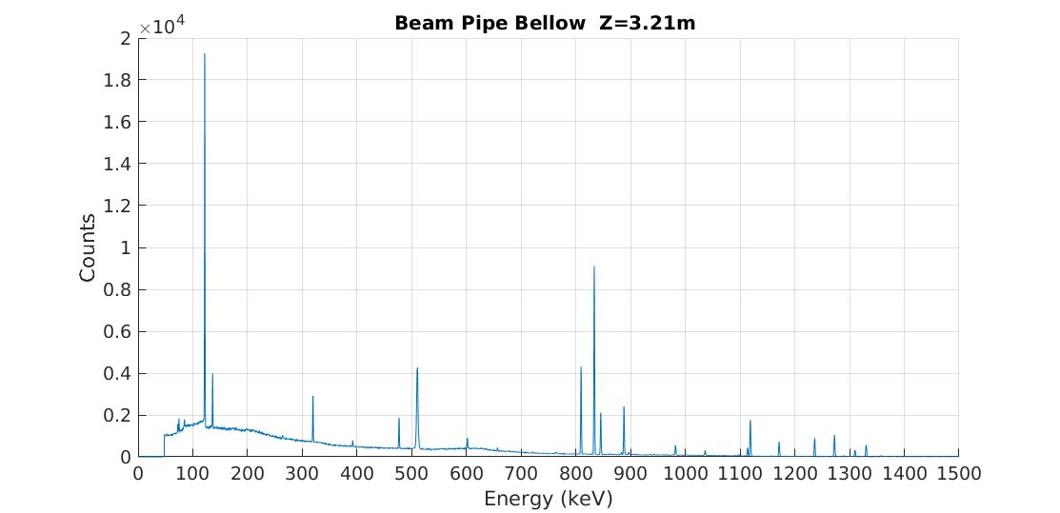
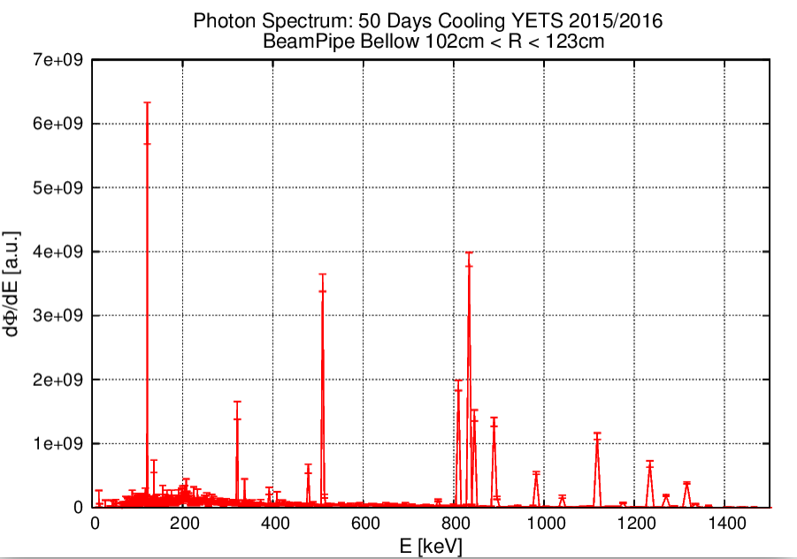
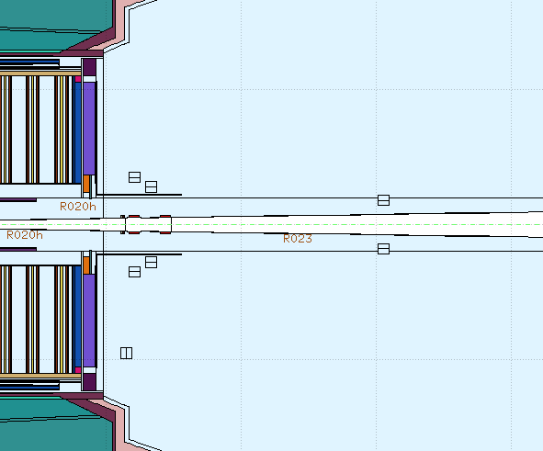
Spectra BeamPipe, Z= 3.21m
!!! Work in Progress
⁵⁷Co
(122keV)
FALCON
Live Time: 600s
11 cm
e+e- annil
(511keV)
⁵⁷Co
(136.4keV)
‘Benchmark’ irradiation profile 2015
12 weeks cooling
Angular acceptance not modelled
But only activation from beampipe components considered– bulkhead etc. switched off as ‘source’ of radiation
Photons crossing boundary which is 360 deg around bellow
Photon Spectrum : YETS 2105/16 12weeks cooling
Photons crossing boundary at R = 35cm
FLUKA

Slide 17
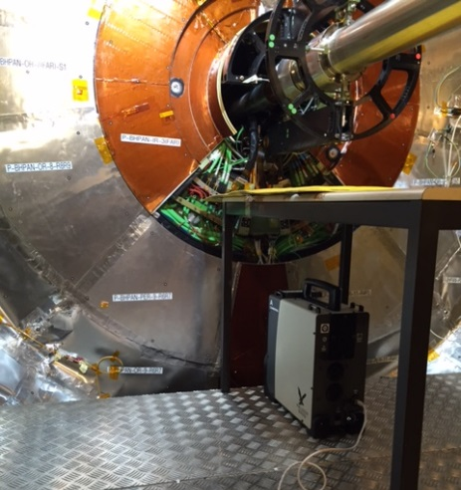
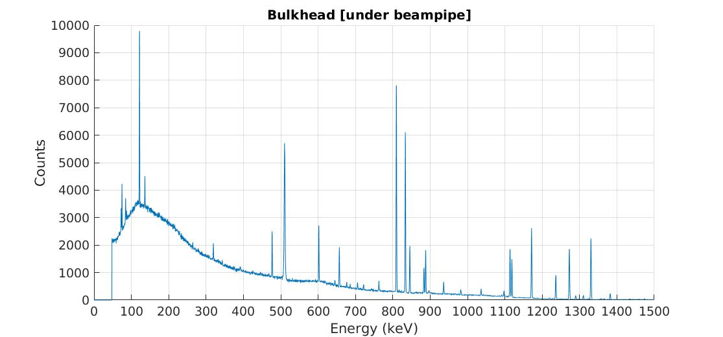
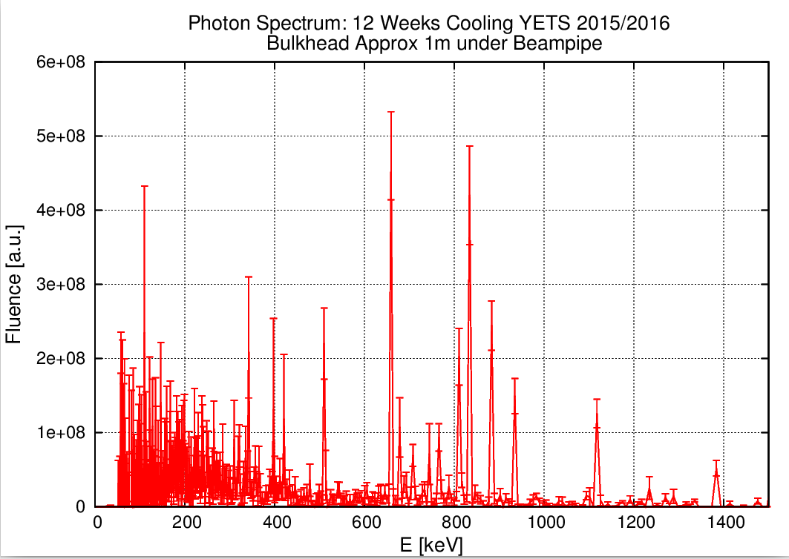
Spectra Bulkhead
!!! Work in Progress
⁵⁷Co (86%IG)
(122keV)
⁵⁸Co (99%IG)
(810.8 keV)
FALCON
Live Time:3651s
⁵⁷Co(10%IG)
(136.4keV)
⁵⁴Mn
(834 keV)
‘Benchmark’ irradiation profile 2015
12 weeks cooling
Angular acceptance not modelled
& Activation from all elements simulated
Photons crossing boundary at bulkhead
Poor Stats- small boundary crossing! FLUKA
^{110m}Ag
(656 keV)
,

Slide 18
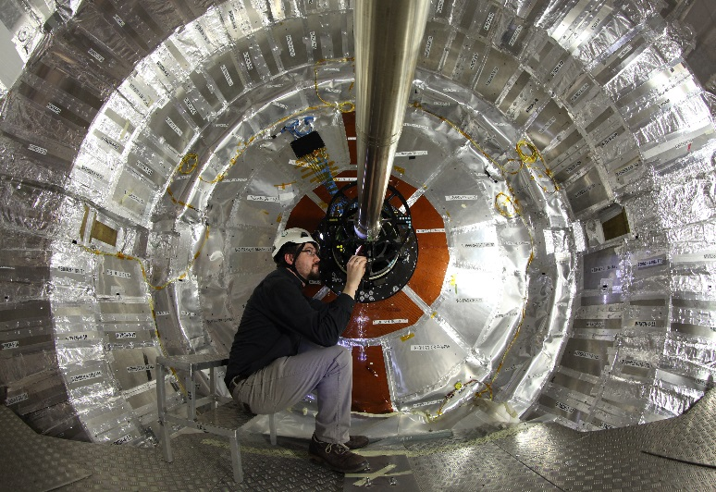
Measurements: Ambient Dose Eq Rates
Taken at: 40 + locations with AD6 device within vac tank
  Example measurement/simulations near (1cm from bulkhead): FLUKA (2011.2c.0) over predicts
C
B
A
R ~130cm
Location
Distance (R)
MEAS
FLUKA (v2011.2c.3)
A
73cm
1.3 µSv/hr
8 µSv/hr
B
123cm
0.79 µSv/hr
6.4 µSv/hr
C
153cm
0.53 µSv/hr
Measurements at 1cm from bulkhead surface

Slide 19
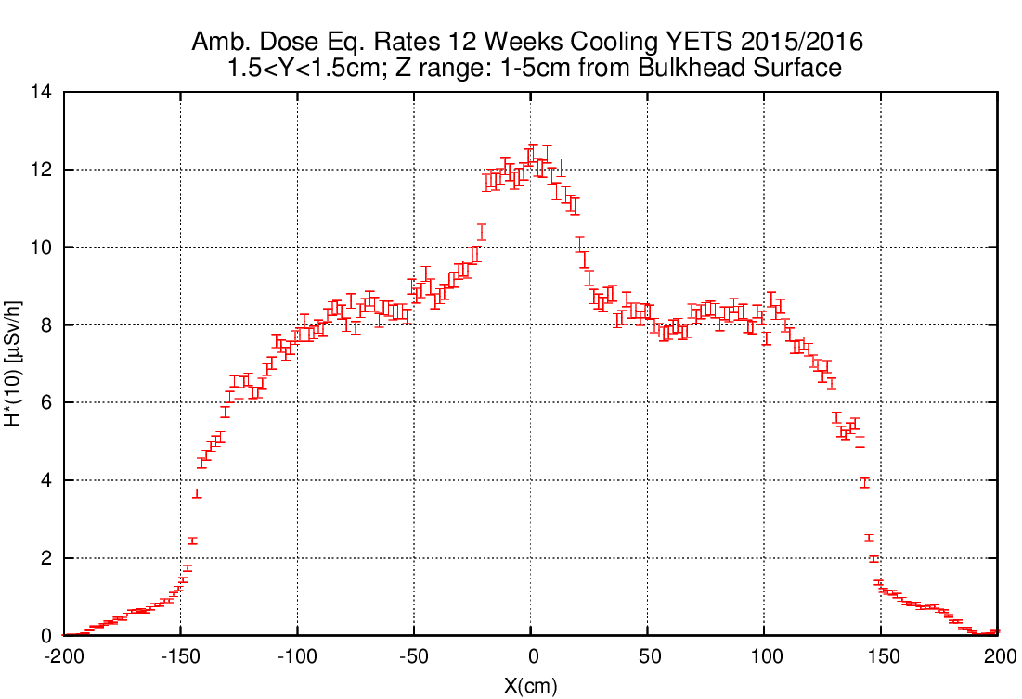
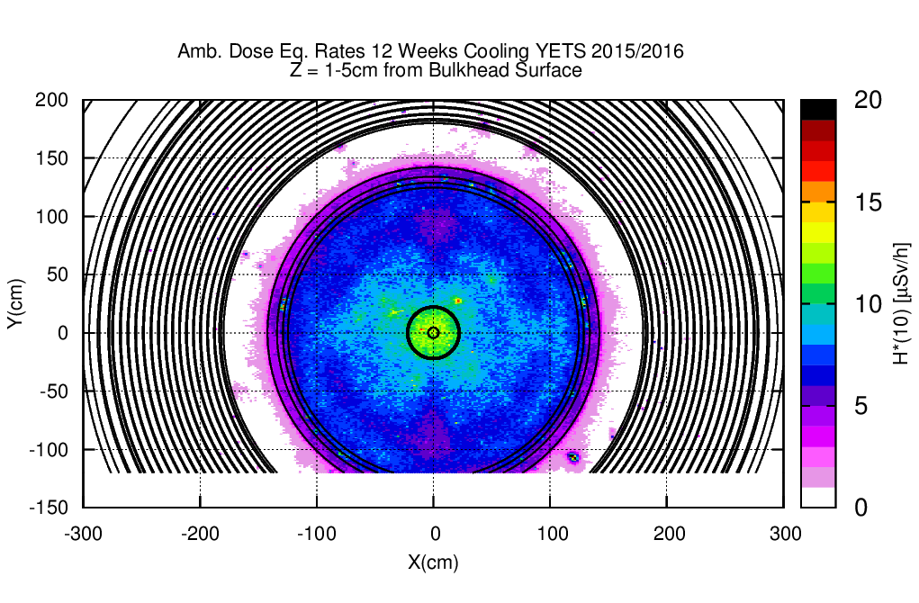

FLUKA Results Ambient Dose Eq Rates
Close to Bulkhead
nose
Edge of BH

Slide 20
Summary
Comparison measurements data (LS1 and YETS 15/16) suggests over prediction of residual amb dose eq. rates in certain regions
BRIL CMS inputs / tools are okay
  We can always continue with minor improvements.
Simulation settings used/suggested by RP group okay
Cause of over prediction seems to be a particular isomer production problem with FLUKA code (current 2011 vers
YETS 2015 measurement campaign invaluable for verifying future CMS FLUKA simulations can be trusted
  Comparisons to be made with development FLUKA asap.
Simulations for residual radiation in EYETS 2016/17 pixel insertion with final beampipe shielding designs and FLUKA development version will be performed by HSE/RP group

Slide 21
Back-Up Slides

Slide 22
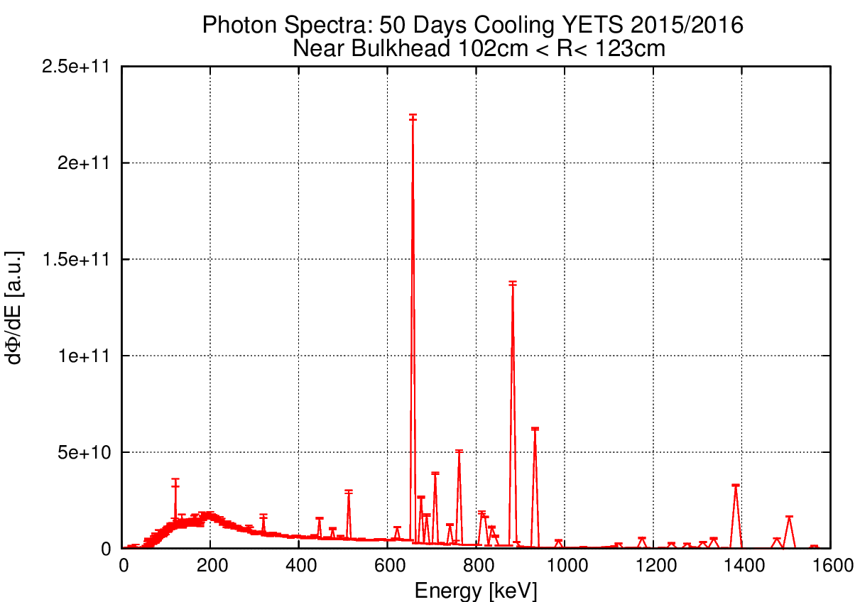

Slide 23
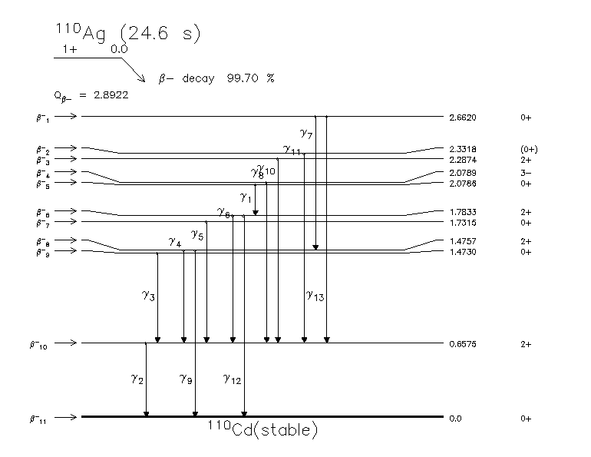
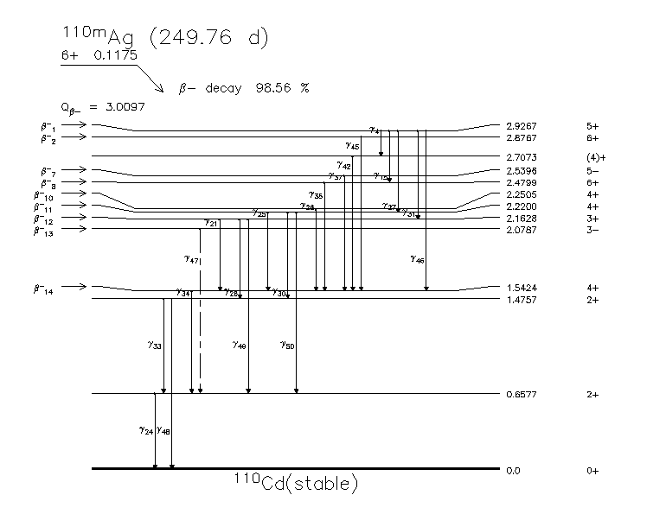
Ag-110 Ag-110m
http://www.nucleide.org/DDEP_WG/Nuclides/Ag-110m_tables.pdf

Slide 24
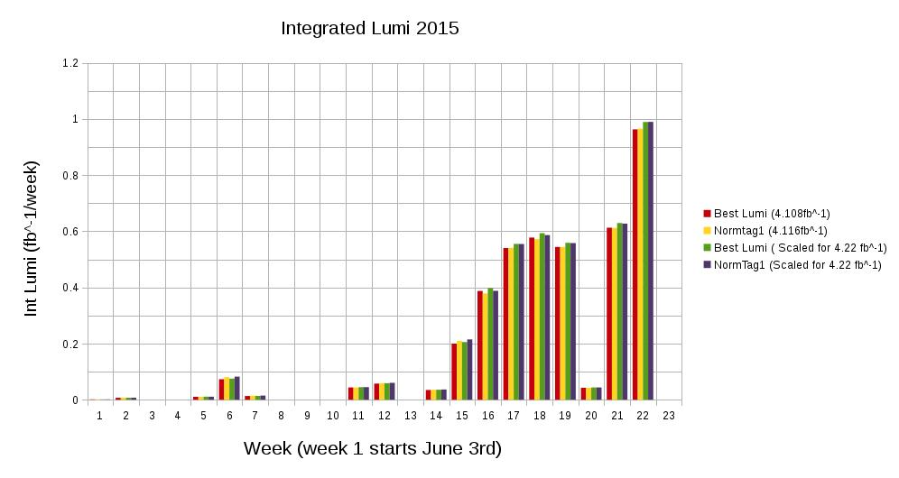
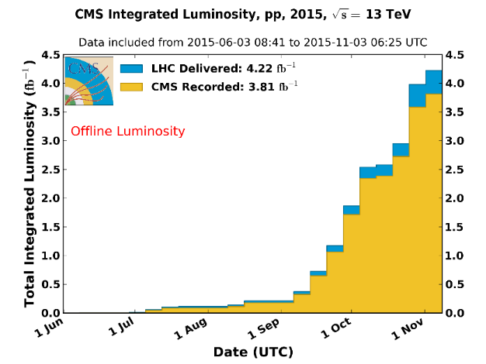
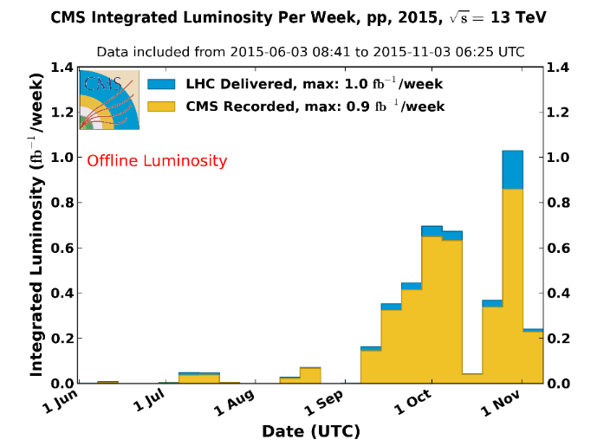
Forming FLUKA PP collision profile

Slide 25
Cobalt 57 & 58
Gammas from ⁵⁷Co (271.79 d 9)
Eg (keV) Ig (%) Decay mode
14.41300 15 9.16 15 e
122.0614 4 85.60 17 e
136.4743 5 10.68 8 e
230.29 2 0.0004 4 e
339.54 18 0.0139 3 e
352.36 1 0.0132 3 e
366.75 1 0.0013 3 e
569.92 4 0.017 1 e
692.03 2 0.157 9 e
706.40 20 0.0253 5 e
Gammas from ⁵⁸Co (70.86 d 7)
Eγ (keV) | Iγ (%) | Decay mode
810.775 9 | 99 | ε+β⁺
863.959 9 | 0.683 11 | ε+β⁺
1674.730 10 | 0.518 8 | ε+β⁺

Slide 26
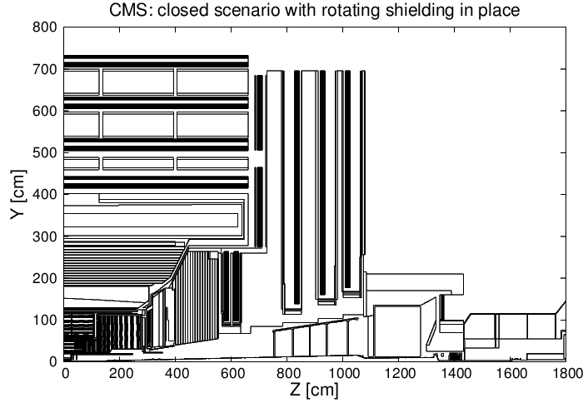
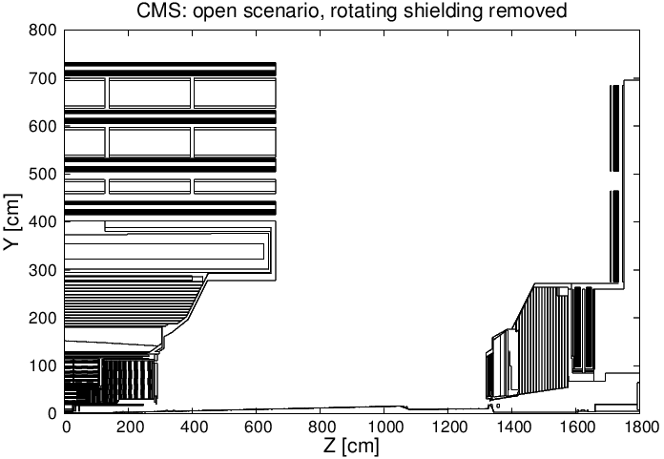
SESAME
Developed by Tim Cooijmans (Technical student 2014/2015) and Moritz Guthoff
A BRIL-developed tool for FLUKA activation simulations with CMS open scenarios
Such scenarios can be approximated by simulating prompt radiation in the closed
geometry and decay radiation in the open geometry
Sesame provides the tools and workflow to separate the prompt and decay
simulations and transform the model in between
Download and manual:
https://espace.cern.ch/cms-project-bril/SitePages/Sesame.aspx
simulation of prompt radiation
simulation of decay radiation
transformation of
geometry model
(including shielding)
transformation of
residual nuclei

Slide 27
Region Represents: Axial Cable
FLUKA region name: Tktstcba
FLUKA Material name: CAB-AXIA
Information from GEANT 4 model in CMSSW, checked with CMS Internal Note 2007/000
Volume: 113160 cm³
Density: 0.89388 g/cm
Relative Mass Compositions (%) :
Carbon | 17.1
Hydrogen * | 2.4
Nitrogen | 0.1
Oxygen | 0.7
Fluorine | 9.5
Aluminium | 40.1
Silicon | 0.1
Copper | 28
Silver | 2
* bound state

Slide 28
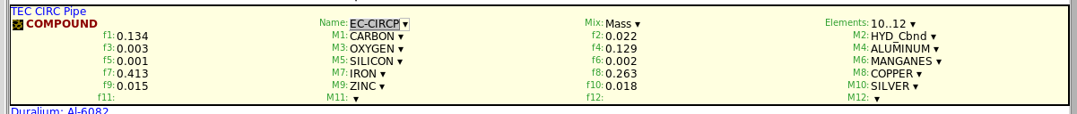
Region Represents: Thermal Shield, Cooling Pipes
FLUKA region name: Tkectsh3
FLUKA Material name: EC-CIRCP
Information from GEANT 4
carbon | 13.40
copper | 26.30
oxygen | 0.30
hydrogen * | 2.20
silicon | 0.10
iron | 41.30
aluminum | 12.90
silver | 1.80
zinc | 1.50
manganese | 0.20
Volume: 16256 cm³
Density: 0.78 g/cm
Relative Mass Compositions (%) :
* bound state

Slide 29
Region Represents: PIXEL CABLE
FLUKA region name: Tkbhpcab
FLUKA Material name: BHPIXCAB
Information from GEANT 4 model in CMSSW
Volume: 1861.3 cm³
Density: 2.25064 g/cm
Relative Mass Compositions (%) :
carbon | 26.30
iron | 14.80
manganese | 0.10
copper | 47.50
fluorine | 7.20
hydrogen * | 4.10
* bound state

Slide 30
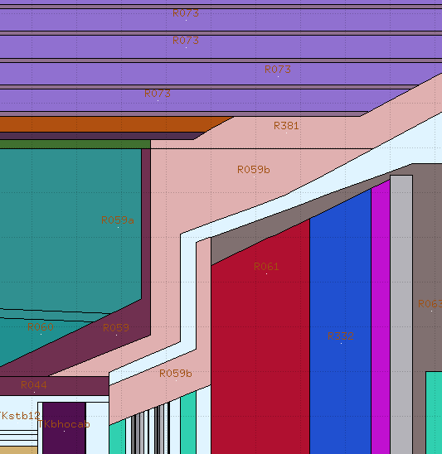
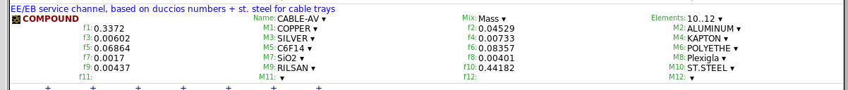
Region Represents: Cable Tray and Cables
FLUKA region name: R059b
FLUKA Material name: CABLE_AV
Information from Duccio’s tables
Volume: ?
Density: 0.88 g/cm
Relative Mass Compositions (%) :
CABLE-AV:
Copper | 33.720
Silver | 0.602
Aluminium | 4.529
Iron | 27.296
Nickel | 6.185
Manganese | 0.884
Chromium | 8.174
Molybdenum | 1.105
Phosphor | 0.020
Sulfur | 0.004
Cobalt | 0.044
Carbon | 9.689
Nitrogen | 0.109
Hydrogen | 1.293
Oxygen | 0.435
Silicon | 0.521
Fluorine | 5.402
* bound state

Slide 31
