Slide 1
CMS End-of-the-Year Safety Tours 2019
Once a day the following short tour through Point 5 has to be done
The exact time of the tour can be chosen by the shift crew in mutual agreement
Any shift crew consists of two people
On the tour the following places have to be visited:
SCX5 – Building of the CMS control room – accessible with your access card
SX 5 – Surface hall – including CMS RP area
Building 3584 – Membrane Plant and Dry Air Plant
Building 3594 – office building
SDX5 – Area between control room and elevator
USC55 – Underground Service Cavern including CV room and gas room
UXC55 – Underground Detector Cavern
All necessary keys are in the control room on the desk of the access control PC
In case of problems call +41 75 411 5000 (or if on swiss network 16 5000)
Technical problems e.g. lift failure must be reported to TCR 72201
Problems with the access system must be reported to 72201
(Only) for Emergencies call 74444
Fire brigade technical assistance can be called by 74848
DO NOT GO UNDERGROUND IF THE LIFT FAILED OR THERE IS ANY ALARM
IN DOUBT CALL +41 75 411 5000

Slide 2
In Case of Problems with the Access System
Surface SDX5 - PM54
If the access is not given to one of the shifters the second one
should let in the colleague via the MAD from the inside
If both shifters cannot enter, open the MAD from the outside to enter. Call the Fire Brigade (74848) to inform them before and after as you will not be registered underground
Underground UPX56
If the access system is in closed mode, call TI at 72201 to request the mode change.
If one of you will have no access to UXC you can enter in UPX56
by turning the emergency handle.
In this case you MUST reset the handle afterwards with the key
If the key box does not open when exiting, please wait 5 minutes
then badge again – if the system takes the key give it, otherwise
let it time out (don’t take another key!!) and bring the key up to the
control room. Please make a note in the shift report.

Slide 3
Control Room
Your Tour starts and ends in the control room
Before you go downstairs open the PM54 on the terminal of the access system
Click on the on the green “General” button to open (and confirm)
Before you leave please make sure you
Checked for new DSS alarms and reset the siren if necessary
Checked for Sniffer alarms
Checked the cooling screen
Checked temperatures and dew points
Closed the PM54 - Click on the on the red “Closed” button to close (and confirm)
Have put back keys and documentation

Slide 4
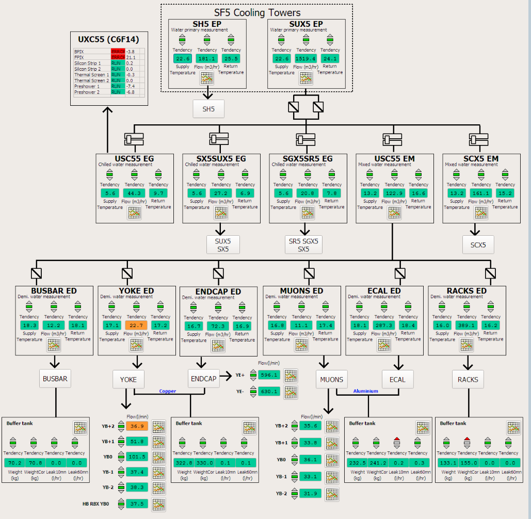
Cooling Screen
Ok !
Don’t exist anymore
All circuits must
be running !!
In case any of the
fluxes is 0 or any
Temp is >25º C,
please call
+41 75 411 5000
4

Slide 5
Shift Report, Temperatures and Dewpoints
After the tour a short E-log in the category GENERAL→SLIMOS should be created http://cmsonline.cern.ch/ and click on Elog
The report can be written on one of the PCs in the control room or at home
IMPORTANT
Please also check the temperatures and dew points in USC &UXC :
http://cmsonline.cern.ch/ and click on DSS and Environment
The entries are ordered by alphabet
USC: If the difference between temperature and dewpoint becomes less than
5 degrees, please call +41 75 411 5000
UXC: If the difference between temperature and dewpoint
is smaller than +5 degrees call +41 75 411 5000
The temperatures in USC and UXC should be between 15 and 23 degrees

Slide 6
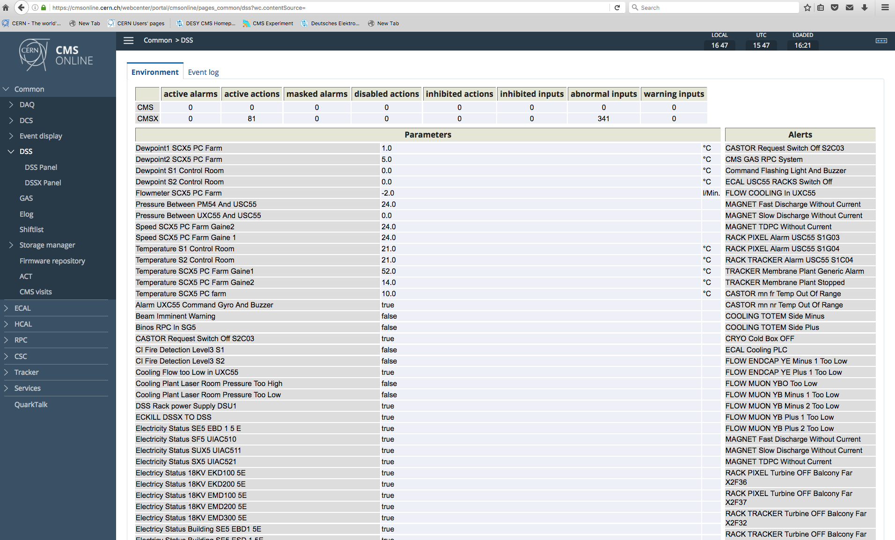
Temperatures and Dew Points – DCS
CMSONLINE – DSS - Environment
Dew points,
Temperature USC, for UXC scroll down

Slide 7
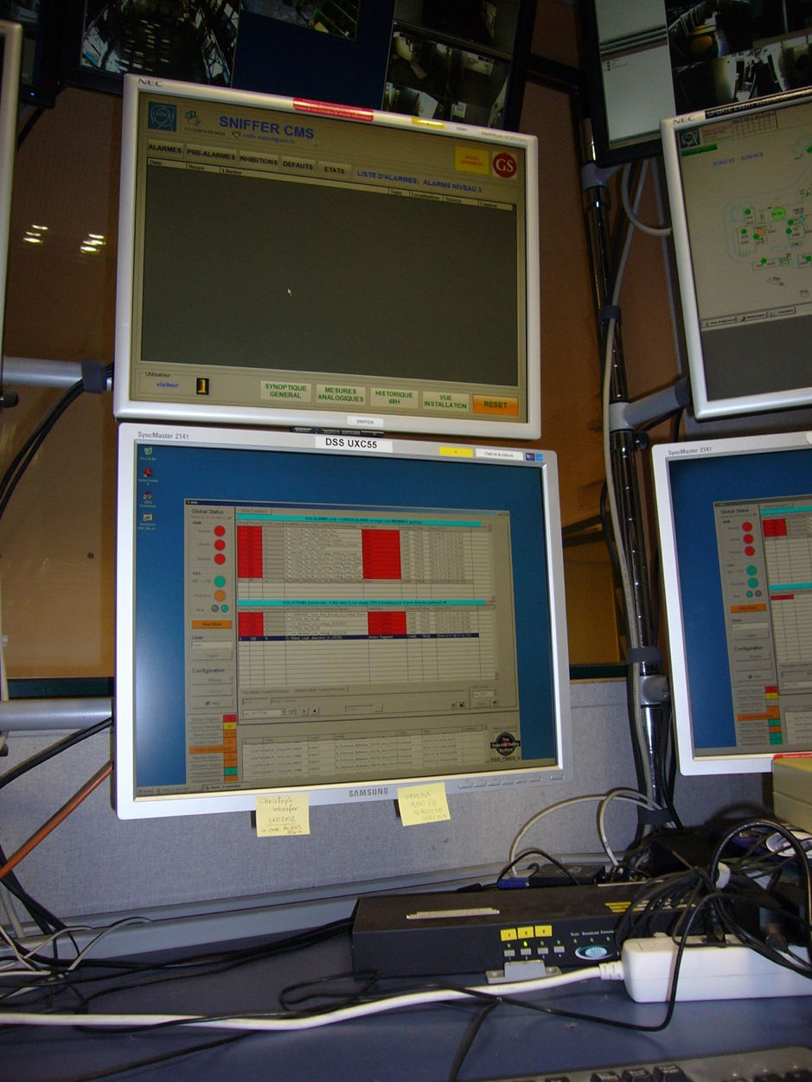
Sniffer Alarms
Please check for any new sniffer alarm
In case there is a new alarm
Try to reset it
Press 2 on the black box
Use the mouse to press the
Reset on the sniffer screen
If the alarm does not disappear
call +41 75 411 5000
else
write the alarm message into your
shift report mentioning you have
reset it

Slide 8
SCX5 & SX5
Enter SCX5 with your access card on the ground floor
Check that the Computer room on the 1st floor is locked
Check control room for any obvious anomalies
Check the bathrooms
Pick up the keys for SX5 from the table of the access PC
Go to SX5 and take the tour
Walk around in SX5 and look for any obvious anomalies
Check that all doors are locked
Check the Pixel clean room in RP-zone
Check the Membrane and Dry Air Plants in building 3584 details Transp. 15-19
Continue through B3594 – check the bathrooms on both floors
Go to the elevator to continue the tour underground through SDX5
The access system underground is in RESTRICTED AUTOMATIC MODE
You (as registered shifter) will have access

Slide 9
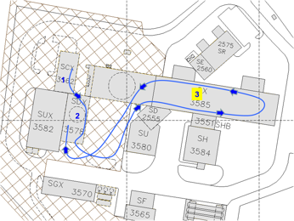
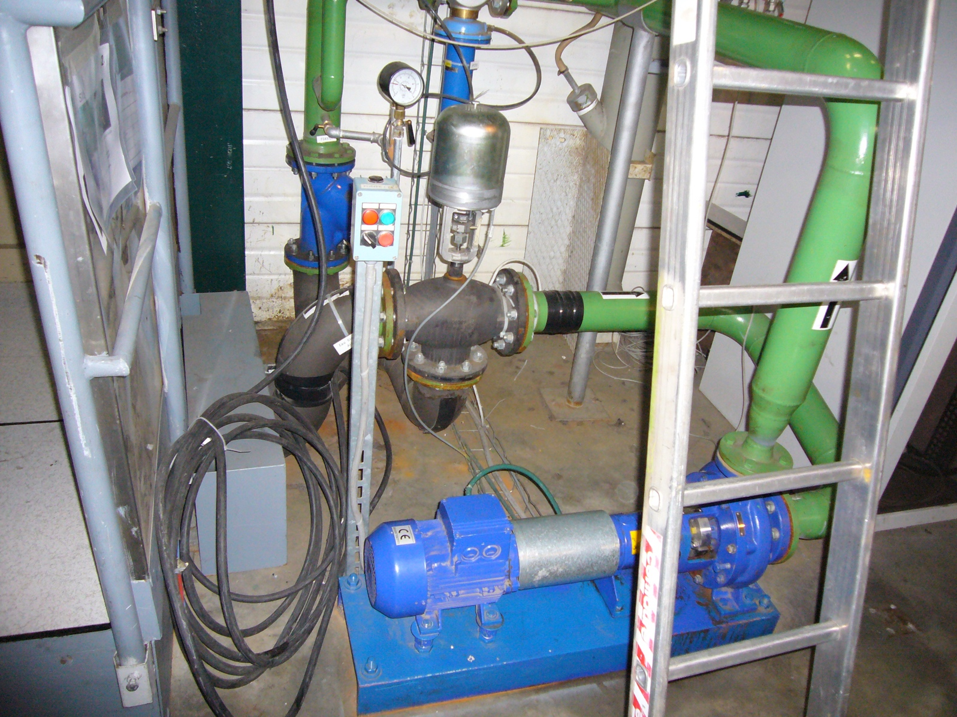
To switch on: Turn switch to local
Press green button
Turn switch to remote
In case the pump cannot be restarted
call 72201
Pump for Green Barrack

Slide 10
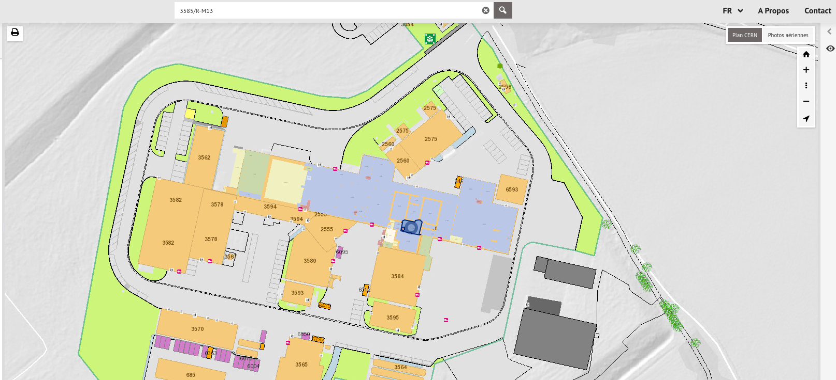
Where is the clean room?
Pixel Clean Room in the SX5 RP Area
RP zone in SX5:
3585/R-M13
Entrance to CMS premises
CMS control room (3562/R-020)

Slide 11
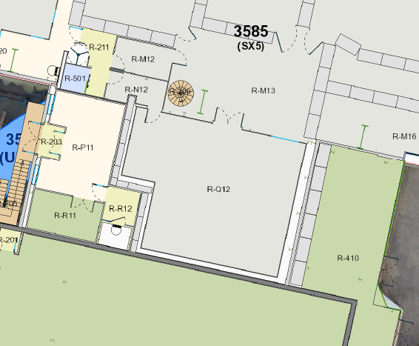
What is where in the SX5 clean room?
Chiller
next to the spiral stair
Dry gas panel
Right corner opposite to
to entrance door
Chiller
Dry Air

Slide 12
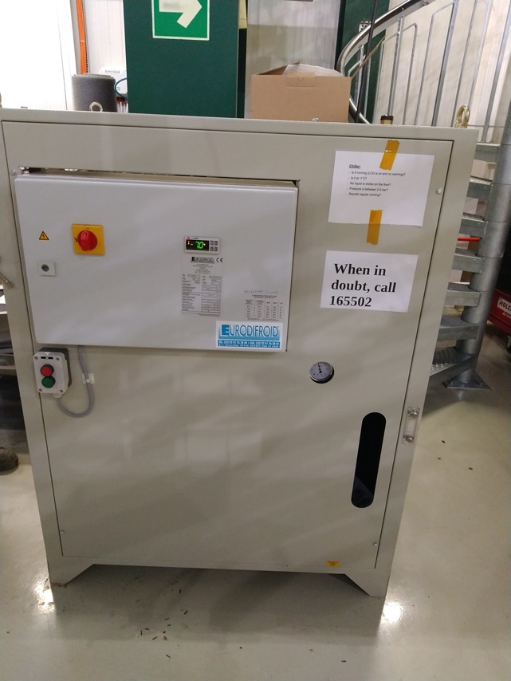
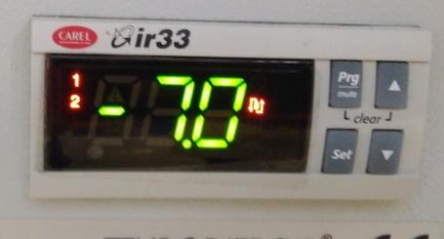
Is the chiller running and tight?
Barrel detector parts are in this room behind the chiller
Forward detectors are upstairs
Different detector parts are cooled to about 0 °C with this chiller.
Check that the display is on and shows the set point of -7 °C. It should not blink / say OFF.
chiller
Check for leaks
Water glycol can spill under/behind the chiller.
It is red/pink.
If display is blinking -7/OFF, call +41 75 411 5502

Slide 13
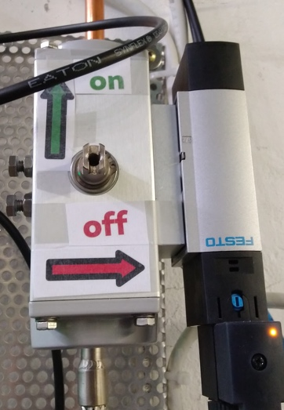
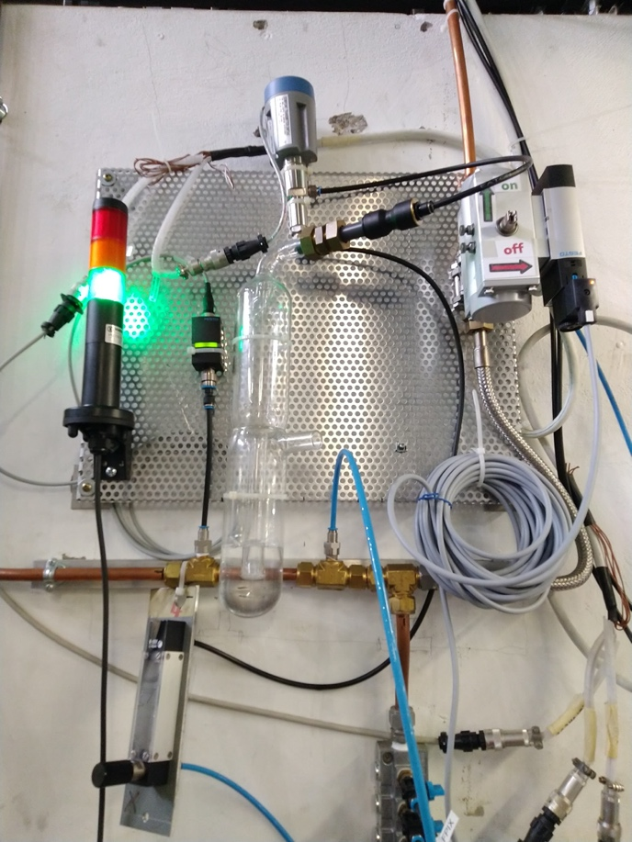
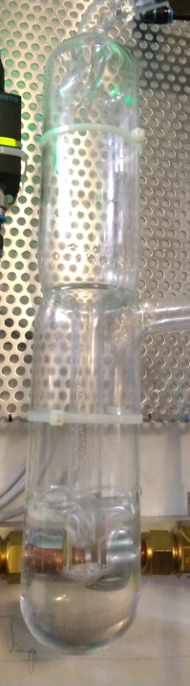
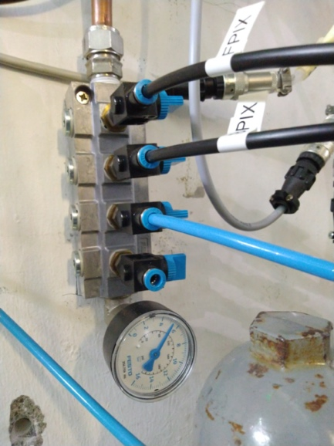
Is dry air flowing to the detector?
Dry gas panel
Light is green
Bubbler has flow
FESTO valve is vertically aligned
4 indicators of air correctly flowing to detector:
Light
Festo valve orientation
Pressure
Bubbler
Pressure is about
4-5bar
In case of problems call +41 75 411 5502

Slide 14
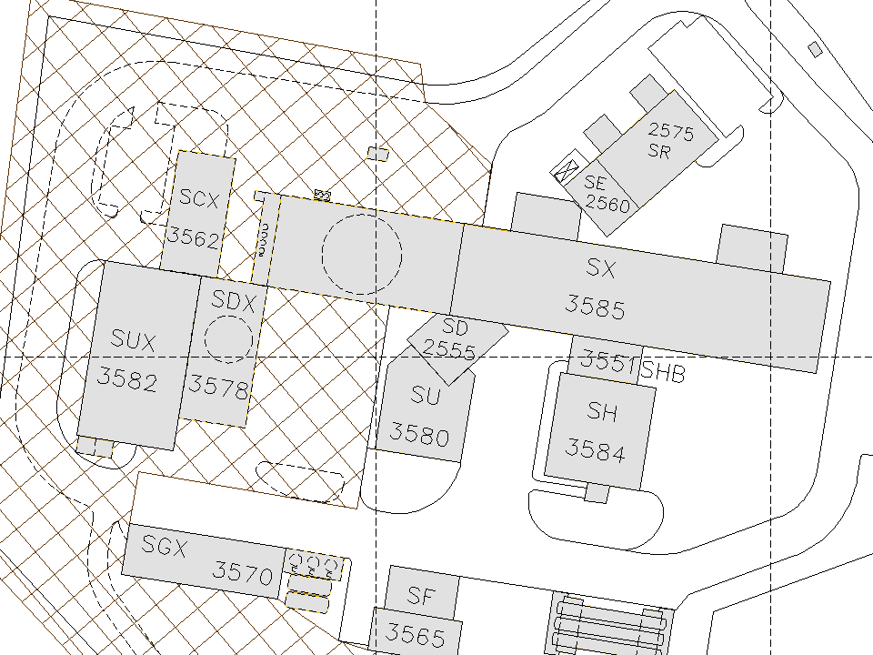
Itinerary – Surface zone
Surface Point 5
1
2
3594
5
4
3

Slide 15
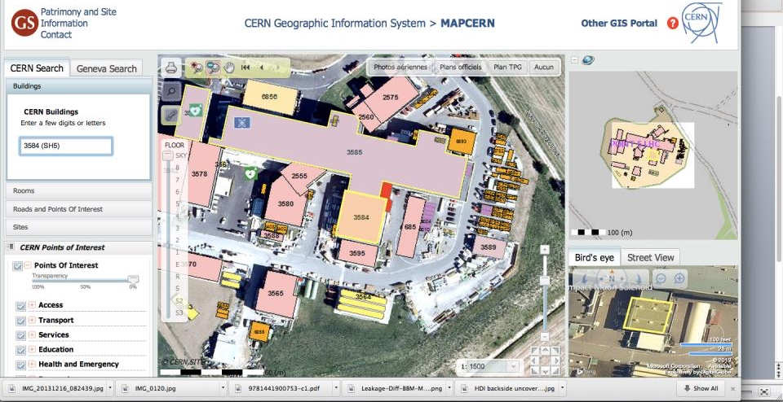
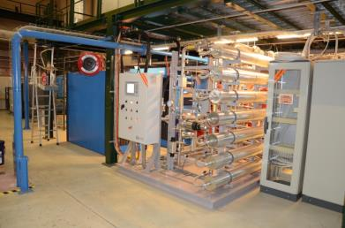
Membrane Plant
Building 3584 – SH5
The membrane plant supplying dry-gas for the tracker system is
located in bldg#3584 (SH5)
The box indicates the approximate location of the plant inside the building.

Slide 16
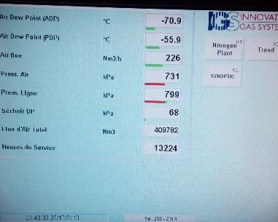
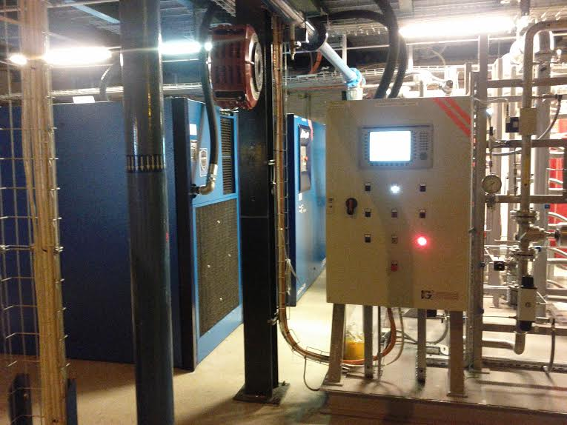
Membrane Plant
Compressor
2
Compressor
1
Control
Panel
Dew point (ADP, at -70.9 in picture above) higher than -40 deg C or pressure below 700 kPa are anomalous and you should
call +41 75 411 5503
(if not reachable
+41 75 411 5502)

Slide 17
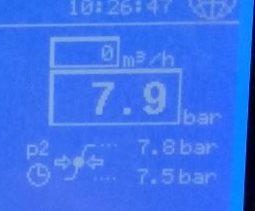
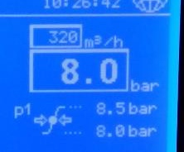
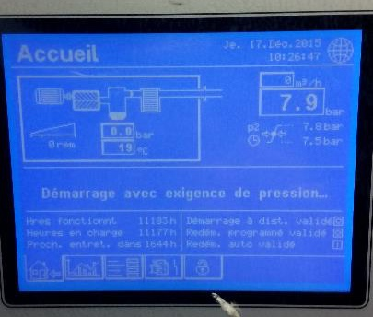
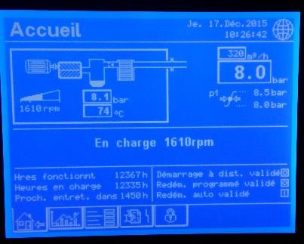
Membrane Plant
At any given time only one compressor should be active.
In case both compressors are active there is something wrong with the system call +41 75 411 5503 (if not reachable: +41 75 411 5502)
One Compressor
should have ~380 m3/h flow
Pressure should be ~8.0 bar
One Compressor should have zero flow

Slide 18
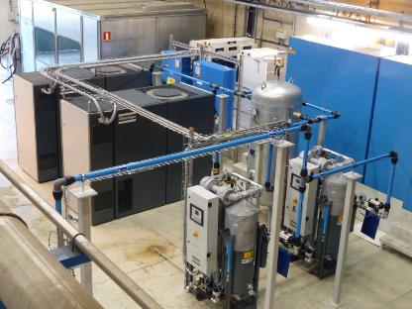
Dry AirPlant
The surface dry air plant is also located in bldg#3584 (SH5)
The box indicates the approximate location of the plant inside the building.
Compressor 1
Compressor 2

Slide 19
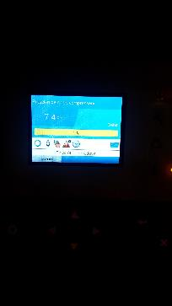

Dry AirPlant
Only one of the two compressors should be running at around 50-80% capacity
(If the touch screen is off, press one of the arrow keys to switch it on)
Consumption ~ 50-80%
Consumption ~ 0%
If both compressors are running or the
consumption is outside the indicated window
by more than 5% call +41 75 411 5503 ( +41 75 411 5502 if not reachable )
A howling noise due to varying consumption is normal

Slide 20
Access to the Underground Facilities
The PAD on the surface (PM54) should be in closed mode
For the tour it can be opened by clicking the green field on the
left side of the screen located next to access system screen in the control room
After the tour it should be closed again by pressing the red field
In case the PAD cannot be opened or your access card does not work
use the key with the blue head to open the MAD.
UPX56 will be in automatic mode and give access by badging.
In case one of the shifter cannot enter the other one should let him/her in with
the MAD key – as for visitors
In case the access system does not work at all, pull the green handle and enter.
In this case it is important to re-arm the door with the small key after the tour.
Call the Fire Brigade (74848) to inform them as you will be not registered underground
The lights in UXC should stay on all times
In case you find them off, go to level -3 and switch them back on
You have to visit:
USC 55 : S2-counting room, S4-rack area, S1-counting room,
S1-CV room, USC gas room
UXC 55
Please also check the bathrooms in USC S1 and UXC X1

Slide 21
All racks to be checked in S2/S4 in alphabetical order
S2A04 | S2B10 | S2C05 | S2D16 | S2F16 | S2G02
 | S2B17 | S2C07 | S2D19 | S2F18 | S2G03
 |  | S2C18 |  | S2F19 | S2G04
S2A12 |  |  |  |  | S2G10
S2A15 |  |  |  |  | S2G11
 |  |  |  |  | S2G12
S2A19 |  |  |  |  | S2G13
 |  |  |  |  | S2G19
On S4, (right of the elevator) please check S4F08 & S4F09
If you find a rack off, please:
For those indicated in blue, mention it in the shift report
indicated in red, call +41 75 411 5503 (if not reachable: +41 75 411 5502)
indicated in green, send an Email to cms-dcs@cern.ch
Continue your tour by going down to level -2 (=S1)

Slide 22
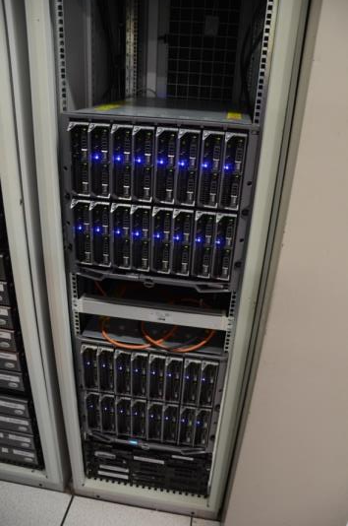
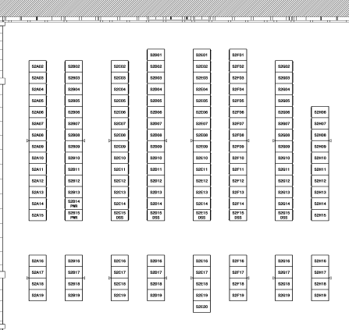
Racks in S2
Tracker Hardware in USC Counting Rooms
S2F16: DCS PCs in Dell blade system.
The two computers indicated by the boxes
should be on. If any of them is off,
call +41 75 411 5503
(if not reachable: +41 75 411 5502)
S2B18
S2B17
S2F16

Slide 23
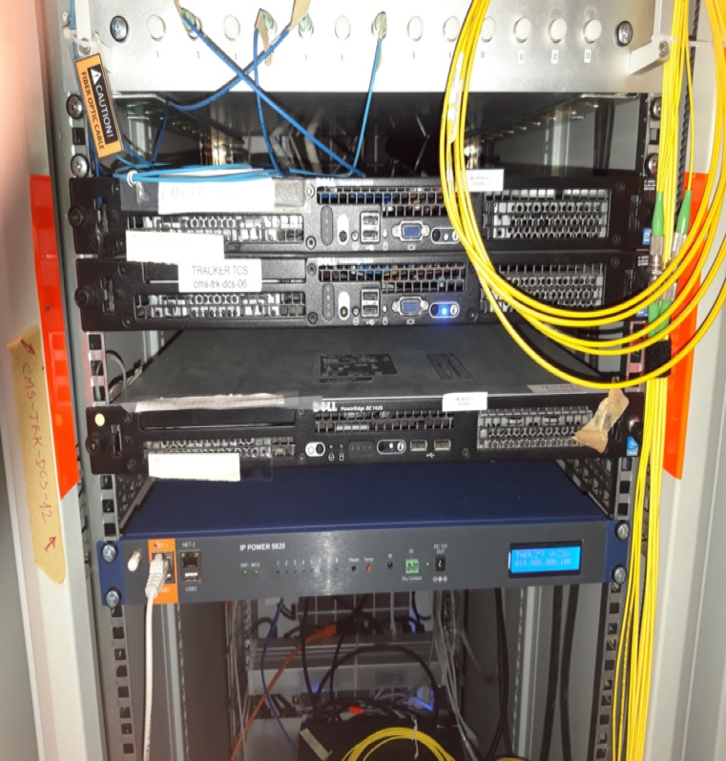
Racks in S2
Tracker Hardware in USC Counting Rooms
S2C18: DCS PCs
The two computer indicated by the box
should be on. If any of them is off,
call +41 75 411 5503
(if not reachable:+ 41 75 411 5502)
S2B18
S2B17
S2C18
S2C18

Slide 24
All racks to be checked in S1
in alphabetical order
S1A01 – S1A09, S1A15
S1B12, S1B13, S1B14, S1B15
S1C14
S1G02
If you find any of the racks off indicated in red, please call
+41 75 411 5503 (if not reachable: +41 75 411 5502)
If you find any of the racks off indicated in green, please
send an Email to cms-dcs@cern.ch
Continue your tour by going to the CV- Cooling room

Slide 25
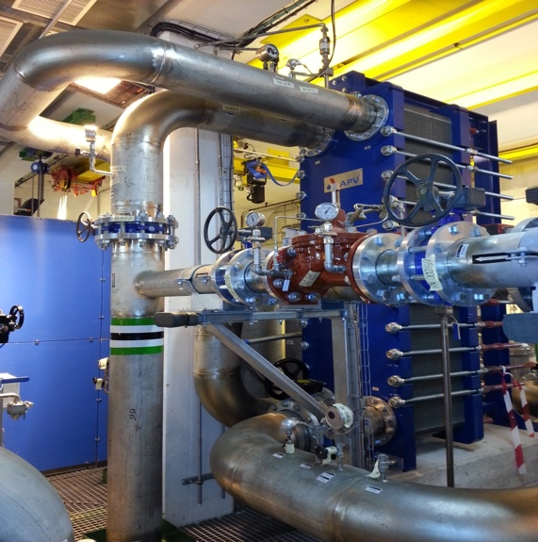
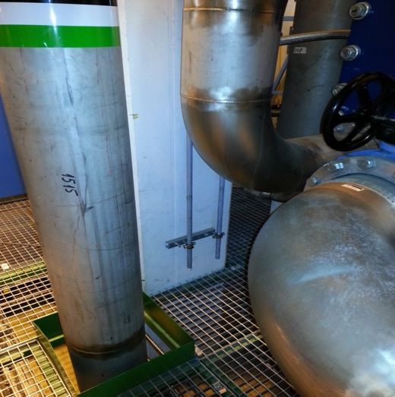
CMS cooling YETS - USC
Purgers on Rack circuit
Purge lines
CV zone - circuits in operation (pumps on)
RACK, ECAL, ENDCAP, YOKE and BUSBAR CIRCUITS
Check for water leaks next to the pumps or the purgers lines (see pictures)
In case of problems, call TI desk 72201
and ask for EN/CV piquet
Continue your tour by going to the USC gas room

Slide 26
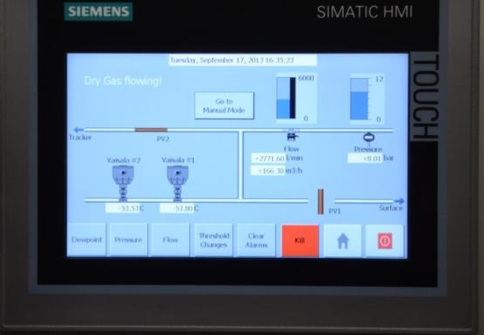
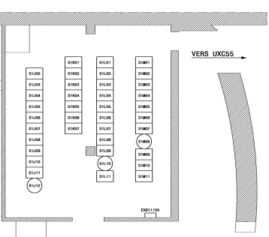
USC Gas Room (UGX5)
Rack S1K04
If anything out of limit call
+41 75 411 5503
Total flow from surface plant
should be > 3000 l/min
Input pressure from surface plant
should be >6.5 bar
Exhaust valve status
should be closed
Status of valve to tracker
should be open
Dew points measured
by Vaisala sensors
should be < -40 deg C

Slide 27
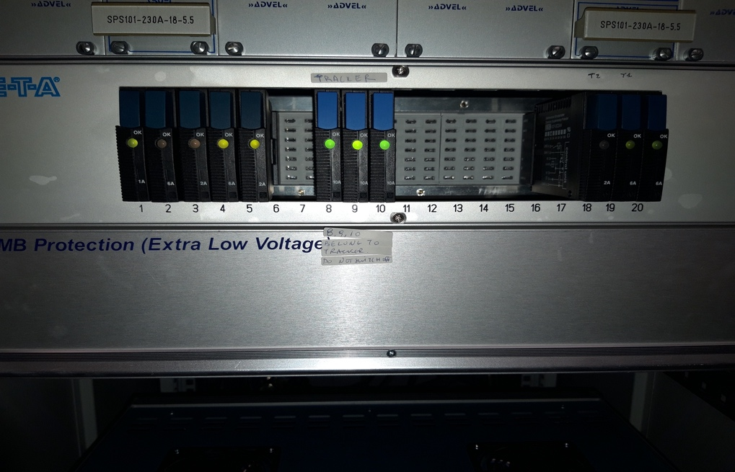
USC Gas Room
Rack S1K05
must be powered,
and the 3 LEDs indicated must be on – if not
call +41 75 411 5503
(if not reachable:
+41 75 411 5502)

Slide 28
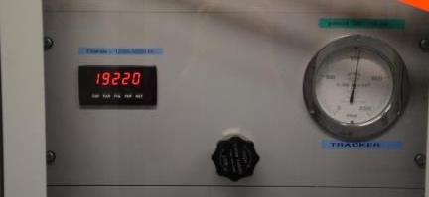
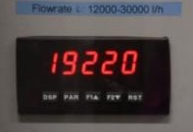
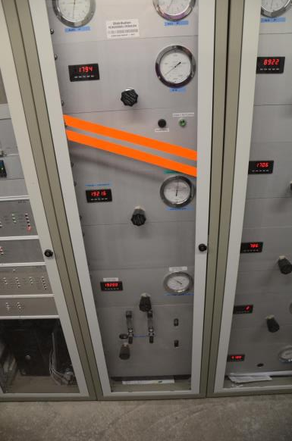
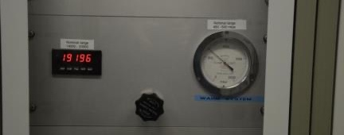
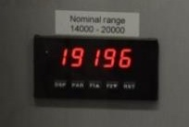
USC Gas Room
Rack S1K06
should be >15000 if
not call +41 75 411 5503
(if not reachable:
+41 75 411 5502)
should be >14000 if not call
+41 75 411 5503
(if not reachable: +41 75 411 5502)

Slide 29
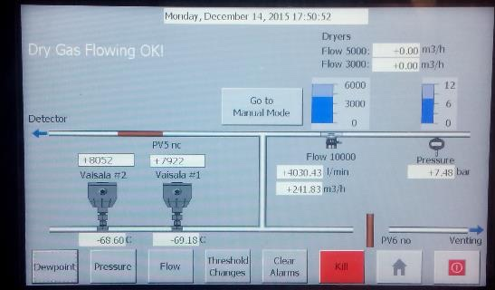
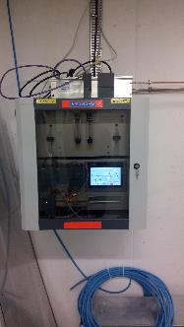
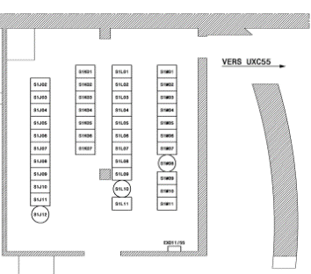
USC Gas Room (UGX5)
Dry gas panel on wall
Total flow from surface plant
should be > 3800 l/min
Status of valve to tracker
should be open
Input pressure from surface plant
should be > 7 bar
Exhaust valve status
should be closed
Dew points measured
by Vaisala sensors
should be < -40 deg C

Slide 30
Underground UXC
Leave USC on the negative end and enter UXC through the UPX56 PAD
Check for any obvious anomalies
All racks should be off
except X4 near XN24, 45 for ECAL temperature monitoring
If you find them noisy, hot or smoking – turn them off
If you find them off, mention in E-Log no need to call anybody
Check the cooling plants of TS and PS – details next on transparency
Go to ground floor and walk along the hall on both sides, near & far
One person should go down to X0 the other should stay in X1
Look for water
Go to the green ladders that lead underneath YB0
Climb up and look for water underneath the detector
Go to the back side of UP55 and check that the MAD is closed
Leave through the same door you came in (give back the key or rearm the door)

Slide 31
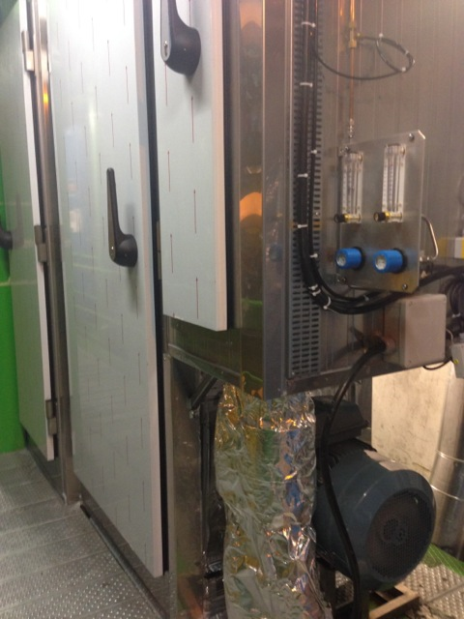
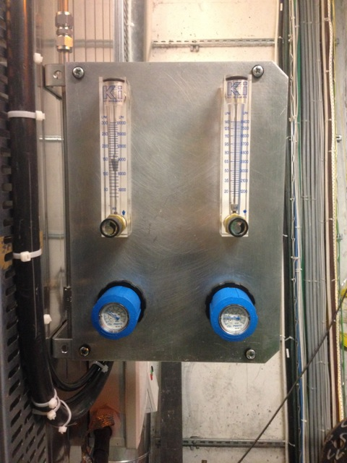
CMS cooling YETS – UXC
Cooling plants in operation: TS1, TS2, SS1 (far side, X2), PS1, PS2, SS2 (near side X2)
Pumps of the 6 plants shall be ON
Dry air of all plants shall be on (visible flow on one of the two flowmeter attached to the cabinet)
No condensation shall be visible from outside the cabinets
IF PROBLEMS: call 72201 & ask for CV detector cooling piquet

Slide 32
The End
Go back to the control room
Before leaving, please have a look on slide 3 once more
Thank You, you are done !!!

Slide 33
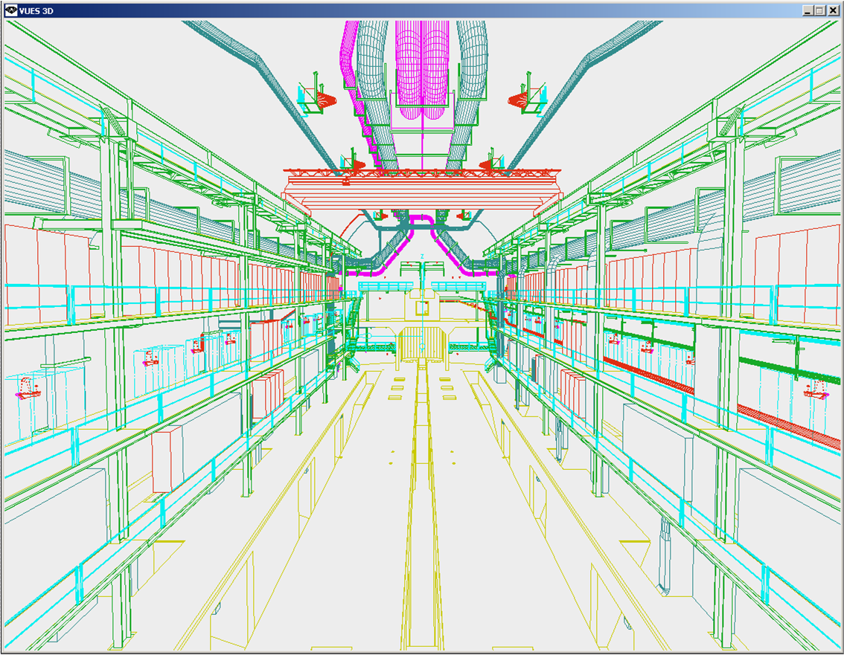
Numbering Convention of UXC55 levels
Experimental CAVERN
X6
Crane rail
X5
Top of detector
X4
X3
X2
X1
X0
(below the detector)

