Slide 1
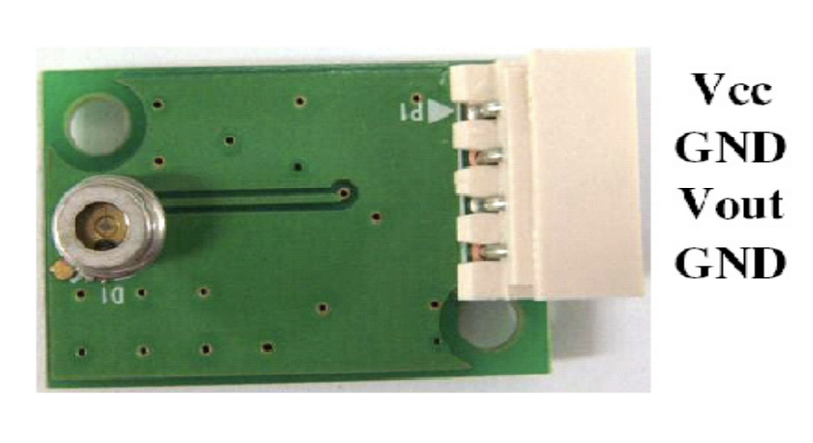
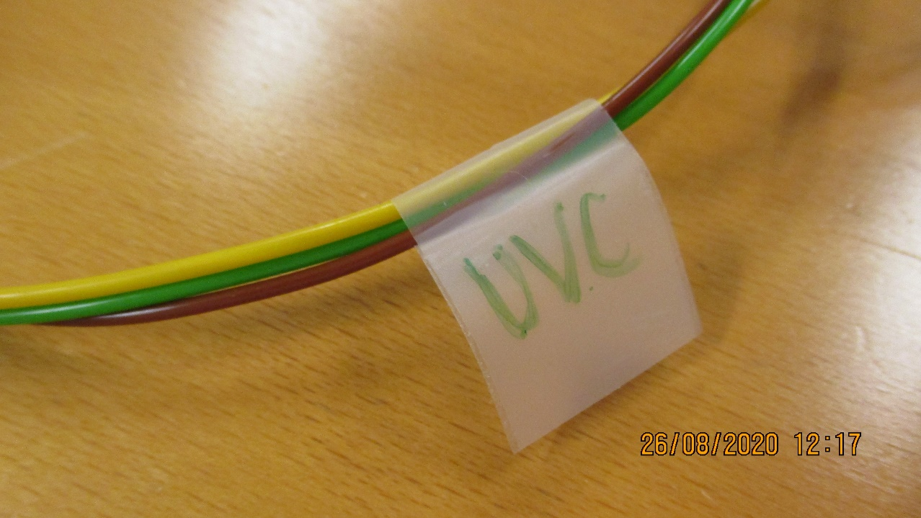
Get UVC sensor and identify corresponding cable of the blue controller
Identify cable with UVC label:
UVC sensor:

Slide 2
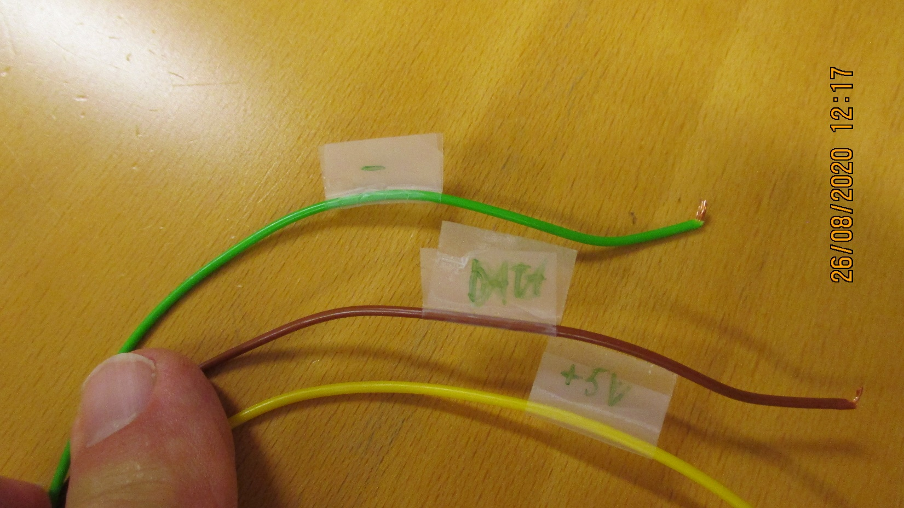
Pinouts:

Slide 3
Connection scheme
Connect cable +5V to VCC pin of the sensor
Connect cable “-” to GND pins of the sensor
Connect cable ”data” to Vout pin of the sensor

Slide 4
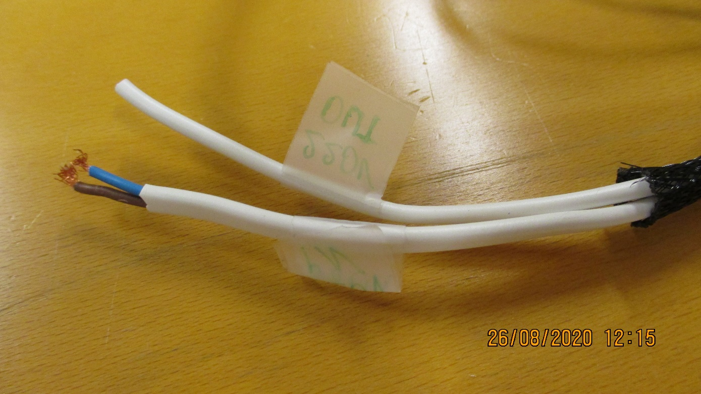
Wire controller
Connect 220V input line to 220V mains supply
WARNING: Isolate 220V out line properly

Slide 5
Run Controller
Once controller is feed with 220V/230V it will wake up
Push rotary switch (black one) to go to menu
Select illumination time (in this case it defines how long box will be measuring) by rotating nope
Once desired time is selected, bush down once more to set selected value
Now push green button, measurements will start and will stop once selected time is over. You will see reading on the display
Also check this video out: https://photos.app.goo.gl/Rn9AjSgXbsXnEfbN9
In case of troubles we could speak in zoom, have ready everything and I will guide you trough necessary steps.

