Slide 1
Connections for David Lomidze UVC electronics control module.
Ian 26 Aug 2020
david.lomidze@cern.ch

Slide 2
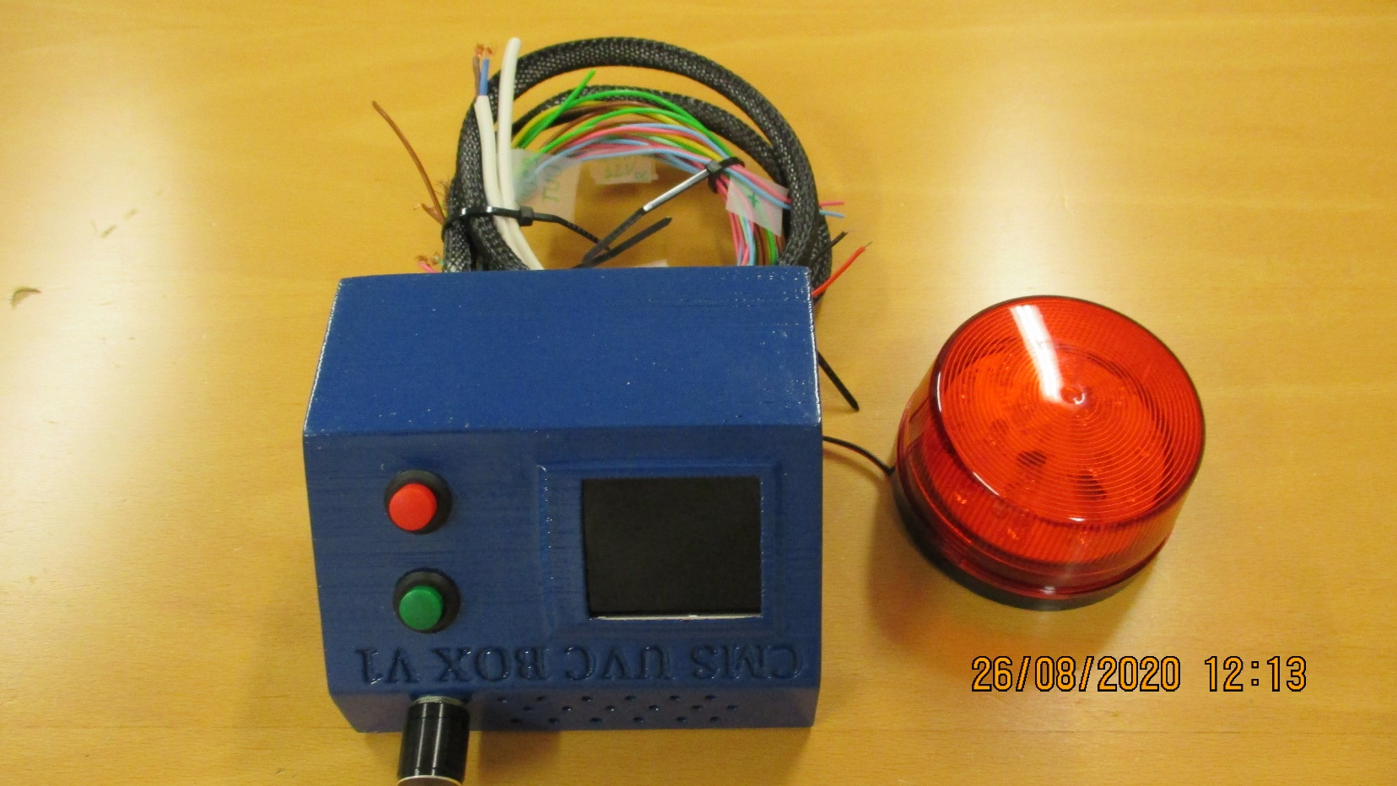
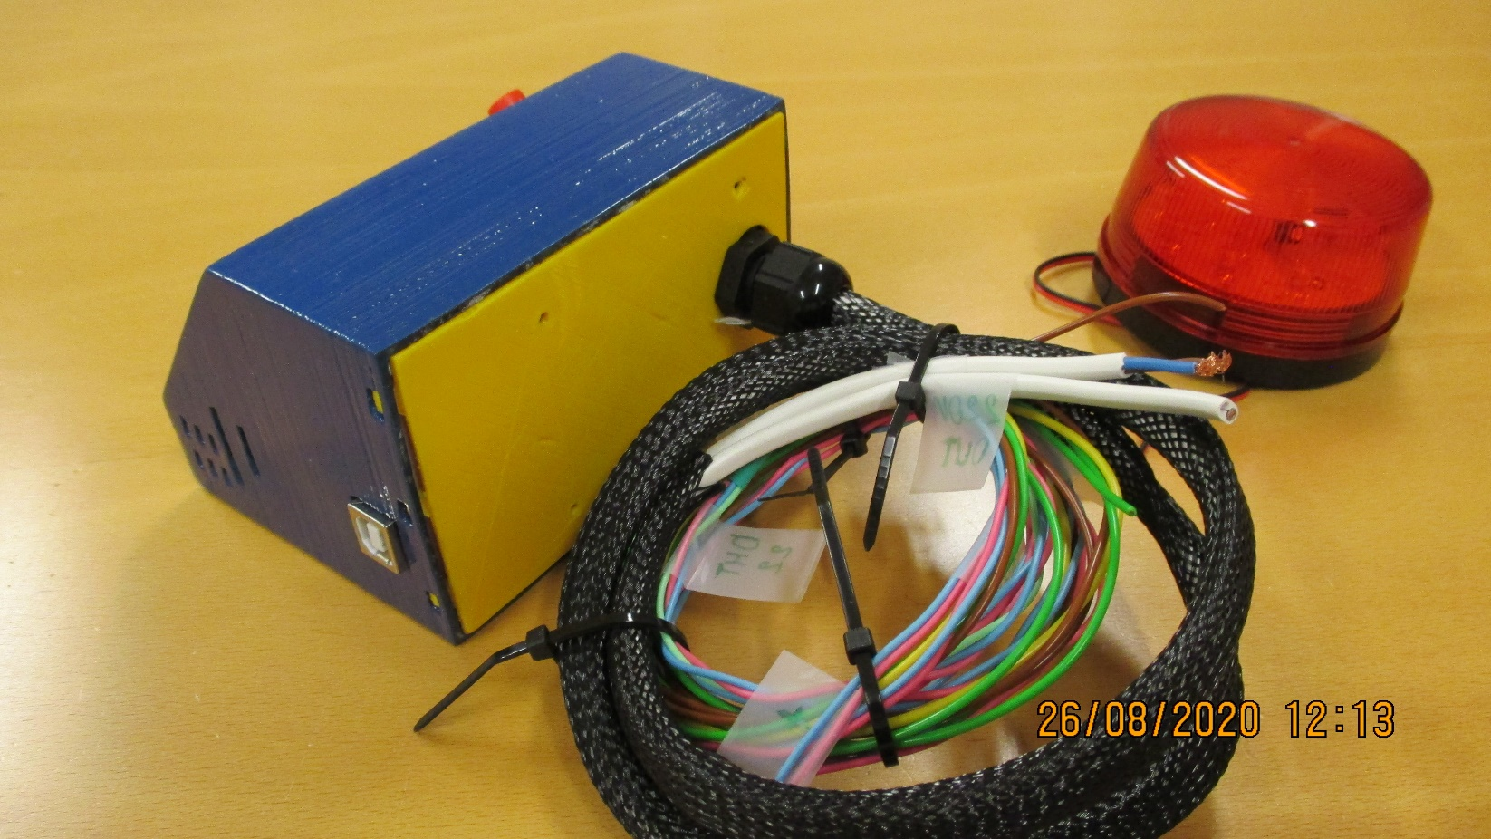

Slide 3
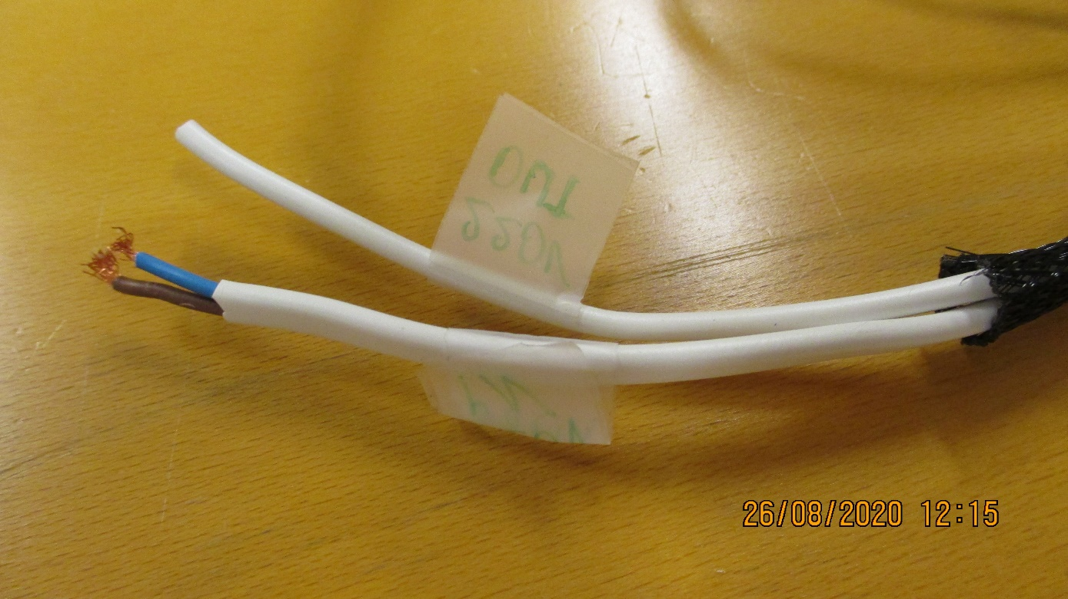
Out 220V
In 220V

Slide 4
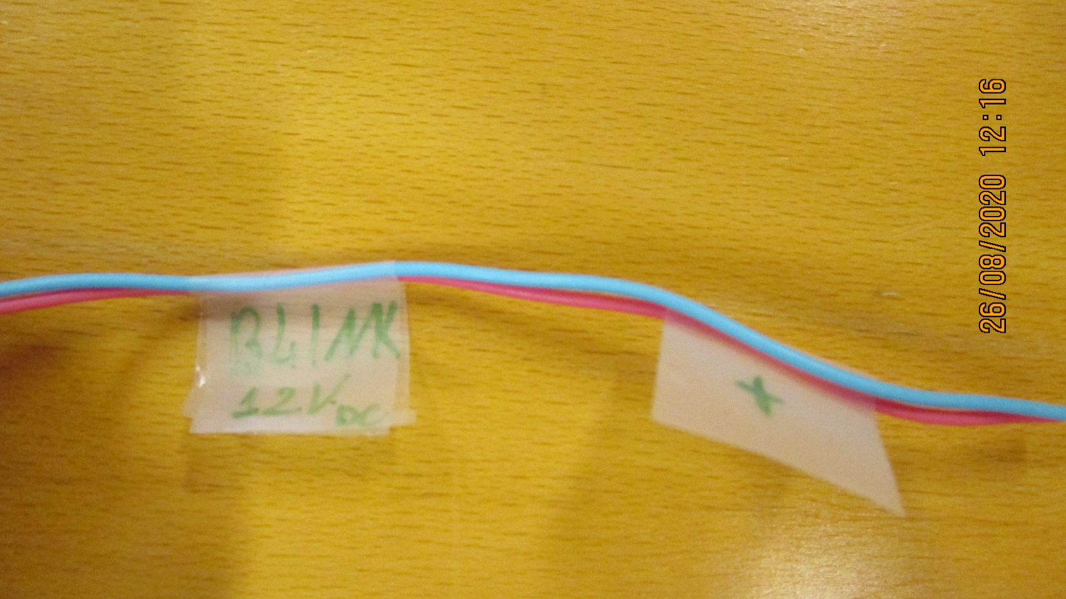
Blink 3.2 Vdc
“ + “

Slide 5
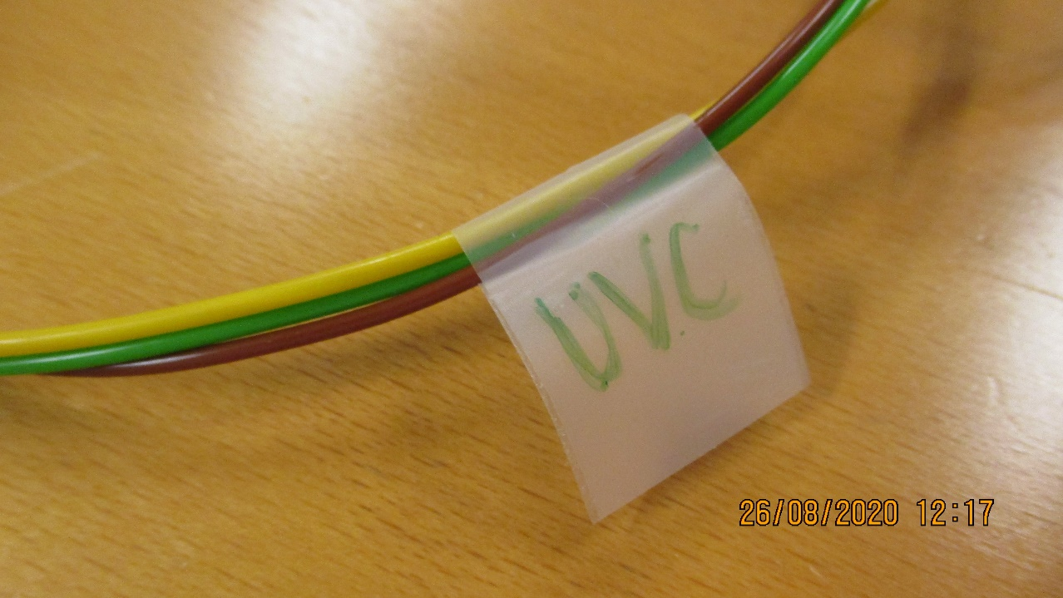
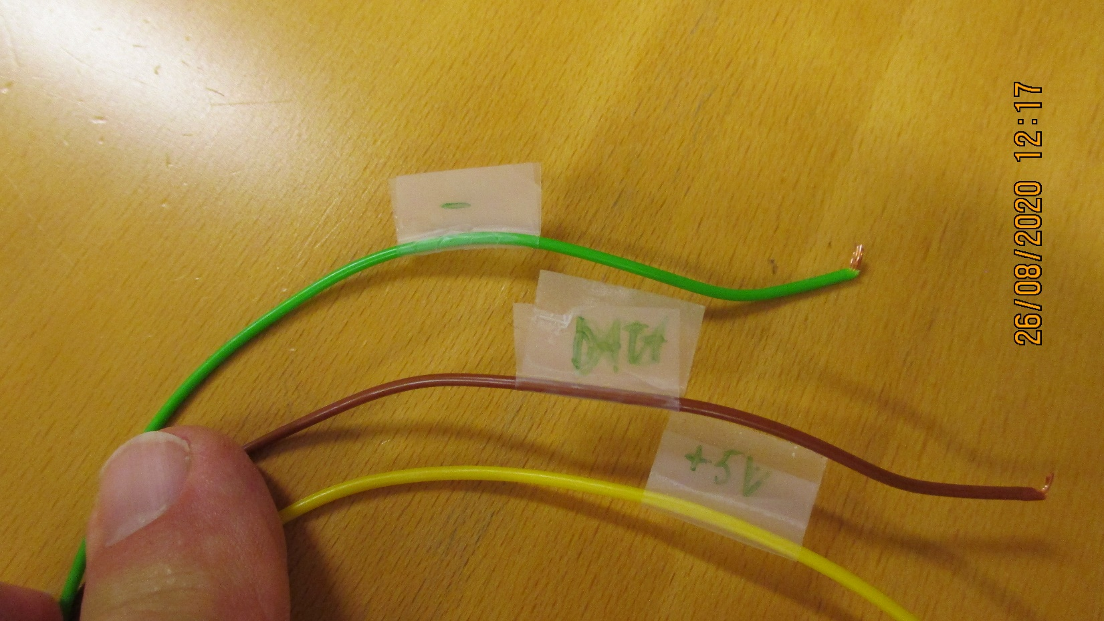
UVC
“ – “
Data
+5V

Slide 6
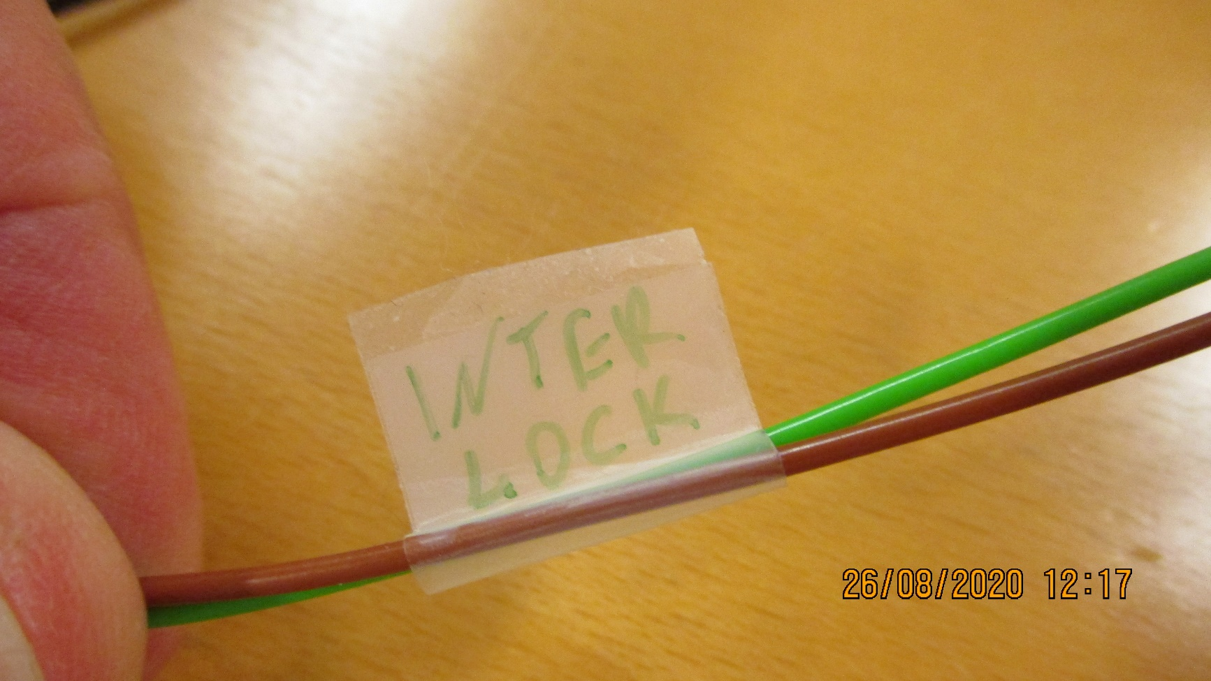
Interlock

Slide 7
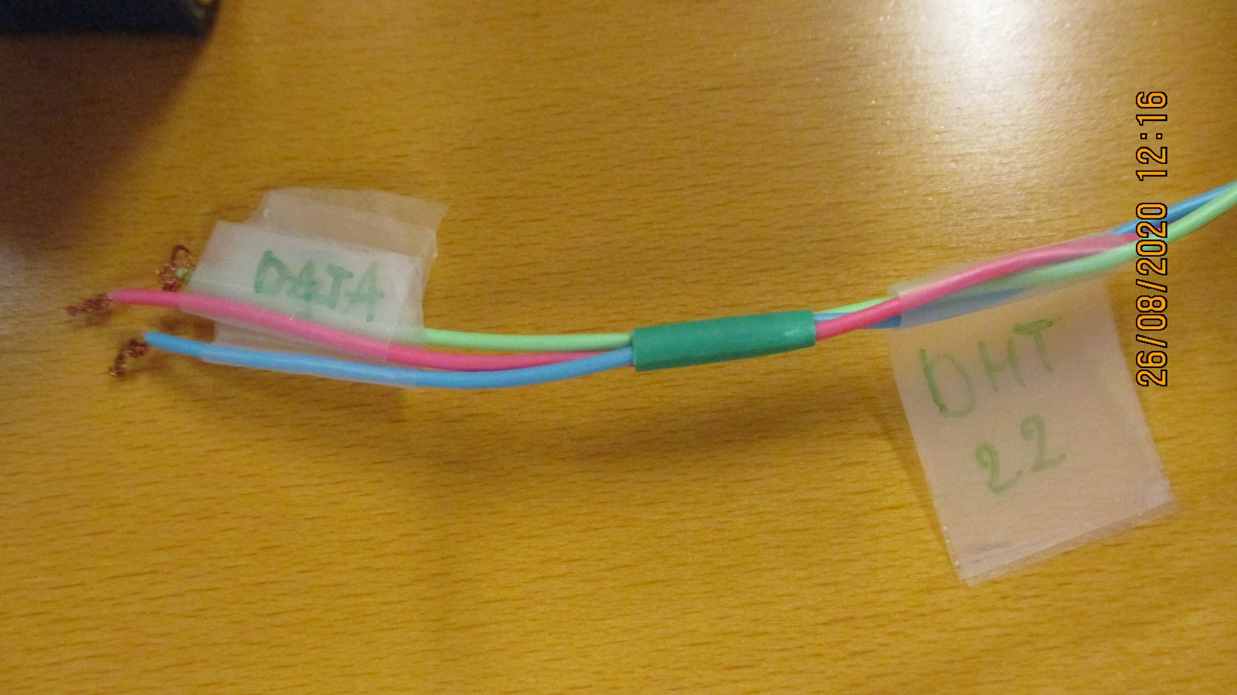
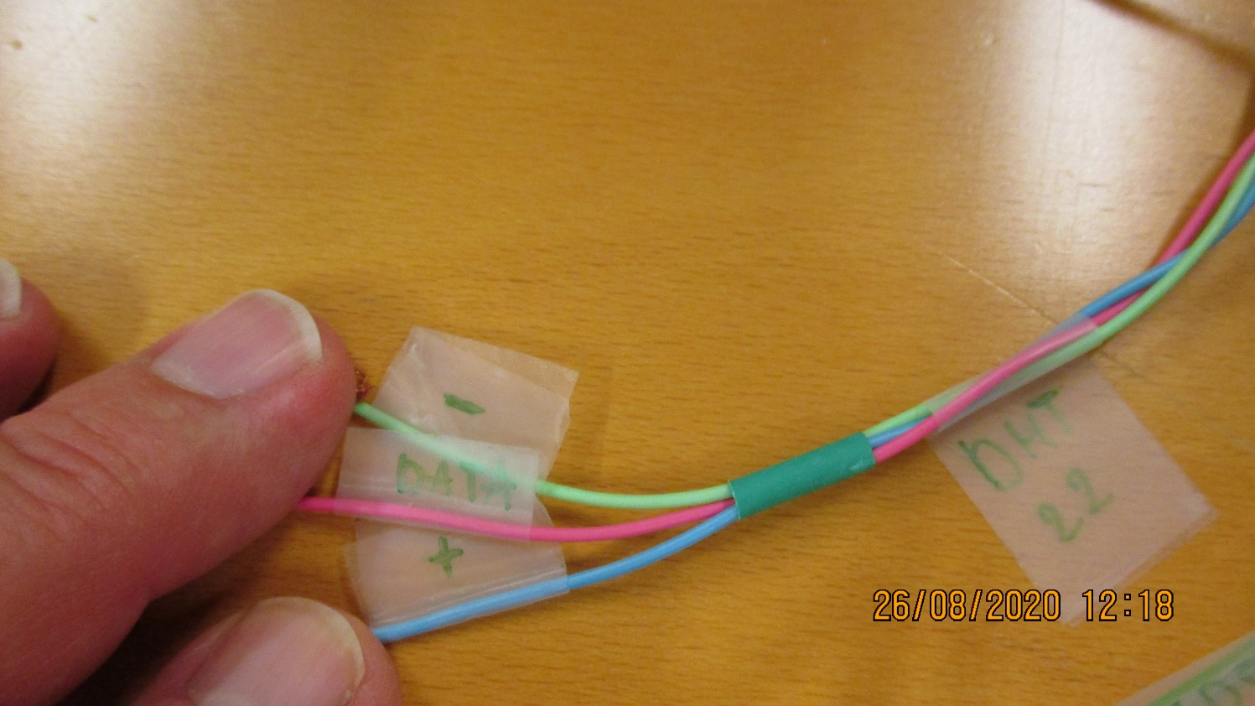
Data
DHT 2.2
“ – “
“ + “

