Slide 1

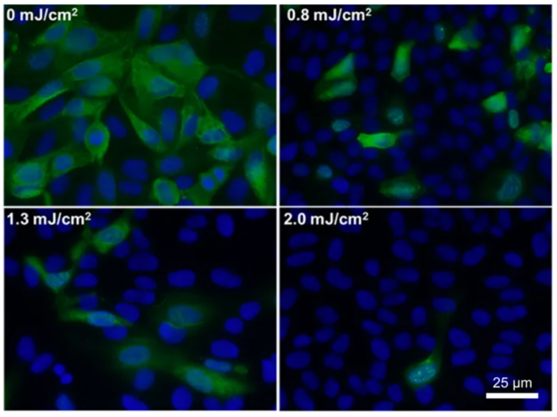
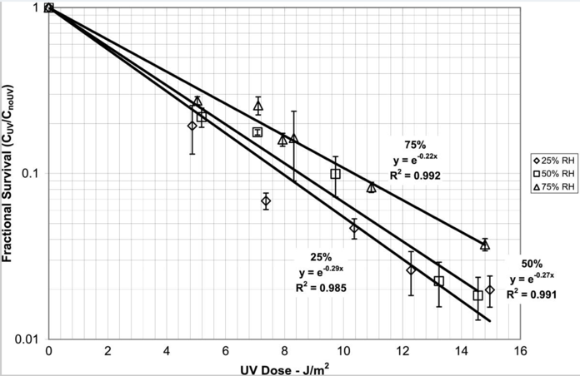
UV-C Disinfection Box project
N. Beni, S. Buontempo, I. Crotty, E. Dimovasili, N.Dupont, A. Lanaro, D. Lomidze, S. Lusin, R. Perruzza, G. Pugliese, Z. Szillasi
UV-C Photon Destroys Virus and Bacteria
98.2% of viruses destroyed by 15 J/m² dose at 75% RH using 4.9 eV photons -> 254nm UVC
Source: https://www.ncbi.nlm.nih.gov/pmc/articles/PMC3298127/
Green fluorescence: test samples incubated with N1H1 virus
Blue fluorescence: number of sterilized cells
Source: Sci Rep 8, 2752 (2018). https://doi.org/10.1038/s41598-018-21058-w

Slide 2
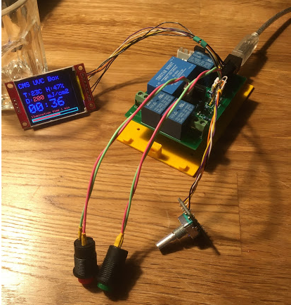
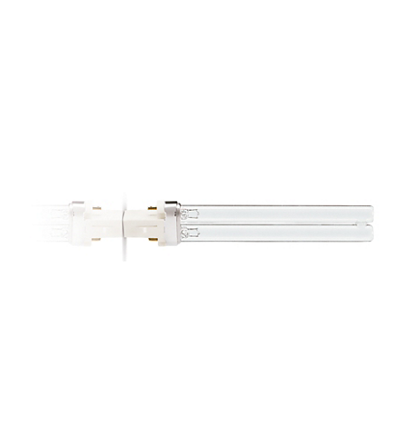
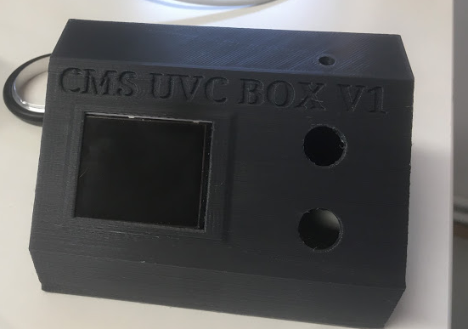
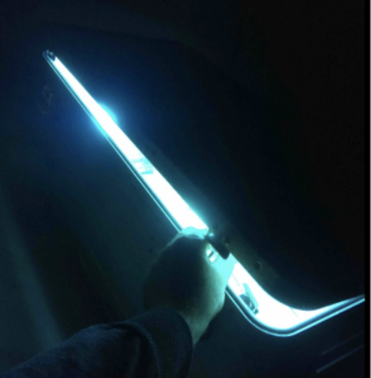
CFL Based UVC Disinfection Box
A first prototype of UV-C disinfection box was designed and built by our CMS colleague David Lomidze in Germany.
Box design:
  Aluminium box
  UVC source: 6 x Mercury vapour based CFL
  54 W total power (electrical)
  Mirrored Inner Surface / Uniform Illumination
Features:
  Console for local or remote (wifi) control
  Time based dose regulation
  Dose, temperature and humidity monitoring
  Interlock system for radiation and high voltage safety
Philips 9W CFL
Glowing UVC radiation from 1st prototype

Slide 3
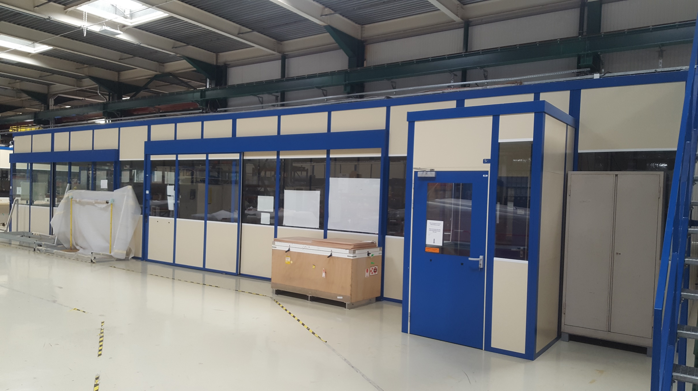
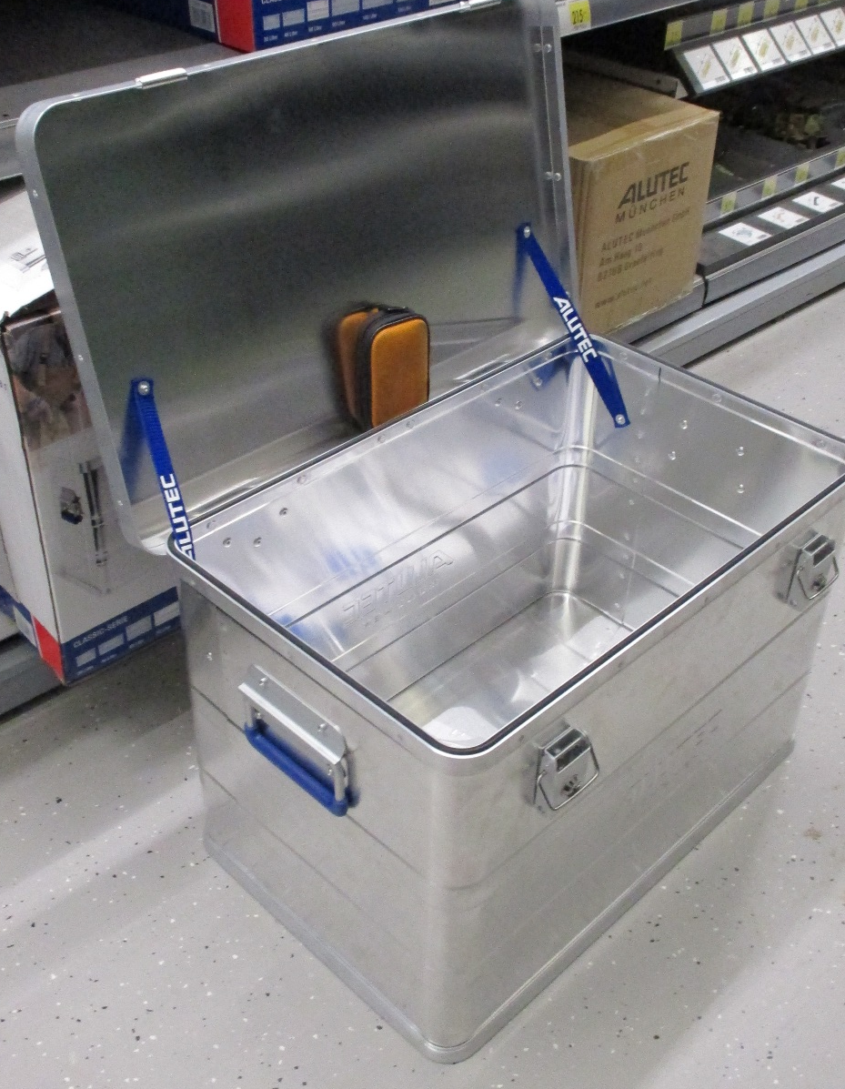
CFL Based UVC Disinfection Box @ CERN
  The CMS team is working to produce and test several disinfection boxes to disinfect tools, materials, PPE.
  Status and plan
  CSC lab in 904 building has been prepared
  Material procurement on going
  Box assembling starting this week
Circuit diagram

Slide 4
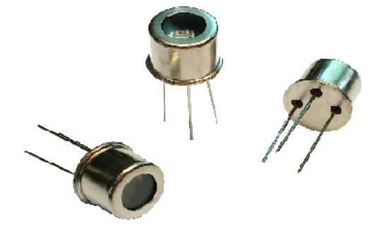
CFL Based UVC Disinfection Box @ CERN
Box validation @ CERN
Dose measurements
UV-C sensors will be installed in order to measure:
Irradiation uniformity and optimization of the lamp location
Dose measurements vs. time
Based on our estimation: ~500 uWSec/cm² x 20 sec irradiation
→ 10 mJ/cm² dose (in the fairest point 16cm away)
→ 5 min irradiation delivers 150 mJ/cm² dose
Electrical and radiation safety
Preliminary irradiation validation:
Tools of different materials (plastic, metal, etc) will be irradiated. The integrity will checked with visual inspection
Masks will be irradiated and efficiecy valuated
UV-C sensors: GUVC-T21GH
Distributor: https://www.tecnosens.it/
  Final validation will be performed in Biological laboratories specialized on studies of SARS-CoV-2 virus

