Slide 1
UVC disinfection Box for surfaces
Ian
25 June 2020

Slide 2
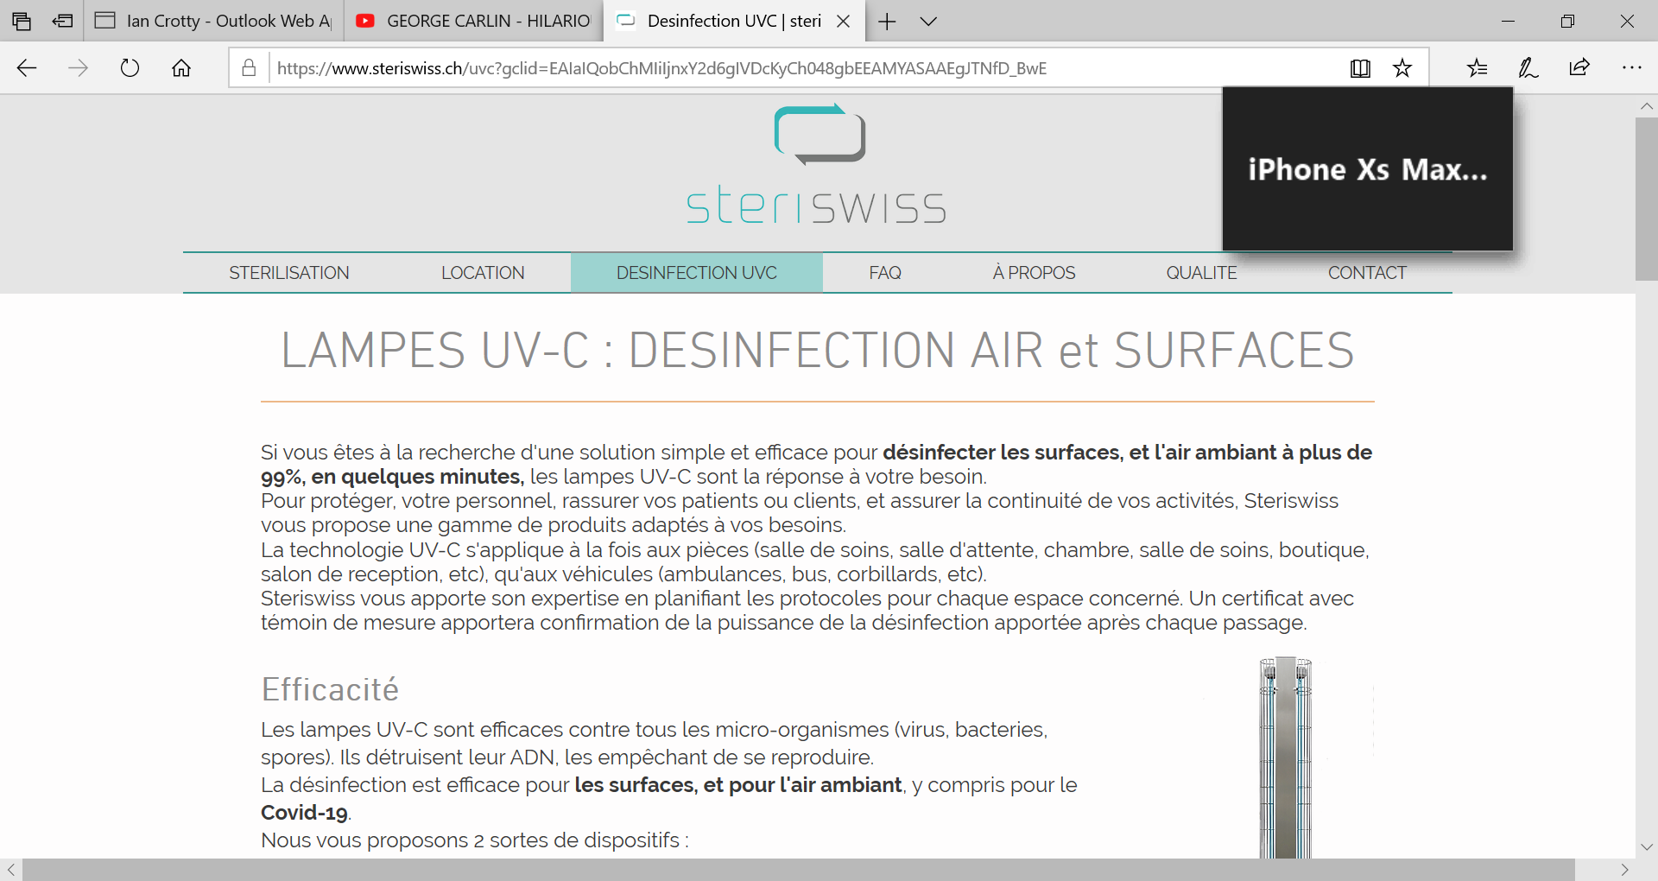
https://www.steriswiss.ch/uvc?gclid=EAIaIQobChMIiIjnxY2d6gIVDcKyCh048gbEEAMYASAAEgJTNfD_BwE

Slide 3
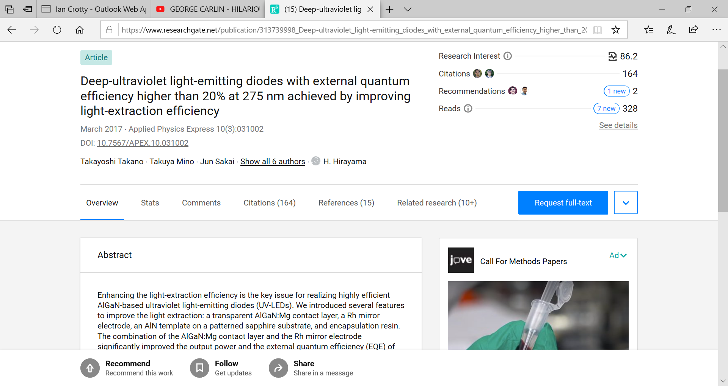
https://www.researchgate.net/publication/313739998_Deep-ultraviolet_light-emitting_diodes_with_external_quantum_efficiency_higher_than_20_at_275_nm_achieved_by_improving_light-extraction_efficiency

