Slide 1
Cables & Cooling installation in P5 MPR Ian Crotty 24 July 2013

Slide 2
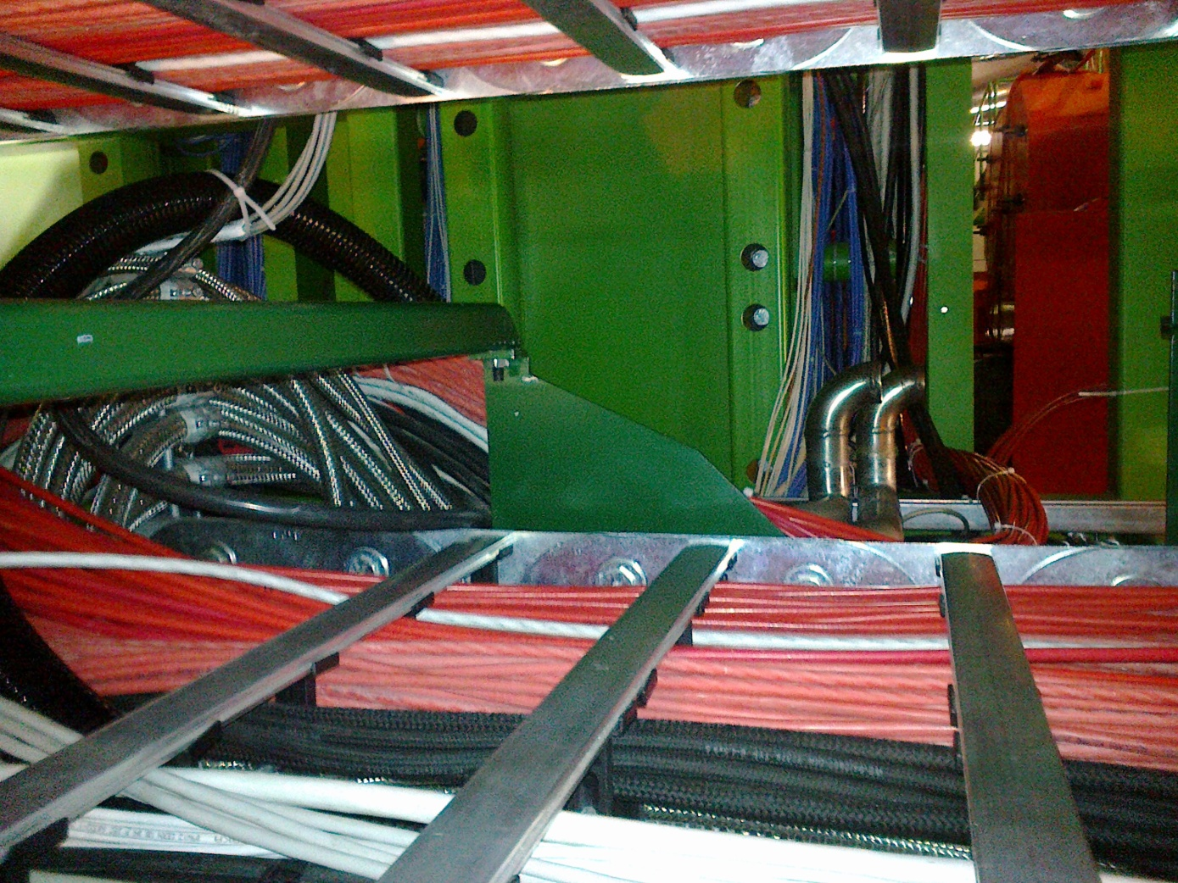
Newly installed HV cables YE1 PP
Far is done , Near Finished week 30.
Cables are laid out near the Chambers as there is no access to the non-IP side of YE3 today
Need to do some repairs & mount new male screen connectors.
New cables

Slide 3
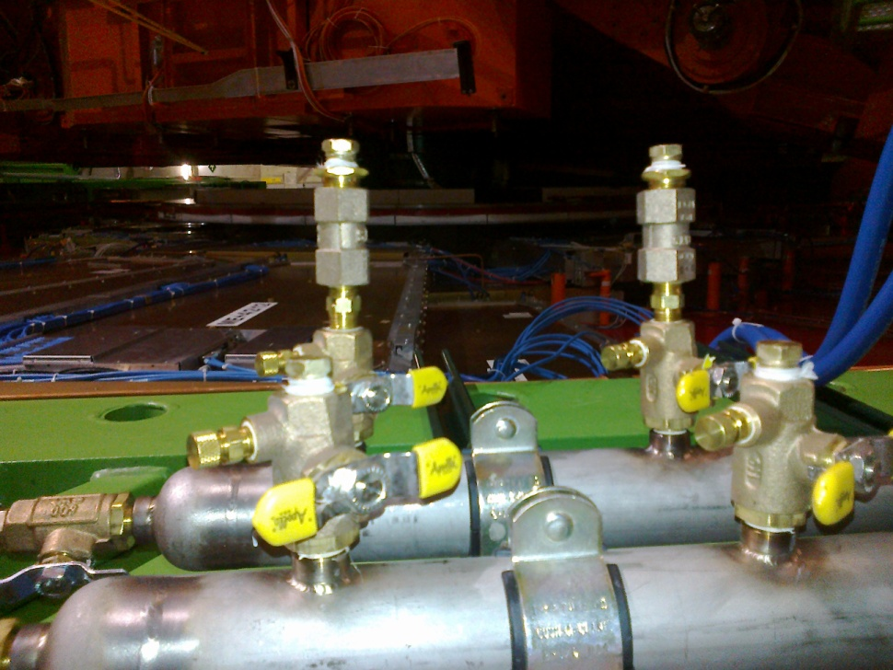
Cooling Manifolds on YE+3
YE -3 will be done by ZEC by the end of the year
Flexibles will go from these points to the SMs.
Return with Valve and Impedance
commissioned and running at 10.5Bar
Supply shut off Valves

Slide 4
Signal cables & DCS
All 864 cables (& 144 DCS) delivered to P5 and tested, inc skew.
A few cables on the RE-4 will be re-assembled.
Cable path is defined but alternative paths are under investigation to reduce intervention time & costs. The passage thru’ the floor is difficult.
Do we Pre-install the signal, as done for the HV, before the Chamber installation ?

Slide 5
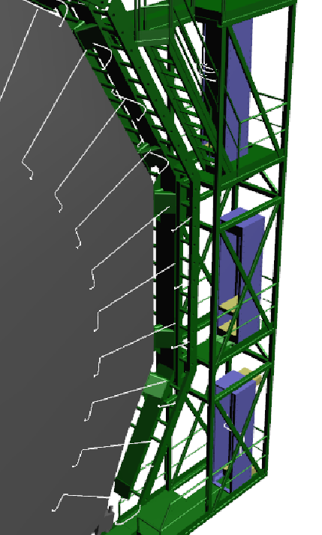
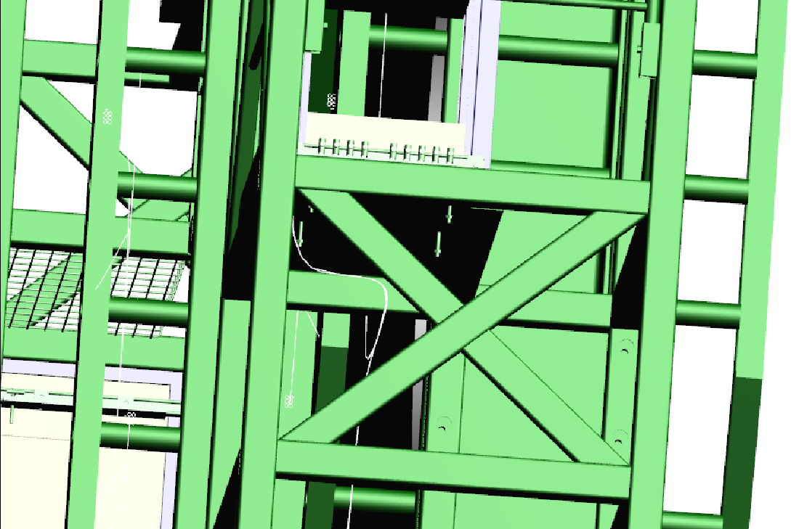
Signal Cables paths 3D model
All 3D models done y S. Bally
Passage under racks

Slide 6
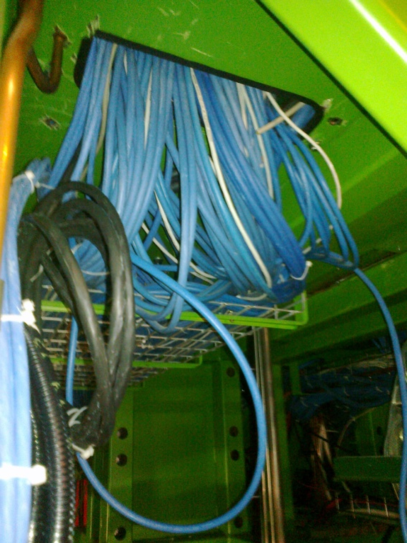
This is a big job. New cable trays & cabling under racks to be tidied
Add new Cable trays

Slide 7
Conclusions
Cables from Chambers to racks/PP are ready, installation on YE+3 is progressing with Bulgarian team till mid Aug 2013.
Cabling within and between racks is being established.
Cabling in Main cable chains, if needed(Umbilical HV, Branch Controller), will be a difficult job, paid by TC.
Cooling is ready for final installation.

