Slide 1
HV Cables installation in P5 & service concerns Mini Cable Chains YE1PP to Chambers Main Cable Chains USC to UXC Ian Crotty 10 July 2013

Slide 2
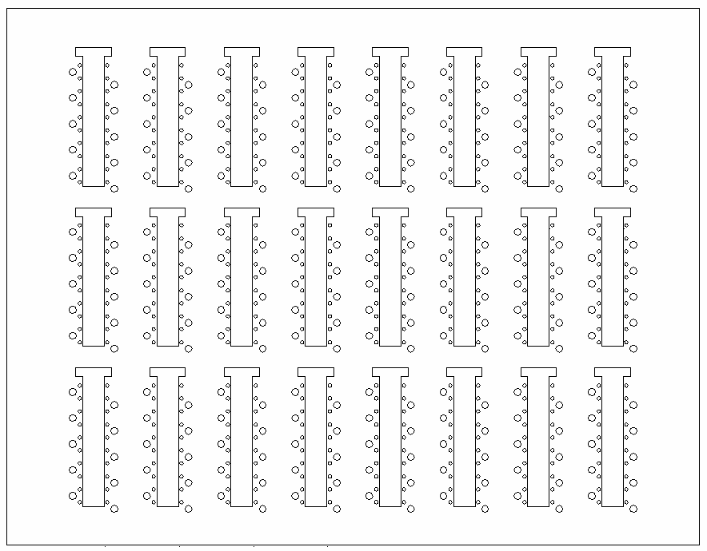
Cables in back of rack
1
3
5
7
9
11
13
16
RE YE+1 Far HV PP as seen from IP
2
4
6
8
10
12
14
15
PP in UXC
spare
spare
spare
spare
RE3/1
RE2/1
RE1/1
Sp
28
27
26
25
24
23
22
21
20
RE1/1
Sp
19
18
17
16
15
14
13
12
11
The original layout
RE1/1
RE4 only ½ of the chambers
16
12
RE4/2
RE4/2
RE3/2
Sp
28
27
26
25
24
23
22
21
20
RE3/2
Sp
19
18
17
16
15
14
13
12
11
RE2/2
Sp
28
27
26
25
24
23
22
21
20
RE2/2
Sp
19
18
17
16
15
14
13
12
11
RE1/2
Sp
28
27
26
25
24
23
22
21
20
RE1/2
Sp
19
18
17
16
15
14
13
12
11
Sp
28
27
26
25
24
23
22
21
20
1
2
3
4
13
14
15
RE4/3
RE4/3
RE3/3
Sp
28
27
26
25
24
23
22
21
20
RE3/3
Sp
19
18
17
16
15
14
13
12
11
RE2/3
Sp
28
27
26
25
24
23
22
21
20
RE2/3
Sp
19
18
17
16
15
14
13
12
11
RE1/3
Sp
28
27
26
25
24
23
22
21
20
RE1/3
Sp
19
18
17
16
15
14
13
12
11
Sp
19
18
17
16
15
14
13
12
11
5
6
7
8
9
10
11

Slide 3
Cables in back of rack
1
3
5
7
9
11
13
16
RE YE+1 Far HV PP as seen from IP
2
4
6
8
10
12
14
15
PP in UXC
spare
spare
spare
spare
RE3/1
RE2/1
RE4/3
RE4/2
Sp
19
18
17
16
15
14
13
12
11
Sp
19
18
17
16
15
14
13
12
11
The new layout
For RE4 low eta
16
12
RE4/2
RE4/2
RE3/2
Sp
28
27
26
25
24
23
22
21
20
RE3/2
Sp
19
18
17
16
15
14
13
12
11
RE2/2
Sp
28
27
26
25
24
23
22
21
20
RE2/2
Sp
19
18
17
16
15
14
13
12
11
RE1/2
Sp
28
27
26
25
24
23
22
21
20
RE1/2
Sp
19
18
17
16
15
14
13
12
11
Sp
28
27
26
25
24
23
22
21
20
1
2
3
4
13
14
15
RE4/3
RE4/3
Sp
28
27
26
25
24
23
22
21
20
RE3/3
Sp
28
27
26
25
24
23
22
21
20
RE3/3
Sp
19
18
17
16
15
14
13
12
11
RE2/3
Sp
28
27
26
25
24
23
22
21
20
RE2/3
Sp
19
18
17
16
15
14
13
12
11
RE1/3
Sp
28
27
26
25
24
23
22
21
20
RE1/3
Sp
19
18
17
16
15
14
13
12
11
5
6
7
8
9
10
11

Slide 4
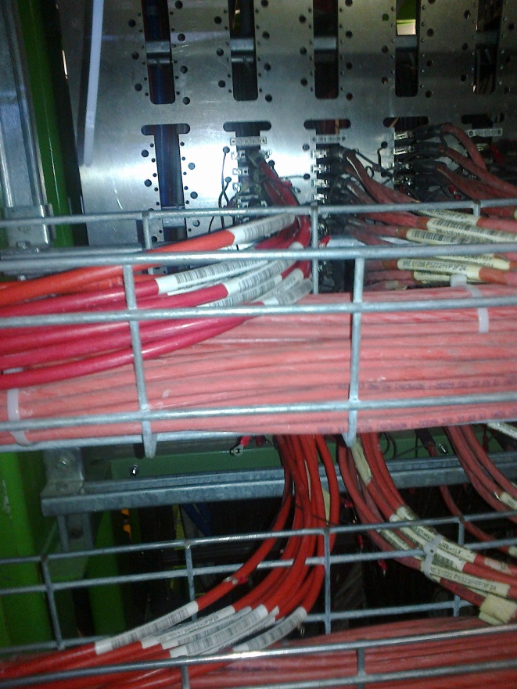
Newly installed HV cables on Far YE1 PP
Situation as of 10 July
New cables

Slide 5
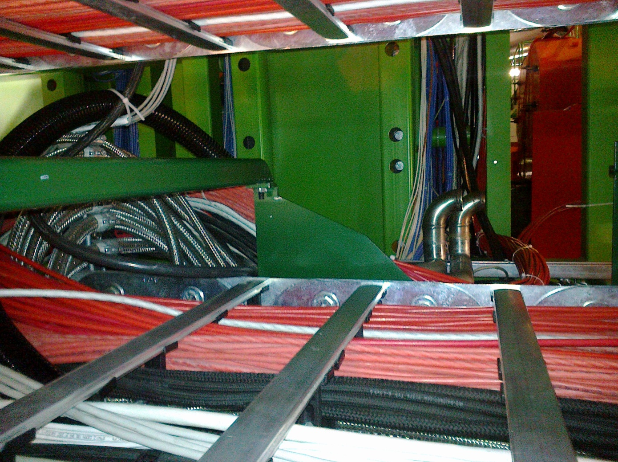
Mini cable chain finally gave little concern
New Cables

Slide 6
YE1 +z Near
Cables underground to be installed in week 29

Slide 7
Main Cable chain proposal
Add umbilical cables between USC & UXC YE1s
Supply RE1/1 chambers
Spares for present system
Demonstrator installations
The job will be slow at 1 cable/2-3days
Between 1-2 cables per main Chains
= 4-8 cables total
Installation costs are paid by TC

Slide 8
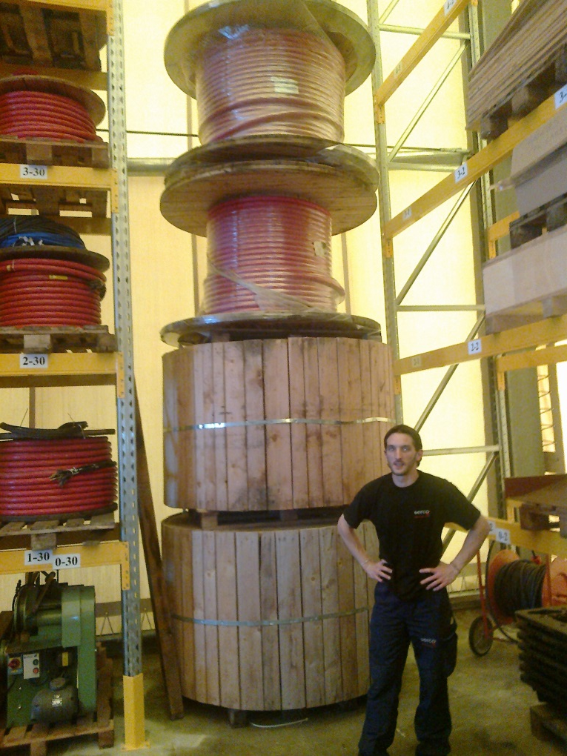
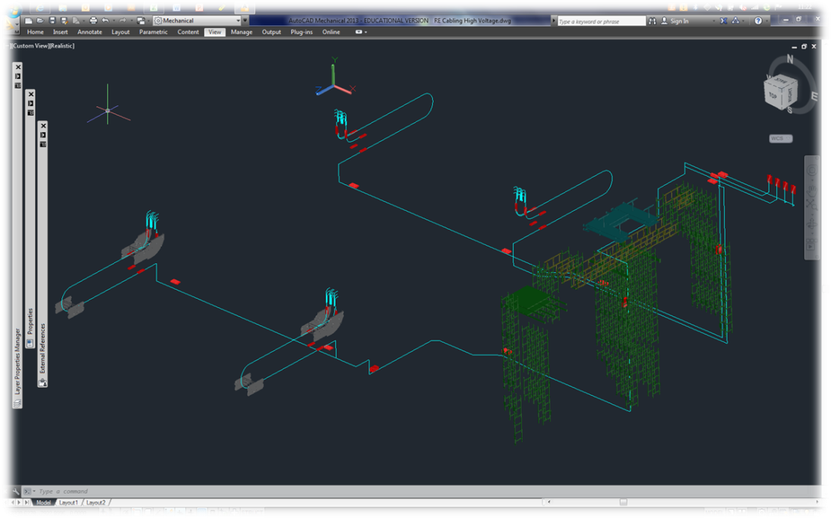
The path is clear and we have the cable. This is a big job
Approx 1.5km
Cable length 57-90m

Slide 9
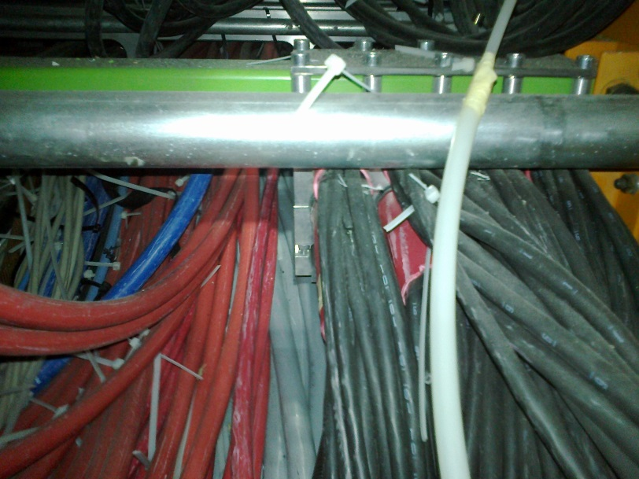
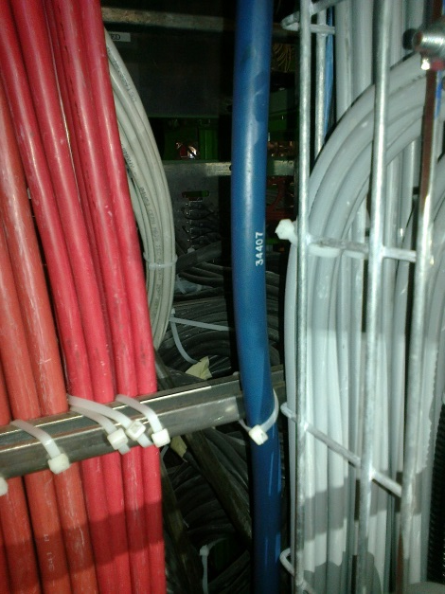
But it gets worse in the last 5% of the path length
Clamp of thee Cable under PP YE1
The Main Cable chains in X0 under CMS
Access to rear of the PP

Slide 10
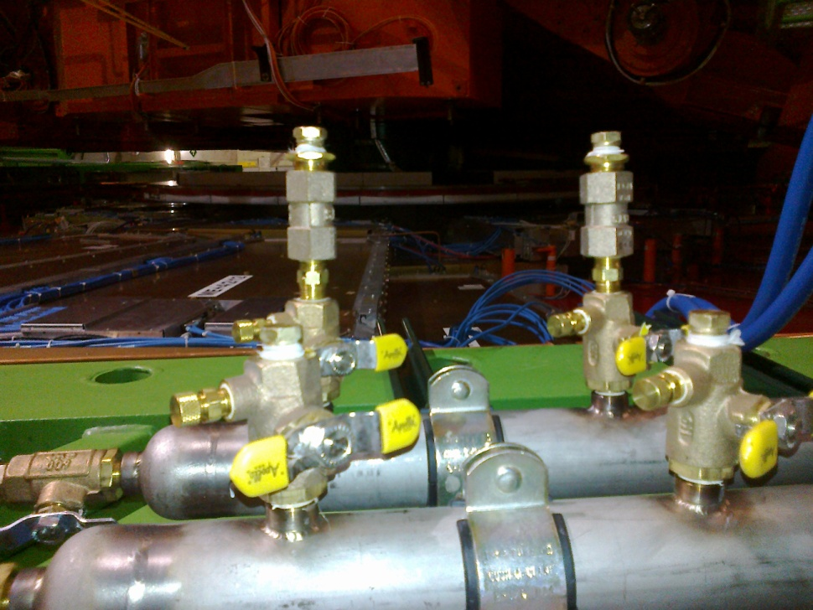
Minor concern with Cooling Manifold
There are 2 different unions required on the RE4 connexion to the manifold. We have today only the1/4”. The others will be found as they have been sent to CERN.
3/8” union on Flow restrictor
¼ inch union on the Valves

Slide 11
Leak rates
The CSCs have had their cooling circuits tested with snoop. Implying ~1E-02 [mbar.l/s]
The P5 circuits required <100mbar/hr for a volume of some few hundred litres ~
5E0 [mbar.l/s]
To be understood.

Slide 12
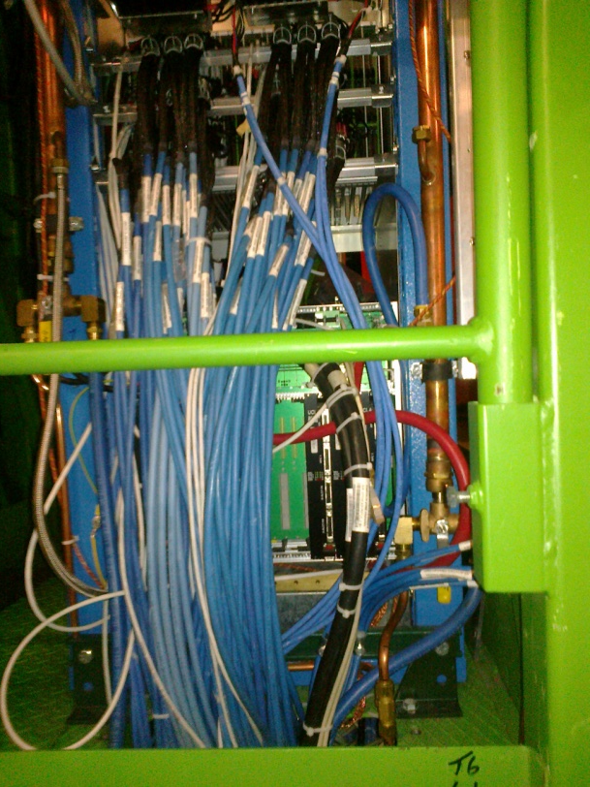
Rack questions
X3J51 & X3V51
CSCs need to install cards soon.
Holes belong to CSCs & must
be made bigger. Remove the floor under
rack ?
Tidy up cabling.
Install new cable trays.
(Recent ?) LV cabling not allowing access to crates.

Slide 13
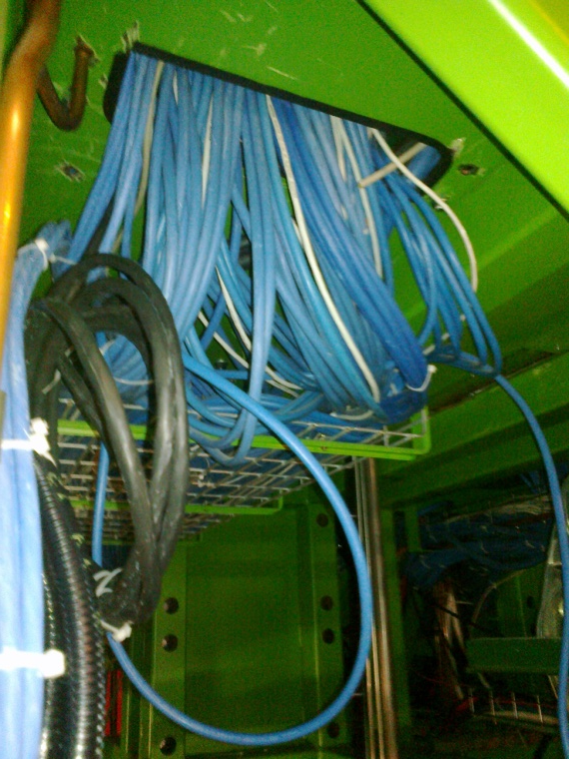
New cable trays & cabling under racks to be tidied
Add new Cable trays

Slide 14
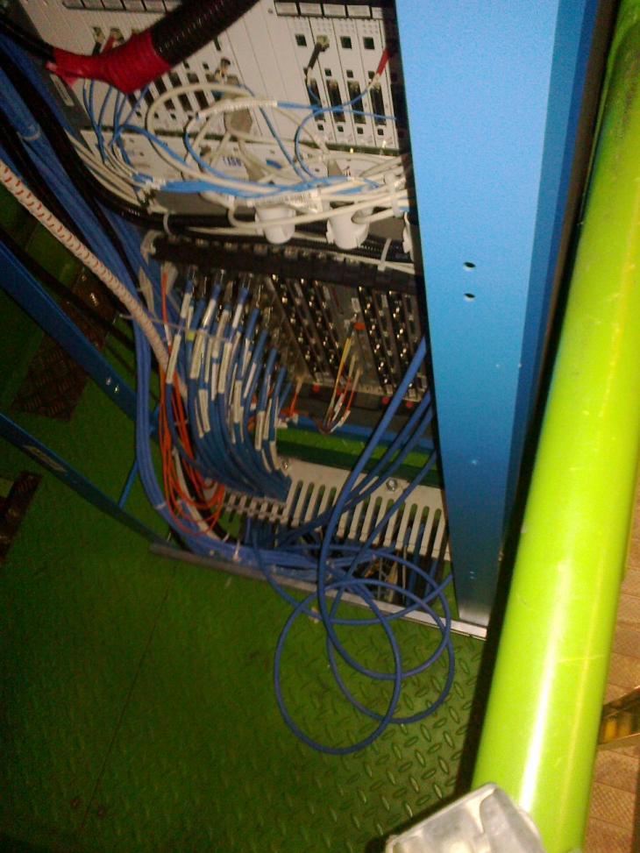
Cabling paths to be refined as now the space is far more limited

Slide 15
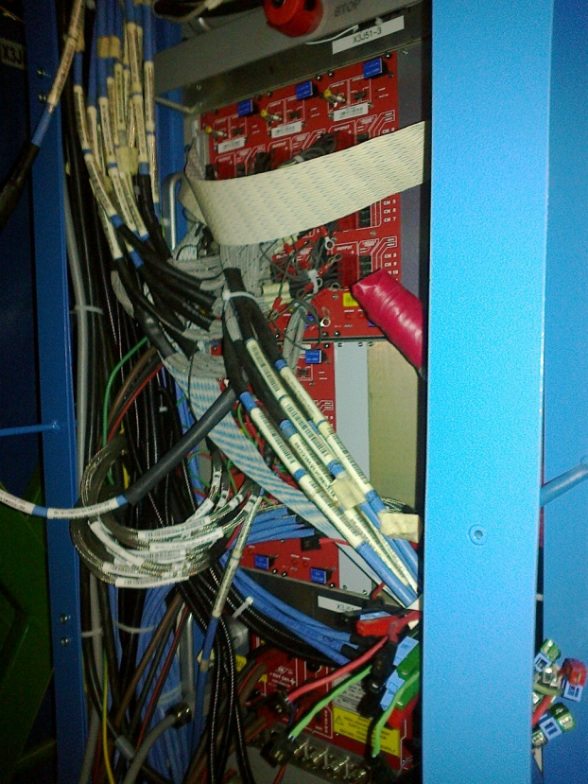
Need to improve cabling routing

