Slide 1
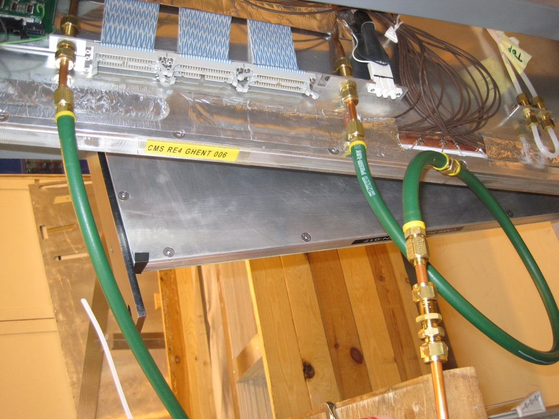
Flexible assembly done onto SMs
“Flexible and union assembly Method” document has started.
http://rpc-cms-re4-upscope.web.cern.ch/rpc-cms-re4-upscope/RPC/Services/Cooling/AssemblyFlexibles/FlexibleAssemblyCoolingRE4.docx
Ian Crotty 11 June 2013

