Slide 1
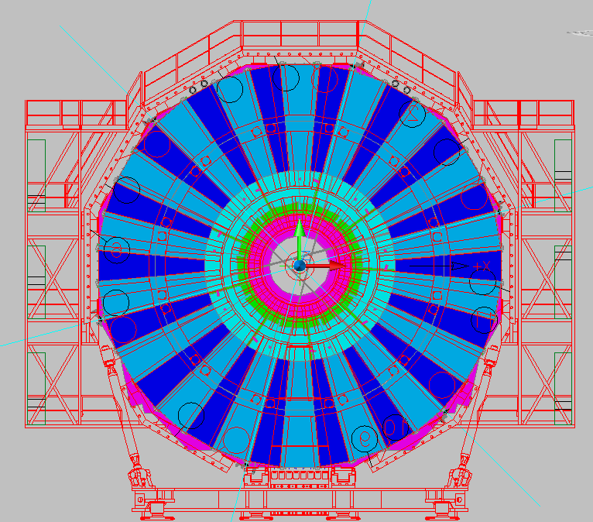
R1 R1 S1 S1 S2 S2 R2 R2
RE4 Bulkheads for gas
R1 R1 S1 S1 S2 S2 R2 R2
6
5
4
7
3
8
2
9
1
10
18
11
17
12
13
16
14
15

Slide 2
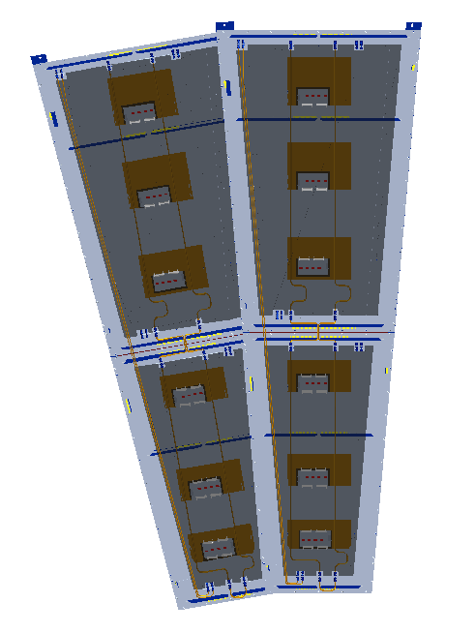
Gas
1 2 3 4 5 6 7 8
5
7
4
2
6
8
3
1
Top and bottom gas gaps on separate channels with “reverse” flow (HF)

Slide 3
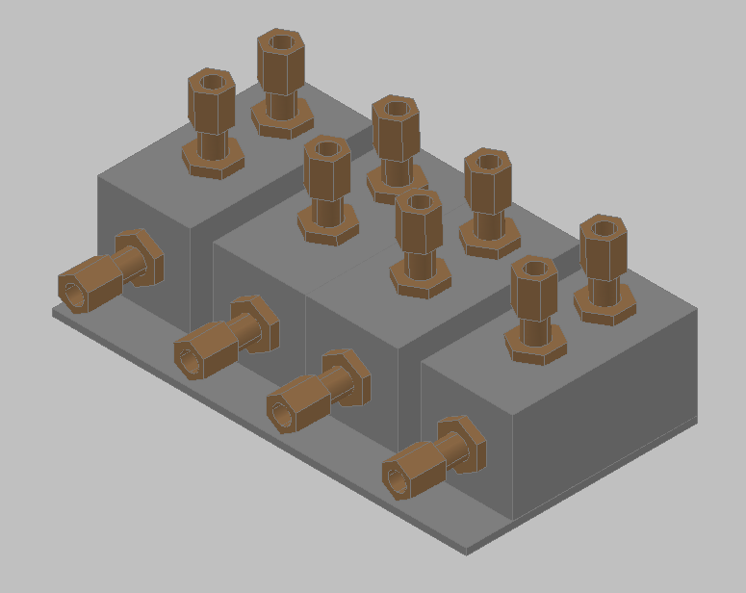

Slide 4
