Slide 1
HV Patch Panel Layout Plan
Waqar Ahmed

Slide 2
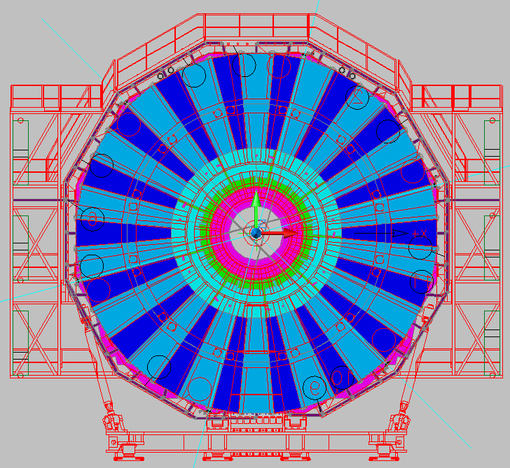
HV cable RE+4 Layout
FAR
11- 28
NEAR
1- 10
29-36

Slide 3
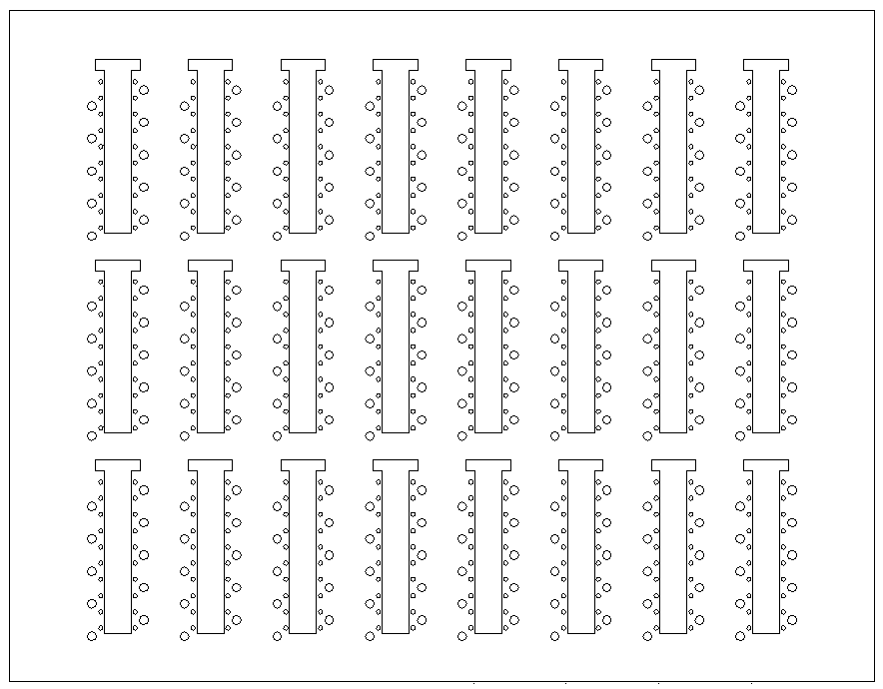
Cables in back of rack
2
4
6
8
13
14
15
16
RE YE+1 Near HV PP as seen from IP
1
3
5
7
9
10
11
12
PP in UXC
RE1/1
Sp
09
08
07
06
05
04
03
02
01
RE1/1
Sp
36
35
34
33
32
31
30
29
10
RE2/1
RE3/1
spare
spare
spare
spare
9
16
RE1/2
Sp
09
08
07
06
05
04
03
02
01
RE1/2
Sp
36
35
34
33
32
31
30
29
10
RE2/2
Sp
09
08
07
06
05
04
03
02
01
RE2/2
Sp
36
35
34
33
32
31
30
29
10
RE3/2
Sp
09
08
07
06
05
04
03
02
01
RE3/2
Sp
36
35
34
33
32
31
30
29
10
RE4/2
RE4/2
Sp
36
35
34
33
32
31
30
29
10
11
14
13
7
8
6
2
RE1/3
Sp
09
08
07
06
05
04
03
02
01
RE1/3
Sp
36
35
34
33
32
31
30
29
10
RE2/3
Sp
09
08
07
06
05
04
03
02
01
RE2/3
Sp
36
35
34
33
32
31
30
29
10
RE3/3
Sp
09
08
07
06
05
04
03
02
01
RE3/3
Sp
36
35
34
33
32
31
30
29
10
RE4/3
RE4/3
Sp
09
08
07
06
05
04
03
02
01
15
10
12
4
3
5
1

Slide 4
Cables in back of rack
2
4
6
8
13
14
15
16
RE YE+1 Near HV PP as seen from IP
1
3
5
7
9
10
11
12
RE 4 HV
PP in UXC
RE4/2
Sp
09
08
07
06
05
04
03
02
01
RE4/3
RE2/1
RE3/1
spare
spare
spare
spare
Sp
09
08
07
06
05
04
03
02
01
9
16
RE1/2
Sp
09
08
07
06
05
04
03
02
01
RE1/2
Sp
36
35
34
33
32
31
30
29
10
RE2/2
Sp
09
08
07
06
05
04
03
02
01
RE2/2
Sp
36
35
34
33
32
31
30
29
10
RE3/2
Sp
09
08
07
06
05
04
03
02
01
RE3/2
Sp
36
35
34
33
32
31
30
29
10
RE4/2
RE4/2
Sp
36
35
34
33
32
31
30
29
10
11
14
13
7
8
6
2
RE1/3
Sp
09
08
07
06
05
04
03
02
01
RE1/3
Sp
36
35
34
33
32
31
30
29
10
RE2/3
Sp
09
08
07
06
05
04
03
02
01
RE2/3
Sp
36
35
34
33
32
31
30
29
10
RE3/3
Sp
09
08
07
06
05
04
03
02
01
RE3/3
Sp
36
35
34
33
32
31
30
29
10
RE4/3
Sp
36
35
34
33
32
31
30
29
10
RE4/3
15
10
12
4
3
5
1

Slide 5
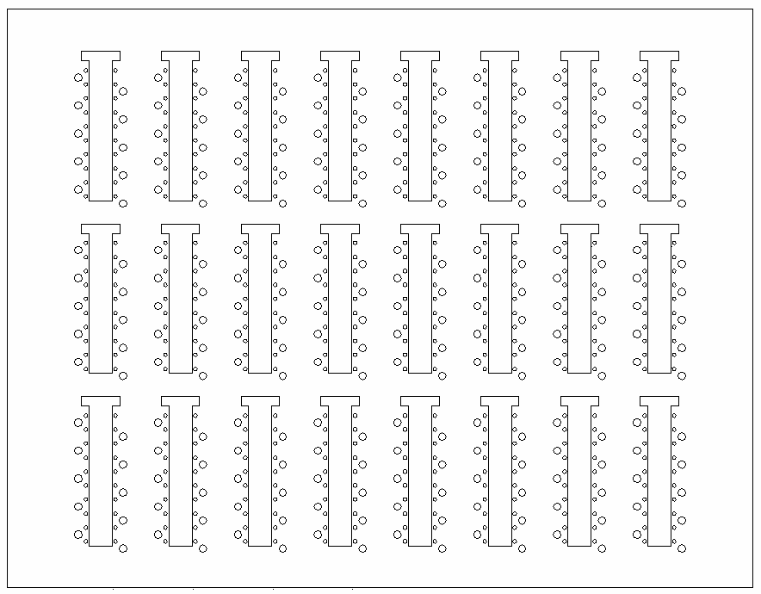
Cables in back of rack
1
3
5
7
9
11
13
16
RE YE+1 Far HV PP as seen from IP
2
4
6
8
10
12
14
15
PP in UXC
spare
spare
spare
spare
RE3/1
RE2/1
RE1/1
Sp
28
27
26
25
24
23
22
21
20
RE1/1
Sp
19
18
17
16
15
14
13
12
11
16
12
RE4/2
RE4/2
RE3/2
Sp
28
27
26
25
24
23
22
21
20
RE3/2
Sp
19
18
17
16
15
14
13
12
11
RE2/2
Sp
28
27
26
25
24
23
22
21
20
RE2/2
Sp
19
18
17
16
15
14
13
12
11
RE1/2
Sp
28
27
26
25
24
23
22
21
20
RE1/2
Sp
19
18
17
16
15
14
13
12
11
Sp
28
27
26
25
24
23
22
21
20
1
2
3
4
13
14
15
RE4/3
RE4/3
RE3/3
Sp
28
27
26
25
24
23
22
21
20
RE3/3
Sp
19
18
17
16
15
14
13
12
11
RE2/3
Sp
28
27
26
25
24
23
22
21
20
RE2/3
Sp
19
18
17
16
15
14
13
12
11
RE1/3
Sp
28
27
26
25
24
23
22
21
20
RE1/3
Sp
19
18
17
16
15
14
13
12
11
Sp
19
18
17
16
15
14
13
12
11
5
6
7
8
9
10
11

Slide 6
Cables in back of rack
1
3
5
7
9
11
13
16
RE YE+1 Far HV PP as seen from IP
2
4
6
8
10
12
14
15
PP in UXC
spare
spare
spare
spare
RE3/1
RE2/1
RE4/3
RE4/2
Sp
19
18
17
16
15
14
13
12
11
Sp
19
18
17
16
15
14
13
12
11
16
12
RE4/2
RE4/2
RE3/2
Sp
28
27
26
25
24
23
22
21
20
RE3/2
Sp
19
18
17
16
15
14
13
12
11
RE2/2
Sp
28
27
26
25
24
23
22
21
20
RE2/2
Sp
19
18
17
16
15
14
13
12
11
RE1/2
Sp
28
27
26
25
24
23
22
21
20
RE1/2
Sp
19
18
17
16
15
14
13
12
11
Sp
28
27
26
25
24
23
22
21
20
1
2
3
4
13
14
15
RE4/3
RE4/3
Sp
28
27
26
25
24
23
22
21
20
RE3/3
Sp
28
27
26
25
24
23
22
21
20
RE3/3
Sp
19
18
17
16
15
14
13
12
11
RE2/3
Sp
28
27
26
25
24
23
22
21
20
RE2/3
Sp
19
18
17
16
15
14
13
12
11
RE1/3
Sp
28
27
26
25
24
23
22
21
20
RE1/3
Sp
19
18
17
16
15
14
13
12
11
5
6
7
8
9
10
11

Slide 7
HV cable RE- 4 Layout
FAR
1- 10
29-36
NEAR
11- 28

Slide 8
Cables in back of rack
1
3
5
7
9
11
13
16
RE YE-1 Near HV PP as seen from IP
2
4
6
8
10
12
14
15
PP in UXC
spare
spare
spare
spare
RE3/1
RE2/1
RE1/1
Sp
28
27
26
25
24
23
22
21
20
RE1/1
Sp
19
18
17
16
15
14
13
12
11
RE4/2
RE4/2
RE3/2
Sp
28
27
26
25
24
23
22
21
20
RE3/2
Sp
19
18
17
16
15
14
13
12
11
RE2/2
Sp
28
27
26
25
24
23
22
21
20
RE2/2
Sp
19
18
17
16
15
14
13
12
11
RE1/2
Sp
28
27
26
25
24
23
22
21
20
RE1/2
Sp
19
18
17
16
15
14
13
12
11
Sp
28
27
26
25
24
23
22
21
20
1
2
3
4
13
14
15
RE4/3
RE4/3
RE3/3
Sp
28
27
26
25
24
23
22
21
20
RE3/3
Sp
19
18
17
16
15
14
13
12
11
RE2/3
Sp
28
27
26
25
24
23
22
21
20
RE2/3
Sp
19
18
17
16
15
14
13
12
11
RE1/3
Sp
28
27
26
25
24
23
22
21
20
RE1/3
Sp
19
18
17
16
15
14
13
12
11
Sp
19
18
17
16
15
14
13
12
11
5
6
7
8
9
10
11

Slide 9
Cables in back of rack
1
3
5
7
9
11
13
16
RE YE-1 Near HV PP as seen from IP
2
4
6
8
10
12
14
15
PP in UXC
spare
spare
spare
spare
RE3/1
RE2/1
RE4/3
RE4/2
Sp
19
18
17
16
15
14
13
12
11
Sp
19
18
17
16
15
14
13
12
11
RE4/2
RE4/2
RE3/2
Sp
28
27
26
25
24
23
22
21
20
RE3/2
Sp
19
18
17
16
15
14
13
12
11
RE2/2
Sp
28
27
26
25
24
23
22
21
20
RE2/2
Sp
19
18
17
16
15
14
13
12
11
RE1/2
Sp
28
27
26
25
24
23
22
21
20
RE1/2
Sp
19
18
17
16
15
14
13
12
11
Sp
28
27
26
25
24
23
22
21
20
2
3
4
13
14
15
RE4/3
RE4/3
Sp
28
27
26
25
24
23
22
21
20
RE3/3
Sp
28
27
26
25
24
23
22
21
20
RE3/3
Sp
19
18
17
16
15
14
13
12
11
RE2/3
Sp
28
27
26
25
24
23
22
21
20
RE2/3
Sp
19
18
17
16
15
14
13
12
11
RE1/3
Sp
28
27
26
25
24
23
22
21
20
RE1/3
Sp
19
18
17
16
15
14
13
12
11
6
7
8
9
10
11

Slide 10
Cables in back of rack
2
4
6
8
13
14
15
16
RE YE-1 Far HV PP as seen from IP
1
3
5
7
9
10
11
12
PP in UXC
RE1/1
Sp
09
08
07
06
05
04
03
02
01
RE1/1
Sp
36
35
34
33
32
31
30
29
10
RE2/1
RE3/1
spare
spare
spare
spare
9
16
RE1/2
Sp
09
08
07
06
05
04
03
02
01
RE1/2
Sp
36
35
34
33
32
31
30
29
10
RE2/2
Sp
09
08
07
06
05
04
03
02
01
RE2/2
Sp
36
35
34
33
32
31
30
29
10
RE3/2
Sp
09
08
07
06
05
04
03
02
01
RE3/2
Sp
36
35
34
33
32
31
30
29
10
RE4/2
RE4/2
Sp
36
35
34
33
32
31
30
29
10
11
14
13
7
8
6
2
RE1/3
Sp
09
08
07
06
05
04
03
02
01
RE1/3
Sp
36
35
34
33
32
31
30
29
10
RE2/3
Sp
09
08
07
06
05
04
03
02
01
RE2/3
Sp
36
35
34
33
32
31
30
29
10
RE3/3
Sp
09
08
07
06
05
04
03
02
01
RE3/3
Sp
36
35
34
33
32
31
30
29
10
RE4/3
RE4/3
Sp
09
08
07
06
05
04
03
02
01
15
10
12
4
3
5
1

Slide 11
Cables in back of rack
2
4
6
8
13
14
15
16
RE YE-1 Far HV PP as seen from IP
1
3
5
7
9
10
11
12
RE 4 HV
PP in UXC
RE4/2
Sp
09
08
07
06
05
04
03
02
01
RE4/3
RE2/1
RE3/1
spare
spare
spare
spare
Sp
09
08
07
06
05
04
03
02
01
RE1/2
Sp
09
08
07
06
05
04
03
02
01
RE1/2
Sp
36
35
34
33
32
31
30
29
10
RE2/2
Sp
09
08
07
06
05
04
03
02
01
RE2/2
Sp
36
35
34
33
32
31
30
29
10
RE3/2
Sp
09
08
07
06
05
04
03
02
01
RE3/2
Sp
36
35
34
33
32
31
30
29
10
RE4/2
RE4/2
Sp
36
35
34
33
32
31
30
29
10
11
14
13
7
8
6
RE1/3
Sp
09
08
07
06
05
04
03
02
01
RE1/3
Sp
36
35
34
33
32
31
30
29
10
RE2/3
Sp
09
08
07
06
05
04
03
02
01
RE2/3
Sp
36
35
34
33
32
31
30
29
10
RE3/3
Sp
09
08
07
06
05
04
03
02
01
RE3/3
Sp
36
35
34
33
32
31
30
29
10
RE4/3
Sp
36
35
34
33
32
31
30
29
10
RE4/3
15
10
12
4
3
5

Slide 12
Cable Routing
Need to check cable no and routing from USC to UXC according to labeling.

Slide 13
Thanks

