Slide 1
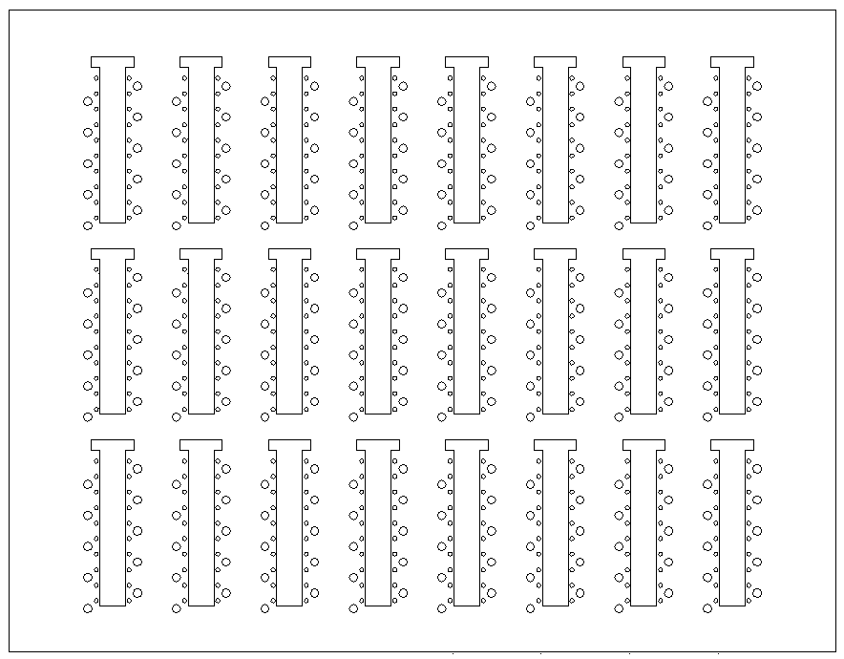
Cables in back of rack
2
4
6
8
13
14
15
16
RE YE+1 Near (+x) HV PP as seen from IP
1
3
5
7
9
10
11
12
PP in UXC
RE1/1
Sp
09
08
07
06
05
04
03
02
01
RE1/1
Sp
36
35
34
33
32
31
30
29
10
RE2/1
RE3/1
spare
spare
spare
spare
9
16
RE1/2
Sp
09
08
07
06
05
04
03
02
01
RE1/2
Sp
36
35
34
33
32
31
30
29
10
RE2/2
Sp
09
08
07
06
05
04
03
02
01
RE2/2
Sp
36
35
34
33
32
31
30
29
10
RE3/2
Sp
09
08
07
06
05
04
03
02
01
RE3/2
Sp
36
35
34
33
32
31
30
29
10
RE4/2
RE4/2
Sp
36
35
34
33
32
31
30
29
10
11
14
13
7
8
6
2
RE1/3
Sp
09
08
07
06
05
04
03
02
01
RE1/3
Sp
36
35
34
33
32
31
30
29
10
RE2/3
Sp
09
08
07
06
05
04
03
02
01
RE2/3
Sp
36
35
34
33
32
31
30
29
10
RE3/3
Sp
09
08
07
06
05
04
03
02
01
RE3/3
Sp
36
35
34
33
32
31
30
29
10
RE4/3
RE4/3
Sp
09
08
07
06
05
04
03
02
01
15
10
12
4
3
5
1

Slide 2
Cables in back of rack
2
4
6
8
13
14
15
16
RE YE+1 Near (+x) HV PP as seen from IP
1
3
5
7
9
10
11
12
RE 4 HV
PP in UXC
RE4/2
Sp
09
08
07
06
05
04
03
02
01
RE4/3
Sp
36
35
34
33
32
31
30
29
10
RE2/1
RE3/1
spare
spare
spare
spare
9
16
RE1/2
Sp
09
08
07
06
05
04
03
02
01
RE1/2
Sp
36
35
34
33
32
31
30
29
10
RE2/2
Sp
09
08
07
06
05
04
03
02
01
RE2/2
Sp
36
35
34
33
32
31
30
29
10
RE3/2
Sp
09
08
07
06
05
04
03
02
01
RE3/2
Sp
36
35
34
33
32
31
30
29
10
RE4/2
RE4/2
Sp
36
35
34
33
32
31
30
29
10
11
14
13
7
8
6
2
RE1/3
Sp
09
08
07
06
05
04
03
02
01
RE1/3
Sp
36
35
34
33
32
31
30
29
10
RE2/3
Sp
09
08
07
06
05
04
03
02
01
RE2/3
Sp
36
35
34
33
32
31
30
29
10
RE3/3
Sp
09
08
07
06
05
04
03
02
01
RE3/3
Sp
36
35
34
33
32
31
30
29
10
RE4/3
RE4/3
Sp
09
08
07
06
05
04
03
02
01
15
10
12
4
3
5
1

Slide 3
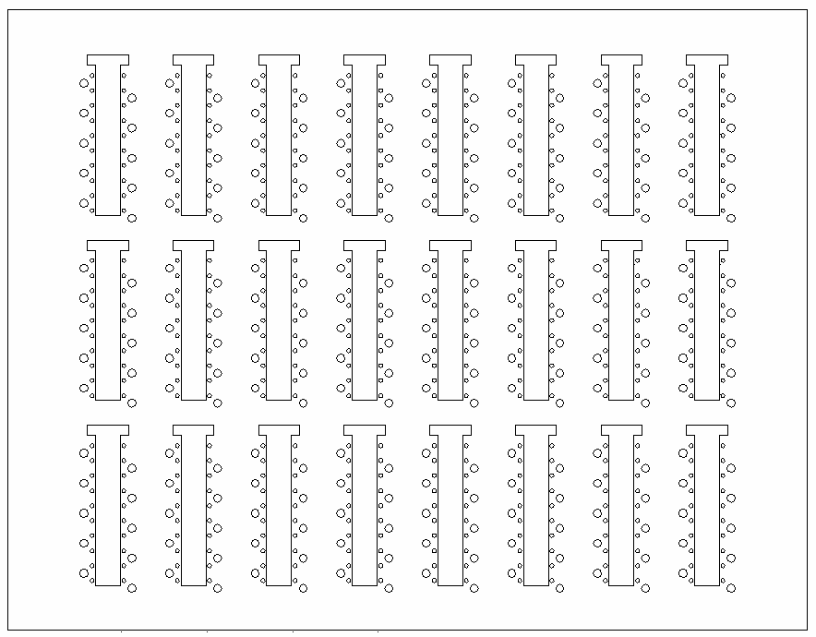
Cables in back of rack
1
3
5
7
9
11
13
16
RE YE+1 Far HV PP as seen from IP
2
4
6
8
10
12
14
15
PP in UXC
spare
spare
spare
spare
RE3/1
RE2/1
RE1/1
Sp
28
27
26
25
24
23
22
21
20
RE1/1
Sp
19
18
17
16
15
14
13
12
11
16
12
RE4/2
RE4/2
RE3/2
Sp
28
27
26
25
24
23
22
21
20
RE3/2
Sp
19
18
17
16
15
14
13
12
11
RE2/2
Sp
28
27
26
25
24
23
22
21
20
RE2/2
Sp
19
18
17
16
15
14
13
12
11
RE1/2
Sp
28
27
26
25
24
23
22
21
20
RE1/2
Sp
19
18
17
16
15
14
13
12
11
Sp
28
27
26
25
24
23
22
21
20
1
2
3
4
13
14
15
RE4/3
RE4/3
RE3/3
Sp
28
27
26
25
24
23
22
21
20
RE3/3
Sp
19
18
17
16
15
14
13
12
11
RE2/3
Sp
28
27
26
25
24
23
22
21
20
RE2/3
Sp
19
18
17
16
15
14
13
12
11
RE1/3
Sp
28
27
26
25
24
23
22
21
20
RE1/3
Sp
19
18
17
16
15
14
13
12
11
Sp
19
18
17
16
15
14
13
12
11
5
6
7
8
9
10
11

Slide 4
Cables in back of rack
1
3
5
7
9
11
13
16
RE YE+1 Far HV PP as seen from IP
2
4
6
8
10
12
14
15
PP in UXC
spare
spare
spare
spare
RE3/1
RE2/1
RE4/3
Sp
28
27
26
25
24
23
22
21
20
RE4/2
Sp
19
18
17
16
15
14
13
12
11
16
12
RE4/2
RE4/2
RE3/2
Sp
28
27
26
25
24
23
22
21
20
RE3/2
Sp
19
18
17
16
15
14
13
12
11
RE2/2
Sp
28
27
26
25
24
23
22
21
20
RE2/2
Sp
19
18
17
16
15
14
13
12
11
RE1/2
Sp
28
27
26
25
24
23
22
21
20
RE1/2
Sp
19
18
17
16
15
14
13
12
11
Sp
28
27
26
25
24
23
22
21
20
1
2
3
4
13
14
15
RE4/3
RE4/3
RE3/3
Sp
28
27
26
25
24
23
22
21
20
RE3/3
Sp
19
18
17
16
15
14
13
12
11
RE2/3
Sp
28
27
26
25
24
23
22
21
20
RE2/3
Sp
19
18
17
16
15
14
13
12
11
RE1/3
Sp
28
27
26
25
24
23
22
21
20
RE1/3
Sp
19
18
17
16
15
14
13
12
11
Sp
19
18
17
16
15
14
13
12
11
5
6
7
8
9
10
11

Slide 5
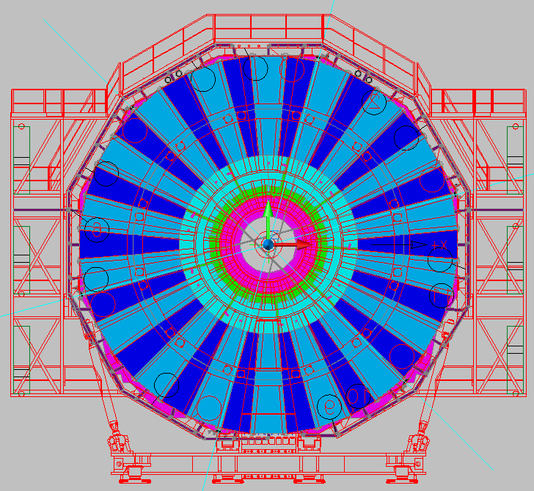
HV cable RE+4 Layout
FAR
11- 28
NEAR
1- 10
29-36

Slide 6
