Slide 1
Proposed UXC Racks layout for RE4 LV System

Slide 2
Hardware Information
Rack space is needed for the following RE4 hardware :
Link Board Box(LBB) for RE4 signal cables
3 LBBs per tower.
i.e. one per level (X2, X3, X4).
MAO and EASY Crate for RE4 Low Voltage Cables
1 MAO/disc
1 EASY Crate/tower
-RE4 hardware will be installed in the existing racks in USC and UXC
18 LV cables in one easy crate
72 signal cable in one Link Board Box

Slide 3
After RE4 EDR, we had an agreement with CSC Colleagues for the rack distribution of our equipments
This new layout was verified in UXC55
On the basis of this layout and after a visual inspection of the cable paths near to the racks length of all the cables has been calculated with a 3-d model of station 3.
A new layout has been proposed and agreed with CSC colleagues taken in to the account the constraint of a maximum length of 16.5m for the signal cables in order keep the same trigger latency.
Lengths of the HV and LV cables have been evaluated
Paths and lengths need to be x-checked by the integration team

Slide 4
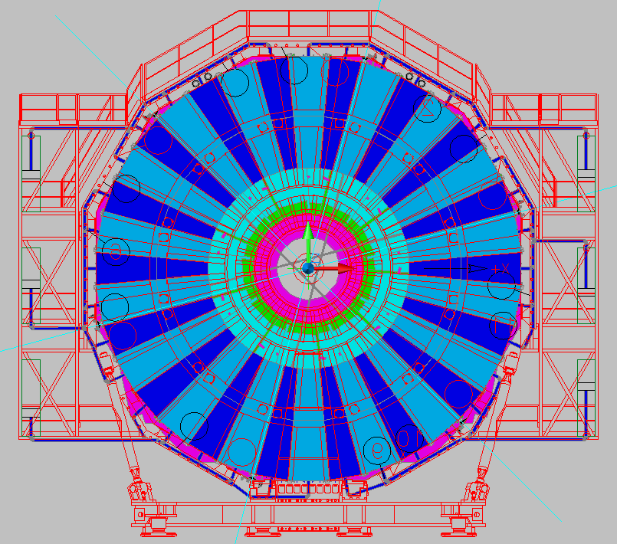
Signal Cable RE+4

Slide 5
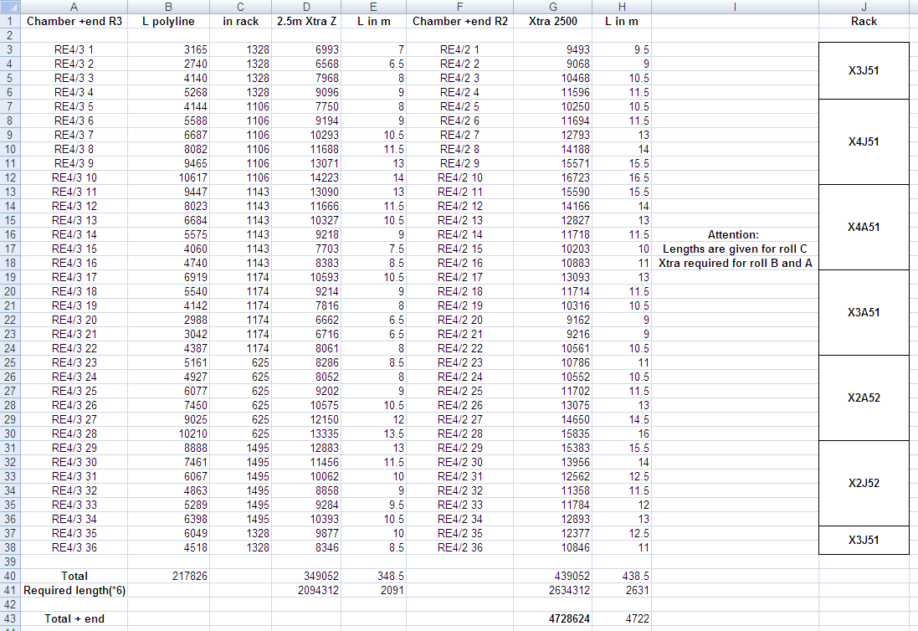

Slide 6
YE+3 FAR
X2A52
X3A51
X4A51

Slide 7
YE+3 NEAR
X2J52
X3J51
X4J51

Slide 8
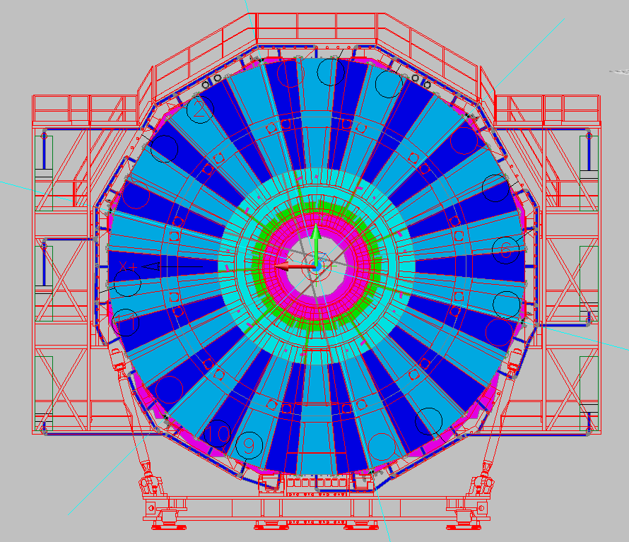
Signal cable RE-4

Slide 9
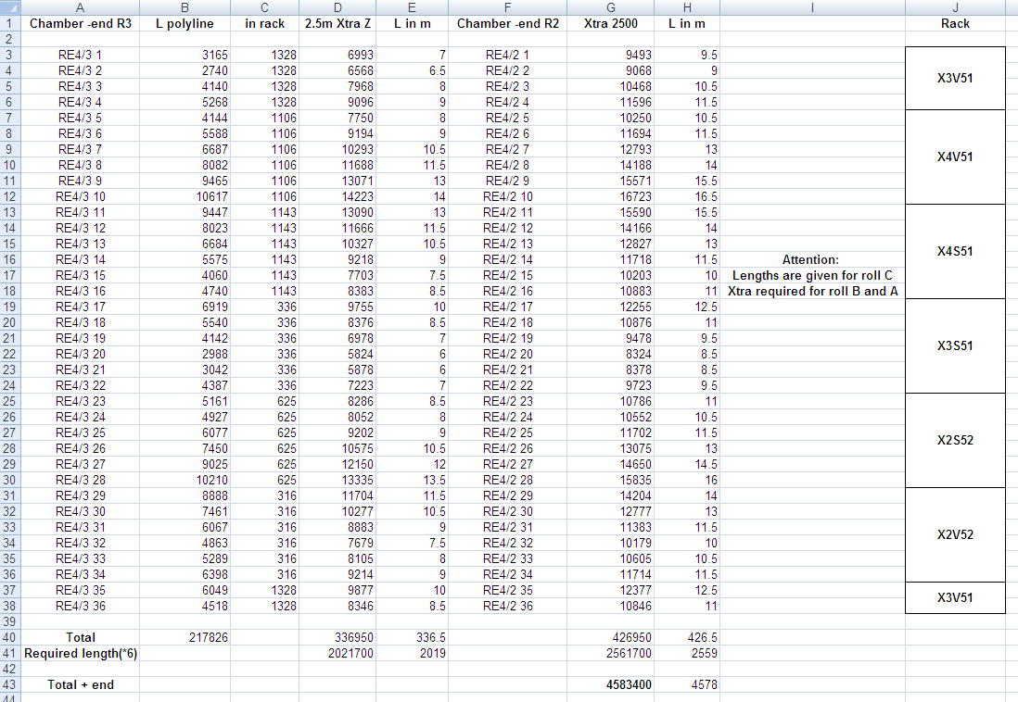

Slide 10
YE-3 FAR
X2S52
X3S51
X4S51

Slide 11
YE-3 NEAR
X2V52
X3V51
X4V51

Slide 12
X2A52
X2S52
If needed Heat Exchanger for LV crates:
Power dissipation:
Easy crate : 3 x 0.32=0.96 KW
LV MAO A3486 AC to DC :
0.45 KW
remove Blank panel 1U on the top as in X2S52 and move up all the equipments by one unit
(big job)
New Heat Exchanger

