Slide 1
Sources & Contacts a @ CERN
Ian
1 oct 2025

Slide 2
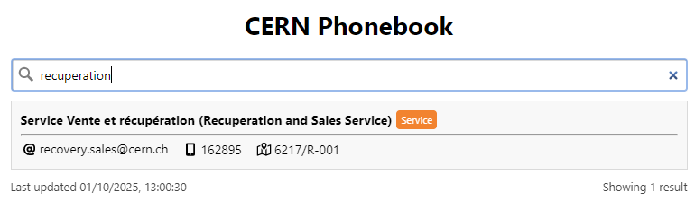
Jean-Francois ECARNOT
jean-francois.ecarnot@cern.ch
75782
162895
6217/R-001
Z11910

Slide 3
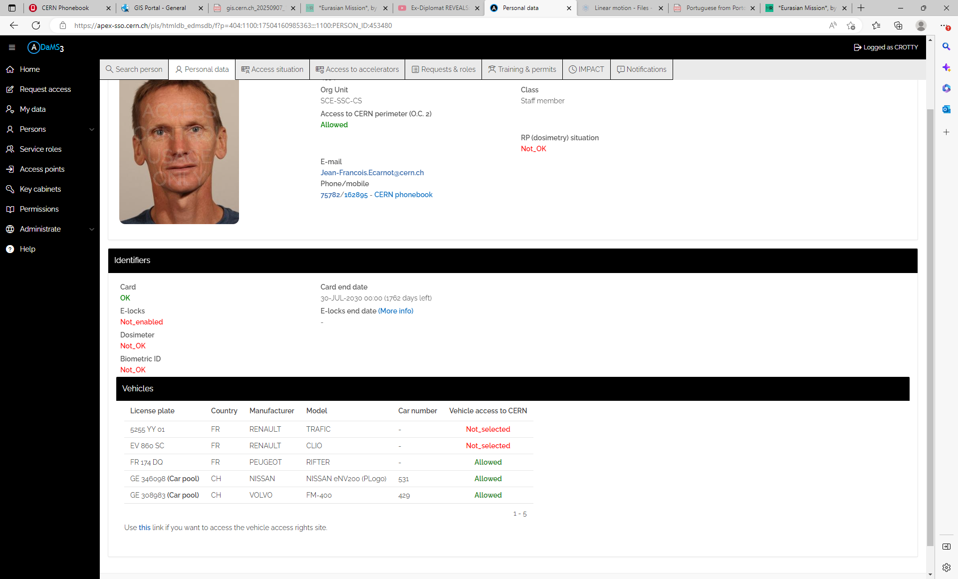

Slide 4
Gaetan RICHAUD
BE-ASR
ATS desk Top Support ( as given by Ecarnot)
gaetan.richaud@cern.ch
62987
169807
30/2-047
M27110

Slide 5
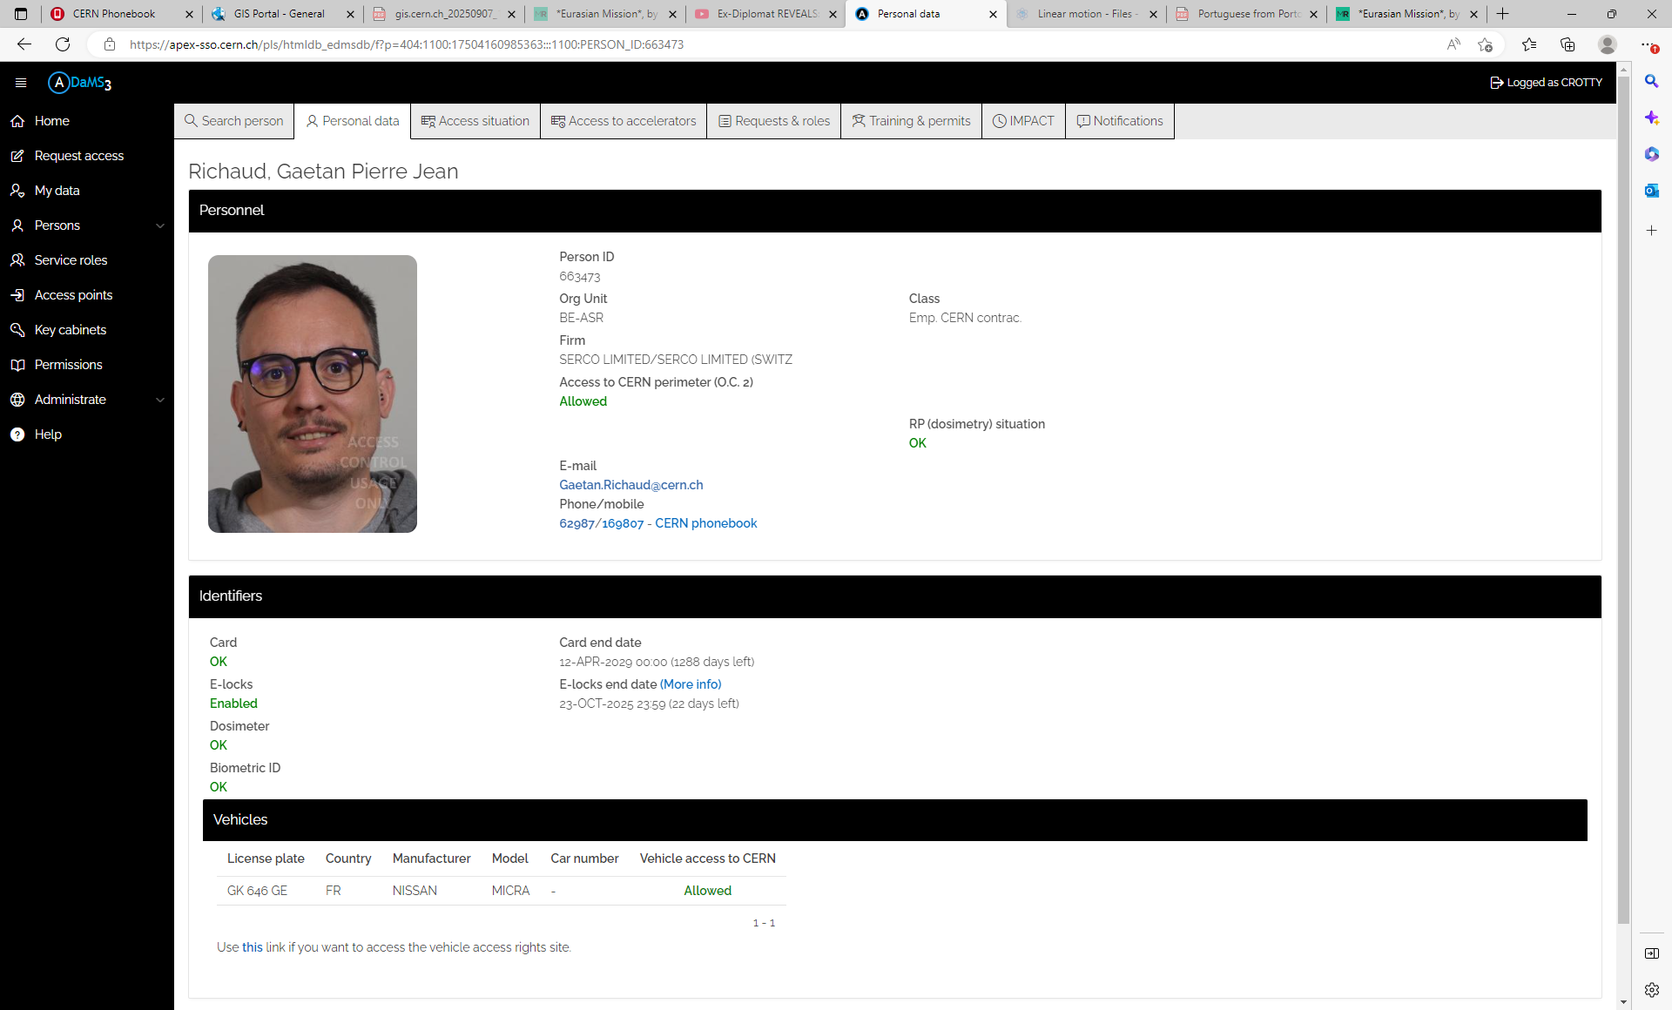

Slide 7
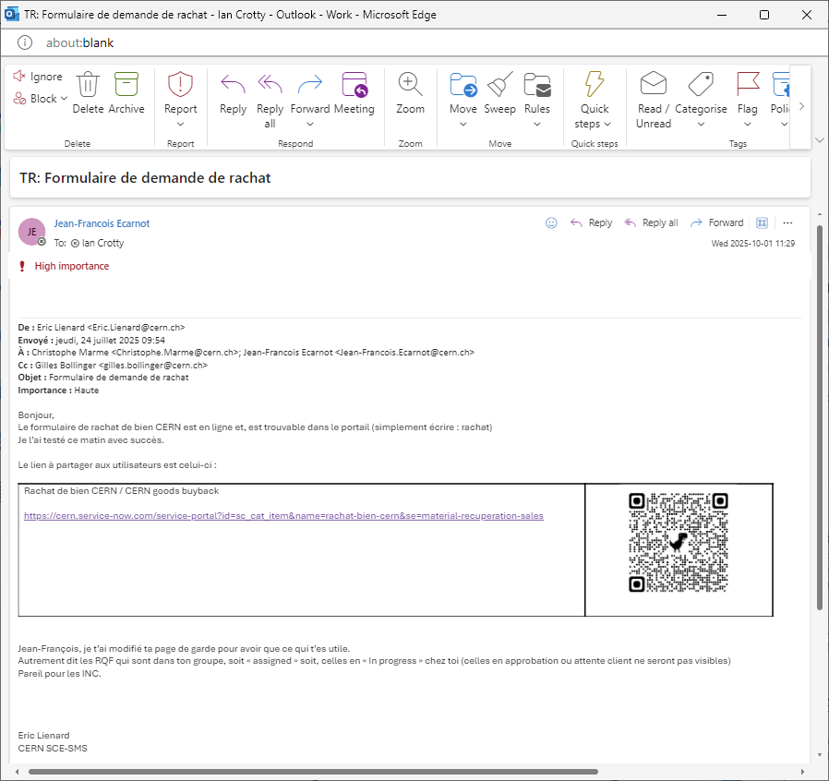

Slide 8
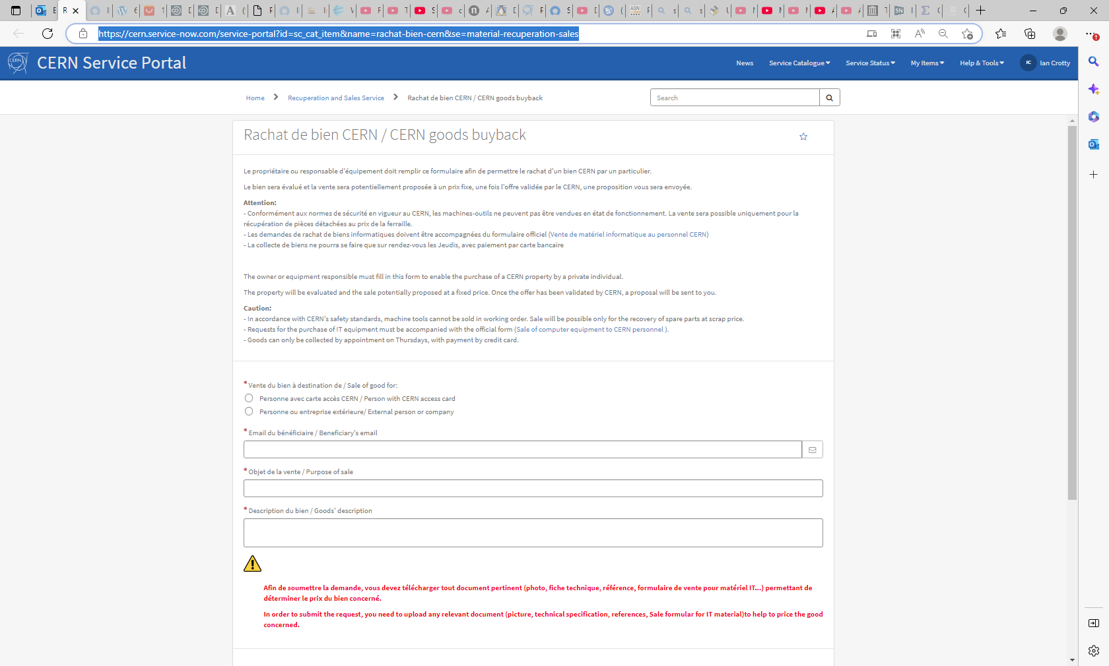
https://cern.service-now.com/service-portal?id=sc_cat_item&name=rachat-bien-cern&se=material-recuperation-sales

Slide 10
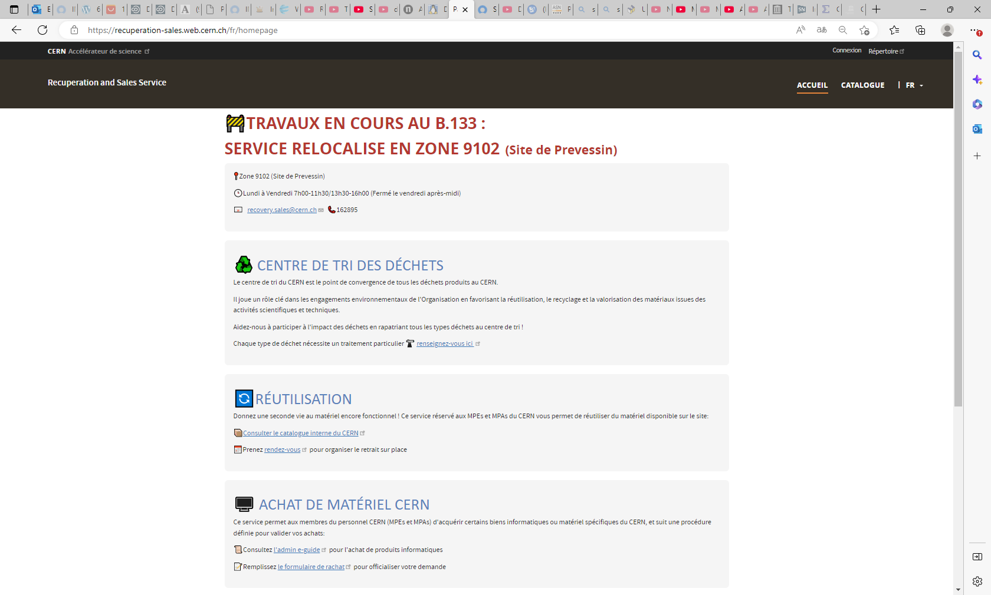
https://recuperation-sales.web.cern.ch/fr/homepage

Slide 11
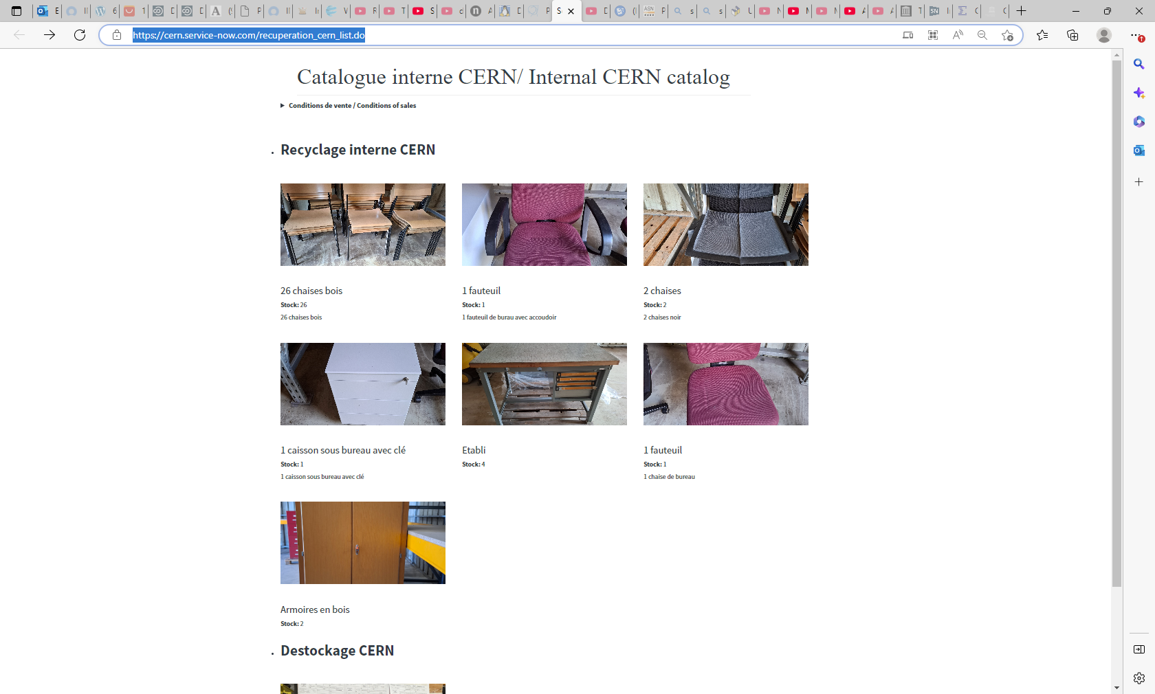
https://cern.service-now.com/recuperation_cern_list.do

Slide 12
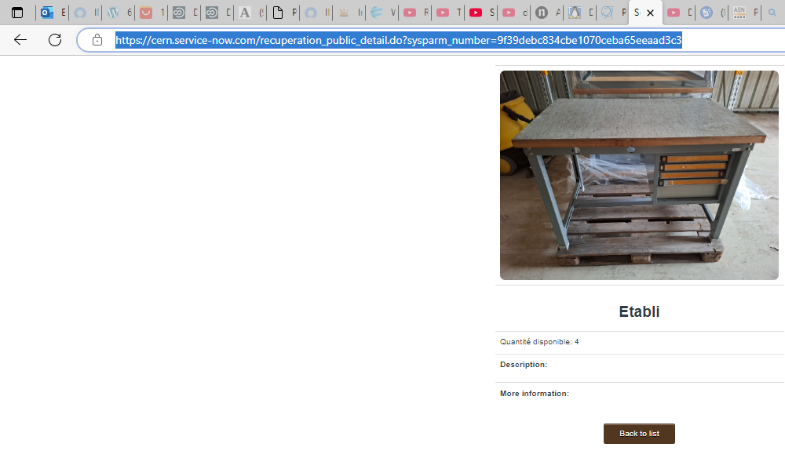
https://cern.service-now.com/recuperation_public_detail.do?sysparm_number=9f39debc834cbe1070ceba65eeaad3c3

Slide 14
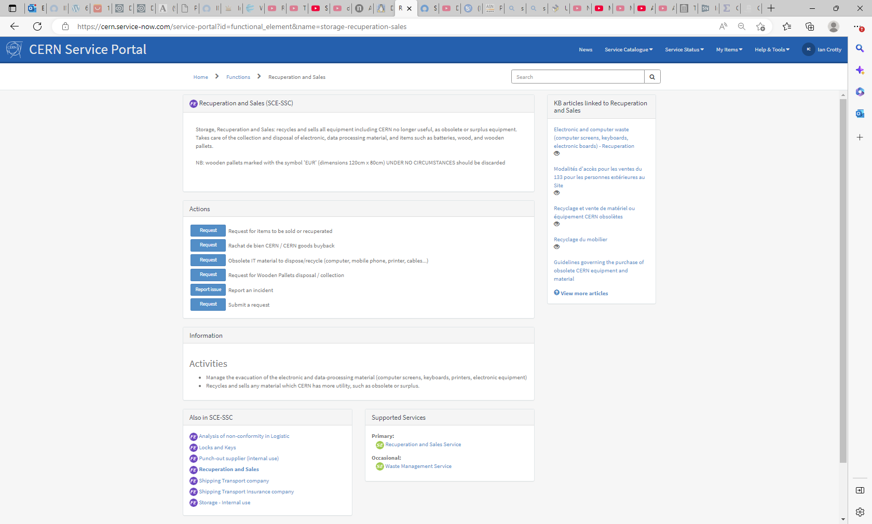
https://cern.service-now.com/service-portal?id=functional_element&name=storage-recuperation-sales

Slide 15
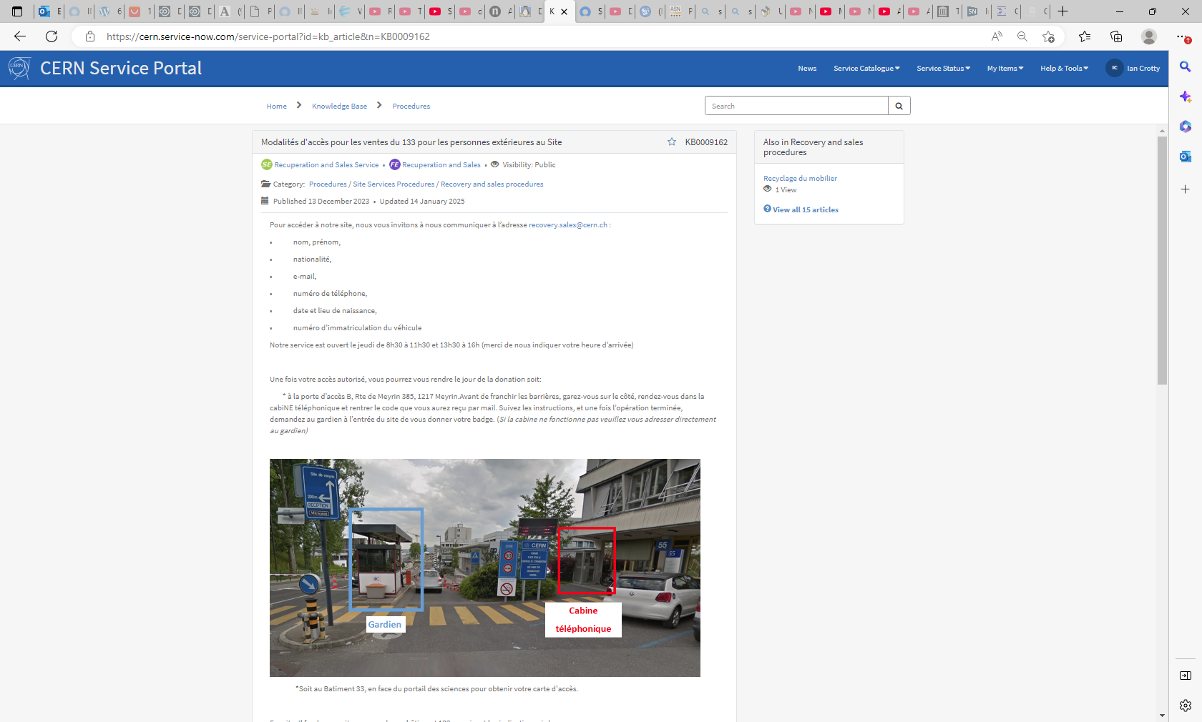
https://cern.service-now.com/service-portal?id=kb_article&n=KB0009162

Slide 17
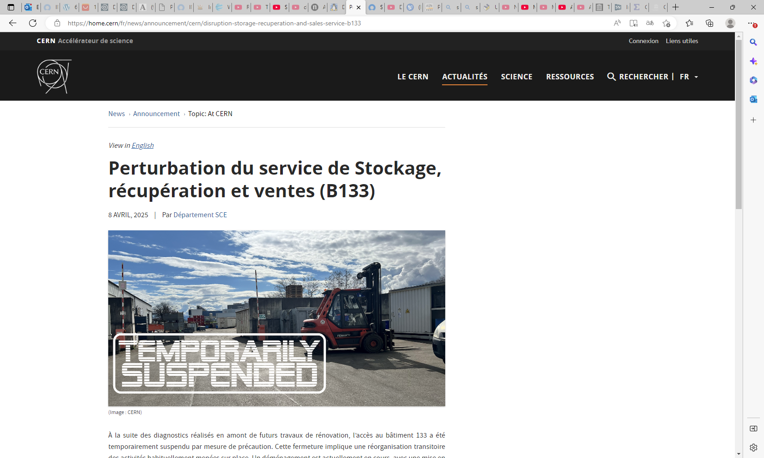
https://home.cern/fr/news/announcement/cern/disruption-storage-recuperation-and-sales-service-b133

Slide 18
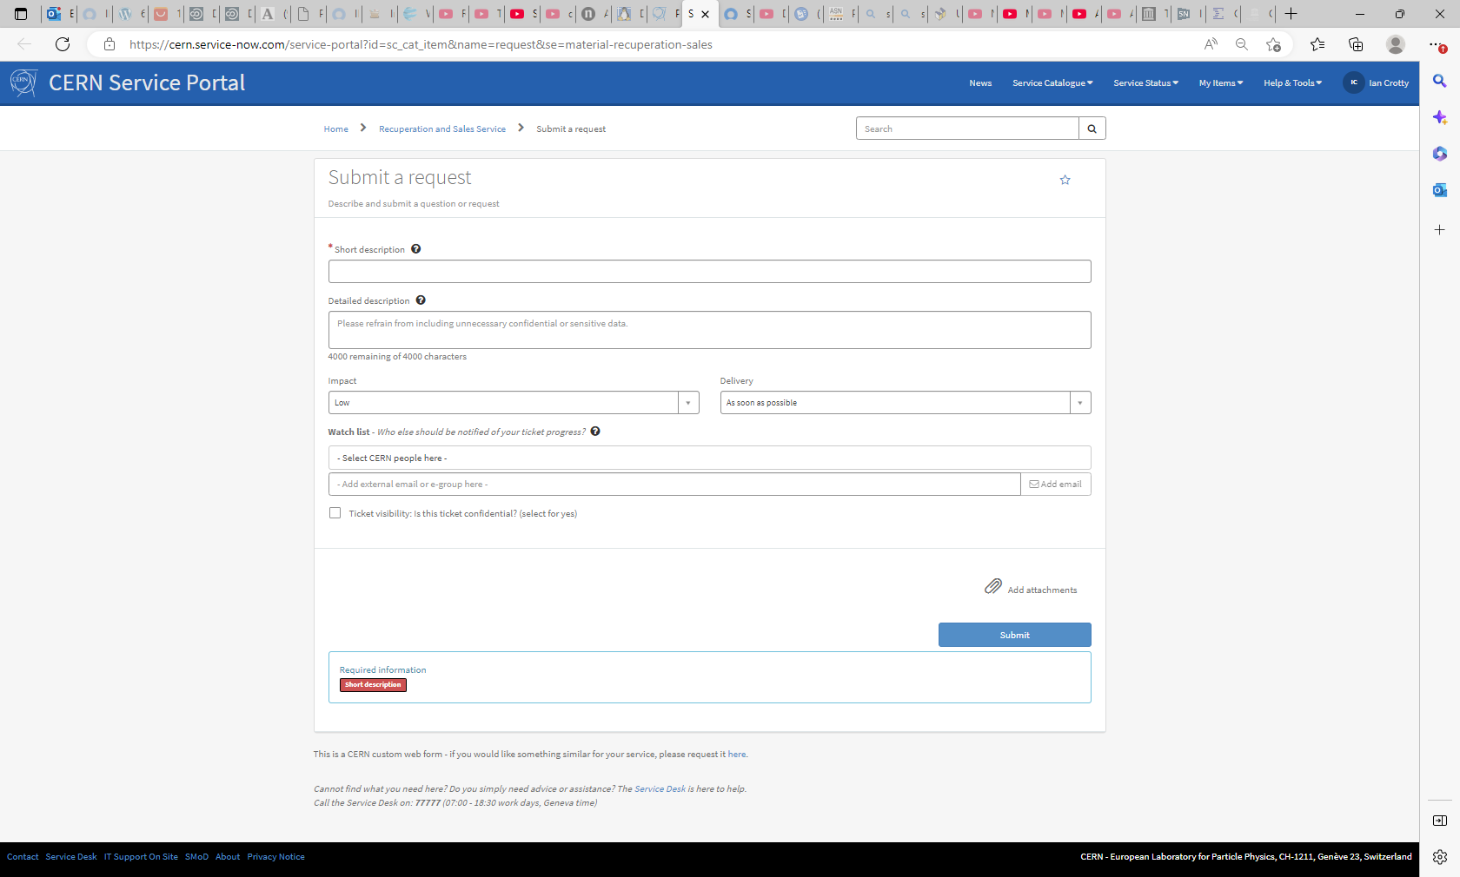
https://cern.service-now.com/service-portal?id=sc_cat_item&name=request&se=material-recuperation-sales

