Slide 1
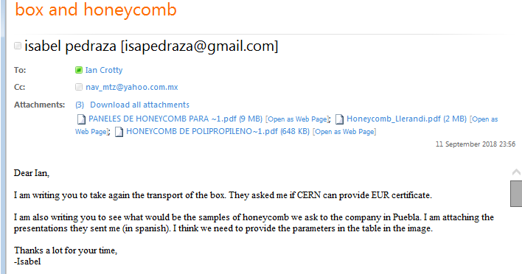
Three attachments in this folder.

Slide 2
