Slide 1
Lab and Industrial contacts in Mexico
Feb 2018
Ian

Slide 2
Puebla BUAP
Lab
Industrial contacts Panels and Gas

Slide 3
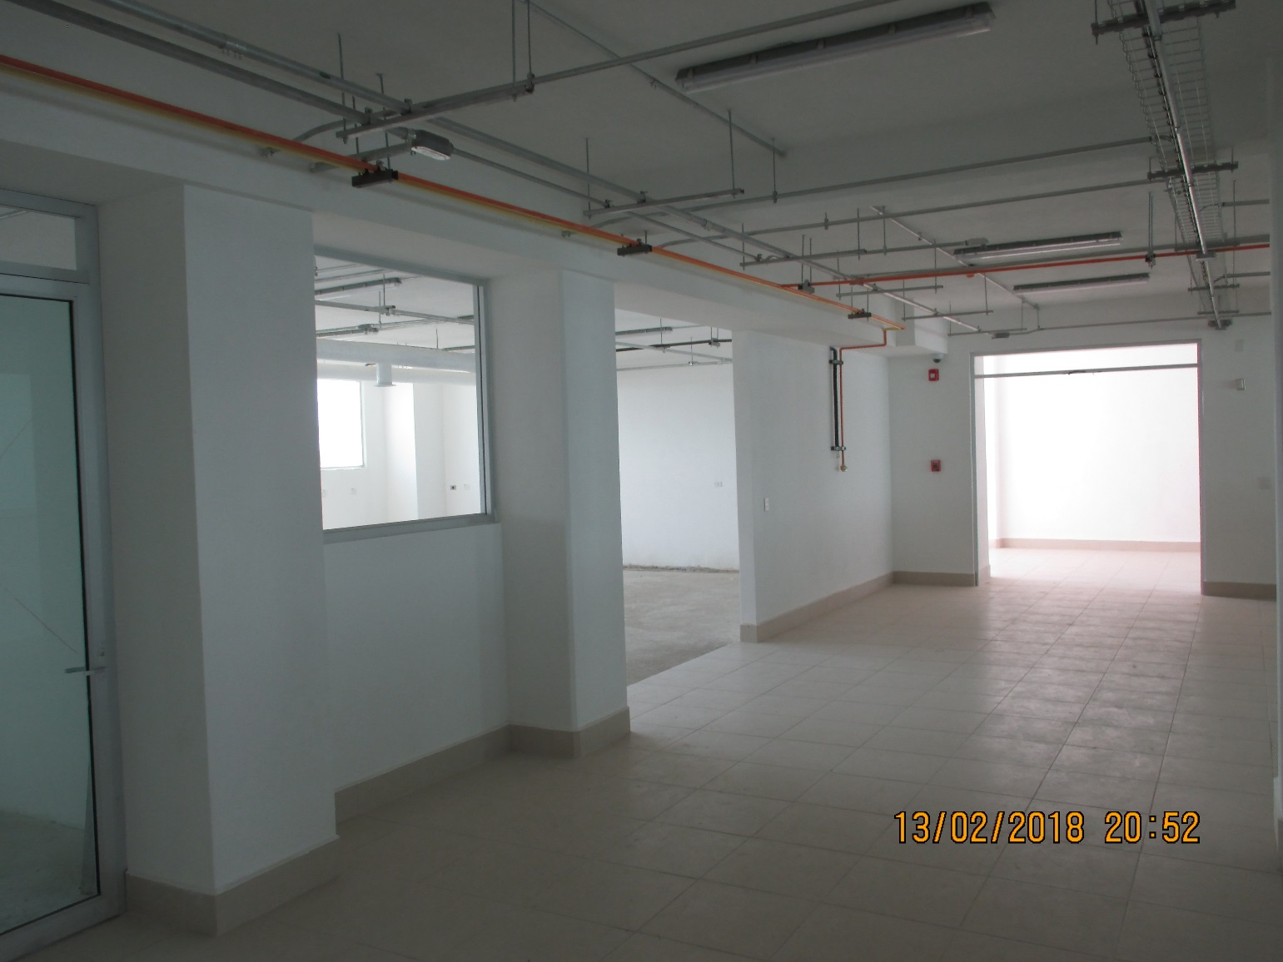
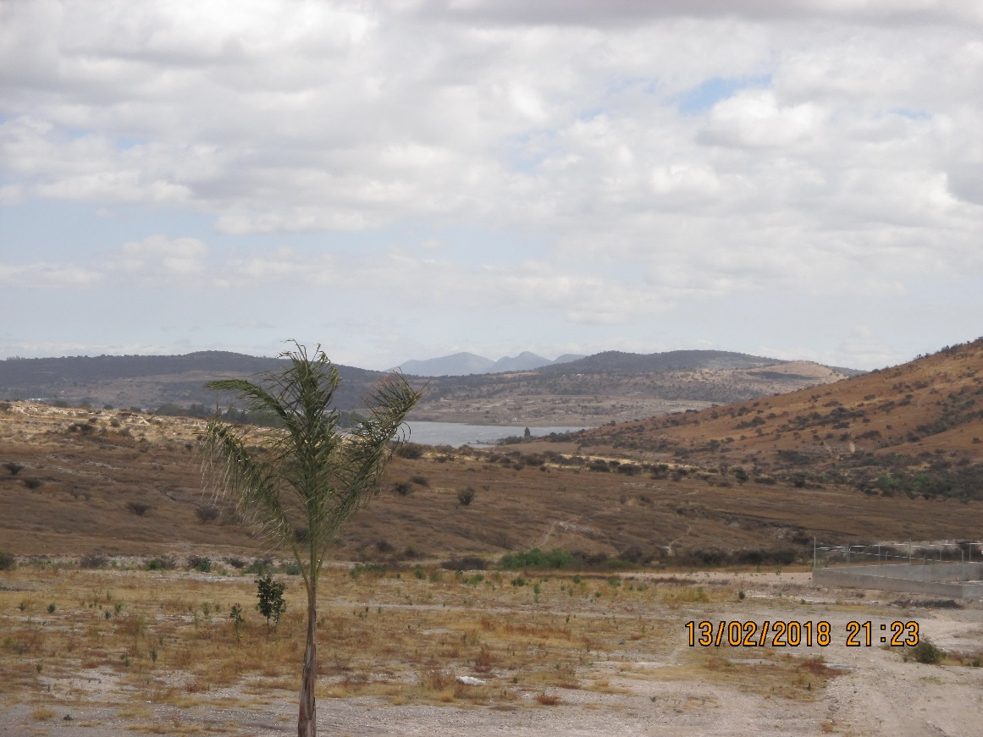
Beautiful location
Storage space 7.85 x 6.67m = 52m2
Office space 2.8 x 4.10m = 11.5m2
Lab space 12.0 x 8.3m = 99m2

Slide 4
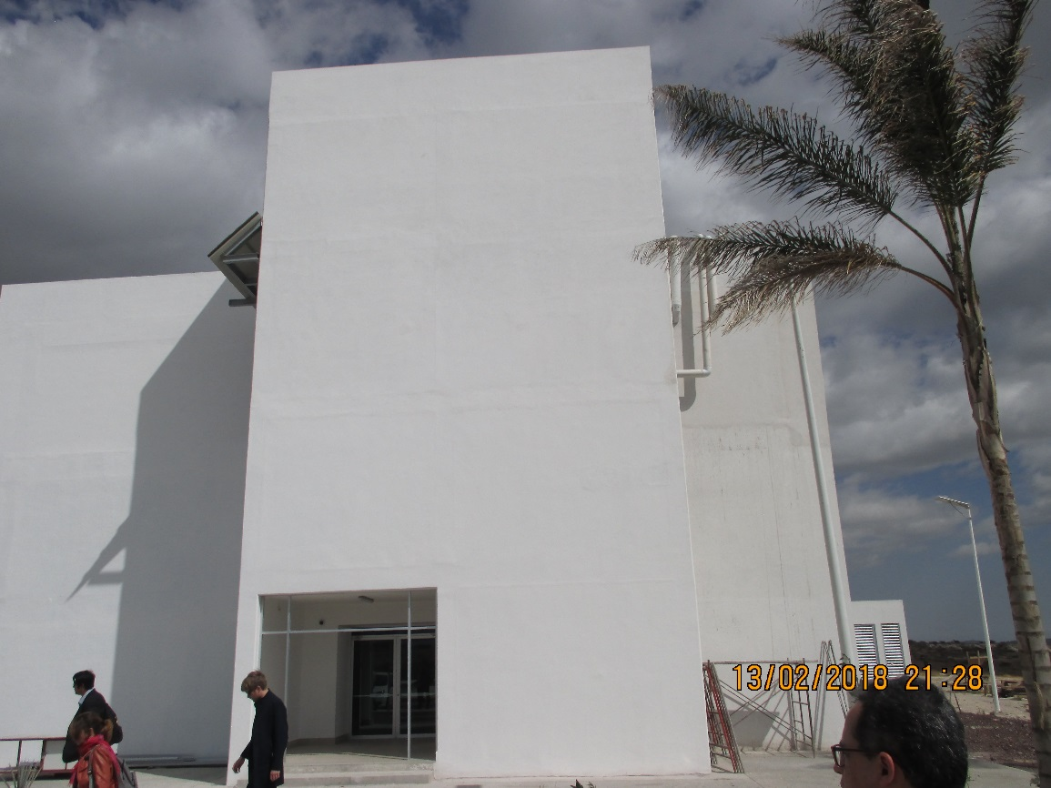
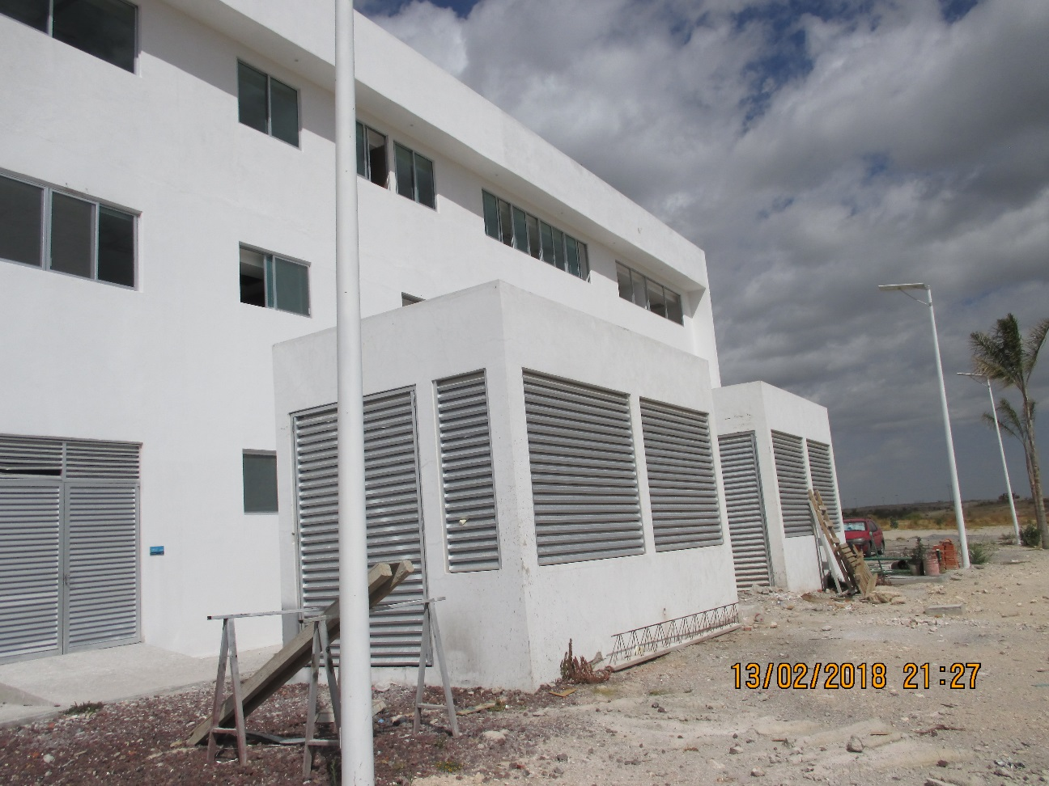
Access to the lab on 3rd floor by chain from steel beam
AC installation on roof going to lab
Gas building will be next to the other gas buildings

Slide 5
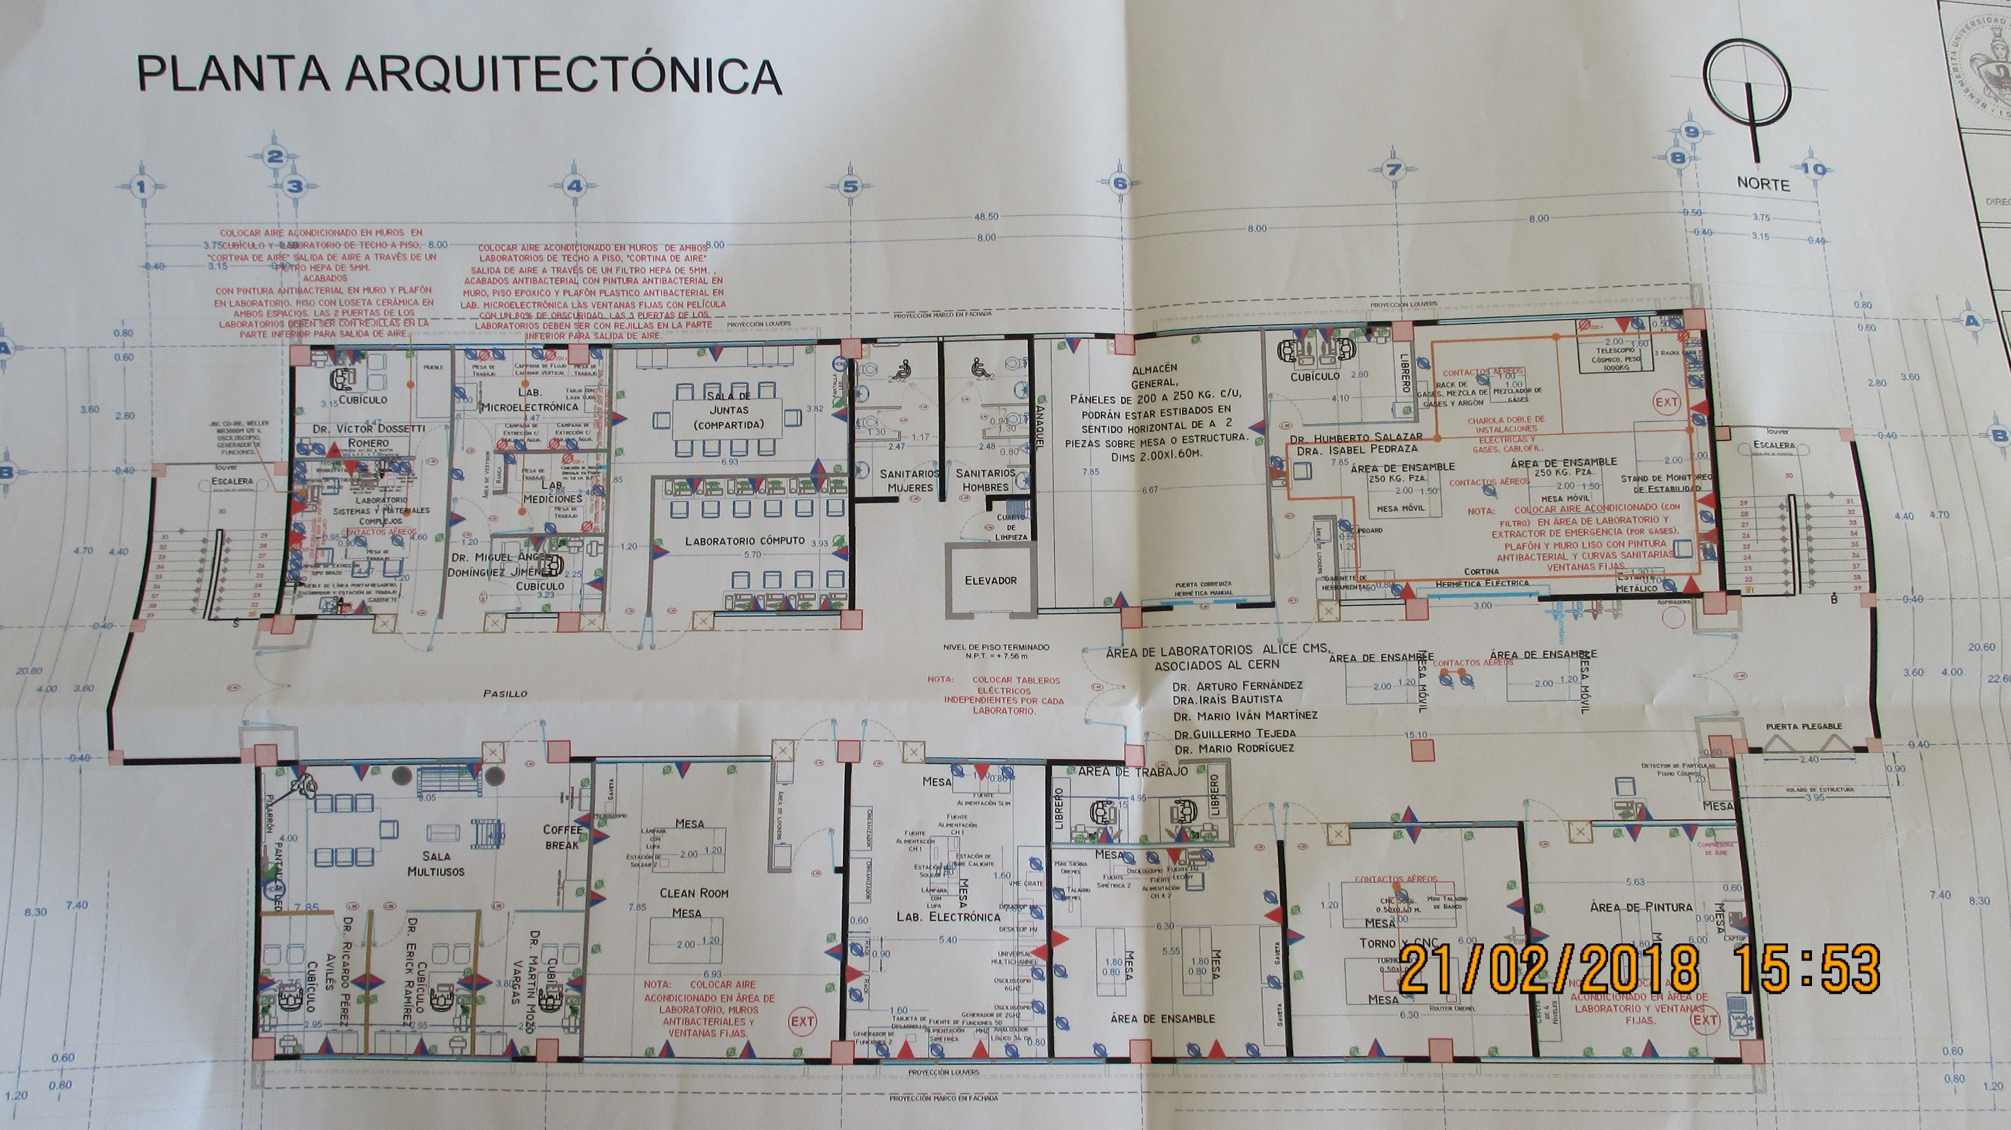

Slide 6
Industrial Gas supply and gas mixer
3 companies contacted fro MFC in USA and Mexico
  Parker, USA
  Matheson, USA
  Aaborg , Mexico
One supplier of gas piping and unions Munoz, ALICE colleague, in Puebla.

Slide 7
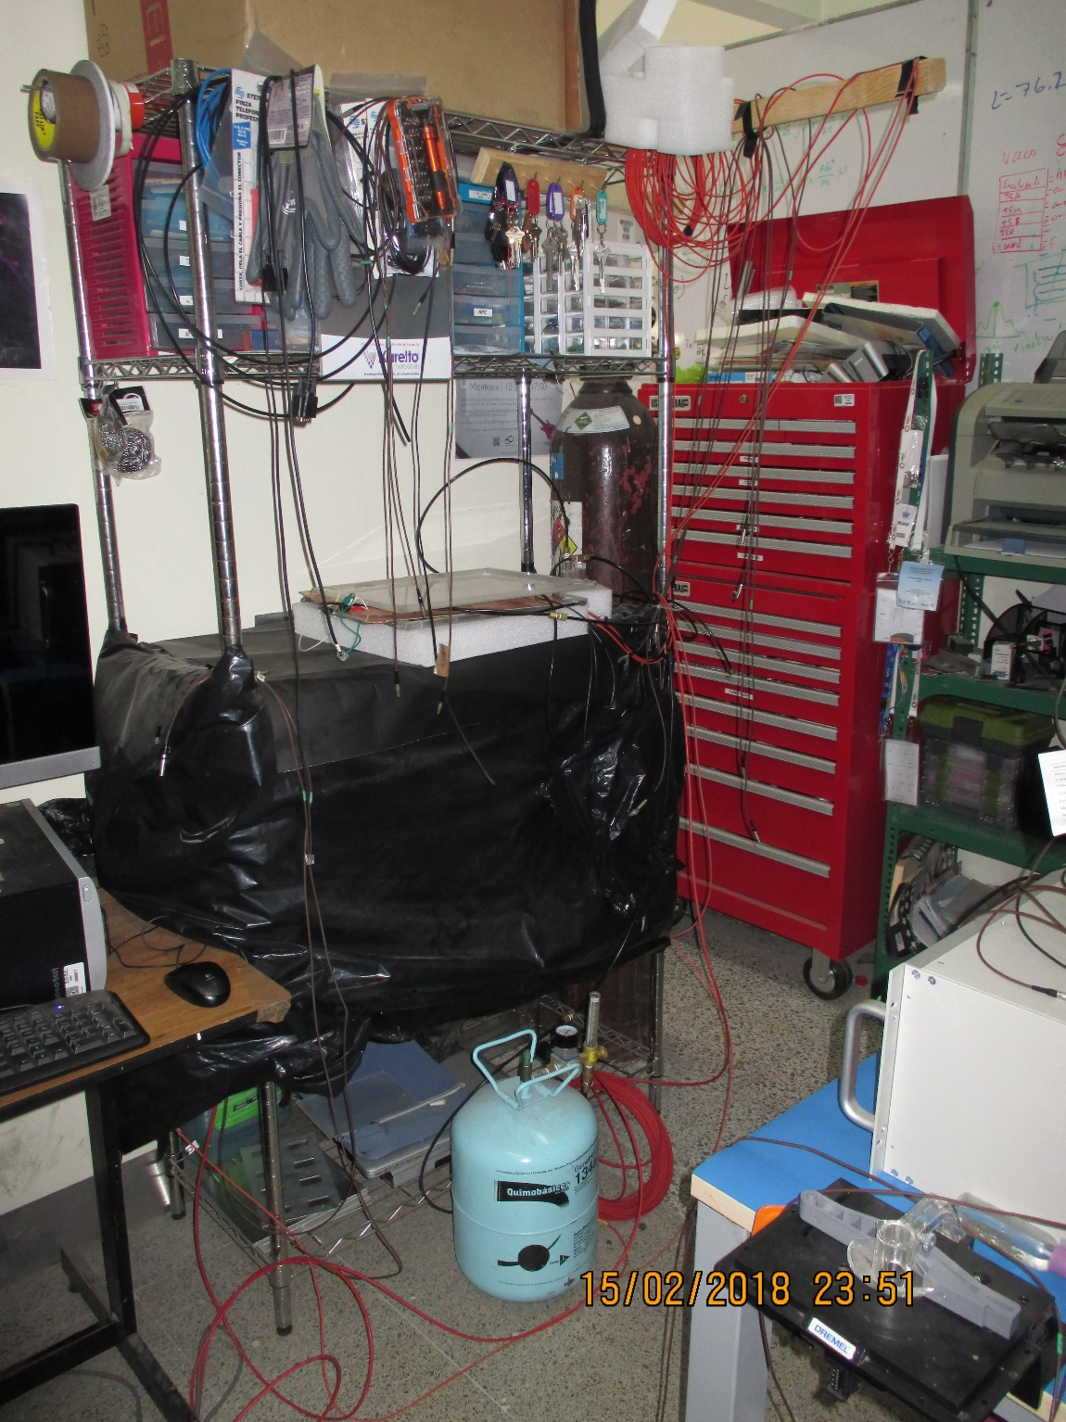
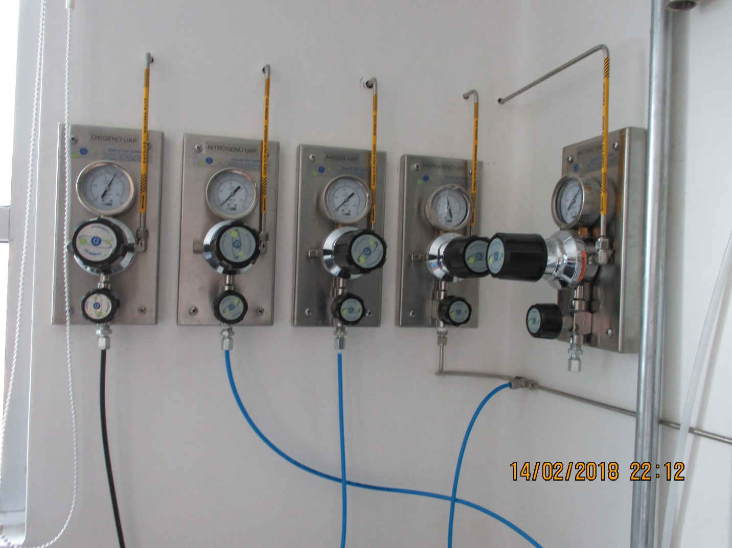
Operational labs as examples

Slide 8
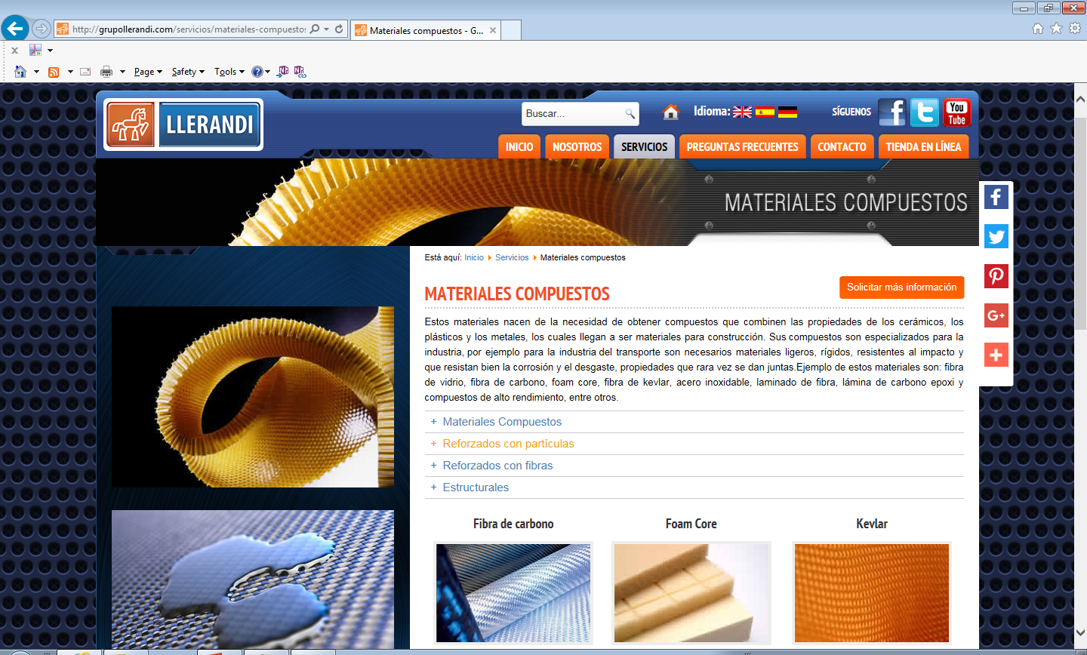
Honeycomb Panels
Llerandi
http://grupollerandi.com/servicios/materiales-compuestos
Factory is outside Puebla at Chihuahua (?)

Slide 9
Gas supplier
INFRA in Puebla can supply the 3 RPC gases, and many others.
Prices are lower for education than industry.

Slide 10
Salvador IBERO
Plan of lab
Put gas room out side
More next week

Slide 11
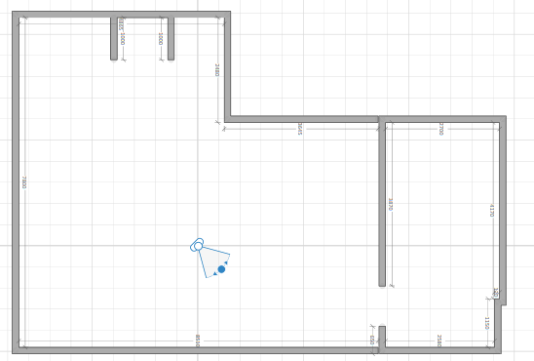
Extended area
Gas room outside with mixer
5.3 x 11m = 58.3m2
+ 11.8m2 = 70m2
Taking down plaster wall adds > 30m2
Total approx. 100m2

Slide 12
Salvador
Check out next week for gas installation
Time line for wall modification
And AC

Slide 13
Actions
Find 2 more HCP companies, compare quality and costs
Prepare spec for proto panel to check supplier performance
Locate MFC suppliers
Purchase gas bottles
Clean gas pipe

Slide 14
Conclusion
Great potential in both labs
All materials available in Mexico , speciality products from USA
Learn to import, and later export the chambers

Slide 15
REfs
https://www.homestyler.com/floorplan/?lang=en_US&assetId=c0987b64-b30e-48a8-b460-217ddb090e63

