Slide 1
Address for Ibero

Slide 2
See in following slide original info from Mexico
Source;
http://rpc-cms-re4-upscope.web.cern.ch/rpc-cms-re4-upscope/RPC/Chamber%20Institutes/Mexico/MexicoCity/Iberio/Shipping/TrialShipment2018/Upgrade_Meeting-09-Oct-2018_ShipmentTrialMexico_SalvadorCarrillo_v02.pptx

Slide 3
INVOICE TO:
SISTEMAS AUTOMATIZADOS E INDUSTRIALES DIVISION ELECTROQUIMICA S. A. DE C. V.
ADDRESS:
CALLE 2 Nº 509 COLONIA FRANCISCO I. MADERO
DELEGACION MIGUEL HIDALGO,
C.P. 11480 MEXICO D. F.
TELEPHONE: (55) 46 33 04 53.
TAX ID: SAI060718N80
SHIP TO:
AEROPUERTO INTERNACIONAL DE LA CIUDAD DE MEXICO PALAZUELOS HERMANOS S. A. DE C. V. TO
ATTENTION: SR. ARMANDO TORRES ADDRESS: ENTRONQUE 602 S/N STREET, COLONIA PEÑON DE LOS BAÑOS MEXICO CITY, DISTRITO FEDERAL STATE, 15520 ZIP CODE,
PHONE: (55) 51 33 72 60
COMMENTS: Please include in the shipment: Original invoice, which includes tax id of SAIDE

Slide 4
My interpretation is ;
PALAZUELOS HERMANOS S. A. DE C. V.
ATTENTION: SR. ARMANDO TORRES,
ENTRONQUE 602 S/N STREET,
COLONIA PEÑON DE LOS BAÑOS,
MEXICO CITY,
DISTRITO FEDERAL STATE,
15520 ZIP CODE,
Mexico
PHONE: (55) 51 33 72 60
Email:
Phone: +52.55.5785.5858 ??

Slide 5
Original invoice, which includes tax id of SAIDE
What is SAIDE ?

Slide 6
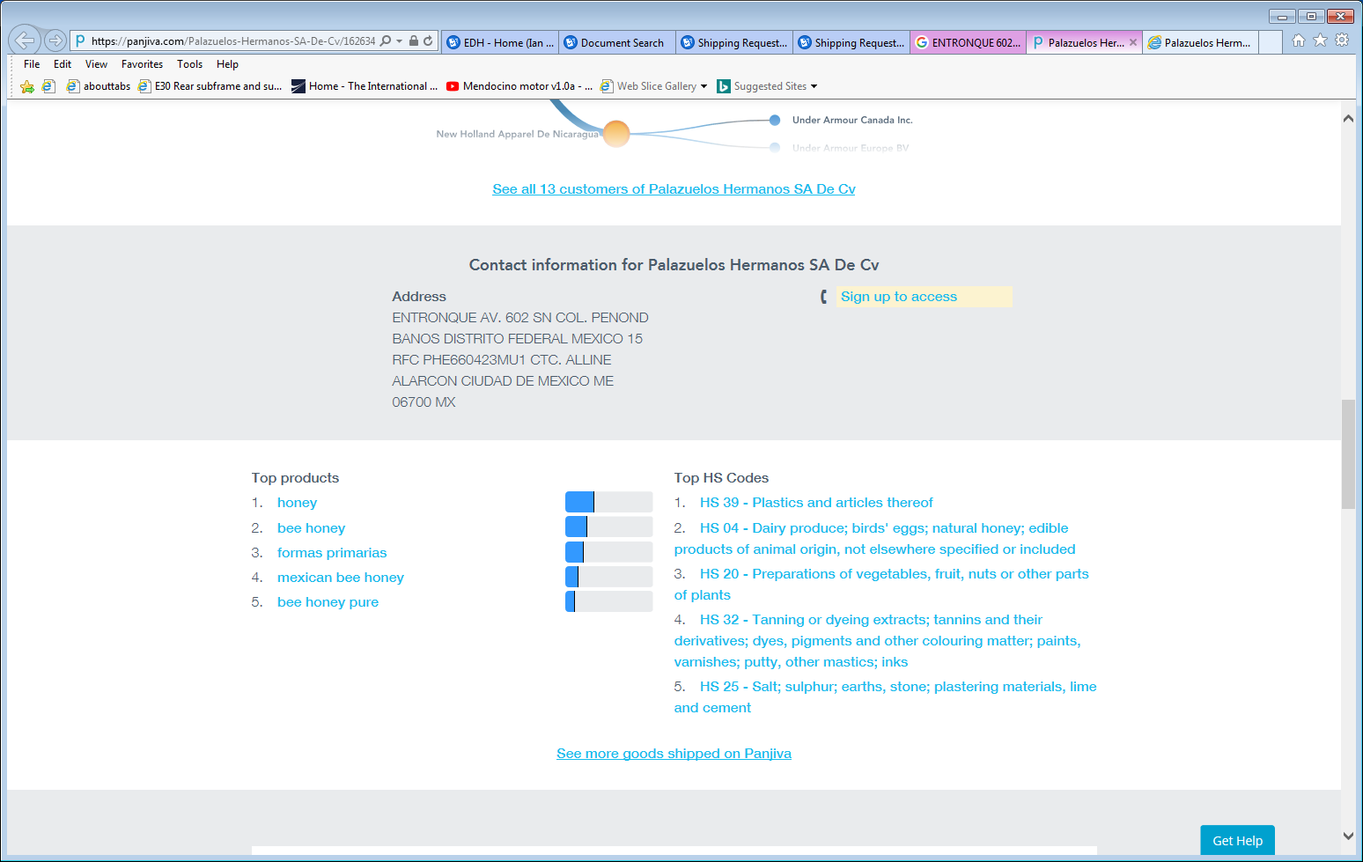
https://panjiva.com/Palazuelos-Hermanos-SA-De-Cv/1626347

Slide 7
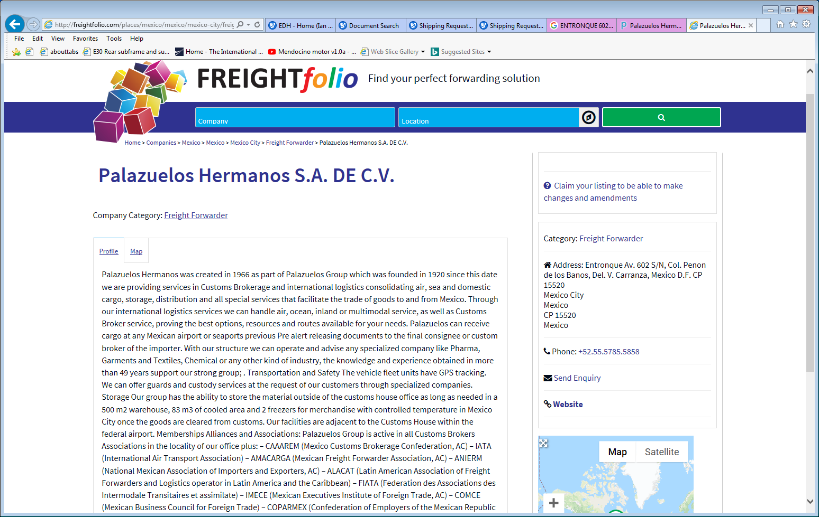
http://freightfolio.com/places/mexico/mexico/mexico-city/freight-forwarder/palazuelos-hermanos-s-a-de-c-v/

Slide 8
http://freightfolio.com/places/mexico/mexico/mexico-city/freight-forwarder/palazuelos-hermanos-s-a-de-c-v/
Entronque Av. 602 S/N,
Col. Penon de los Banos,
Del. V. Carranza,
Mexico D.F. CP 15520
Mexico City
Mexico
CP 15520
Mexico

Slide 9
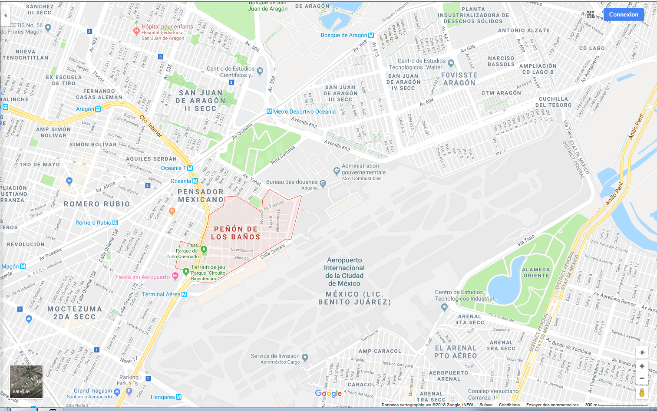

Slide 10
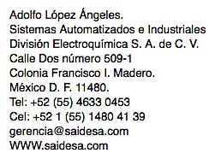
This appears to be the address of the CAEN rep in Mexico. He is good.
Adolfo Lopez Angeles
Tel; 0052 55 4633 0453
Cel 0052 1 55 1480 41 39
gerencia@saidesa.com
www.saidesa.com

Slide 11
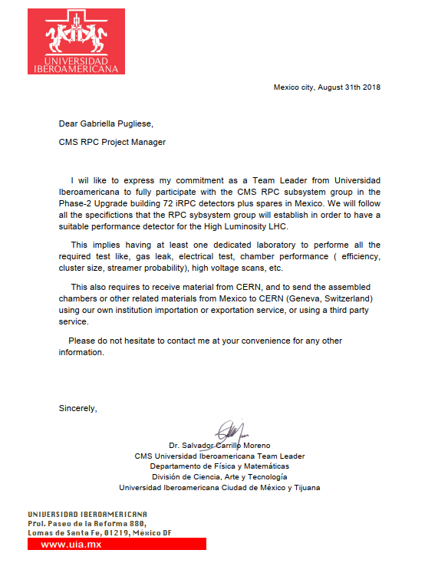
Dr. Salvador Carrillo Moreno
Dept. de Fisica Ciencia, Arte y Tecnologia
Universidad Iberoamericana,
Prol. Paseo de la Reforma,
Division de Reforma 880,
Lomas de Santa Fe,
01219,
Mexico DF
Phone; Tel.:52 (55) 5950-4000 Ext.:7111
Email; Salvador.carrillo@ibero.mx

Slide 12
