Slide 1



Shipment Trial to Mexico
Salvador Carrillo Moreno
MEXICO
Upgrade Meeting Oct-09-2018

Slide 2
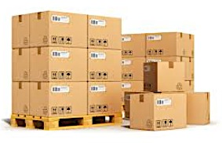

Shipment trial
For Ibero (and could work for Puebla) we have a experience private service:
  Adolfo López Ángeles. (CAEN distributor in Mexico)
Ready for the exercise!

Slide 3
INVOICE TO:
SISTEMAS AUTOMATIZADOS E INDUSTRIALES DIVISION ELECTROQUIMICA S. A. DE C. V.
ADDRESS:
CALLE 2 Nº 509 COLONIA FRANCISCO I. MADERO
DELEGACION MIGUEL HIDALGO,
C.P. 11480 MEXICO D. F.
TELEPHONE: (55) 46 33 04 53.
TAX ID: SAI060718N80
SHIP TO:
AEROPUERTO INTERNACIONAL DE LA CIUDAD DE MEXICO PALAZUELOS HERMANOS S. A. DE C. V. TO
ATTENTION: SR. ARMANDO TORRES ADDRESS: ENTRONQUE 602 S/N STREET, COLONIA PEÑON DE LOS BAÑOS MEXICO CITY, DISTRITO FEDERAL STATE, 15520 ZIP CODE,
PHONE: (55) 51 33 72 60
COMMENTS: Please include in the shipment: Original invoice, which includes tax id of SAIDE

Slide 4
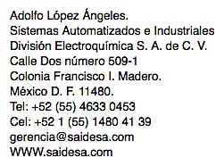
I allow myself to make some observations.
1.- you have to send a list of the material piece by piece co dimension and individual weight.
  Example if they are several equal pieces.
  3 communication cable weighing 30 grs and length of 1.5 meters.
  Example if it is a single piece.
  1 serial communication cable of 50 grs and length of 2 meters.
2.- declare a cable price cost normally with the legend.
  FEES FOR TEMPORARY IMPORTATION PURPOSES.
3.- The invoice and shipping list should be with a number of TAX Id of the sender and receiver, so the tax id of the Ibero-American University and another of the Autonomous University of Puebla should be placed.
4.- Upon your return, charges may be made for the alleged repair of minimum costs of 10 to 25 dollars or Euros, depending on the case that you wish to use with the prepaid legend and final account of $ 0.00.
5.- If it is sent in wooden packaging, it must arrive with the fumigation certificate and the wood with the fumigated stamp.
I hope these comments will be helpful for you
Adolfo López Ángeles.
08/Oct

Slide 5

Muchas gracias a todos por su ayuda

