Slide 1
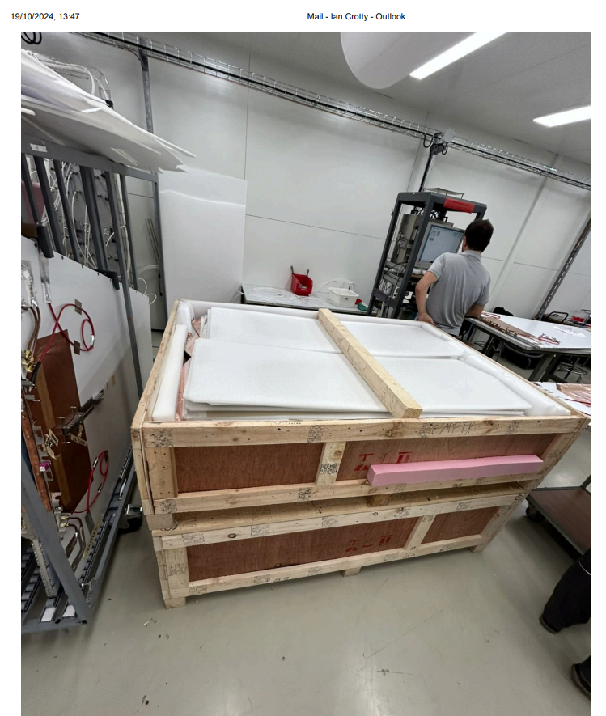
The box for Mexico is shown here.
It is ONLY the top box.
In the picture there are two boxes.
The dimensions in the EDH are correct

