Slide 1
Shipping Puebla
Ian
18 Dec 2018

Slide 2
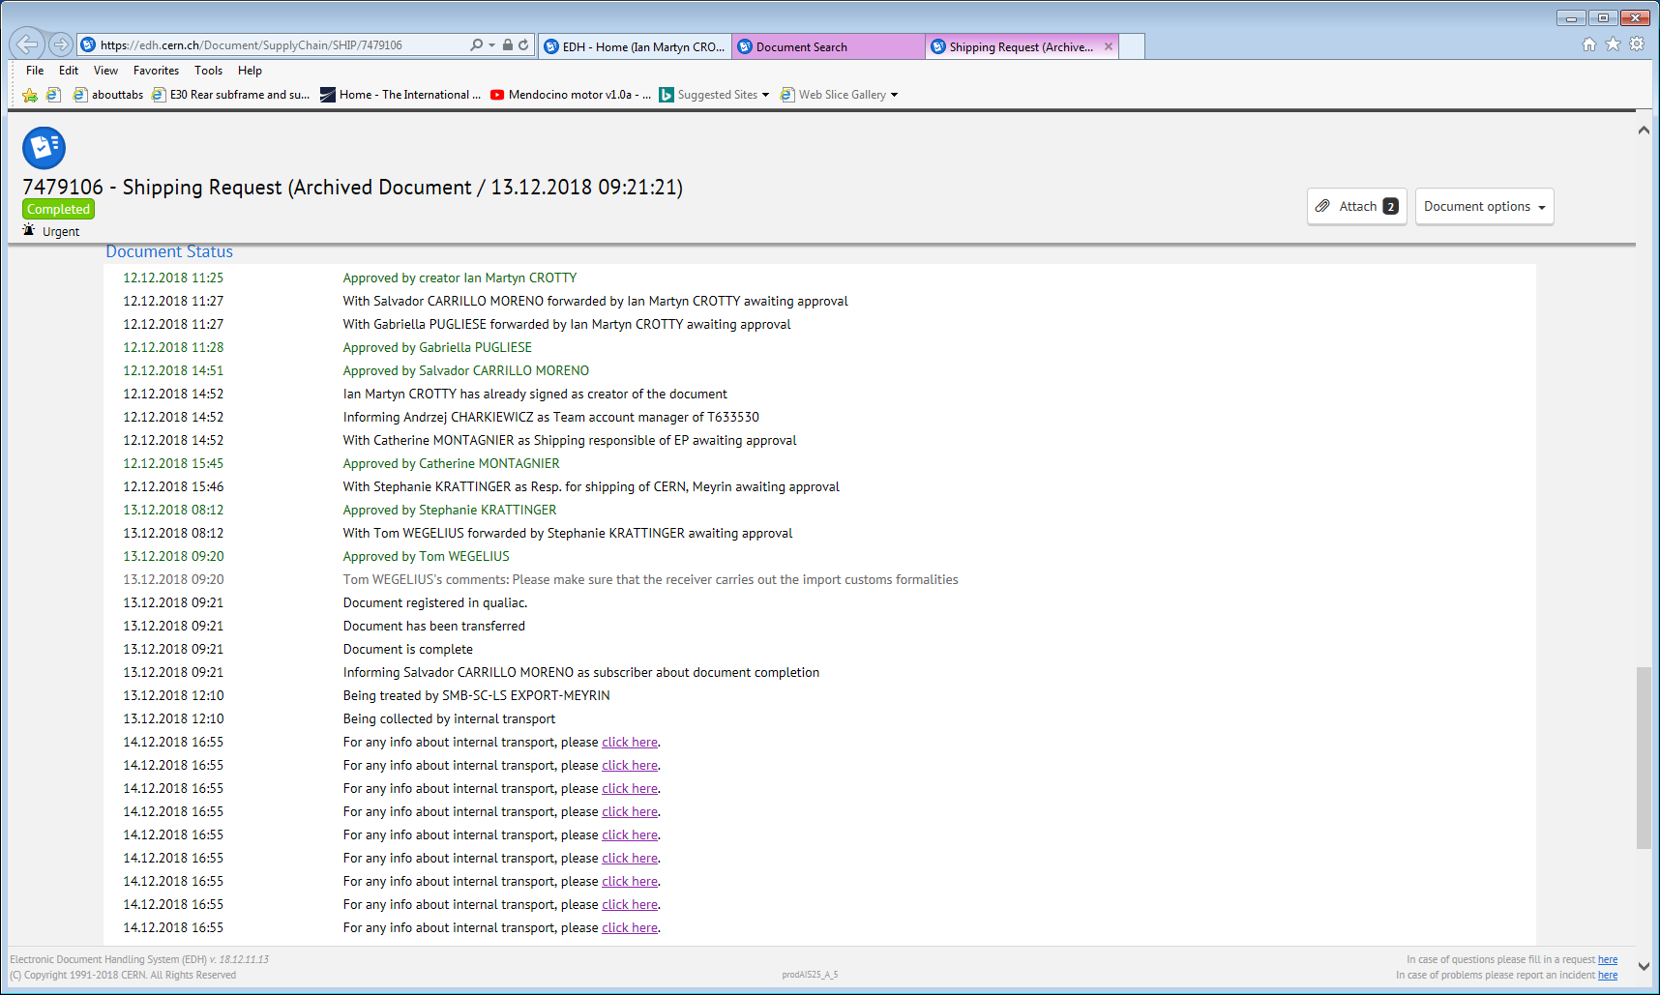

Slide 3
Emails to be sure of the conditions this will be sent

Slide 4
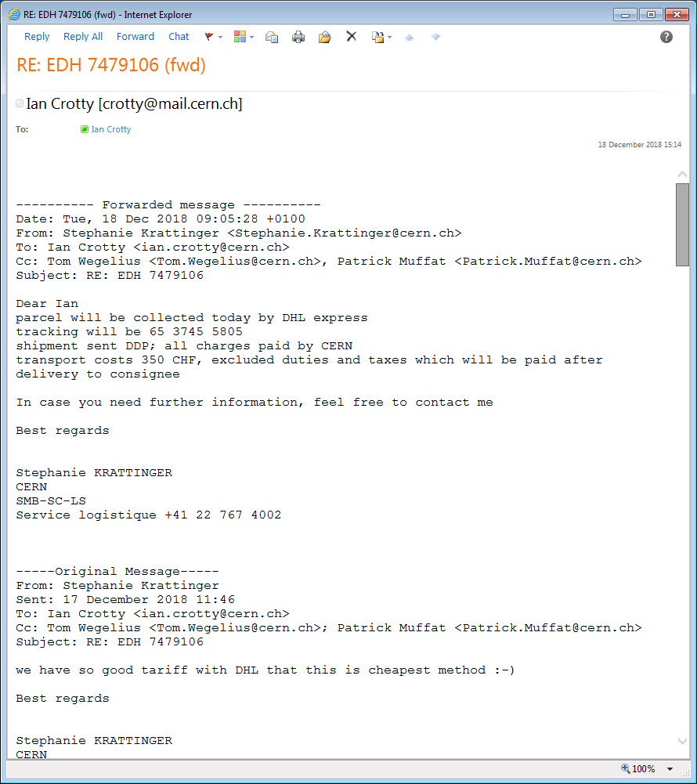

Slide 5
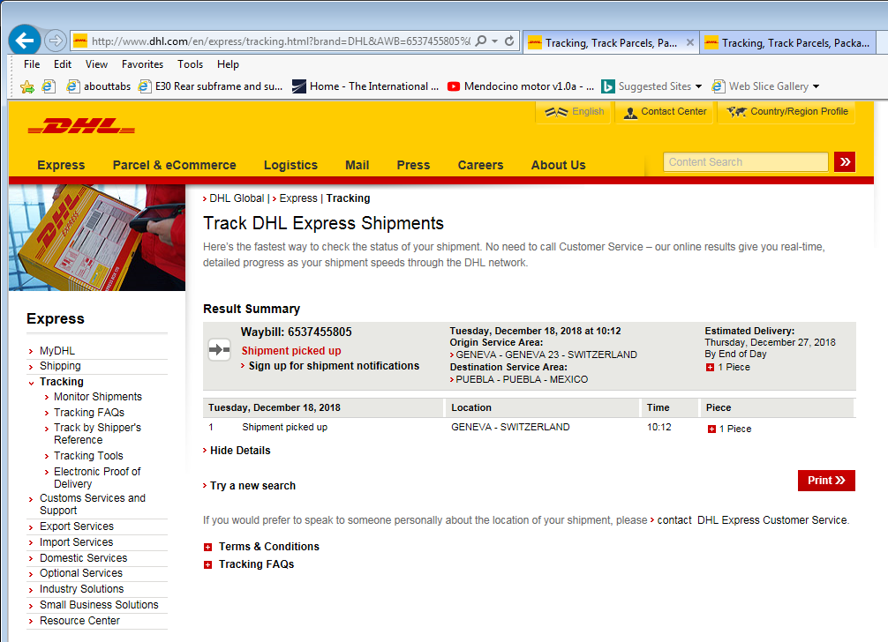
Fill in tracking number. 65 3745 5805 (also refered to as the waybill number)
http://www.dhl.com/en/express.html
http://www.dhl.com/en/express/tracking.html?brand=DHL&AWB=6537455805%0D%0A
Here it did not work..
http://www.dhl.com/en/express/tracking.html
Fill in tracking number. 65 3745 5805 also refered to as the waybill number

Slide 6
Conclusion
Takes a few days to leave CERN due to incoterms conditions.
4 days delivery, expected……..

