Slide 1
Shipping Puebla
Ian
18 Dec 2018

Slide 2
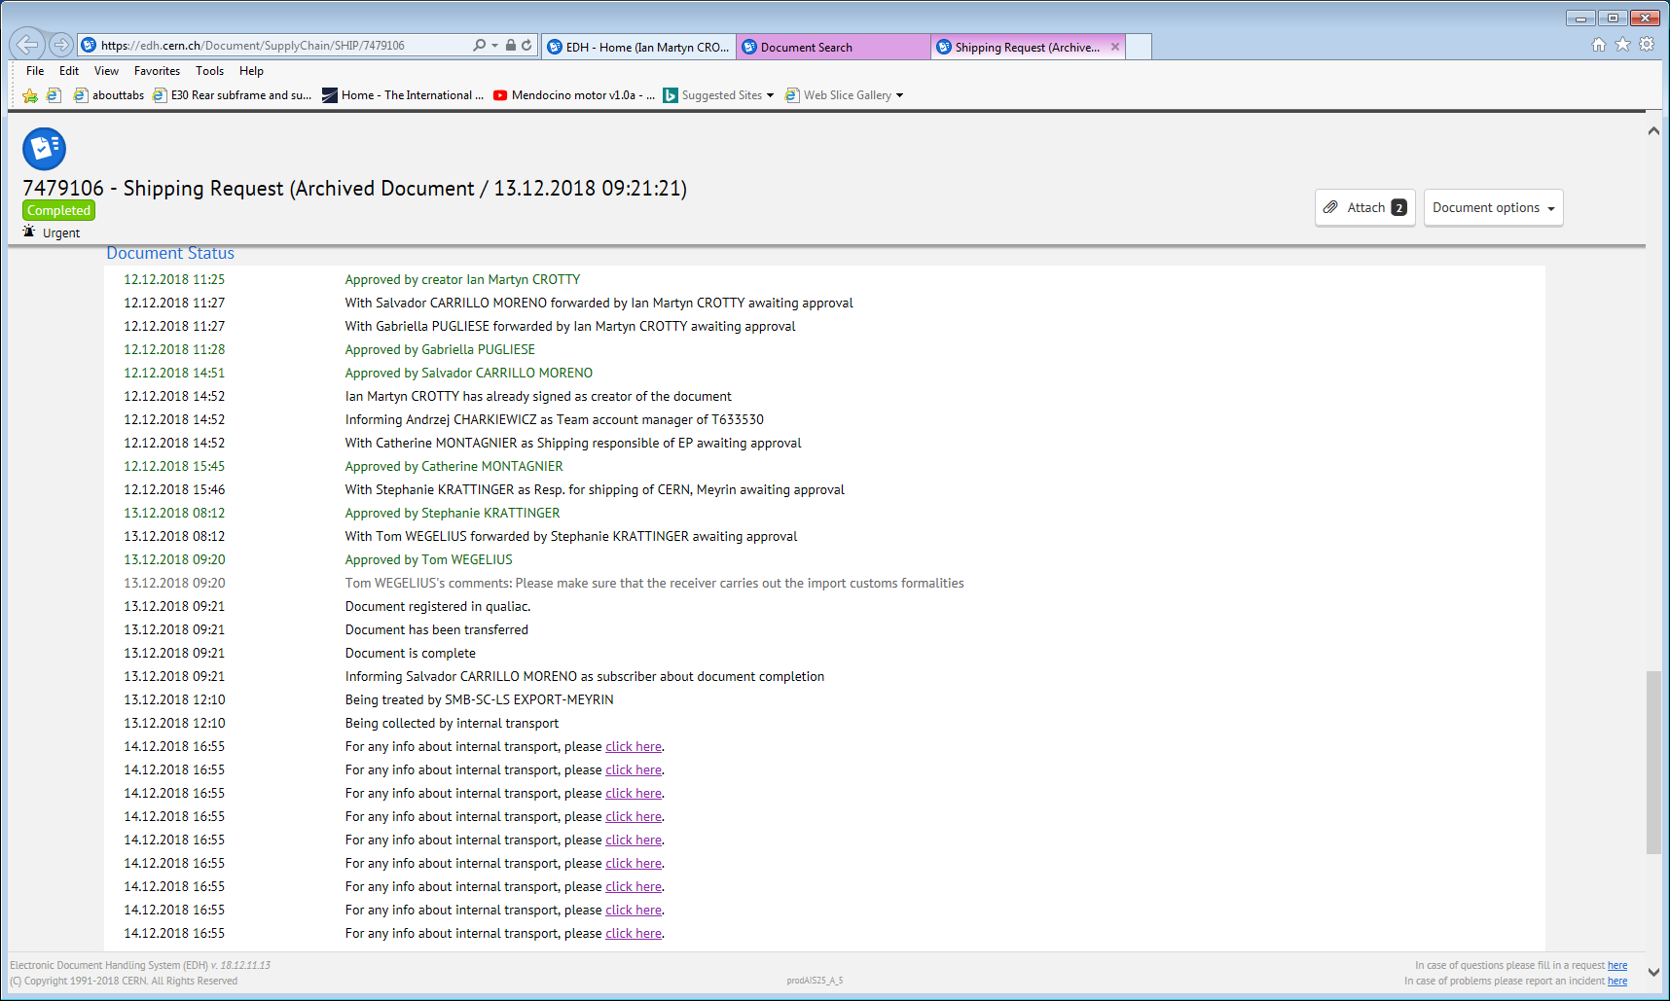

Slide 3
Emails to be sure of the conditions this will be sent

Slide 4
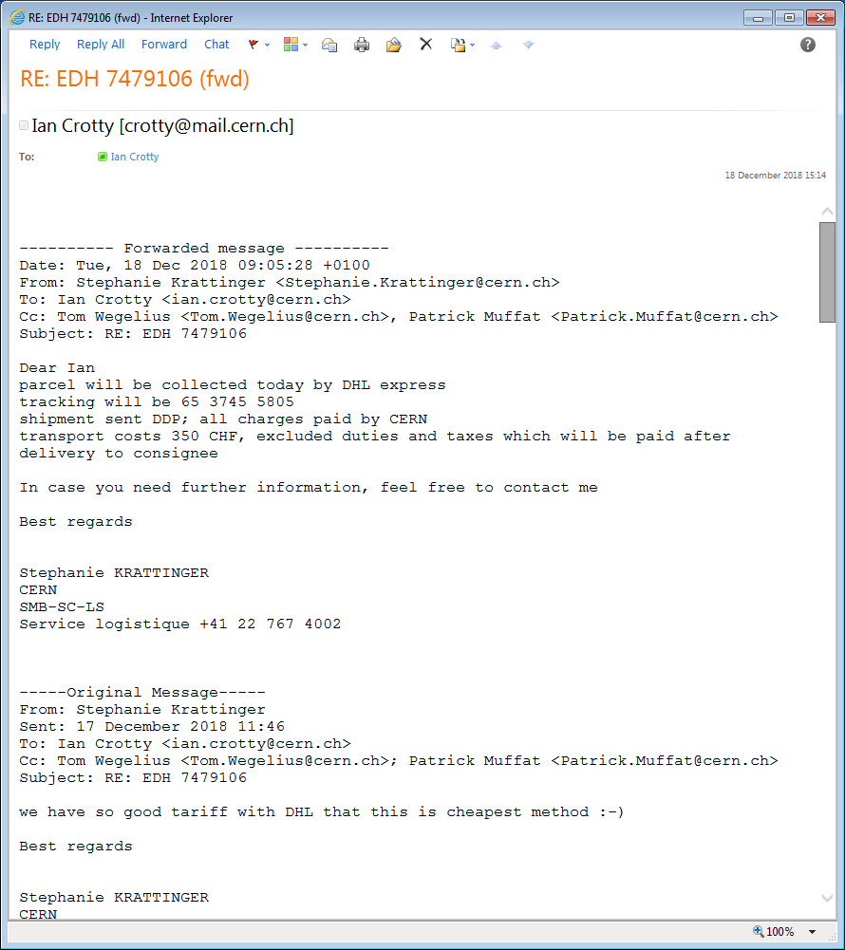

Slide 5
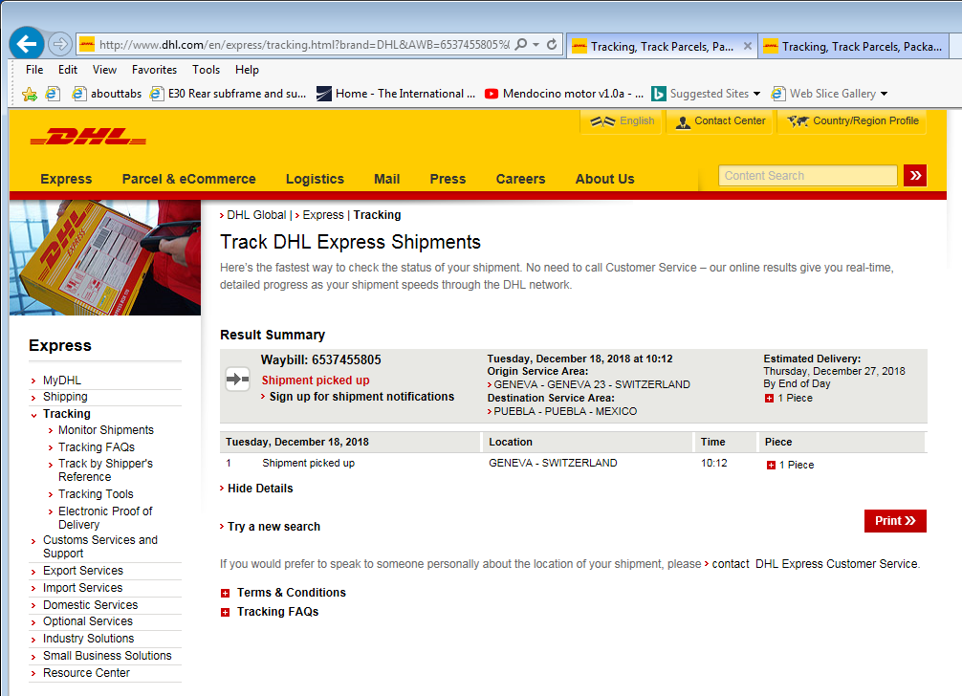
Fill in tracking number. 65 3745 5805 (also refered to as the waybill number)
http://www.dhl.com/en/express.html
http://www.dhl.com/en/express/tracking.html?brand=DHL&AWB=6537455805%0D%0A
Here it did not work..
http://www.dhl.com/en/express/tracking.html
Fill in tracking number. 65 3745 5805 also refered to as the waybill number

Slide 6
Conclusion
Takes a few days to leave CERN due to incoterms conditions.
4 days delivery, expected……..

Slide 7
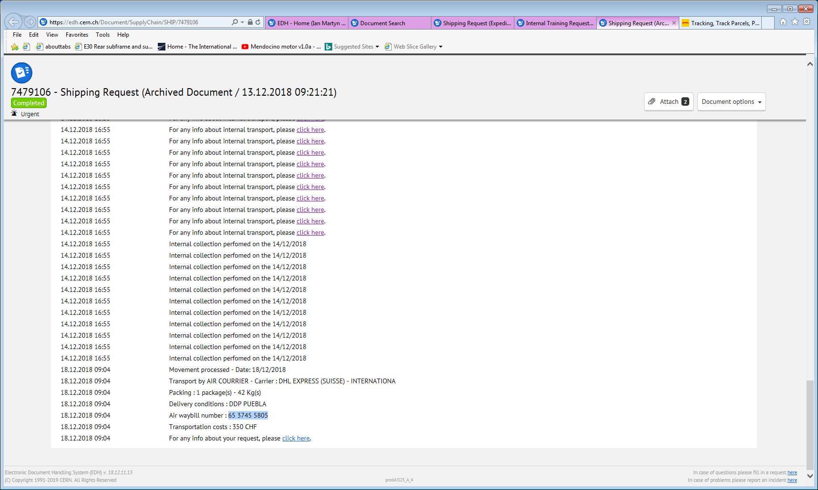

Slide 8
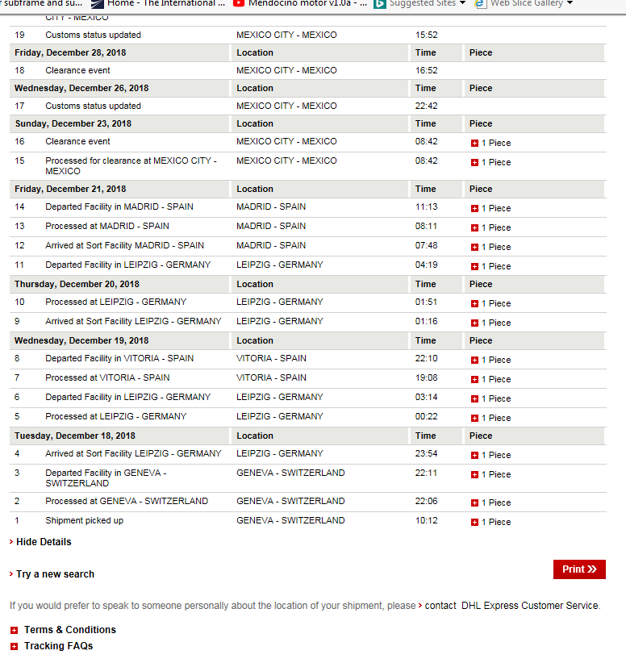
http://www.dhl.com/en/express/tracking.html?brand=DHL&AWB=6537455805%0D%0A

Slide 9
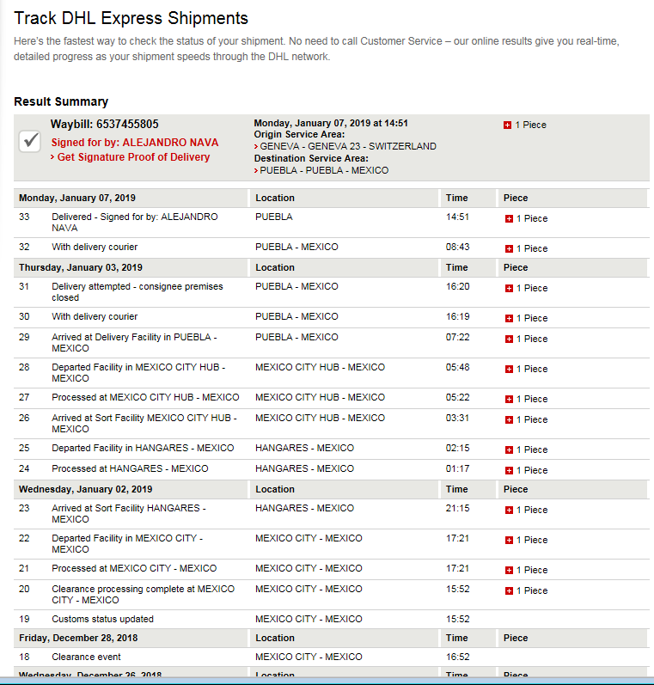

Slide 10
Conclusion
Delivery cost 350chf
Weight 42kg
Delivery duration door to door, over xmas period, 21 days.
Days lost in MEX appear zero…
BUAP closed , so 4 days lost.
What is the condition of the box and contents ?
System works on the way there.
Lets do the return, as planned , organised by CERN end.

