Slide 1
Omar thesis prep
Ian
Sept Dec 2023

Slide 2
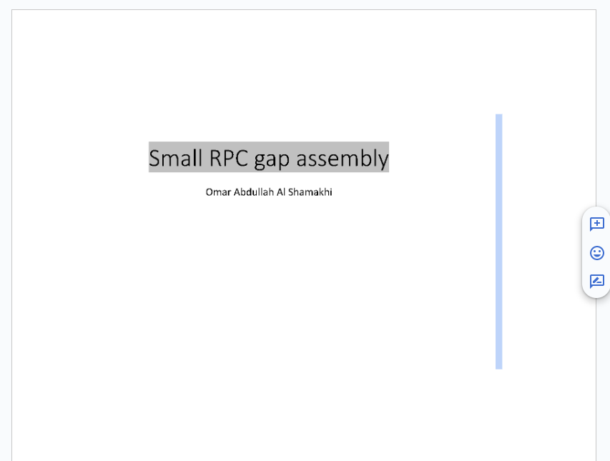
https://docs.google.com/document/d/1Iu97sBedMtjYn5PQ57XYECnsGtTXr0Y9i1qh_iR4-Js/edit

Slide 3
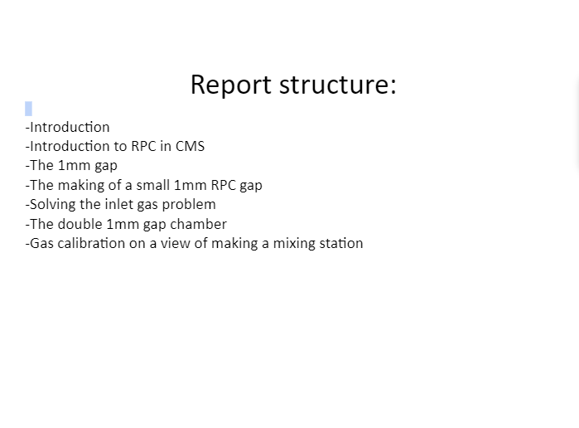

Slide 4
