Slide 1
Regulations change
March 2023
Ian
19 Sept 2023

Slide 2
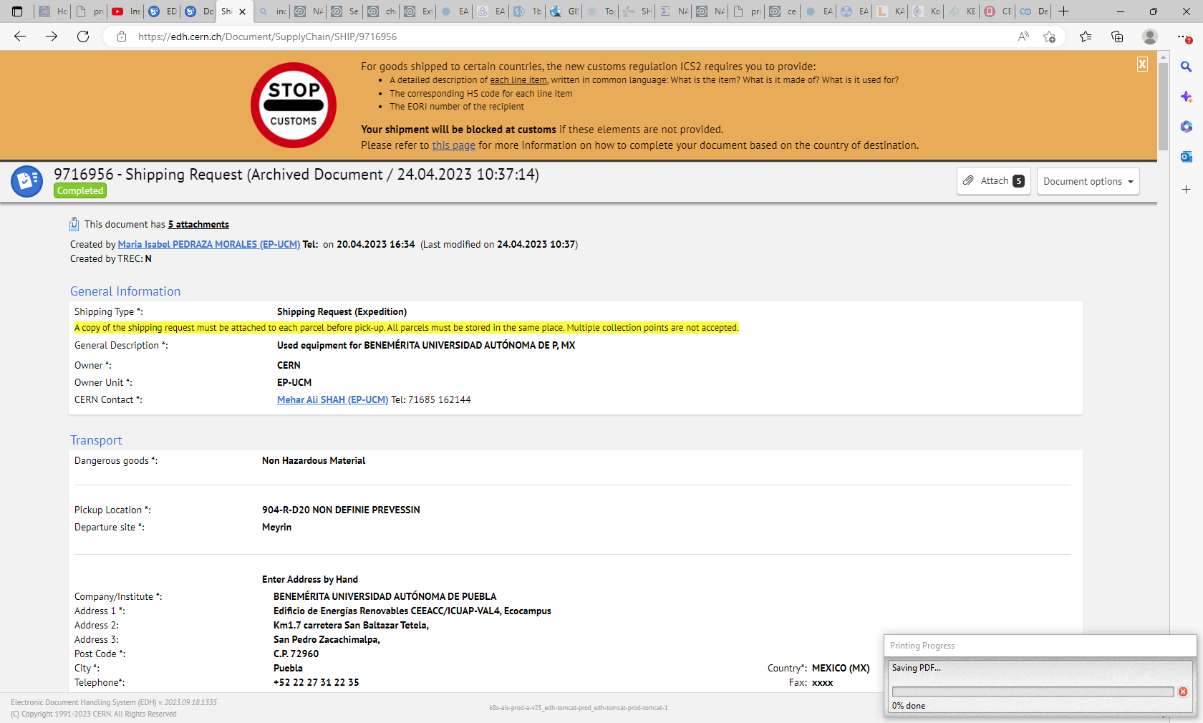

Slide 3
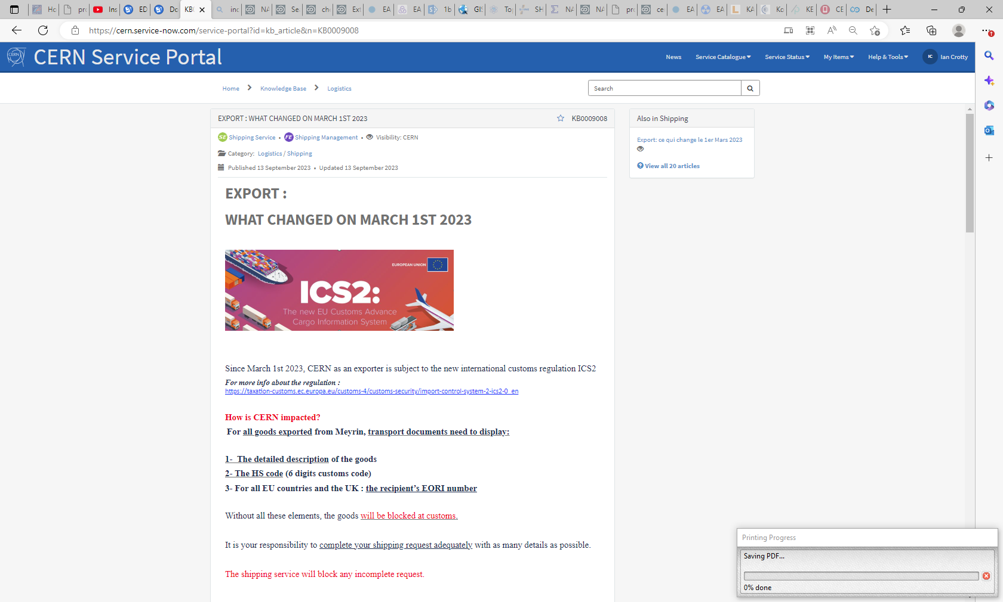
https://cern.service-now.com/service-portal?id=kb_article&n=KB0009008

Slide 4
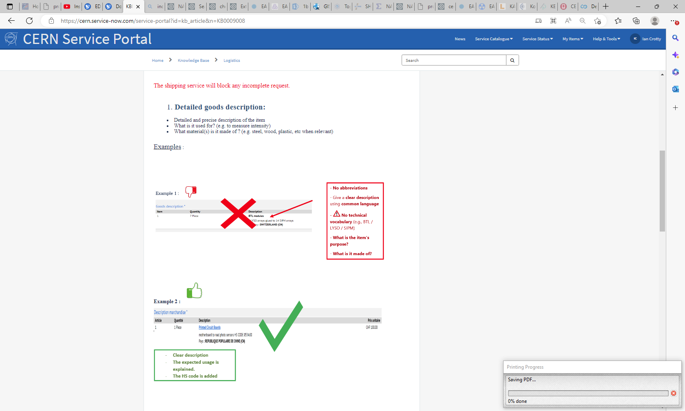

Slide 5
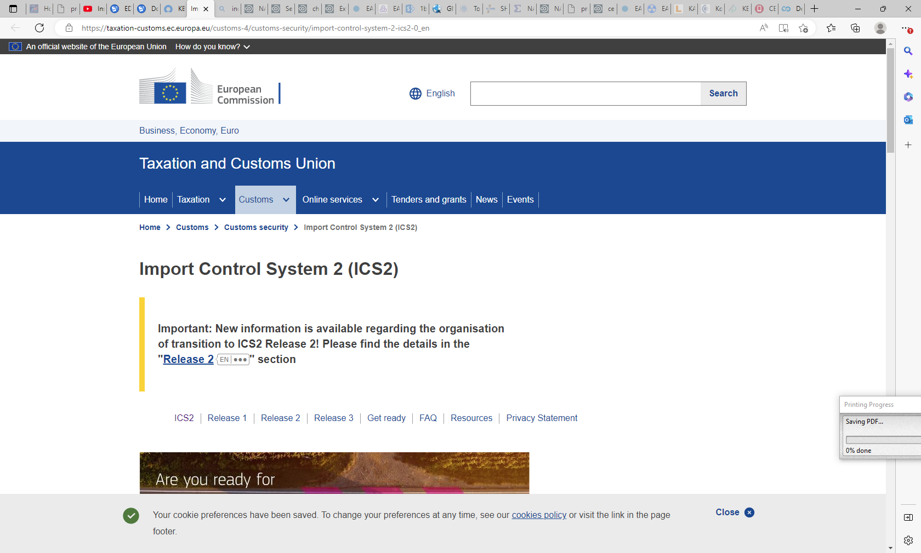
https://taxation-customs.ec.europa.eu/customs-4/customs-security/import-control-system-2-ics2-0_en

Slide 6
